Slide 1
Mining Data Streams
Cam Tu Nguyen
阮锦绣
Software Institute, Nanjing University
nguyenct@lamda.nju.edu.cn
ncamtu@gmail.com

Slide 2
Data Streams
In many data mining situations, we know the entire data set in advance
Sometimes the input rate is controlled externally
Google queries
Twitter or Facebook status updates

Slide 3
Outline
The Stream Data Model
Sampling Data in a Stream
Filtering Streams
Counting Ones in a Window
Clustering for Streams

Slide 4
The Stream Model
Input tuples can enter rapid rate, at one or more number of streams
Streams need not have the same data rates
The time between elements of one stream need not to be uniform
Systems can not store the entire stream accessibly
How to make critical calculations about the stream using a limited amount of (primary or secondary) memory?

Slide 5
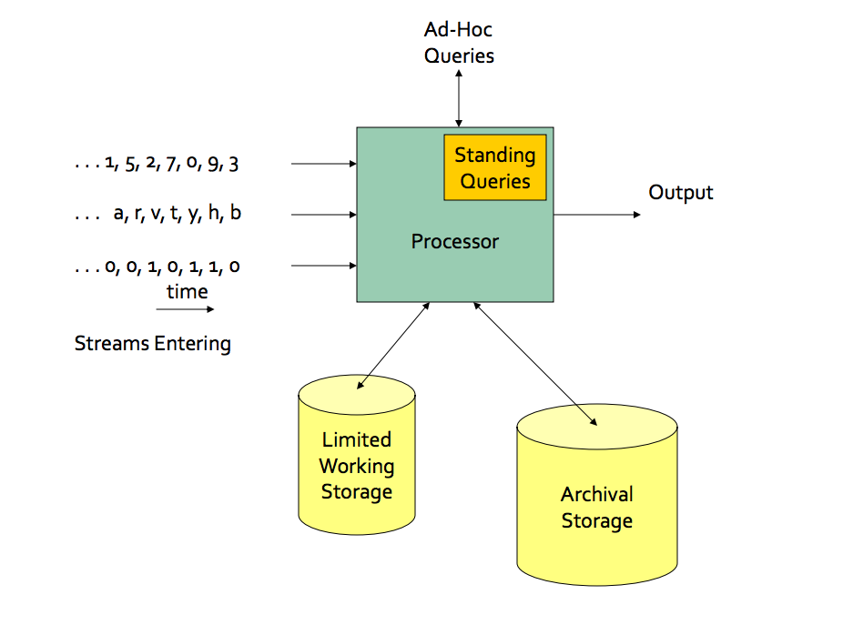

Slide 6
Two Forms of Query
Ad-hoc queries: Normal queries asked one time about streams
Example: what is the maximum value seen so far in stream S?
Standing queries: Queries that are, in principle, asked about the stream at all times
Example: Report each new maximum value ever seen in stream S.

Slide 7
Applications
Mining query streams
Google wants to know what queries are more frequent today than yesterday
Mining click streams
Yahoo! Wants to know which of its pages are getting an unusual number of hits in the past hour
IP packets can be monitored at a switch
Gather information for optimal routing
Detect of denial-of-service attacks
Mining surveillance data
Each surveillance camera produces a stream of images at intervals like one second.
Detect security threats

Slide 8
Outline
The Stream Data Model
Sampling Data in a Stream
Filtering Streams
Counting Ones in a Window
Clustering for Streams

Slide 9
Sampling Data in a stream
Representative Sample
Sample with fixed size.
Sliding windows:
sampling so that the sample has a fixed size.

Slide 10
Representative Sample
Objective: extract reliable samples from a stream.
A Motivating Example:
A search engine receives a stream of queries, and it would like to study the behavior of typical users.
The stream consists of tuples (user, query, time)
Answer queries such as “What fraction of the typical user’s queries were repeated over the past month?”
Assume that we wish to store only 1/10th of the stream elements.
Obvious but not (quite) right approach
Generate a random number between 0 and 9
Store the tuple if the generated number is 0
Counter example: suppose a user generates s queries one time and d search queries twice, and none is queried more than twice.
Correct answer: d/(s+d)
Answer we get with the above solution is d/(10s+19d)
Notes:
Expected number of tuples of s search queries one time in the sample: s/10
The number of search queries twice appears twice in sample: d/100;
The number of search queries twice appears one in the sample: d*(1/10*9/10) = 9d/100
The answer we can get from the sample is:
d/100 / (s/10 + 9d/100) = d/(10s+9d)

Slide 11
Representative Sample
Solution:
Stream of tuples with keys
􏰠 Key is some subset of each tuple’s components
􏰠 E.g., tuple is (user, search, time); key is user
􏰠 Choice of key depends on application 􏰟
To get a sample of size a/b
Hash each tuple’s key uniformly into b buckets
Pick the tuple if its hash value is at most a
With this solution: once a user is chosen, we save all the queries of that user.
Unlike the strategy above, we keep tuples randomly→ wrong answers about the statistics of a typical user.

Slide 12
Maintaining a fixed-size sample
Suppose we need to maintain a sample of size exactly s
E.g., main memory size constraint
Don’t know length of stream in advance
In fact, stream could be infinite
Suppose at time t we have seen n items
Ensure each item is in sample with equal probability s/n

Slide 13
Solution
Store all the first s elements of the stream
􏰟Suppose we have seen n-1 elements, and now the n^{th} element arrives (n > s)
With probability s/n, pick the nth element, else discard it
If we pick the n^{th} element, then it replaces one of the s elements in the sample, picked at random
Claim: this algorithm maintains a sample with the desired property
That is, on the stream with length n, all position have equal probability s/n of being chosen.

Slide 14
Proof: By induction
Assume that after n elements, the sample contains each element seen so far with probability s/n
􏰟 When we see element n+1, it gets picked with probability s/(n+1)
􏰟 For elements already in the sample, probability of remaining in the sample is:
If the (n+1)th position didn’t get picked
If the (n+1)th position got picked

Slide 15
Sliding Windows
A useful model of stream processing is that queries are about a window of length N – the N most recent elements received.
Alternative: elements received within a time interval T
Interesting case: N is so large it can not be stored in main memory
Or, there are so many streams that windows for all do not fit in main memory

Slide 16
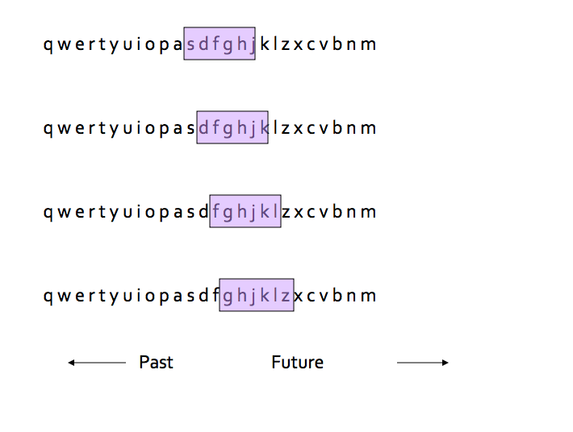

Slide 17
Outline
The Stream Data Model
Sampling Data in a Stream
Filtering Streams
Counting Ones in a Window
Clustering for Streams

Slide 18
Filtering Streams
Filtering: accept those tuples in the stream that meet a criterion.
Criterion:
A property of the tuple that can be calculated (easy)
Lookup for membership in a set, where the set is too large to store in the main memory (interesting)
Bloom Filter
Motivating Examples
Filtered crawled Urls in Web Crawlers
Filtered emails in a blacklist.
Filtered malwares in a blacklist.

Slide 19
Filtering Streams: The Bloom Filter
A Bloom Filter consists of
A large array of n bits, initially all 0’s
A collection of hash functions h₁, h₂, …, h_{k}. Each hash function maps “key” values to n buckets, corresponding to the n bits of the bit array.
A set S of m key values.
Lookup:
Suppose element y appears in the stream, and we want to know if we have seen y before
Compute h_{i}(y) for each hash function 1<=i<=k, set the bit number h_{i}(y) (from the left) of the bit array to 1.
If all the resulting bit positions are 1, say we have seen y before.
False positive is possible due to collisions.
If at least one of these positions is 0, say we have not seen y before
We are certainly right; false negative = 0.

Slide 20
Filtering Streams: Bloom Filter Example
Use n=11 bits for our filter
Stream elements = integers
Use two hash functions:
h1(x) =
Take odd-numbered bits from the right in the binary representation of x.
Treat it as an integer z
Result is z modulo 11
h2(x)= same as h1(x) but take even-numbered bits.

Slide 21
Filtering Streams: Bloom Filter Example
Lookup:
Suppose we have the same Bloom Filter as before, and we have set the filter to 10100101010
Query: have we seen y=118?
Solution:
y=118=1110110 (in binary)
h1(y)=14 modulo 11 = 3
h2(y)=5 modulo 11=5
Bit 5 is 1 but bit 3 is 0 (from the left), so we are sure y is not in the set.

Slide 22
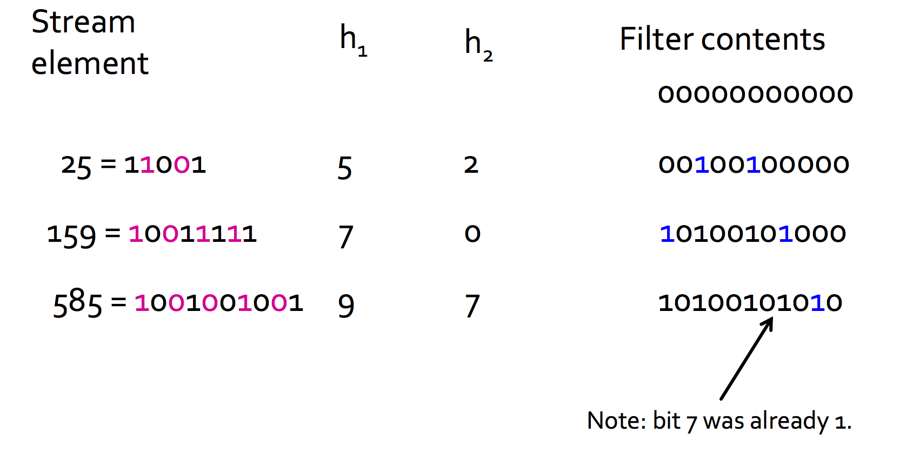
Filtering Streams: Bloom Filter Example

Slide 23
Analysis of Bloom Filtering
Probability of a false positive depends on the density of 1’s in the array and the number of hash functions.
=(fraction of 1’s)^{# of hash functions}.
The number of 1’s is approximately (the number of elements inserted) times (the number of hash functions).
But collisions lower that number slightly.
Notes:
Note:
A false positive:
All the hash functions map to positions with 1.
The probability of one position is 1 = (fraction of 1)
Since the hash functions are “independent”
The probability of a false positive = (fraction of 1)^# number of hash functions.

Slide 24
Analysis of Bloom Filtering: Throwing Darts
Turning random bits from 0 to 1 is like throwing d darts at t targets, at random.
d=number of input elements times the number of hash functions.
t=size of the bit array.
How many targets are hit by at least one dart?
Probability a given target is hit by a given dart = 1/t
Probability that none of d darts hit a given target is (1-1/t)^{d}
Rewrite as (1-1/t)^{t(d/t)} ~= e^{-d/t} since (1-1/t)^{t}~=1/e for t is large
= the fraction of zeros remaining in the bit array.

Slide 25
Analysis of Bloom Filtering: Example of Throwing Darts
Suppose we use an array of 1 billion bits, 5 hash functions, and we insert 100 million elements.
That is, t=10⁹, and d=5*10⁸.
The fraction of 0’s that remain will be e^{-1/2}=0.607
Density of 1 = 0.393
Probability of a false positive = (0.393)⁵=0.00937

Slide 26
Outline
The Stream Data Model
Sampling Data in a Stream
Filtering Streams
Counting Ones in a Window
Clustering for Streams

Slide 27
Counting Ones in a Window
You can show that if you insist on an exact sum or count of the elements in a window, you cannot use less space than the window itself.
But if you are willing to accept an approximation, you can use much less space.
We’ll consider the simple case of counting elements of a certain type as a special case.
Sums are a fairly straightforward extension.

Slide 28
Counting Bits
Problem: given a stream of 0’s and 1’s, be prepared to answer queries of the form “how many 1’s in the most recent k bits?” where k <= N.
Naïve solution: store the most recent N bits.
But answering the query will take O(k) time.
Very possibly too much time.
And the space requirements can be too great
Especially if there are many streams to be managed in main memory at once or N is huge.

Slide 29
Example: Bit Counting
Count recent hits on URL’s belong to a site
Stream is a sequence of URL’s
Window size N=1 billion
Think of the data as many streams – one for each URL
Bit on the stream for URL x is 0 unless the actual stream has x.

Slide 30
DGIM Method
Name refers to the inventors
Datar, Gionis, Indyk, and Motwani
Store only O(log²N) bits per stream, where N is the window size.
Give approximate answer, never off by more than 50%.
Error factor can be reduced to any epsilon > 0, with more complicated and proportionally more stored bits.

Slide 31
Timestamps
Each bit in the stream has a timestamp, starting 0, 1, ..
Record timestamps modulo N (the window size), so we can represent any relevant timestamp in O(log₂N) bits.

Slide 32
Buckets
A bucket is a segment of the window; it is represented by a record consisting of
The timestamp of its end O(logN) bits
The number of 1’s between its beginning and end
Number of 1’s = size of the bucket
Constraint on bucket sizes: number of 1’s must be a power of 2.
Thus, only O(loglogN) bits are required for this count.

Slide 33
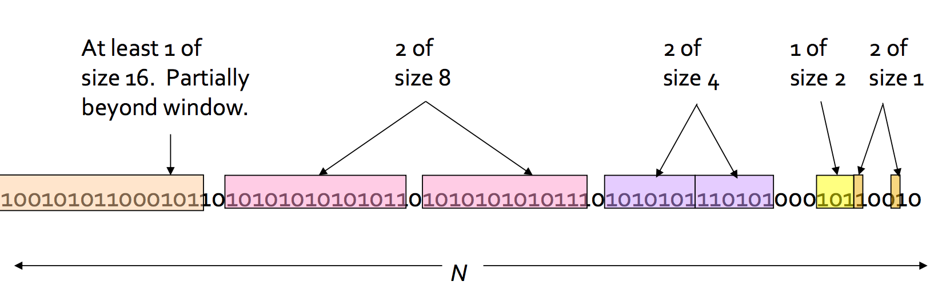
Representing a Stream by Buckets
Bucket requirements:
The right end of a bucket is always a position with a 1.
Every position with a 1 is in some bucket
Either one or two buckets any given size, up to some max size.
All sizes must be a power of 2.
Buckets do not overlap
Buckets are sorted by size: older buckets are not smaller than newer buckets
Buckets disappear when their end-time is > N time units in the past.

Slide 34
Updating Buckets
When a new bit comes in, drop the last (oldest) bucket if its end-time is prior to N time units before the current time.
If the current bit is 0, no other changes are needed.
If the current bit is 1
Create a new bucket of size 1, just for this bit
End timestamp = current time
If there are now three buckets of size 1, combine the oldest two into a bucket of size 2.
If there are now three buckets of size 2, combine the oldest two into a bucket of size 4.
And so on….

Slide 35
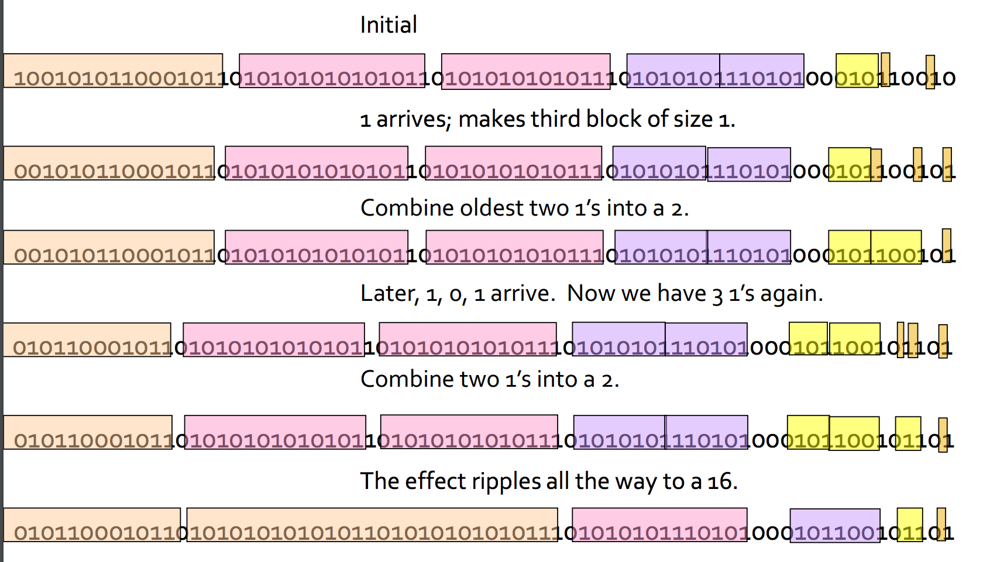
Example: Managing buckets

Slide 36
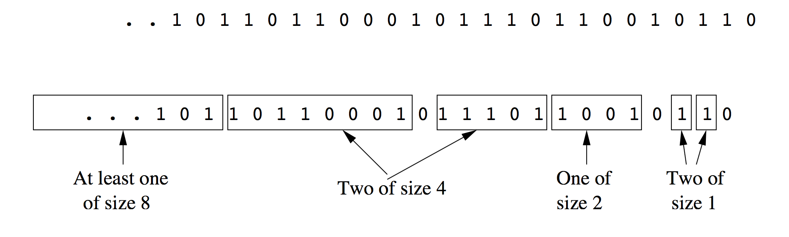
Querying
To estimate the number of 1’s in the most recent k<=N bits
Find the bucket b with the earliest timestamp that includes at least some of the k most recent bits.
Estimate the number of 1’s to be the sum of the sizes of all the buckets more recent than bucket b, plus half the size of b itself.
Example: k=10

Slide 37
Error Bound
Suppose the oldest bucket within the range has size 2^{i}.
Then by assuming 2^{i-1} of its 1’s are still within the window, we make the error at most 2^{i-1}.
Since there is at least one bucket of each of the sizes less than 2^{i}, and at least 1 from the oldest bucket, the true sum is no less than 2^{i}.
Thus the error is at most 50%.

Slide 38
Space Requirement
We can represent one bucket in O(logN) bits
No bucket can be of the size greater than N
There are at most 2 buckets of the same size (in range 1 to logN)
There are at most 2logN buckets
Thus, the space required is O(log²N)

Slide 39
Outline
The Stream Data Model
Sampling Data in a Stream
Filtering Streams
Counting Ones in a Window
Clustering for Streams

Slide 40
Clustering for Streams
A stream of data points in some space (Euclidean or non-Euclidean)
Problem:
The centroids or clustroids (representative points of clusters) of the best clusters formed from the last m of the points, for any m<=N.
We will consider some possible solutions, depending on our assumptions about how clusters evolve in a stream.

Slide 41
BDMO algorithm
BDMO (for the authors, B. Babcock, M. Datar, R.Motwani, and L.O’Callaghan)
BDMO algorithm builds on the methodology for counting ones in the stream (DGIM algorithm). The key similarities and differences are:
Like DGIM, the points of the stream are partitioned into, and summarized by buckets.
Here, the size of a bucket is the number of points it represents, rather than the number of stream elements that are 1.
As before, the sizes of buckets obey the restriction that there are one or two of each size, up to some limit.
We do not assume that the sequence of allowable buckets sizes starts with 1. Rather, they are required only to form a sequence where each size is twice the previous size., e.g. 3, 6, 12, 24…
Bucket sizes are no decreasing as we go back in time.

Slide 42
BDMO algorithm
The contents of a bucket:
The size of the bucket
The timestamp of the bucket
A collection of records that represent the clusters into which the points of that bucket have been partitioned.
The number of points in the cluster
The centroid or clustroid of the cluster.
Any other parameters needed to merge clusters and maintain approximations to the full set of parameters for the merged cluster.

Slide 43
Initializing Buckets
Our smallest bucket size will be p times (a power of 2).
Thus, every p stream elements, we create a bucket, with the most recent p points.
The timestamp for each bucket is the timestamp of the most recent point in the bucket.
Cluster points in the buckets (or leave them as one point as one cluster)
Compute the centroids or clustroids for the clusters & count the points in each cluster.

Slide 44
Merging Buckets
Similar to merging buckets in the problem of counting 1’s for streams.
If some bucket has a timestamp that is more than N time units prior to the current time, drop it.
If we have three buckets of size p, merge the oldest two of the three.
If there are now 3 buckets of size 2p, merge the oldest two of the three.
If there are now 3 buckets of size 4p, …

Slide 45
Merging Buckets
To merge two consecutive buckets
The size of the new bucket is twice the sizes of the two buckets being merged.
The timestamp for the merged bucket is the timestamp of the more recent of the two consecutive buckets.
Consider merging clusters in 2 buckets (depending on the clustering algorithm)

Slide 46
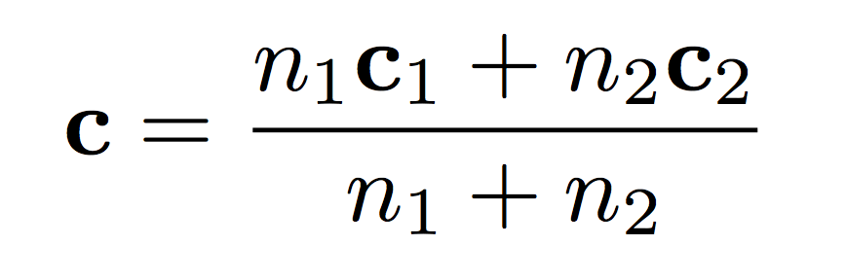
Merging Buckets: Example
Clustering algorithm: K-means in a Euclidean space.
Clusters are represented by centroids, the #points in each cluster.
We pick p=k
Problem: merging 2 buckets, each containing K clusters.
Solution
Find the best matching from K clusters of the first bucket and K clusters from the second bucket.
Best matching = minimum distance between centroids.
To merge two clusters (c1, n1) and (c2, n2), we create a new cluster with n=n1+n2 points and the new centroid

Slide 47
Answering Queries
Query: a request for the clusters of the most recent m points in the stream (m<=N).
Solution:
Select the smallest set of buckets that cover m points.
Those buckets may not contain more than 2m points.
Assumption: the points between 2m and m+1 will not have radically different statistics from the most recent m points (for good approximation).
Pool all the clusters from the selected buckets.
For example: if you ask for K-clusters, we keep on merging until we reach K-clusters with the bucket-merging method in the previous slide.

Slide 48
Summary
The Stream Data Model
Sampling Data in a Stream
Filtering Streams
Counting Ones in a Window
Clustering for Streams

