Slide 1
Recommendation Systems
Cam Tu Nguyen
阮锦绣
Software Institute, Nanjing University
nguyenct@lamda.nju.edu.cn
ncamtu@gmail.com

Slide 2
Outline
Recommendation Systems
Main Approaches
Content-Based Recommendations
Collaborative Filtering
Approximate Nearest Neighbor Search
Locality Sensitive Hashing

Slide 3
Recommendations
Product Recommendations
Online retailers such as Amazon, Alibaba
Return to users the products that they might like to buy
Movie Recommendations
Netflix offers its customers recommendations of movies they might like.
The recommendations are based on ratings provided by users
News Articles
News services have attempted to identify articles of interest to readers ,based on the articles that they have read in the past.
Other applications: blogs recommendations, video recommendations on Youtube, etc.

Slide 4
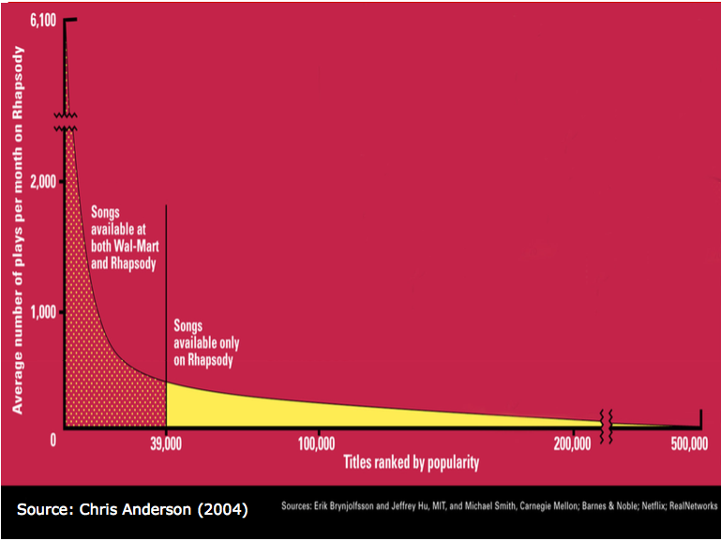
The Long Tail

Slide 5
Recommendation Types
Editorial
Simple aggregates
Top 10, Most Popular, Recent Uploads
Tailored to individual users
Amazon, Netflix, …

Slide 6
Formal Model
C = set of Customers
S = set of Items
Utility function u: C x S → R
R = set of ratings
R is a totally ordered set
E.g., 0-5 starts, real number in [0,1]

Slide 7
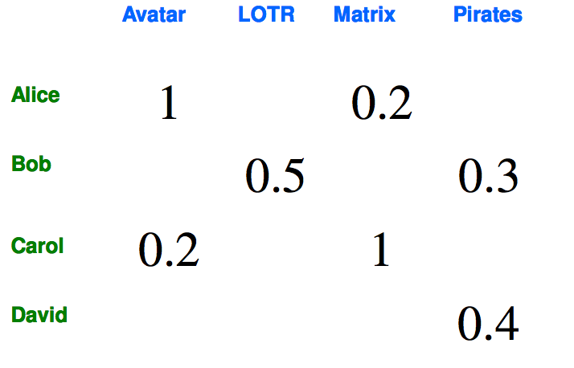
Utility Matrix

Slide 8
Populating the Utility Matrix
Explicit
Ask people to rate items
Doesn’t work well in practice – people can’t be bothered.
Implicit
Learn ratings from user actions
E.g., purchase implies high ratings
What is about

Slide 9
Two basic architectures for a recommendation system
Content-based systems focus on properties of items
Similarity of items is determined by measuring the similarity in their properties.
Collaborative-Filtering systems focus on the relationship between users and items.
Similarity of items is determined by the similarity of the ratings of those items by the users who have rated both items.

Slide 10
Outline
Recommendation Systems
Main Approaches
Content-Based Recommendations
Collaborative Filtering
Approximate Nearest Neighbor Search
Locality Sensitive Hashing

Slide 11
Item Profiles
For each item, create an item profile
Profile is a set of features/attributes
Movies: author, title, actor, director, …
Text: set of “important” words in document
Music Product: artist, composer, and genre.

Slide 12



TF.IDF
How to pick important words?
Use heuristic is TF.IDF (Term Frequency times Inverse Doc Frequency)
TF.IDF
f_{ij} = frequency of term t_{i} in document d_{j}
n_{i} = number of docs that mention term i
N = total number of docs
TF.IDF score
Doc profile = set of words with highest TF.IDF scores, together with their scores.

Slide 13
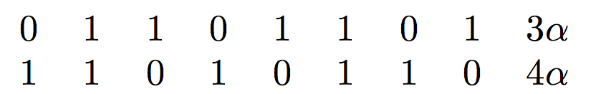
Representing Item Profiles
Example: Suppose the only features of movies are the set of actors and the average rating. Consider two movies with five actors each.
Two of the actors are in both movies
One movie has an average rating of 3, and the other an average of 4.
Alpha is introduced as a scaling factor for the average rating feature.
Similarity between 2 items can be measured using cosine

Slide 14
User profiles and predictions
User profiles describe users’ preferences
User profile possibilities
Average of rated item profiles.
Variation: normalize the utilities by subtracting the average value for a user. That way, we get negative weights for items with a below-average rating, and positive weights for items with above-average rating.
…

Slide 15
Recommending Items to Users Based on Content
Given user profile c and item profile s
Estimate u(c,s) = cos(c,s)=c.s/(|c||s|)
Need efficient method to find items with high utility
Locality Sensitive Hashing (stay tune!)

Slide 16
Limitations of content-based approach
Find the appropriate features
E.g., images, movies, music
Overspecialization
Never recommend items outside user’s content profile
People might have multiple interests
Recommendations for new users
How to build a profile?

Slide 17
Collaborative Filtering
Consider user c
Find set D of other users whose ratings are “similar” to c’s ratings
Estimate user’s ratings based on ratings of users in D

Slide 18
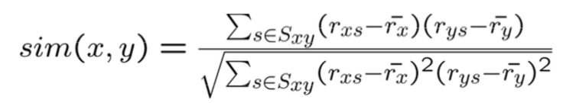
Similar Users
Let r_{x} be the vector of user x’s ratings
Cosine similarity measure
Sim(x,y) = cos(r_{x}, r_{y})
Pearson correlation coefficient
S_{xy} = items rated by both users x and y
Other similarity measures: Jaccard Distance, etc.

Slide 19
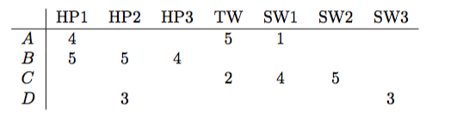


Similar Users
Cosine Similarity
We can treat blanks as a 0 value (it might be not the best choice)
The cosine of the angle between A and B is
The cosine of the angle between A and C is

Slide 20
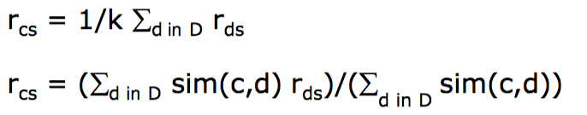
Rating predictions
Let D be the set of k users most similar to c who have rated item s
Possibilities for prediction function (item s):
Notes:
The second function:
Rating prediction of user c for item s is a weighted sum of rating of similar users for item s.

Slide 21
Complexity
Expensive step is finding k most similar customers
For each user, O(|U|)
How to make it faster? (Again, Locality Sensitive Hashing comes to rescue!)
Too expensive to do at runtime
Could pre-compute (e.g. using MapReduce in offline mode)
Can use clustering, partitioning as alternatives, but quality degrades.

Slide 22
Item-Item Collaborative Filtering
So far: User-user collaborative filtering
Another view
For item s, find other similar items
Estimate rating for item based on ratings for similar items
Can use same similarity metrics and prediction functions as in user-user model.
In practice, it has been observed that item-item often works better than user-user.

Slide 23
Pros and cons of Collaborative Filtering
Works for any kind of item
No feature selection needed
New user problem
New item problem
Sparsity of rating matrix
Cluster-based smoothing
Add more data.

Slide 24
Evaluating Predictions
Compare predictions with known ratings
Root-mean-square error (RMSE)
Another approach: 0/1 model
Coverage
Number of items/users for which system can make predictions
Precision
Accuracy of predictions
Receiver operating characteristic (ROC)
Tradeoff curve between false positives and false negatives.

Slide 25
Finding similar vectors
Common problem that comes up in many settings
Given a large number N of vectors in some high-dimensional space (M dimensions), find pairs of vectors that have high similarity
E.g. User profiles, item profiles
We need a method to solve this problem fast! (Locality Sensitive Hashing)

Slide 26
Outline
Recommendation Systems
Main Approaches
Content-Based Recommendations
Collaborative Filtering
Near Neighbor Search in High Dimensional Data
Locality Sensitive Hashing

Slide 27
Locality Sensitive Functions
Locality-sensitive (LS) family is a family of functions that can be combined to distinguish strongly between pairs at a low distance from pairs at a high distance.
Three conditions for a LS family function
They must be more likely to make close pairs be candidate pairs than distant pairs
They must be statistically independent
They must be efficient, in two ways
Serve to identify candidates pairs in time much less than the time it takes to look at all pairs.
They must be combinable to build functions that are better at avoiding false positives and negatives.

Slide 28
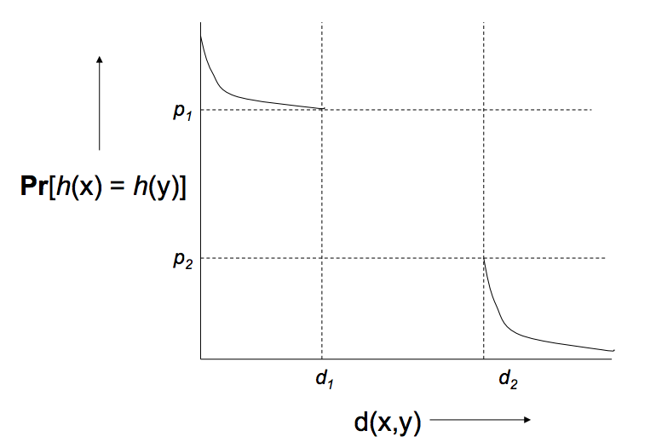
A (d₁, d₂, p₁, p₂)-sensitive function

Slide 29
Amplifying a LS-family
Two constructions:
AND construction
OR construction
AND of Hash functions
Given family H, construct family H’ consisting of r functions from H
For h=[h₁,…,h_{r}] in H’, h(x)=h(y) if and only if h_{i}(x)=h_{i}(y) for all i.
Theorem: If H is (d₁, d₂, p₁, p₂)-sensitive, then H’ is (d₁, d₂, (p₁)^{r}, (p₂)^{r})-sensitive.
OR of Hash functions
Given family H, construct family H’ consisting of b functions from H
For h=[h1, …, h_{b}] in H’, h(x)=h(y) if and only if h_{i}(x)=h_{i}(y) for some i.
Theorem: If H is (d₁, d₂, p₁, p₂)-sensitive, then H’ is (d₁, d₂, 1-(1-p₁)^{b}, 1-(1-p₂)^{b})-sensitive.
Notes:
Proof: Use the fact that h_i are independent
AND of hash function
d(x,y) < d1
P(h_i(x)=h_i(y)) >= p1
P(h_1(x)=h_1(y), h_2(x)=h_2(y),,…)=\prod_i P(h_i(x)=h_i(y)) >= (p1)^r
Or hash function:
P(h(x)=h(y)) = 1-P(h_1(x)!=h_1(y), h_2(x)!=h_2(y),…) >= 1-(1-p1)^b
P(h_i(x)=h_i(y))>=p1 → P(h_i(x)!=h_i(y)) <=1-p1

Slide 30
AND-OR Composition
Apply a r-way AND construction followed by an b-way OR construction.
Transforms probability p into 1-(1-p^{r})^{b}.
Example: Take H and construct H’ by the AND construction with r=4. Them from H’, construct H’’ by the OR construction with b=4.

Slide 31
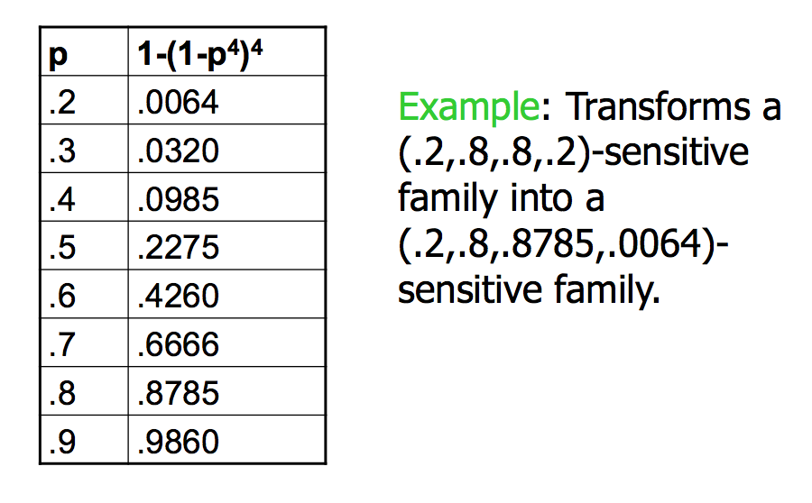
AND-OR Composition
Example: Take H and construct H’ by the AND construction with r=4. Them from H’, construct H’’ by the OR construction with b=4.

Slide 32
OR-AND Composition
Apply a b-way OR construction followed by an r-way AND construction.
Transforms probability p into (1-(1-p)^{b})^{r}.
Example: Take H and construct H’ by the OR construction with b=4. Then from H’, construct H’’ by the AND construction with r =4.

Slide 33
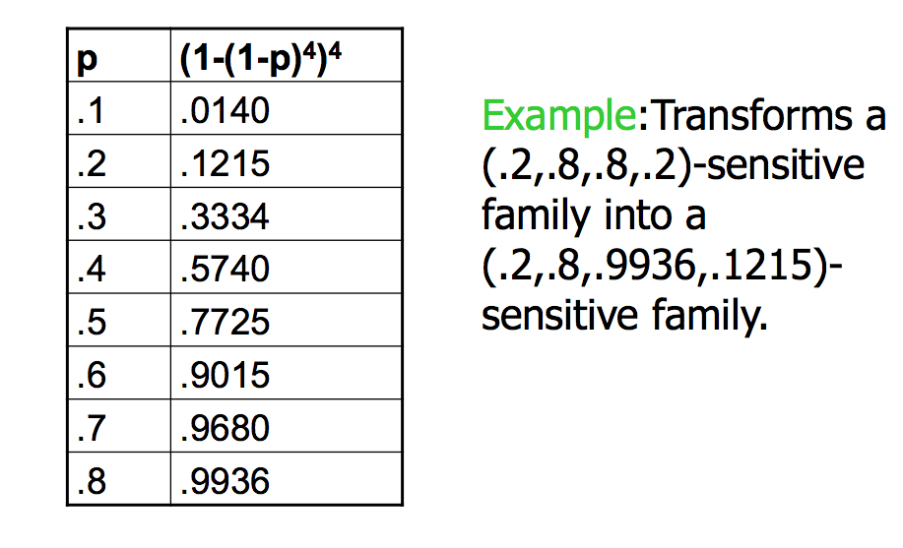
OR-AND Composition
Example: Take H and construct H’ by the OR construction with b=4. Then from H’, construct H’’ by the AND construction with r =4.

Slide 34
Summary of LS families
Pick any two distances x < y
Start with a (x,y, (1-x), (1-y))-sensitive family
Apply constructions to produce (x,y, p, q)-sensitive family, where p is almost 1 and q is almost 0.
The closer to 0 and 1 we get, the more hash functions must be used.

Slide 35
LSH for Cosine Distance
Random Hyper planes
Convert data matrix to signature matrix (each signature corresponds to one object).
How?
A (d₁,d₂, (1-d₁/180), (1-d₂/180))-sensitive family for any d₁, d₂.
Apply hashing to the signature matrix
Objects in the same buckets are candidate pairs.

Slide 36
Random Hyperplanes
Pick a random vector v, which determines a hash function h_{v} with two buckets
h_{v}(x) = +1 if v.x > 0; -1 if v.x < 0
LS-family H = set of all functions derived from any vector.
Claim: For points x and y
P[h(x)=h(y)] = 1 – d(x,y)/180

Slide 37
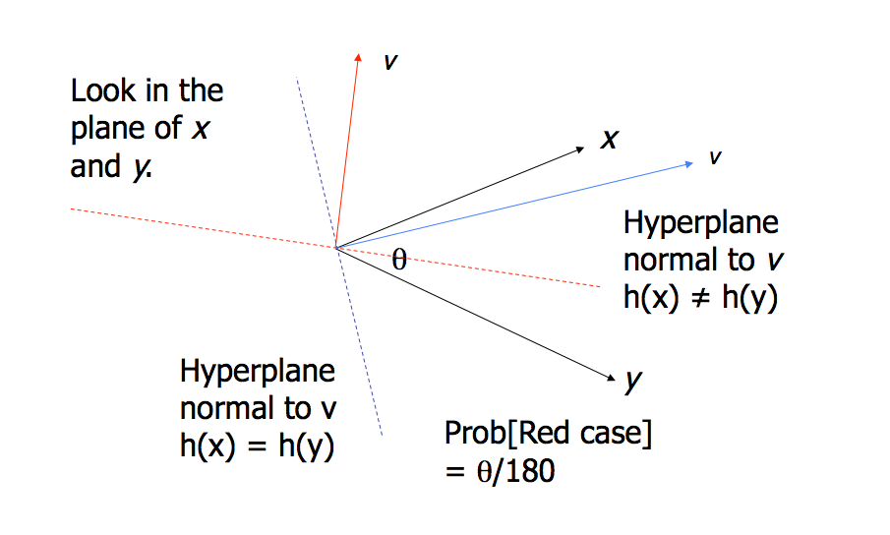
Proof of Claim
Notes:
x.y = ||x|| ||y|| cos\theta
Red hyperplane: x and y are on two different half spaces
Blue hyperplane: x and y are on the same half space

Slide 38
Locality Sensitive Hashing for Cosine Distance
Signatures for Cosine Distance
Pick some number of random vectors, and hash your data for each vector.
It suffices to consider only vectors consisting of +1 and -1 components
The result is a signature (sketch) of +1 and -1’s for each data point.

Slide 39
Locality Sensitive Hashing for Cosine Distance
Example: Suppose our space is 4-dimensional space
Consider two vectors x=[3,4,5,6] and y=[4,3,2,1]
The cosine of the angle between x and y is 0.7875, or the angle between x and y is about 38 degrees.
We pick 3 random vectors: v1=[+1, -1, +1, +1]; v2=[-1, +1, -1, +1], and v3=[+1, +1, -1, -1].
For the vector x=[3,4,5,6], the sketch is [+1,+1, -1]
For the vector y=[4,3,2,1], the sketch is [+1, -1, +1]
The sketches for x and y agree in 1/3 of the positions, we estimate the angle between them is 120 degrees. (not even close!)
If we look at all 16 random vectors (why 16?)
There are only 4 of v vectors where v.x and v.y have different signs.
The vectors include v₂, and v₃
The estimate of the angle would have been 180/4=45 degrees. (better)
Notes:
16 = 2^4

Slide 40
Locality Sensitive Hashing for Cosine Distance
Main idea:
Hash columns of signature matrix several times
Arrange that (only) similar columns are likely to hash to the same bucket.
Candidate pairs are those that hash at least once to the same bucket.

Slide 41
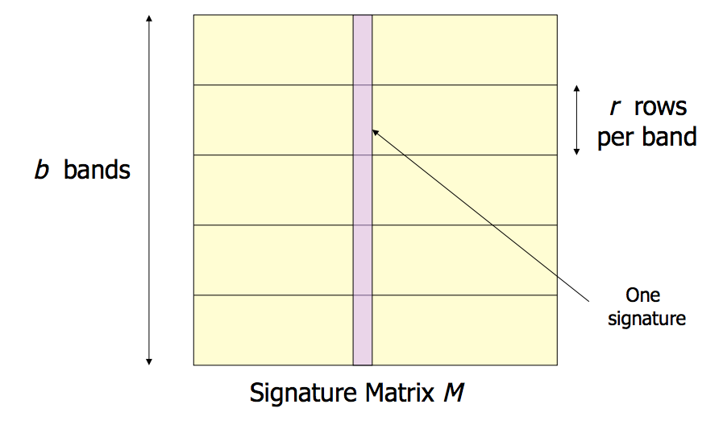
Locality Sensitive Hashing for Cosine Distance
LSH: Partition into bands
Signature Matrix:
#rows = # random vectors
#columns = # data objects

Slide 42
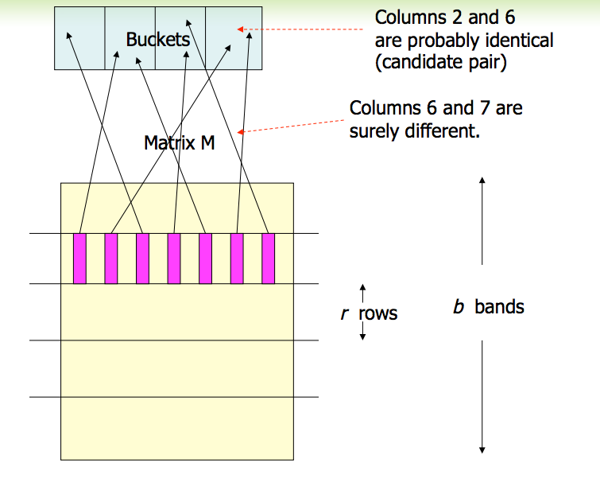
Notes:
Combining buckets from all the bands → candidates

Slide 43
Partition into Bands (cont.)
Divide signature matrix M into b bands of r rows.
Create one hash table per band.
For each band, hash its portion of each column to its hash table
Candidate pairs are columns that hash to the same bucket for >= 1 band.
Tune b and r to catch most similar pairs, but few non-similar pairs.

Slide 44
Other LSH
LSH for Jaccard distance
LSH for Euclidean distance
LSH for Hamming distance

Slide 45
Summary
Recommendation Systems
Main Approaches
Content-Based Recommendations
Collaborative Filtering
Approximate Nearest Neighbor Search
Locality Sensitive Hashing

