Slide 1
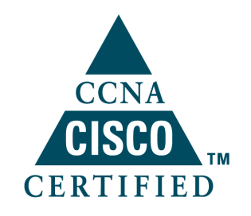
Single-Area OSPF

Slide 2
OSPF Overview
Open Shortest Path First (OSPF) is a link-state routing protocol based on open standards.
It is described in several standards of the Internet Engineering Task Force (IETF). The most recent description is RFC 2328.
OSPF is becoming the preferred IGP protocol when compared with RIPv1 and RIPv2 because it is scalable.
Notes:
Open
Rfc1131 version1；Rfc1247 V2; rfc2740(OSPF for IPv6); RFC 5340 OSPF for IPv6
与RIP的对比，体系化设计，多区域的划分，减少开销提高性能
1000台的规模，密码的要求
组播比广播的优点：设备性能损耗小

Slide 3
Routing Information
The state of the link is a description of an interface and the relationship to its neighboring routers.
The collection of link-states forms a link-state database, sometimes called a topological database.
Link-state routers do this by applying the Dijkstra shortest path first (SPF) algorithm against the link-state database to build the shortest path first tree, with the local router as the root.
The link-state database is used to calculate the best paths through the network. The best paths are then selected from the SPF tree and placed in the routing table.
Notes:
没有跳数限制
成本作为度量值，速率增大而减小

Slide 4
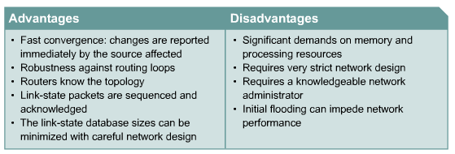
Advantages and Disadvantages of Link-State Routing
Notes:
Sequence and ack!!

Slide 5
OSPF vs. RIP
OSPF
RIP
Uses Metrics such as Bandwidth
Appropriate for Large Networks
Can further subdivide a network into areas
Supports VLSM
Fast convergence
Supports equal-cost multipath
Uses Hop Count
Designed for Small Networks (15 hops)
Flat hierarchy design
None VLSM (for RIP v1)

Slide 6
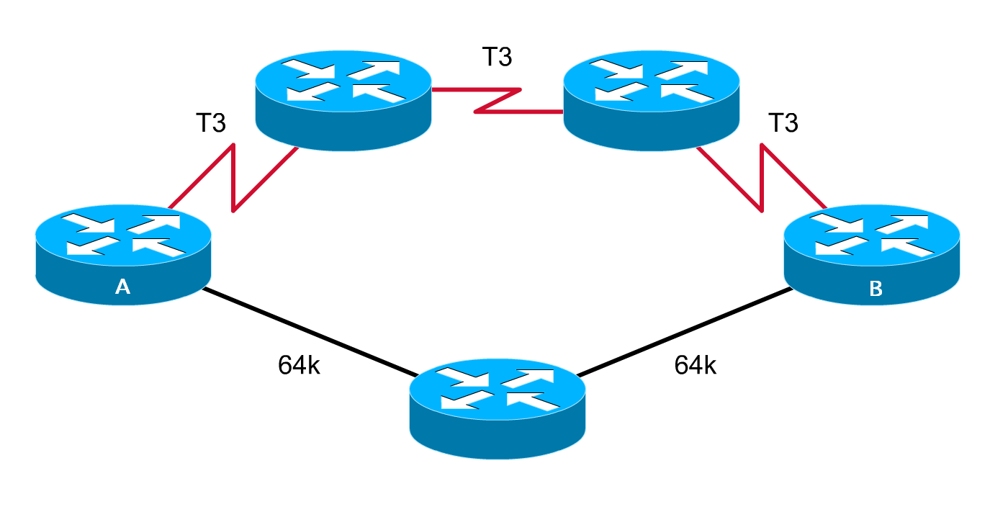
OSPF vs. RIP (cont.)
What is the Best Path from A to B?
OSPF Chosen Path
RIP Chosen Path
Notes:
OSPF chooses the best path based on bandwidth and therefore the T3 link are chosen.
RIP in the other hand uses Hop count and chooses the path that has the minimum number of hops to the destination.

Slide 7
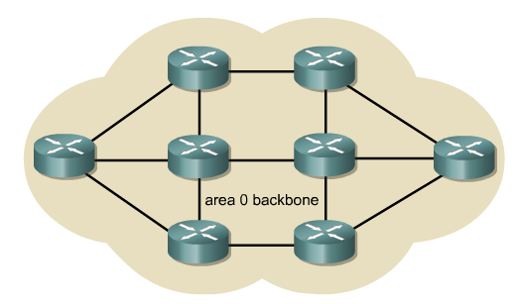
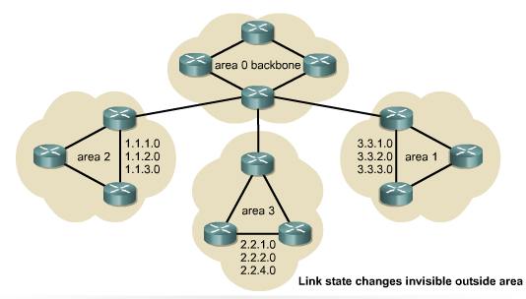
OSPF Feature
OSPF overcomes these limitations and proves to be a robust and scalable routing protocol suitable for the networks of today.
Large OSPF networks use a hierarchical design.

Slide 8
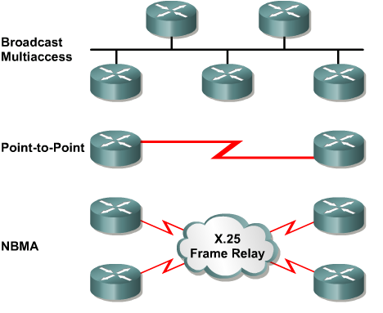
OSPF Network Types
Broadcast multi-access, such as Ethernet
Point-to-point networks
Nonbroadcast multi-access (NBMA)
Notes:
OSPF接口自动识别三种类型的网络，P2P类型时不需要DR选举
点对多点是一种特有的情况，只有当NBMA不是全部点都有效时，才会手工地配置点对多点的模式。

Slide 9
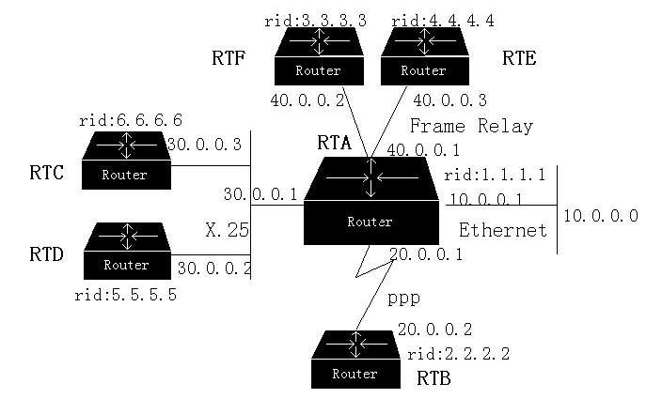
OSPF Terminology
Link
Link: A physical and electrical connection between two network devices.
An interface on a router
Notes:
OSPF把下层链路抽象划分为4种方式：1、单一路由器；2、点对点连接；3、1对多不广播连接（帧中继）；4、多路复用（以太、x25虚电路）。

Slide 10
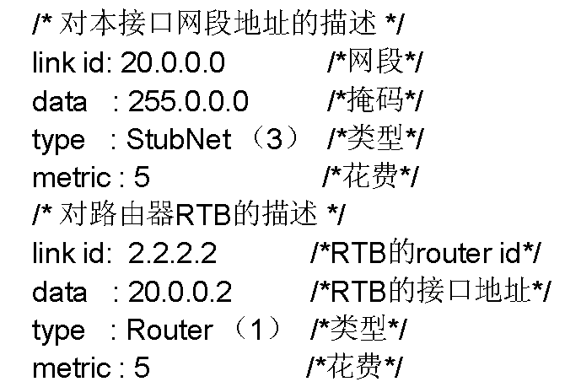
OSPF Terminology
Neighbors
Link
Link-State: The status of a link between two routers. This status includes information about a router's interface and its relationship to neighbouring routers.
Notes:
链路状态数据库的描述包括：
链路状态类型、通告路由器的地址、链路成本、一个序列号码。
链路状态描述网络结构：路由器有几个接口，分别是什么链路状态、连接目的路由器，拓扑方式
10：网络ID，类型3，cost
11：网络ID，类型3，cost；另一个路由器的接口

Slide 11
OSPF Terminology
Neighbors
Link
Cost = 10
Cost = 1785
Cost = 6
Cost: The value assigned to a link. Rather than hops, link-state protocols assign a cost to a link, which is based on the bandwidth of the link (transmission speed).

Slide 12
OSPF Terminology
Neighbors
Link
Area 1
Cost = 10
Area 0
Cost = 1785
Cost = 6
Area: A collection of networks and routers that has the same area identification. Each router within an area has the same link-state information. A router within an area is called an internal router.

Slide 13
OSPF Terminology
Autonomous System
Neighbors
Link
Area 1
Cost = 10
Area 0
Cost = 1785
Cost = 6
Notes:
AS

Slide 14
OSPF Terminology
Autonomous System
Neighbors
Link
Area 1
Cost = 10
Cost = 1785
Cost = 6
Area 0
Neighborship
Database
Lists Neighbors
Adjacencies database: A listing of all the neighbors to which a router has established a bi-directional communication.
Notes:
Adjacencies database：每个OSPF路由器都试图与同IP网段的所有路由器双向通信。
什么样的路由器才能是邻居？

Slide 15
OSPF Terminology
Neighbors
Autonomous System
Link
Area 1
Area 0
Cost = 10
Cost = 1785
Cost = 6
Neighborship
Database
Lists Neighbors
Topology
Database
Lists All Routes
Link-state database (or topology database): A list of information about all other routers in the internetwork. It shows the internetwork topology.

Slide 16
OSPF Terminology
Autonomous System
Neighbors
Link
Area 1
Cost = 10
Area 0
Cost = 1785
Cost = 6
Neighborship
Database
Lists Neighbors
Topology
Database
Lists All Routes
Routing
Table
Lists Best Routes
Routing table: The routing table, which is sometimes know as the forwarding database, is generated when an algorithm is run on the link-state database. The routing table for each router is unique.

Slide 17
OSPF Terminology
Who is DR?
Priority + Router ID
DR
0-255
Default:1
BDR
Designated Router (DR) : One router on an OSPF multiaccess network that is elected to represent all the routers in that network. Each OSPF network has a DR and BDR.
Backup Designated Router (BDR) : A standby router that becomes the DR, if the original DR fails.

Slide 18
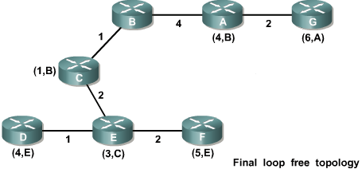
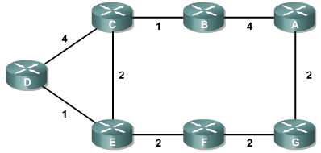

Set up the Adjacency Relationships
The shortest path algorithm calculates a loop-free topology using the node as the starting point and examining in turn information it has about adjacent nodes.
starting point

Slide 19
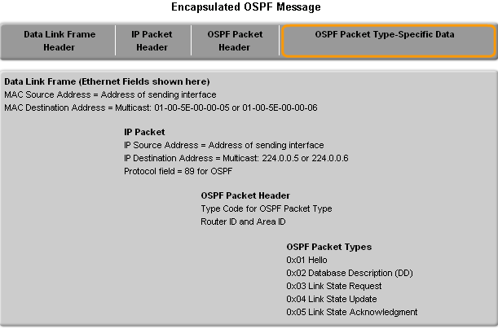
OSPF Message Encapsulation
OSPF packet type
There exist 5 types
OSPF packet header
Contains - Router ID and area ID and Type code for OSPF packet type
IP packet header
Contains - Source IP address, Destination IP address, & Protocol field set to 89
Notes:
报文不转发，ttl置一，防止黑洞，不会有拓扑不知道的情况

Slide 20
OSPF Packets
There are 5 types of OSPF routing protocol packets
Function Name
Hello Hello
Database Description DBD
Link-State Request LSR
Link-State Update LSU
Link-State Acknowledgement LSAck
Notes:
Hello：与邻居建立和维持邻居关系；
DBD：一个OSPF路由器的链路状态数据库
LSR：请求链路状态数据库中的具体条目

Slide 21
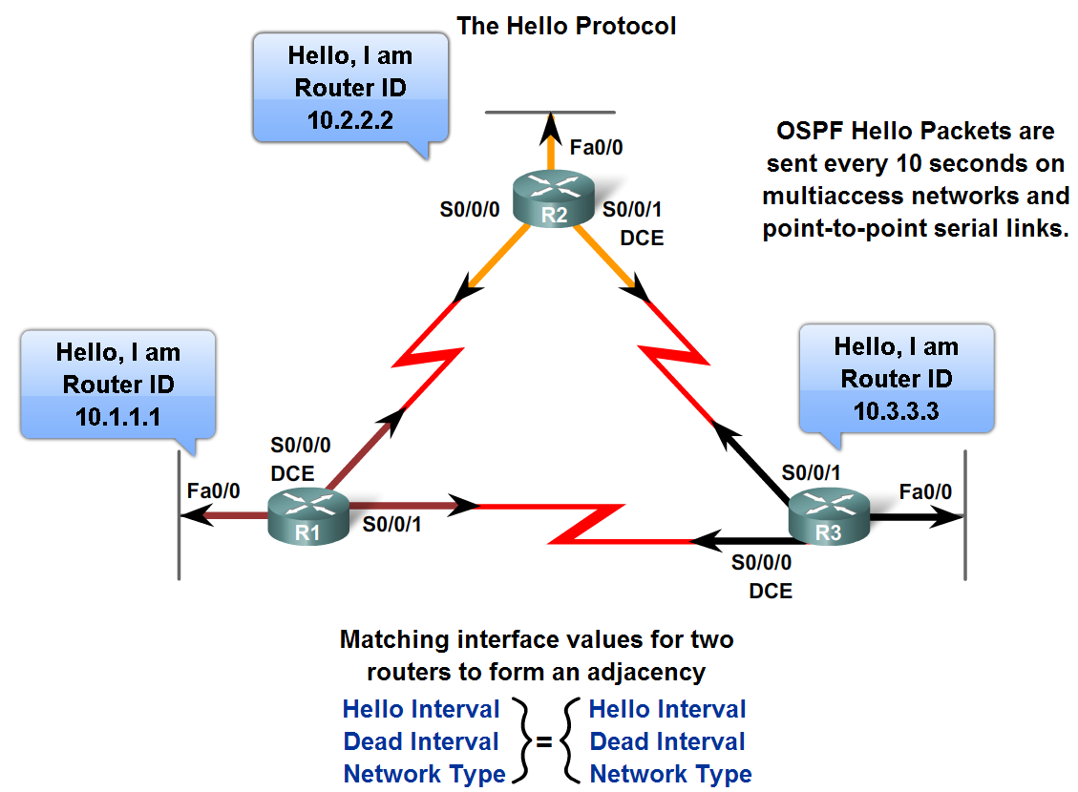
Purpose of Hello Packet
Discover OSPF neighbors & establish adjacencies
Advertise guidelines on which routers must agree to become neighbors
Used by multi-access networks to elect a designated router and a backup designated router
Notes:
hello是rip30秒的功能之一，但更加高效
信息包含在下一页

Slide 22
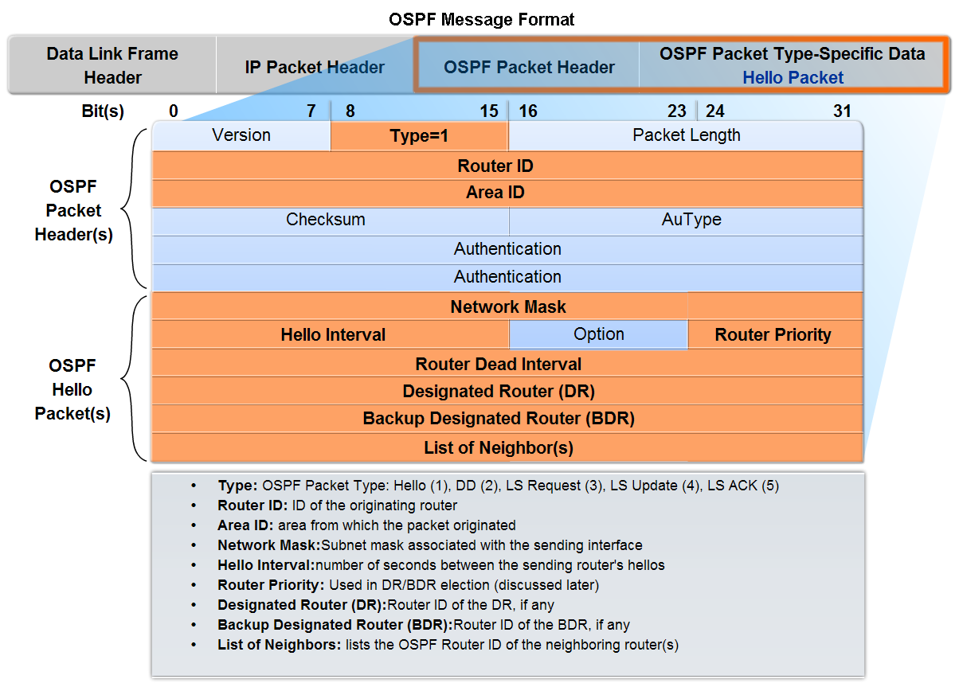
Hello Packet
Notes:
Router ID：路由器的最大UP地址（那个接口可以不在OSPF网络），也可以分配回路地址
区域号为32比特
Autype: 0,不检验；1，简单口令，最长64位口令；2，MD5验证，KeyID、验证数据长度和一个不减小的加密序列号
认证：由于是组播地址224.0.0.5，一般为加密的认证类型。01005E
OSPF Hello Intervals：30 seconds for NBMA segments
OSPF Dead Intervals：Default time is 4 times the hello interval
网络掩码表示只能在一个网段??

Slide 23
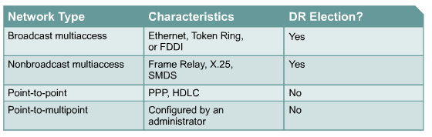
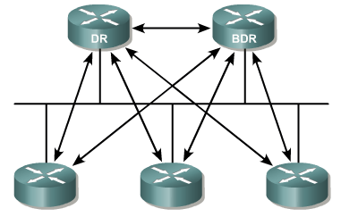
DR & BDR
Each router then forms adjacency with DR and BDR
The DR sends link-state information to all other routers on the segment using the multicast address of 224.0.0.5 for all OSPF routers.
To ensure that both the DR and the BDR see the link states all routers send on the segment, the multicast address for all designated routers, 224.0.0.6, is used.
Notes:
减少通信量：打招呼的例子
DR : Designated Routers >>
Reduce OSPF traffic on Multiaccess Links
Store and Distribute neighbors LSDBs
BDR exist as a backup for redundancy.
DR election:
OSPF Priority is used in the selection : 1 – 255, default = 1, 0 for noncandidate
If priorities are the same, higher Loopback IP address.
In case of no existing Loopbacks highest IP address of interfaces are used.
OSPF Order of events:
Establish router adjacencies
Elect a Designated Router
Discover Routes
Select appropriate routes
Maintain routing info
Relies on IP packets for delivery of routing information (uses protocol number 89)

Slide 24

OSPF in Multi-Access media
Giga/Fast/Ethernet, FDDI, Token Ring
DR
BDR
BDR
DR
Notes:
一个OSPF域有多个IP网段，所以有多个DR

Slide 25
Router ID
A loopback IP address
If the absence of loopback IP address, the highest-value address interface IP
If the interface goes down, the router must re-establishing adjacency and readvertising LSA
Why a loopback address has higher priority than other addresses?
To avoid too many recalculating operations
A loopback interface will never be down in case the router is up
By manipulating loopback addresses, you can specify which router would be the “master” and which would be the “slave.”

Slide 26
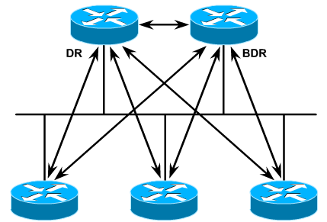
DR/BDR Election
DRother
DRother
DRother
The roles of DR/BDR in multiaccess networks drastically reduces the amount of network traffic devoted to establishing adjacencies.
Non-DR/BDR routers, called DRothers, only establish adjacencies with the DR & BDR (see graphic).
On all multiaccess networks, a DR is elected using Hello packets.
The DR has two main functions:
Establish adjacencies with every other router on the network
Act as spokesperson for all LSA activity; other routers will multicast LSA updates to the DR/BDR pair.
On all multiaccess networks, a BDR is also elected.
If only the DR existed, it would be a single point of failure.
The BDR mirrors the DR’s functions
The BDR becomes the DR if the DR fails
Notes:
DR用来保证网段内的LSDB一致

Slide 27
OSPF operation
OSPF uses neighbor adjacencies to gain full knowledge of the network.
OSPF operation include five steps:
Step1: Set up the adjacency relationships
Step2: Elect DR and BDR (if needed)
Step3: Discover the routes
Step4: Choose appropriate routes
Step5: Maintain the route information
OSPF has seven states. Briefly, they are:
Init, 2Way, Ex Start, Exchange, Loading, Full

Slide 28
OSPF Steps
Step1: Set up the adjacency relationships
Step2: Elect DR and BDR (if needed)
Step3: Discover the routes
Step4: Choose appropriate routes
Step5: Maintain the route information

Slide 29
Set up the adjacency relationships
172.16.5.1/24
E0
172.16.5.2/24
E1
A
B
Down State
I am router ID 172.16.5.1 and I see no one.
Init State
Router B
Neighbors List
172.16.5.1/24, int E1
I am router ID 172.16.5.2, and I see 172.16.5.1.
Router A
Neighbors List
172.16.5.2/24, int E0
Two-Way State
Notes:
双向关系之后，路由器需要决定和谁建立邻居关系，
如果是P2P网络，则直接建立邻居关系，进入ExStart（准启动）；
如果是多路访问网络，则需要进屋DR选举过程，除非已经选举过了

Slide 30
Step 1: Establish Router Adjacencies
If routers discover they are on a multiaccess network (broadcast or nonbroadcast), they enter the DR/BDR election process
If point-to-point or point-to-multipoint, no DR/BDR is elected.
If the DR/BDR fields in the hello packet’s header is already occupied (i.e. a DR/BDR pair already exists), no DR/BDR election occurs.
If no election is necessary, routers enter the ExStart state, skipping Step 2.

Slide 31
Step 2: Elect a DR and a BDR
Electing a DR and a BDR depends on a number of factors.
If no other router is on the network, the router becomes the DR until it fails. The next router to “come up” on the multiaccess network will be the BDR.
The BDR becomes the DR if the DR fails.
If a new OSPF router joins the network with a higher priority or router ID, the DR and BDR do not change.
It would become the new BDR only if the current DR failed or the new DR only if the current DR and BDR failed.

Slide 32
Step 2: Elect a DR and a BDR
If multiple routers (two or more) come online simultaneously, then…
The router with the highest configured priority becomes the DR
Priority of zero means “never DR”
If there is a tie, then the router with the highest router ID becomes the DR
Router ID is the highest loopback or highest interface IP address
Router with second highest priority or highest router ID becomes the BDR

Slide 33
Step 3: Discover Routes
This is the process previously explained in the ExStart to Full State
Routers either determine “master/slave” relationship on point-to-point links or…
DR/BDR in multiaccess networks exchange LSAs and all DRothers send the DR/BDR their Type 2 DBDs.
If necessary, a router may enter the loading state by sending a LSR requesting more information
All routers must wait in Loading State until the requesting router is fully updated.
Routers now enter the Full State before calculating the SPF algorithm.

Slide 34
Discover the routes
Priority:1
DR
Priority:1
E0
172.16.5.1
E0
172.16.5.2
Exstart State
afadjfjorqpoeru
39547439070713
I will start exchange because I have router ID 172.16.5.1.
Hello
No, I will start exchange because I have a
higher router ID.
afadjfjorqpoeru
39547439070713
Hello
Exchange State
afadjfjorqpoeru
39547439070713
Here is a summary of my link-state database.
DBD
afadjfjorqpoeru
39547439070713
DBD
Here is a summary of my link-state database.
Notes:
链路状态数据库的描述包括：
链路状态类型、通告路由器的地址、链路成本、一个序列号码。
类型2的包发送信息，类型5的包来确认。
先只发送LSA的头部，从而减少通讯量

Slide 35
Discover the routes
DR
E0
172.16.5.1
E0 172.16.5.2
afadjfjorqpoeru
39547439070713
afadjfjorqpoeru
39547439070713
LSAck
Thanks for the information!
LSAck
Loading State
afadjfjorqpoeru
39547439070713
I need the complete entry for network 172.16.6.0/24.
LSR
afadjfjorqpoeru
39547439070713
Here is the entry for network 172.16.6.0/24.
LSU
afadjfjorqpoeru
39547439070713
LSAck
Thanks for the information!
Full State
Notes:
根据汇总可能会需要具体的条目
之后Choose appropriate routes，maitain

Slide 36
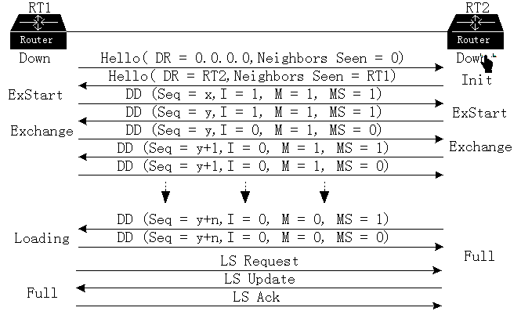
Notes:
可靠传输：确认和超时重传
DD：database 描述
full以后新收到的报文直接lsu给对方

Slide 37
4. Select Appropriate Routes
The SPF Algorithm is now calculated in parallel with every other router on the network.
Remember: All routers must have identical link-state databases before this can occur.
The SPF uses cost as its metric
SPF adds up the cost for each path from itself to the destination
The algorithm builds a tree with the router as the root
OSPF then installs the least cost path in the routing table (also called the “forwarding table”)
Up to 4 equal cost paths will be installed for load sharing
To avoid repeated calculations of the SPF because of a flapping route, change the default holddown timer (10 seconds) with the timers spf command.

Slide 38
5. Maintain Routing Information
The regular exchange of Hellos is the mechanism OSPF uses to detect a new neighbor or a downed neighbor.
Hello packets are sent at different default intervals depending on the type of network.
For links with speeds T1 (1.544 Mbps) or greater, hellos are sent every 10 second: broadcast multiaccess and point-to-point links
For links with less than a T1, hellos are sent every 30 seconds: nonbroadcast multiaccess links
The “dead interval” is four times the hello interval.

Slide 39
Maintaining Routing Information
Link-State Change
DR
1
x
LSU
x
A
B
Router A tells all OSPF DRs on 224.0.0.6

Slide 40
Maintaining Routing Information
2
Link-State Change
LSU
DR
1
x
LSU
x
A
B
Router A tells all OSPF DRs on 224.0.0.6
DR tells others on 224.0.0.5
Notes:
LSA有序列号，从而来确保更新能够进行。

Slide 41
Maintaining Routing Information
2
Link-State Change
LSU
DR
1
x
LSU
x
3
A
B
LSU
Router A tells all OSPF DRs on 224.0.0.6
DR tells others on 224.0.0.5
Notes:
为了确保同步，每30分钟还会对每条LSA记录扩散一次，其序列号都加1.

Slide 42
Maintaining Routing Information
2
Link-State Change
LSU
DR
4
I need to update
my routing table.
1
x
LSU
x
3
A
B
LSU
Router A tells all OSPF DRs on 224.0.0.6
DR tells others on 224.0.0.5

Slide 43
OSPF State
OSPF has seven states:
Init
2Way
Ex Start
Exchange
Loading
Full

Slide 44
Down, Init and 2Way States
Before an OSPF router discovers any neighbors, it is in the “Down State.”
A router enters the Init State when it hears another router’s Type 1 Hello packet for the first time.
Every hello packet includes a list of the sender’s known OSPF neighbors regardless of what state the sender has established with that neighbor.
Since Hello packets are sent at regular intervals, both routers will, on the next exchange of Hellos, list the newly discovered neighbor in the Hello packet.
Once a router sees its own ID in the Hello packet sent by the neighbor, the routers move to 2Way State.
The routers can now begin to exchange Type 2 DBD and Type 5 LSAck packets.

Slide 45
ExStart State
The routers now enter the ExStart State.
This is the beginning of an adjacency relationship.
On point-to-point links, routers exchange hello packets to determine which one will be the “master” in the Exchange State.
In a multiaccess network, routers elect a DR/BDR
If the priority are equal, The highest Router ID wins
Notes:
预启动：建立主从关系

Slide 46
Exchange, Loading, & Full States
During the Exchange State...
“Master” router sends “Slave” a Type 2 DBD; then “Slave” router sends “Master” a Type 2 DBD. Both routers acknowledge receipt with a Type 5 LSAck.
DBD packets describe a summary of each router’s Link-State Database
If any links received in the DBD are “news,” the routers enter the Loading State; otherwise, they go to Full.
During the Loading State...
Router who received “news” sends a Type 3 LSR which asks for more specific information about the new link than was contained in the summary Type 2 DBD.
The receiving router responds with a Type 4 LSU which is then acknowledged with a Type 5 LSAck.
Routers enter Full State and can now both calculate the SPF algorithm (Dijkstra) in parallel.
Note: This will not occur until both routers have identical link-state databases.
Notes:
交换：互发送DBD
加载：交换LSR和LSU填充LSDB
完全邻接：

Slide 47
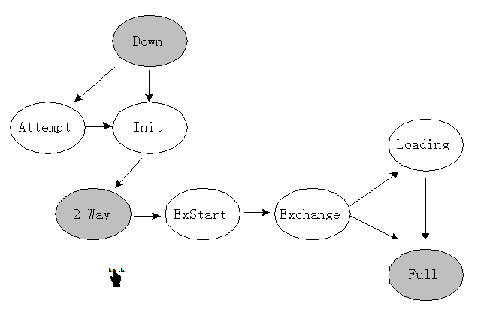
OSPF的邻居状态机

Slide 48

Multiarea OSPF

Slide 49
OSPF Scalability
If the area has more than 50 routers, you should divide the single area into multiple areas. Why?
Reduce memory usage
All routing information must be stored in RAM
Reduce CPU usage
Each time a topology change occurs, all area routers must recalculate the SPF
Take advantage of route summarization
Summarizing an area’s networks yields more efficient routing
Notes:
1000多台路由器会带来的规模问题和动荡（导致协议不能实际应用）。即使硬件升级也不能解决
区域划分要有路由聚合策略，运营商获得的IP一般是连续的

Slide 50
OSPF Areas
A single area is assigned the number 0 and is known as area 0.
In multi-area OSPF networks, all areas are required to connect to area 0. Area 0 is also called the backbone area.
Notes:
画图解释区域之间的DV模式，ABR转告路由的方法，由此可能产生回路。所以必须都联系area0，直径最大为3.ABR都在area0之中。
解释路由项对应的路由器变化的情况；通过所有的ABR在一个区域来避免这个问题

Slide 51
OSPF Areas
OSPF uses a 2 level hierarchical model
Areas are defined with a 32 bits number
Can be either in IP format or single decimal value:
Area 0 or Area 0.0.0.0
All areas must be connected to Area 0 (Backbone)
Notes:
OSPF has to have at least one Area (Area 0 ). This area is the bacbone which all the other areas must be connected to.

Slide 52


OSPF Areas example
Area 1
ABR
Area 0 (Backbone)
ABR
Area 4
Area 2
Area 3
Notes:
ABR: Area border Routers are routers that have interfaces in more than one area, generally between Area 0 and other areas.
OSPF是以路由器作为区域边界的划分，BGP是以网段作为划分。类似于中国棋类和国际棋类的区别。
区域划分要有路由聚合策略，运营商获得的IP一般是连续的
区域间的路由是DV算法的，都连接area0则可以避免，解释路由项对应的路由器变化的情况；通过所有的ABR在一个区域来避免这个问题

Slide 53
Problem & Solution
Problem:
Large OSPF networks demand router resources and create huge routing tables and link-state databases.
Solution:
Separate OSPF into hierarchical areas of no more than 50 routers that can exchange summary information with other areas.

Slide 54
OSPF Scalability
However, moving from single to multiarea OSPF adds complexity
Multiarea OSPF is difficult to design
OSPF Multiarea Router Types
Different areas types
Special LSA types
Various configurations

Slide 55
OSPF Router Types
Where a router’s OSPF interfaces are located in a topology determines its role:
Internal: all interfaces are within the same area
Backbone: at least one interface attached to the backbone (area 0)
Area Border Router (ABR): interfaces attached to multiple areas
AS Boundary Router (ASBR): at least one interface attached to another autonomous system
Notes:
An OSPF router can be multiple types, as seen on the next slide.

Slide 56
OSPF Router Types
Another AS or ISP
AS Boundary Router & Backbone Router
ASBR
IR
Internal Routers
Backbone Area 0
Area 1
ABR
BBR
IR
Area Border Router & Backbone Router
Internal Router & Backbone Router
Notes:
每台路由器的连接区域不要多于3个

Slide 57
What makes an ABR or ASBR?
ABRs and ASBRs do not require any special configurations.
If a router has interfaces configured in more than one OSPF area, then it is an ABR.
If a router has at least one interface configured on an external network, it is an ASBR.
Routers with all interfaces configured in the same area are Internal Routers.

Slide 58
OSPF Packet Types
OSPF Packet Types Review
Type 1: Hello Packet—neighbor discovery/maintenance
Type 2: DBD—Summary of Link-State Database
Type 3: LSR—Request for more specifics
Type 4: LSU—Response to LSR; also called an LSA when sent to “announce” a topology change
Type 5: LSAck—acknowledges receipt of other Types
Type 4: LSU contains LSAs whether it is response to an LSR or is initiated by the router detecting a change
LSAs are further divided into 7 Types

Slide 59
OSPF LSA Types
LSAs are what an OSPF router uses to build the link-state database
By issuing the command, show ip ospf database, you can see the following categories:
Type 1: Router Link Entry (designated by an “O” in the routing table)
Generated by a router for each area it belongs to and is flooded only within that area
Type 2: Network Link Entry (designated by an “O” in the routing table)
Generated by DRs on multiaccess networks describing the routers belonging to that network
Notes:
2类：特定网络上的一组路由器，ID为DR的接口地址

Slide 60
OSPF LSA Types
Type 3 & Type 4: Summary Link Entry (designated by an “IA” for interarea route in the routing table)
(3) Originated by ABRs describing a summary of a non-backbone area and is flooded to other ABRs on the backbone
(4) Originated by ABRs describing the reachability of ASBR and is flooded to other ABRs on the backbone
Notes:
Type3每一个lsa对应一条路由：网段、掩码、metric。头部是自己的RouterID。区域内路由器看待外部路由类似于在ABR下面再挂若干个路由。
减少原来的LSA信息，减少计算、隔离拓扑变化，直接路由操作。
Type 4描述前往ASBR的路由

Slide 61
OSPF LSA Types
Type 5: AS External Link Entry (designated by either an “E1” or an “E2” in the routing table)
Originated by ASBRs describing routes external to the AS and flooded throughout the AS except into stub and totally stubby areas (defined later)
E1: Adds the cost of each link within the AS to the cost of the external link as the Type 5 LSA is flooded
E2: The cost to reach the external link DOES NOT change as the LSA is flooded throughout the AS (default setting on ASBRs)
Notes:
前往AS外部的路由，解释其和Type3的区别。
ASBR引入路由也只是概述，对应为第5类的LSA。并且要传递到整个自治系统。
但是其他area的路由不知道ASBR的地址，所以相应的ABR会生成第4类的LSA来告示ASBR的信息。
之所以这么麻烦不用第三类的LSA来解决问题，是为了避免自环。
因为AS外部的路由可能是错误的，无法根本解决，只能标示之。
OSPF区域内和区域间的路由优先级较高，AS外部的则会较低

Slide 62
OSPF LSA Types
Type 6: NOT USED BY CISCO
Type 7: AS External Link Entry (designated by either an “N1” or an “N2” in the routing table)
Originate by ASBRs connected to NSSAs (defined later) and can be translated into E1 or E2 by ABRs.
Notes:
Type6：用于OSPF的多播应用

Slide 63
OSPF Area Types
Standard and Backbone Areas
Standard Areas can accept all link updates and route summaries
Backbone Areas serve as the transit to other internal areas and external areas; have all the capabilities of a Standard Area
Stub Areas
Does not accept external Type 5 summaries; uses the default route for external connectivity;
Notes:
Stub：只和一个区域相连。故区域外和AS外的路由可以由缺省路由代替。

Slide 64
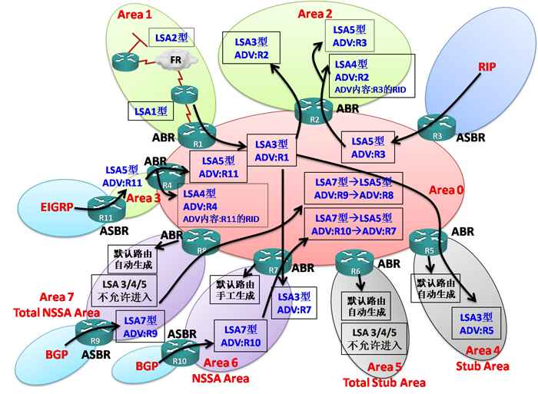
Notes:
① LSA1 路由器LSA（Router LSA） 描述路由器的直连链路状态信息。由每个发起路由器通告，只在本区域内传递，不会超过ABR。 ② LSA2 网络LSA（Network LSA） 描述本区域内BMA/NBMA（串行连接信息不会在此出现）的网络信息以及连接到此网络的路由器。由本BMA/NBMA网络的DR或BDR通告，只在本区域传递。 ③ LSA3 网络汇总LSA（Network summary LSA） 描述OSPF的区域间路由（在路由表中以 O IA 标识）。原LSA 1所描述的路由信息会由所在区域的ABR将其转换为LSA 3。 LSA3可以传播到整个OSPF的所有区域（特殊区域除外）。由ABR通告。 注意：LSA 3每穿越一个ABR，其ADV Router都会发生改变，ADV Router转变为最后一次穿越的ABR路由器。 ④ LSA5 自治系统外部LSA （Autonomous system external LSA） 没有看错，这里是LSA 5，我们先讲LSA 5再反过来看LSA 4。 LSA 5描述的是OSPF区域以外的路由（RIP、EIGRP、BGP等等）。由ASBR所通告，LSA 5可以传播到整个OSPF的所有区域（特殊区域除外）。 注意：LSA 5的通告路由器在穿越ABR的时候是不会改变的。 ⑤ LSA4 ASBR汇总LSA（ASBR summary LSA） LSA 4所承载的内容是：ASBR的Router-ID。LSA 4其实就是图中R4（通告路由器）将Area 3中R11的Router-ID信息转换为LSA 4，在整个OSPF域中泛洪传播（由于LSA 5的通告路由器在穿越ABR的时候不会改变，如图中Area 3的LSA 5在穿越R4到达Area 0时，通告路由器不改变仍然是R11，因此除了Area 3，Area 0和其他区域都不知道R11的信息。此时就需要LSA 4为Area0和其他区域提供R11的信息，可以这么说，LSA 4是为LSA5所服务的）。 ⑥ OSPF的特殊区域：Stub Area末梢区域 在Stub区域中只有域内和域间路由。只允许LSA 3进入本区域，LSA 4/5不允许进入。配置Stub区域后会在区域内自动的生成一条默认路由（以便访问OSPF中其他区域的网络）。 ⑦ OSPF的特殊区域：Total Stub Area绝对末梢区域 在Total Stub Area中只有本区域内的路由。LSA3/4/5均不允许进入本区域。配置Total Stub Area后会在区域内自动的生成一条默认路由（以便访问OSPF中其他区域的网络）。 ⑧ OSPF的特殊区域：NSSA Area次末梢区域 在NSSA区域中允许存在ASBR，所以也就可以引入外部路由。这个外部路由在NSSA区域内以LSA 7存在。当此LSA 7路由离开NSSA区域进入别的区域时，NSSA的ABR会进行LSA 7向LSA 5的转换（如图Area 6所示）。 本区域只允许LSA 3进入，禁止LSA4/5的进入。所以此区域有域内、域间和外部路由。 配置NSSA区域需要在区域内手工的创建一条默认路由（以便访问OSPF中其他区域的网络）。 # router ospf x # area 6 nssa default-information-originate ⑨ OSPF的特殊区域：Total NSSA Area绝对次末梢区域 在NSSA区域中允许存在ASBR，所以也就可以引入外部路由。这个外部路由在NSSA区域内以LSA 7存在。当此LSA 7路由离开NSSA区域进入别的区域时，NSSA的ABR会进行LSA 7向LSA 5的转换（如图Area 7所示）。 本区域禁止LSA3/4/5进入，只有本区域内路由和外部路由。配置Total NSSA Area后会在区域内自动的生成一条默认路由（以便访问OSPF中其他区域的网络）。

Slide 65
OSPF Area Types
Totally Stubby Areas
Does not accept external Type 5 or summary Type 3 LSAs; Sends all interarea and external traffic to default route
Not-So-Stubby Areas (NSSA)
NSSAs connect an AS system to the backbone. The ASBR forwards a Type 7 External link summary through the NSSA to the ABR attached to the backbone. The ABR then converts the Type 7 into a Type 5.
Notes:
所以有Not-So-Stubby Areas 是因为该区域是末节，所以不允许有type5 的报文，从而需要设计type7的报文。

Slide 66
Stub and Totally Stubby Areas
Criteria to qualify:
Single exit point out of the area
Area not needed for a virtual link to connect other areas to the backbone
No ASBR internal to the area
Area is not the backbone
Note1: Totally Stubby is Cisco-specific and is recommended unless area has non-Cisco routers.
Note2: Stub/Totally Stubby areas are usually created by hub-and-spoke topologies.
Totally Stubby
Backbone Area 0
Stub

Slide 67
NSSAs
Not-so-Stubby Areas allow you to get all the benefits of a stub area’s routing table reduction when the area has an external network attached to it (e.g. the RIP network below)
The ASBR internal to the NSSA cannot pass Type 5 summary LSAs in a stub configuration. But it can send Type 7 summary LSAs.
Backbone Area 0
ABR
RIP
ASBR
NSSA 1

Slide 68
LSA Types Overview
Standard Area
ISP
DR originates Type 2 to flood within Standard Area
ASBR generates Type 5 external route and floods through Backbone.
Totally Stubby
ASBR forwards Type 7 LSA throughout NSSA to update OSPF routers about the RIP network
Backbone Area 0
NO LSAs. Only default route to ABR.
RIP
NSSA
Stub
ABR translates Type 7 into Type 5 and forwards throughout Backbone Area
Stub router receives default route and Type 3 Interarea summaries from its ABR.
All Backbone routers generate Type 3 & 4 and flood to each other.
All OSPF routers generate Type 1 and flood in their area

Slide 69
Flooding LSUs to Other Areas
Intra-area routing only requires Type 1 & Type 2 LSUs
To facilitate inter-area routing, ABRs use Type 3 & Type 4 LSUs

Slide 70
Flooding LSUs to Other Areas
Rules for inter-area LSU propagation:
An Area must be synchronized (all area routers have the same link-state database and have calculated their SPF algorithm) before the ABR can send LSU summaries to other ABRs.
The ABR sends Type 3 and Type 4 LSUs out all interfaces attached to the backbone; These LSUs can be reduced by summarizing routes of contiguous addresses.
Receiving ABRs assimilate the LSUs and propagate them to their internal routers according to the area’s properties.
Notes:
assimilate ：吸收
propagate ：传播

Slide 71
Updating the Routing Table
When a router calculates its SPF algorithm, it does so in a logical sequence:
Intra-area routes—closest routes learned from Type 1 and Type 2 LSAs are calculated first
Inter-area routes—internal routes within the same OSPF AS learned from Type 3 and Type 4 LSAs are calculated next
External routes—learned from Type 5 LSAs originated by the ASBR are calculated last
This progression insures that intra-area routes are “believed” over inter-area routes; consequently, inter-area routes are believed over external routes.

Slide 72
Summarizing Routes
With appropriate IP addressing design, ABRs can summarize the internal networks of an area into one address.
Remember: Contiguous IP addressing allows you to supernet your subnets into one routing table entry.
Notes:
Contiguous ：邻近的

Slide 73
Virtual Links
To ensure reachability within an OSPF internetwork, all areas must be connected to the backbone.
However, sometimes an area is added that does not have physical connectivity to the backbone (e.g. when two companies merge).
Cisco has a “work-around” for this situation. Configure a virtual link between the ABR of the new area and the ABR connected to the backbone. On each ABR…
Router(config-router)#area area-id virtual-link router-id
The router-id is the virtual link neighbor’s id.
ABR
Backbone Area 0
New Area
Area 1
ABR
Notes:
两个ABR之间跨过的区域不是area0的时候，在其上配置虚连接，使得其间直接hello，直接把5种报文传递起来。虚连接的时候报文ttl可以大于1.
由于ABR直接通讯，所以可以避免路由自环。

