Slide 1
Routing
What is Routing?
Dynamic Routing Protocols
VLSM and CIDR: Route Aggregation

Slide 2
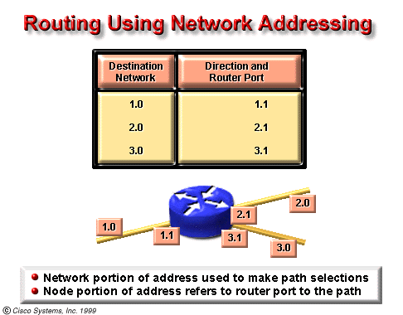
What is Routing?

Slide 3
A router generally relays a packet from one data link to another, using two basic functions, a path determination function and a switching function.
The router uses the network portion of the address to make path selections to pass the packet to the next router along the path.
The switching function allows a router to accept a packet on one interface and forward it through a second interface.
The path determination function enables the router to select the most appropriate interface for forwarding a packet.
The node portion of the address is used by the final router (the router connected to the destination network) to deliver the packet to the correct host.
Notes:
选择-转发-最优-终端

Slide 4
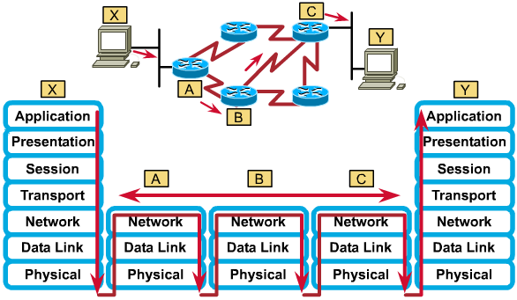
Network protocol operation

Slide 5
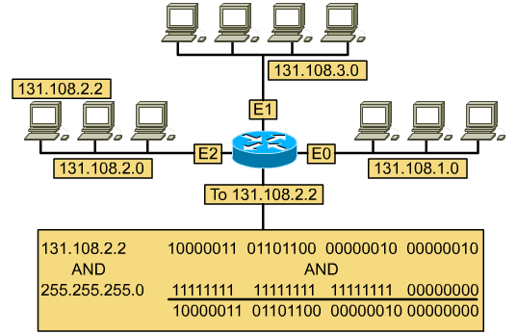
Addressing of a routable protocol
Notes:
无掩码？

Slide 6
Routing table
131.108.1.0 | E0
131.108.2.0 | E1
131.108.3.0 | E2

Slide 7
Routing
What is Routing?
Dynamic Routing Protocols
VLSM and CIDR: Route Aggregation

Slide 8
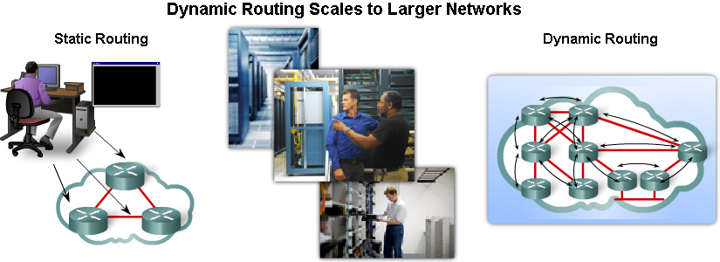
Dynamic Routing Protocols
Classifying Routing Protocols
Metric
Administrative Distance

Slide 9
Dynamic Routing Protocols

Slide 10
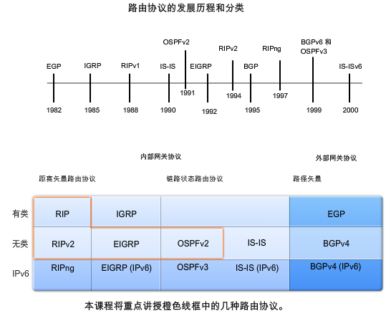
The development of dynamic routing protocol

Slide 11
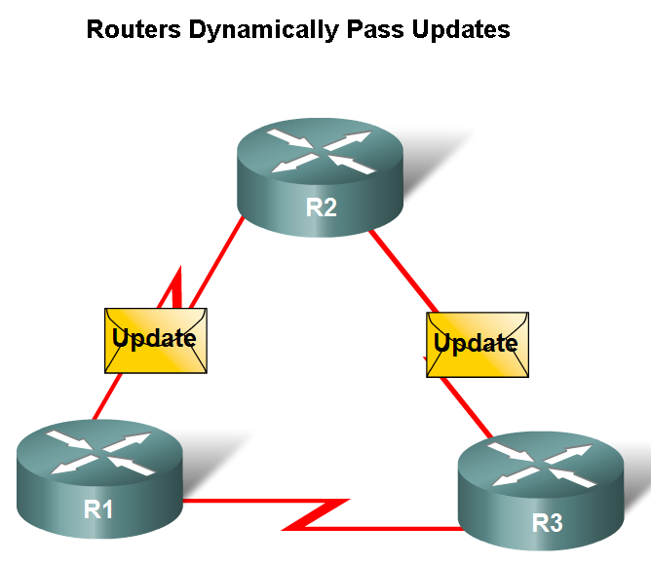
Functions of Dynamic Routing Protocols
Dynamically share information between routers
Automatically update routing table when topology changes
Determine best path to a destination.
Notes:
Hello，update的机制

Slide 12
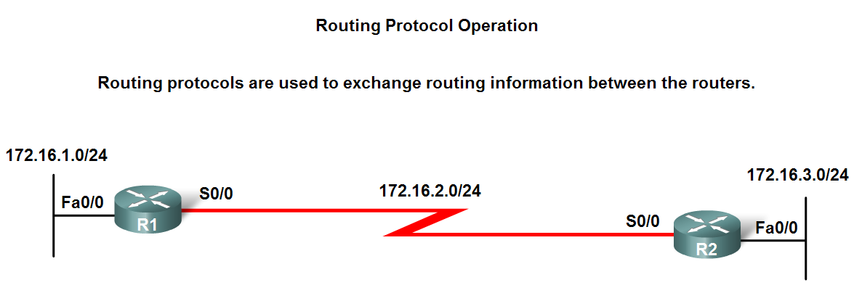
The purpose of a dynamic routing protocols
Discover remote networks
Maintaining up-to-date routing information
Choosing the best path to destination networks
Ability to find a new best path if the current path is no longer available

Slide 13
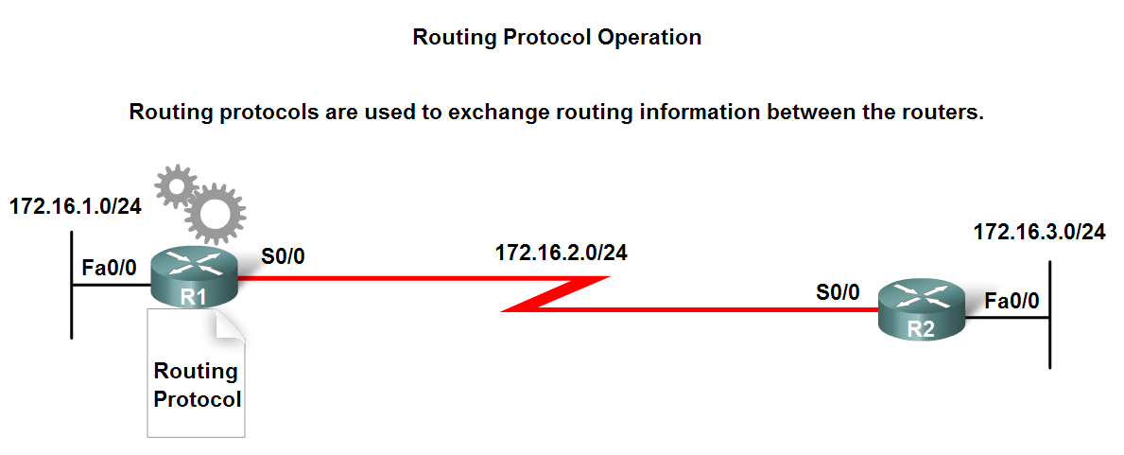
Components of a routing protocol
Algorithm
In the case of a routing protocol algorithms are used for facilitating routing information and best path determination
Routing protocol messages
These are messages for discovering neighbors and exchange of routing information
Notes:
algorithms for 各种状况

Slide 14
Dynamic Routing Protocols
Advantages of static routing
It can backup multiple interfaces/networks on a router
Easy to configure
No extra resources are needed
More secure
Disadvantages of static routing
Network changes require manual reconfiguration
Does not scale well in large topologies
Notes:
安全认证问题

Slide 15
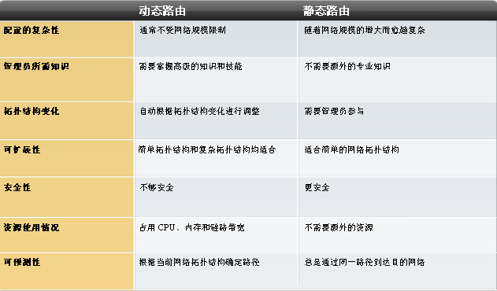

Slide 16
Classifying Routing Protocols

Slide 17
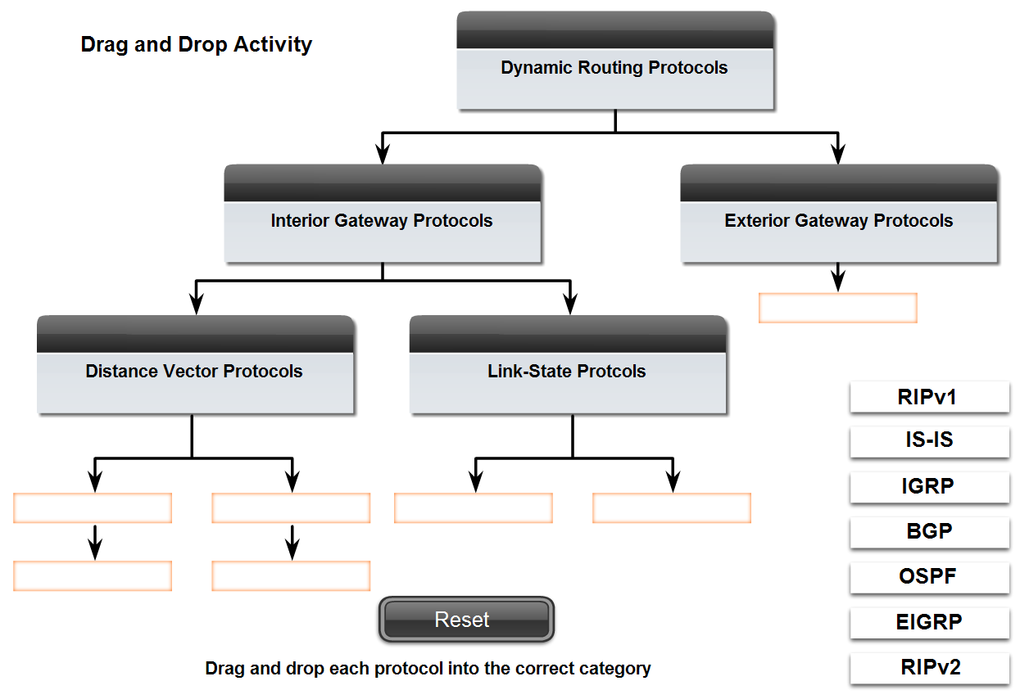
Classifying Routing Protocols
Dynamic routing protocols are grouped according to characteristics.
-RIP
-IGRP
-EIGRP
-OSPF
-IS-IS
-BGP
Autonomous System is a group of routers under the control of a single authority.

Slide 18
Classification #1: Static and Dynamic
Static routes:
The network administrator manually enter the routing information in the router.
Dynamic routes:
Routers can learn the information from each other on the fly.
Using routing protocol to update routing information.
RIP, IGRP, EIGRP, OSPF …

Slide 19
Classification #2: IGP and EGP
Dynamic routes.
Interior Gateway Protocols (RIP, IGRP, EIGRP, OSPF):
Be used within an autonomous system, a network of routers under one administration, like a corporate network, a school district's network, or a government agency's network.
Exterior Gateway Protocols (EGP, BGP):
Be used to route packets between autonomous systems.

Slide 20
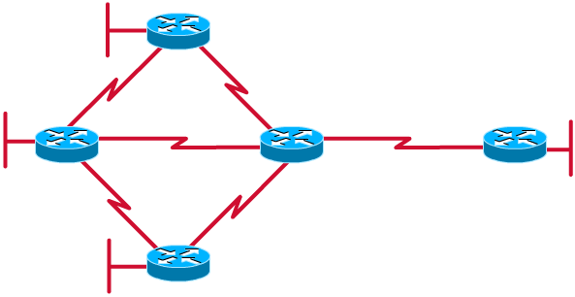
IGP vs. EGP
IGP
EGP

Slide 21
Classification #3: DVP and LSP
Distance-Vector Protocols (RIP, IGRP):
View network topology from neighbor’s perspective.
Add distance vectors from router to router.
Frequent, periodic updates.
Pass copy of routing tables to neighbor routers.
Link State Protocols (OSPF):
Gets common view of entire network topology.
Calculates the shortest path to other routers.
Event-triggered updates.
Passes link state routing updates to other routers.

Slide 22
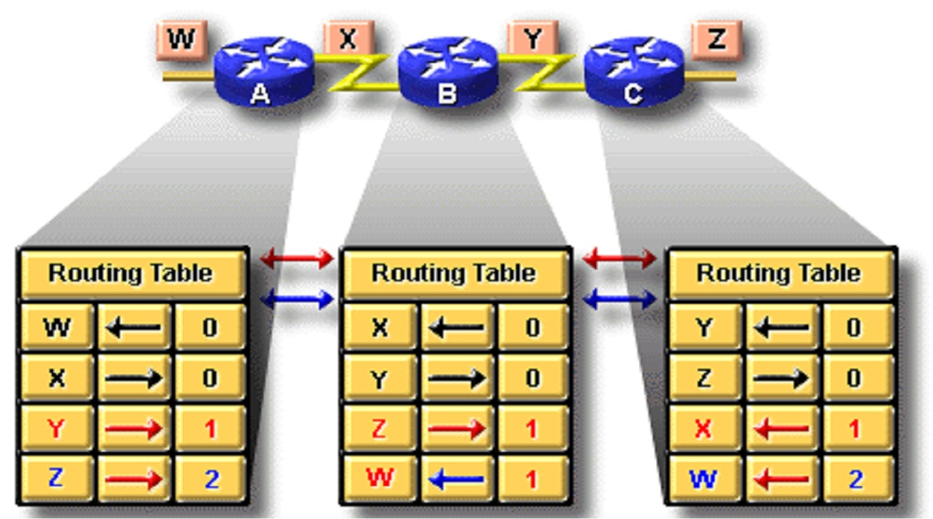
Distance vector routing

Slide 23
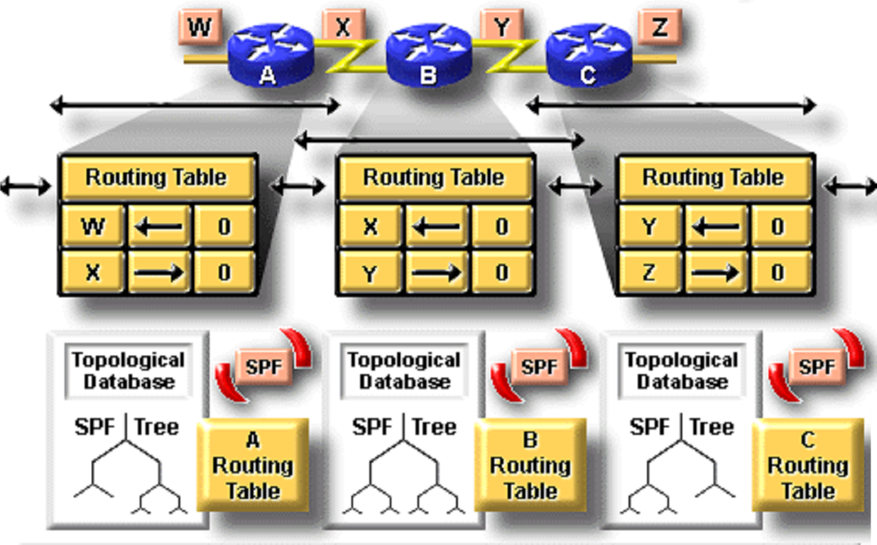
Link state routing

Slide 24
RIP(Route Information Protocol)
Most popular.
Interior Gateway Protocol.
Distance Vector Protocol.
Only metric is number of hops.
Maximum number of hops is 15.
Updates every 30 seconds.
Doesn’t always select fastest path.
Generates lots of network traffic.
RIP v2 is an improved version of RIP v1

Slide 25
IGRP (Interior Gateway Route Protocol) and EIGRP (Enhanced Gateway Route Protocol)
Cisco proprietary.
Interior Gateway Protocol.
Distance Vector Protocol.
Metric is compose of bandwidth, load, delay and reliability.
Maximum number of hops is 255.
Updates every 90 seconds.
EIGRP is an advanced version of IGRP, that is hybrid routing protocol.

Slide 26
OSPF(Open Shortest Path First)
Open Shortest Path First.
Interior Gateway Protocol.
Link State Protocol.
Metric is compose of cost, speed, traffic, reliability, and security.
Event-triggered updates

Slide 27
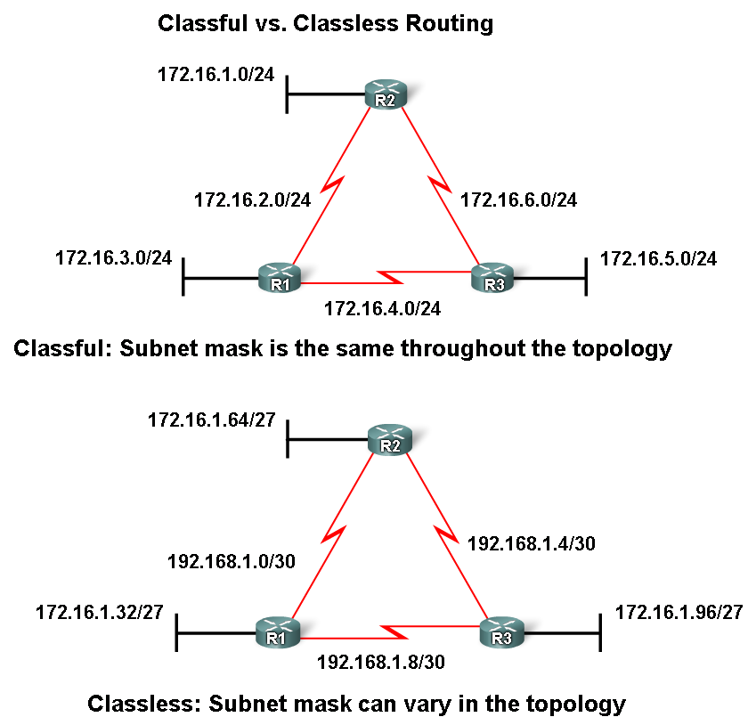
Classful VS. Classless
Classful routing protocols
Do NOT send subnet mask in routing updates
Classless routing protocols
Do send subnet mask in
routing updates.

Slide 28
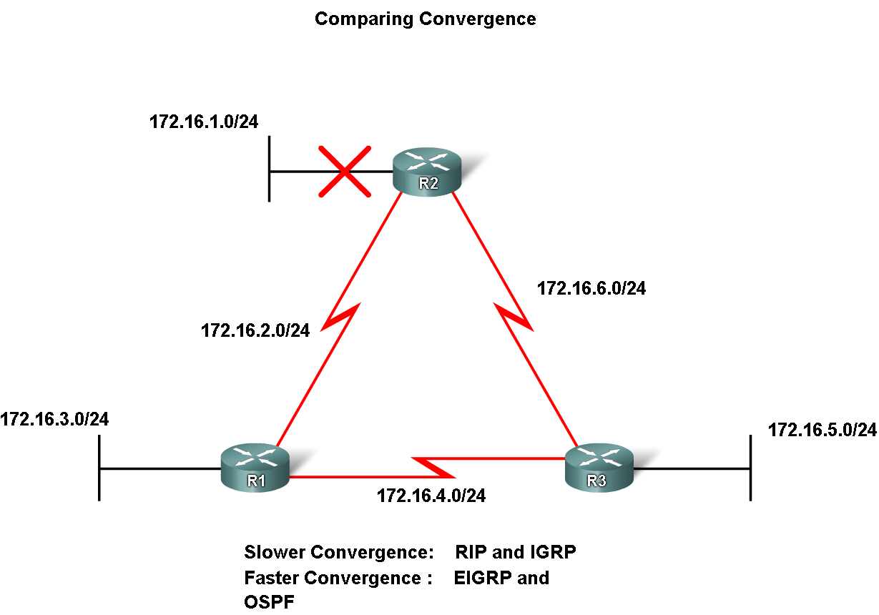
Convergence
Convergence is defined as when all routers’ routing tables are at a state of consistency

Slide 29
Metric

Slide 30
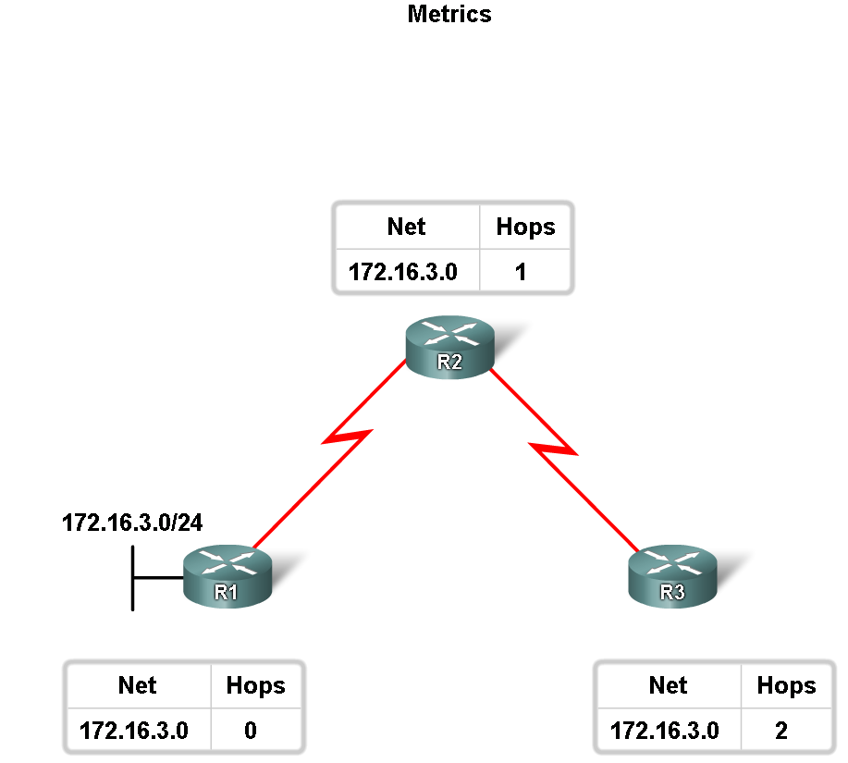
Routing Protocols Metrics
Metric
A value used by a routing protocol to determine which routes are better than others.

Slide 31
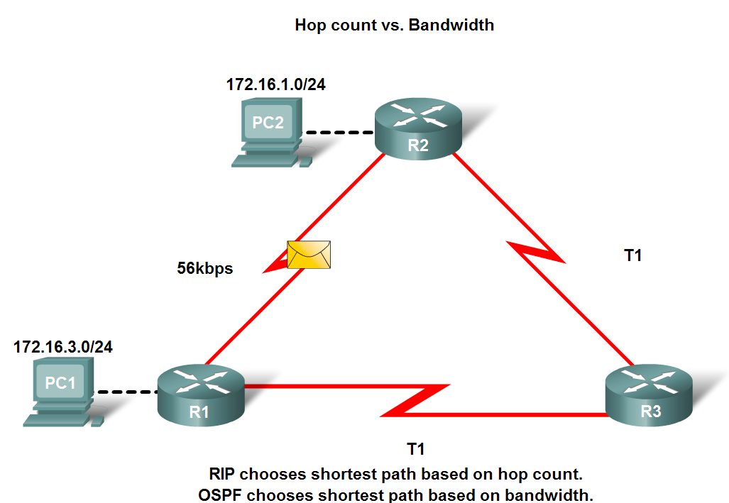
Routing Protocols Metrics
Metrics used in IP routing protocols
Bandwidth
Cost
Delay
Hop count
Load
Reliability

Slide 32

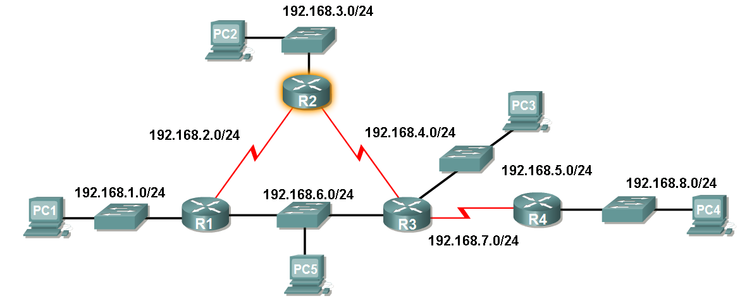
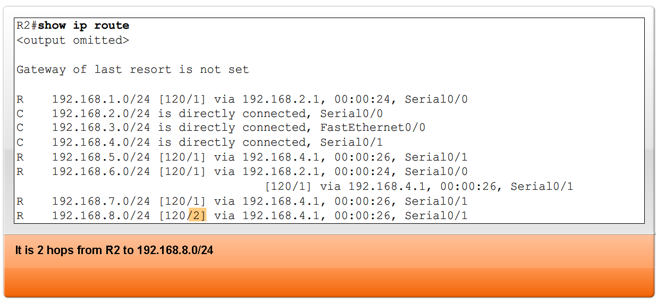
Routing Protocols Metrics
The Metric Field in the Routing Table
Metric used for each routing protocol
RIP :hop count
IGRP & EIGRP : Bandwidth (used by default), Delay (used by default), Load, Reliability
IS-IS & OSPF: Cost, Bandwidth (Cisco’s implementation)

Slide 33
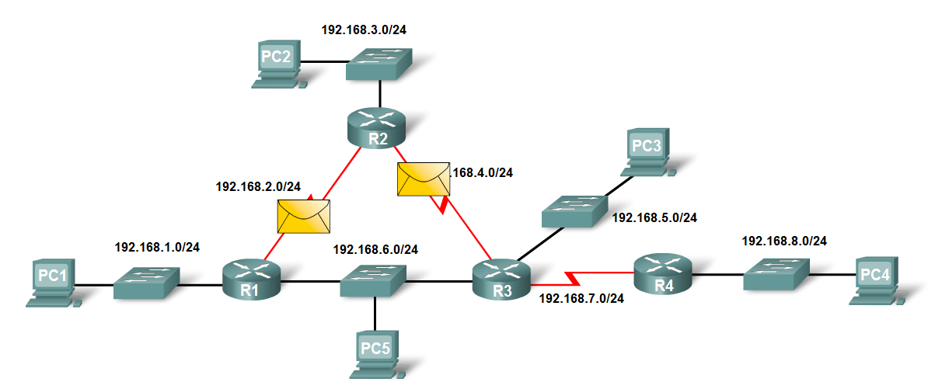
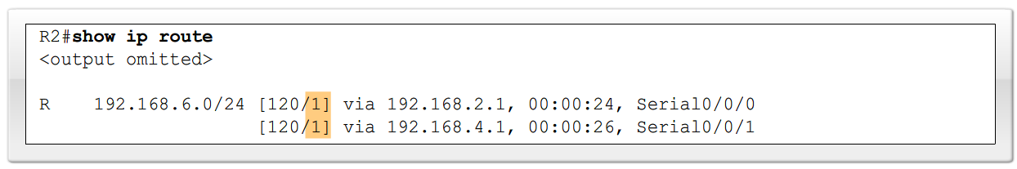
Load balancing
This is the ability of a router to distribute packets among multiple same cost paths

Slide 34
Administrative Distance

Slide 35
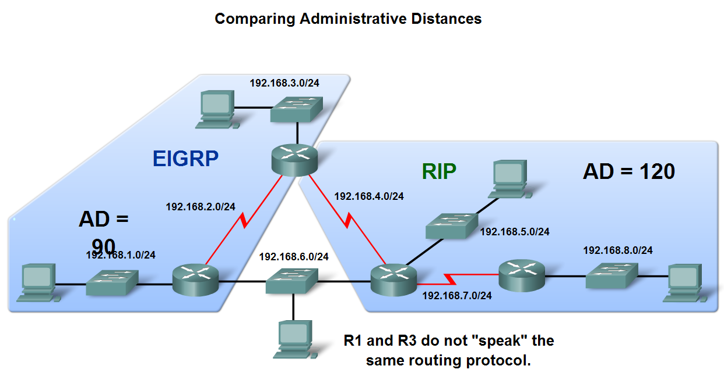
Administrative Distance of a Route
Purpose of a metric
It’s a calculated value used to determine the best path to a destination
Purpose of Administrative Distance
It’s a numeric value that specifies the preference of a particular route

Slide 36
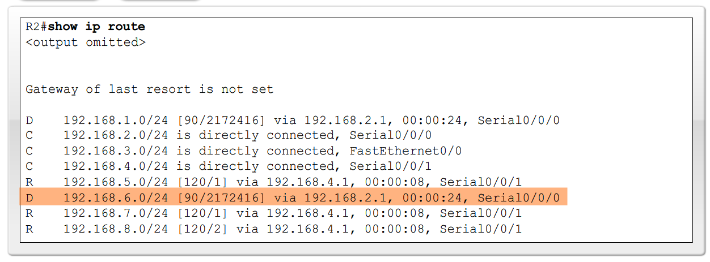

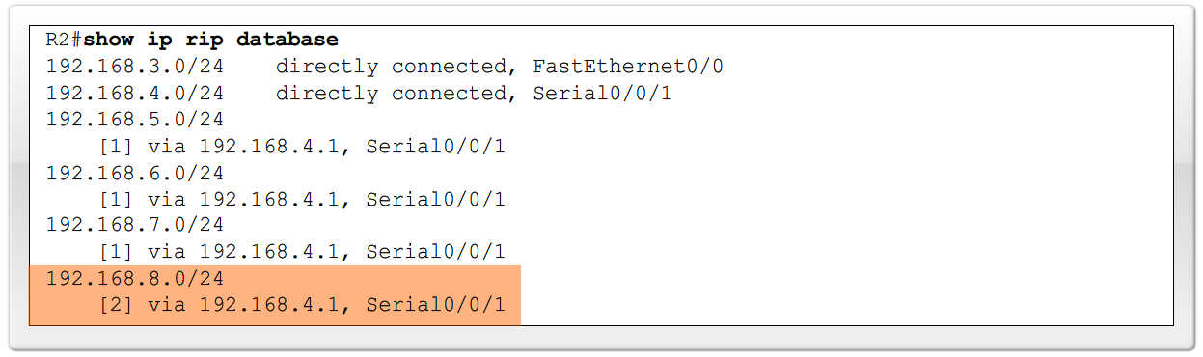
Administrative Distance of a Route
Identifying the Administrative Distance (AD) in a routing table
It is the first number in the brackets in the routing table

Slide 37
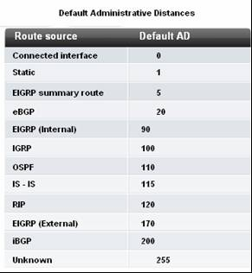
Administrative Distance of a Route
Dynamic Routing Protocols

Slide 38
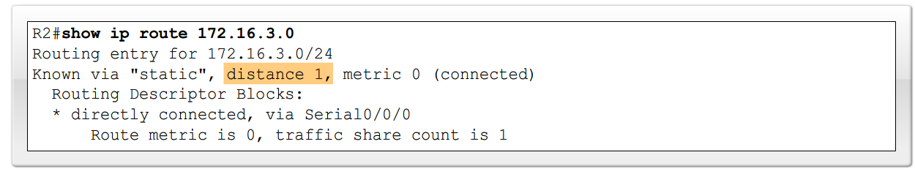
Administrative Distance of a Route
Directly connected routes
Have a default AD of 0
Static Routes
Administrative distance of a static route has a default value of 1

Slide 39
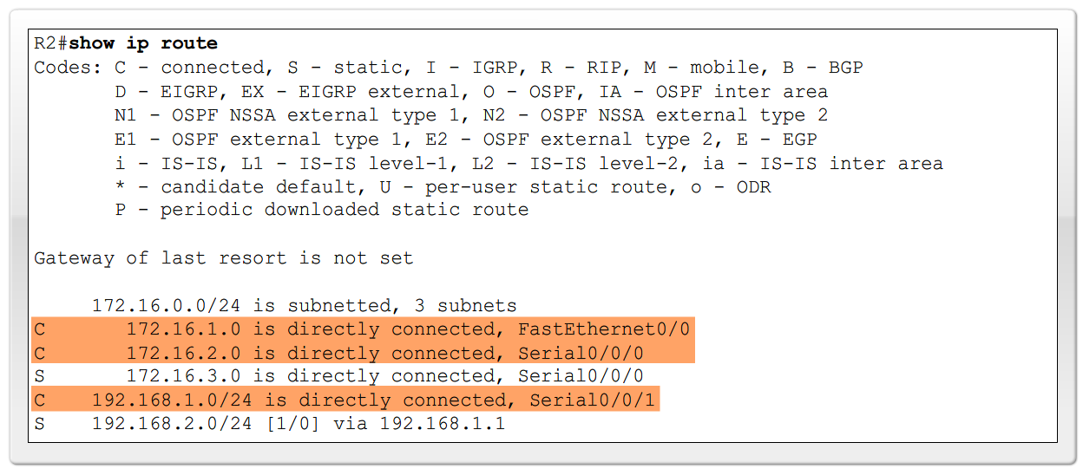
Administrative Distance of a Route
Directly connected routes
Immediately appear in the routing table as soon as the interface is configured

Slide 40
Routing
What is Routing?
Dynamic Routing Protocols
VLSM and CIDR: Route Aggregation

Slide 41

VLSM and CIDR: Route Aggregation

Slide 42
Introduction
Prior to 1981, IP addresses used only the first 8 bits to specify the network portion of the address
In 1981, RFC 791 modified the IPv4 32-bit address to allow for three different classes
IP address space was depleting rapidly
the Internet Engineering Task Force (IETF) introduced Classless Inter-Domain Routing (CIDR)
CIDR uses Variable Length Subnet Masking (VLSM) to help conserve address space.
VLSM is simply subnetting a subnet

Slide 43
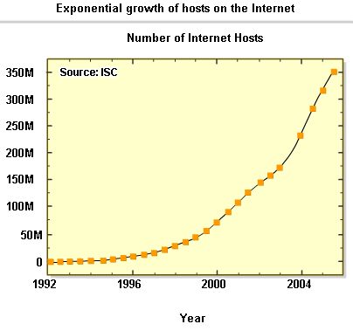
Classful and Classless IP Addressing
Classful IP addressing
As of January 2007, there are over 433 million hosts on internet
Initiatives to conserve IPv4 address space include:
-VLSM & CIDR notation (1993, RFC 1519)
-Network Address Translation (1994, RFC 1631)
-Private Addressing (1996, RFC 1918)
Notes:
1992年，IETF面临的问题：IPV4耗尽。B类地址处于耗尽的边缘；随着internet的发展，更多的C网地址连接到internet，致使路由表快速加大。

Slide 44
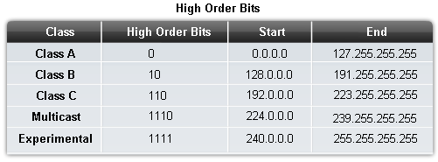
Classful and Classless IP Addressing
Classes of IP addresses are identified by the decimal number of the 1st octet
Class A address begin with a 0 bit
Range of class A addresses = 0.0.0.0 to 127.255.255.255
Class B address begin with a 1 bit and a 0 bit
Range of class B addresses = 128.0.0.0 to 191.255.255.255
Class C addresses begin with two 1 bits & a 0 bit
Range of class C addresses = 192.0.0.0 to 223.255.255.255.
Notes:
A类网络代表巨大的浪费与低效。
224.0.0.5：OSPF
224.0.0.6：OSPF的DR
224.0.0.9：RIPv2
224.0.0.10：EIGRP

Slide 45
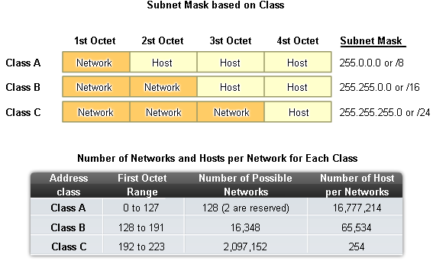
Classful and Classless IP Addressing

Slide 46
Classful Routing & VLSM
Classful routing
Classful routing protocols require that a single network use the same subnet mask.
Example: network 192.168.187.0 must use just one subnet mask such as 255.255.255.0.
VLSM — Variable-Length Subnet Masks
VLSM is simply a feature that allows a single autonomous system to have networks with different subnet masks.

Slide 47
VLSM
With VLSM, a network administrator can use a long mask on networks with few hosts, and a short mask on subnets with many hosts.
If a routing protocol allows VLSM:
use a 30-bit subnet mask on network connections, 255.255.255.252
a 24-bit mask for user networks, 255.255.255.0
Or, even a 22-bit mask, 255.255.252.0, for networks with up to 1000 users.

Slide 48
Why use the VLSM
VLSM allows an organization to use more than one subnet mask within the same network address space.
Implementing VLSM is often referred to as "subnetting a subnet", and can be used to maximize addressing efficiency.
VLSM is one of the modifications that has helped to bridge the gap between IPv4 and IPv6.

Slide 49
VLSM
Advantages:
Efficient use of IP addresses
Better route aggregation
Support VLSM Routing Protocol:
Open Shortest Path First (OSPF),
Integrated Intermediate System to Intermediate System (Integrated IS-IS),
Enhanced Interior Gateway Routing Protocol (EIGRP),
RIP v2,
Static routing.

Slide 50
A Waste of Space
In the past, it has been recommended that the first and last subnet not be used. But we can used the Subnet 0 from Cisco IOS ver12.0.
From IOS ver12.0, the Cisco router use subnet zero by default.
command: router(config)#no ip subnet-zero

Slide 51
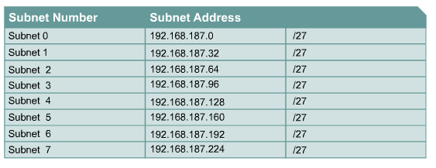
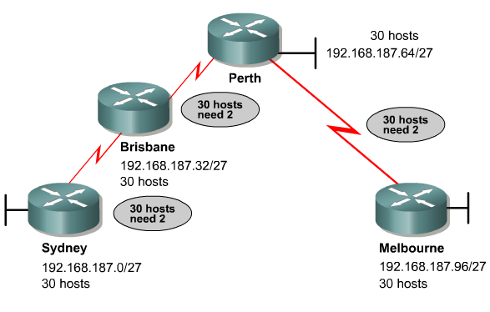
A Waste of Space
192.168.187. 000 *****
255.255.255.224 (1110 0000)
subnet-id
Host-id

Slide 52
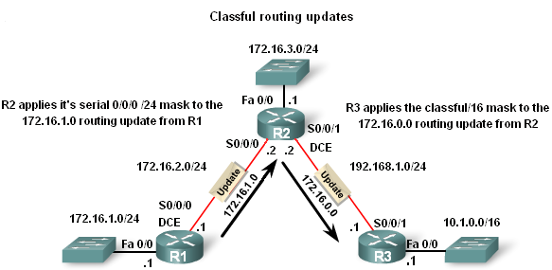
Classful and Classless IP Addressing
Classful Routing Updates
-Recall that classful routing protocols (i.e. RIPv1) do not send subnet masks in their routing updates. The reason is that the Subnet mask is directly related to the network address

Slide 53
Classful and Classless IP Addressing
Classless Inter-domain Routing (CIDR – RFC 1517)
Advantage of CIDR :
More efficient use of IPv4 address space
Route summarization
Requires subnet mask to be included in routing update because address class is meaningless Recall purpose of a subnet mask:
To determine the network and host portion of an IP address

Slide 54
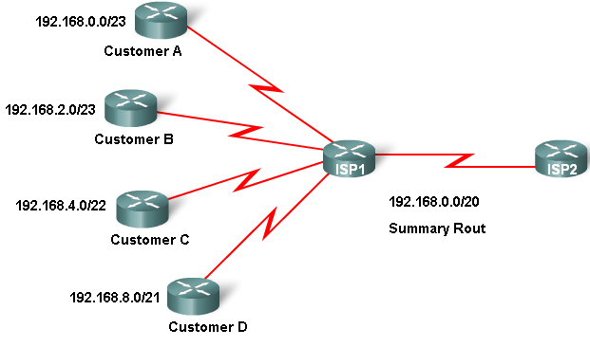
Classful and Classless IP Addressing
Classless IP Addressing
CIDR & Route Summarization
-Variable Length Subnet Masking (VLSM)
-Allows a subnet to be further sub-netted according to individual needs
-Prefix Aggregation a.k.a. Route Summarization
-CIDR allows for routes to be summarized as a single route

Slide 55
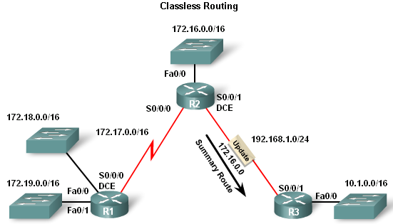
Classful and Classless IP Addressing
Classless Routing Protocol
Characteristics of classless routing protocols:
-Routing updates include the subnet mask
-Supports VLSM
Supports Route Summarization

Slide 56
Classful and Classless IP Addressing
Classless Routing Protocol
Routing Protocol | Routing updates Include subnet Mask | Supports VLSM | Ability to send Supernet routes
Classful | No | No | No
Classless | Yes | Yes | Yes

Slide 57
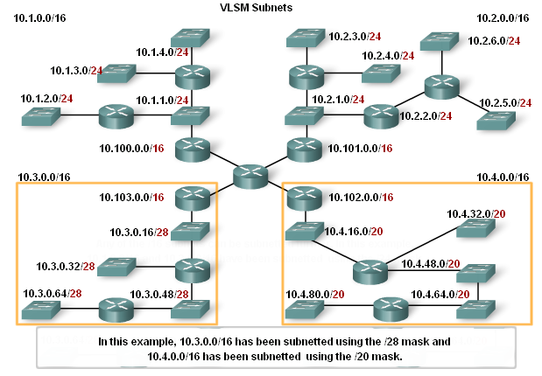
VLSM
Classful routing
only allows for one subnet mask for all networks
VLSM & classless routing
This is the process of subnetting a subnet
More than one subnet mask can be used
More efficient use of IP addresses as compared to classful IP addressing

Slide 58
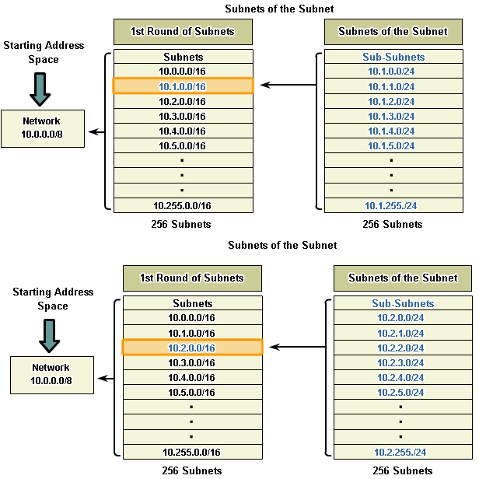
VLSM
VLSM – the process of sub-netting a subnet to fit your needs
-Example:
Subnet 10.1.0.0/16, 8 more bits are borrowed again, to create 256 subnets with a /24 mask.
-Mask allows for 254 host addresses per subnet
-Subnets range from: 10.1.0.0 / 24 to 10.1.255.0 / 24

Slide 59
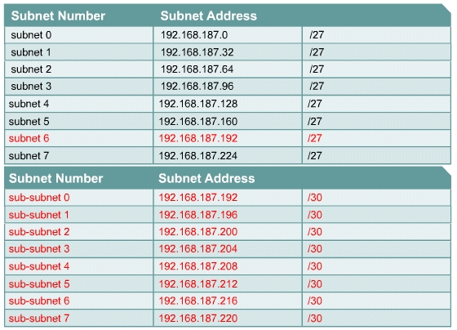
How to use the VLSM
subnetting a subnet
192.168.187.192 (110 00000)
255.255.255.252 (1111 1100)
VLSM subnet id

Slide 60
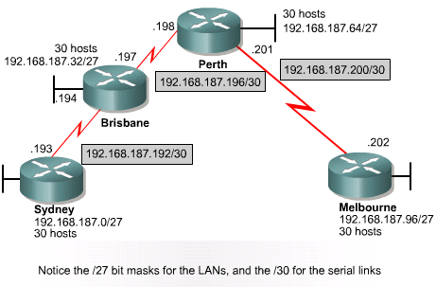
How to use the VLSM

Slide 61
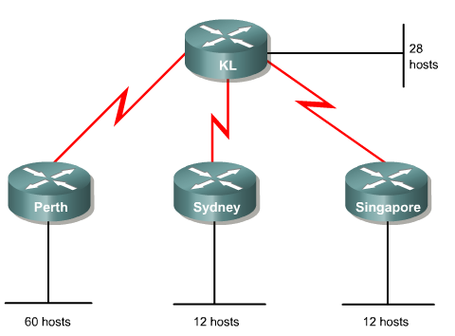
Exercise

Slide 62
Exercise
A class C address of 192.168.10.0/24 has been allocated.
Perth, Sydney, and Singapore have a WAN connection to Kuala Lumpur (KL).
Perth requires 60 hosts.
KL requires 28 hosts.
Sydney and Singapore each require 12 hosts.
To calculate VLSM subnets and the respective hosts allocate the largest requirements first from the address range. Requirements levels should be listed from the largest to the smallest.

Slide 63
Exercise
Step 1
In this example Perth requires 60 hosts.
Use 6 bits since 2⁶ – 2 = 62 usable host addresses. Thus 2 bits will be used from the 4th Octet to represent the extended-network-prefix of /26 and the remaining 6 bits will be used for host addresses.
Applying VLSM on address 192.168.10.0/24 gives:
192.168.10.00 hh hhhh /26
255.255.255.192 (1100 0000)

Slide 64
192.168.10.0/24（Subnetted） | 192.168.10.0/26 (0000 0000) | Perth (60 hosts) 192.168.10.0/26 (Network Address) 192.168.10.1/26 192.168.10.2/26 …… 192.168.10.61/26 192.168.10.62/26 192.168.10.63/26(Broadcast Address)
 | 192.168.10.64/26 (0100 0000) | Unused （Subnetted）
 | 192.168.10.128/26 (1000 0000) | Unused
 | 192.168.10.192/26 (1100 0000) | Unused
See next slide

Slide 65
Exercise
Step 2
KL requires 28 hosts. The next available address after 192.168.10.63/26 is 192.168.10.64/26.
Since 28 hosts are required, 5 bits will be needed for the host addresses, 2⁵ –2 = 30 usable host addresses.
Thus 5 bits will be required to represent the hosts and 3 bits will be used to represent the extended-network prefix of /27.
Applying VLSM on address 192.168.10.64/26 gives:
192.168.10.010 hhhhh /27
255.255.255.224 (1110 0000)

Slide 66
From 192.168.10.64/26 | 192.168.10.64/27 (0100 0000) | KL (28 hosts) 192.168.10.64/27 (Network Address) 192.168.10.65/27 192.168.10.66/27 …… 192.168.10.94/27 192.168.10.95/27 192.168.10.96/27 (Broadcast Address)
 | 192.168.10.96/27 (0110 0000) | Unused （Subnetted）
 | 192.168.10.128/27 (1000 0000) | Unused
 | 192.168.10.160/27 (1010 0000) | Unused
 | 192.168.10.192/27 (1100 0000) | Unused
 | 192.168.10.224/27 (1110 0000) | Unused
See next slide

Slide 67
Exercise
Step 3
Now Sydney and Singapore require 12 hosts each. The next available address starts from192.168.10.96/27.
Since 12 hosts are required, 4 bits will be needed for the host addresses, 2⁴ = 16, 16 – 2 = 14 usable addresses.
Thus 4 bits are required to represent the hosts and 4 bits for the extended-network-prefix of /28.
Applying VLSM on address 192.168.10.96/27 gives:
192.168.10.0110 hhhh /28
255.255.255.240 (1111 0000)

Slide 68
From 192.168.10.96/27 | 192.168.10.96/28 | Sydney(12 hosts) 192.168.10.96/28 (Network Address) 192.168.10.97/28 192.168.10.98/28 …… 192.168.10.109/28 192.168.10.110/28 192.168.10.111/28 (Broadcast Address)
 | 192.168.10.112/28 | Singapore (12 hosts) 192.168.10.112/28 (Network Address) 192.168.10.113/28 192.168.10.114/28 …… 192.168.10.126/28 192.168.10.127/28 192.168.10.128/28(Broadcast Address)
 | 192.168.10.128/28 | Unused （Subnetted）
 | 192.168.10.144/28 | Unused
 | ... … | Unused
 | 192.168.10.240/28 | Unused
See next slide

Slide 69
Exercise
Step 4
Now allocate addresses for the WAN links. Remember that each WAN link will require two IP addresses. The next available subnet is 192.168.10.128/28.
Since 2 network addresses are required for each WAN link, 2 bits will be needed for host addresses, 2² –2 = 2 usable addresses.
Thus 2 bits are required to represent the links and 6 bits for the extended-network-prefix of /30.
Applying VLSM on 192.168.10.128/28 gives:
192.168.10.011000 hh /30
255.255.255.252 (1111 1100)

Slide 70
From 192.168.10.128/28 | 192.168.10.128/30 | Perth – KL 192.168.10.128/30 (Network Address) 192.168.10.129/30 192.168.10.130/30 192.168.10.131/30 (Broadcast Address)
 | 192.168.10.132/30 | Sydney – KL 192.168.10.132/30(Network Address) 192.168.10.133/30 192.168.10.134/30 192.168.10.135/30(Broadcast Address)
 | 192.168.10.136/30 | Singapore – KL 192.168.10.136/30 (Network Address) 192.168.10.137/30 192.168.10.138/30 192.168.10.139/30 (Broadcast Address)
 | 192.168.10.140/30 | Unused
 | 192.168.10.144/30 | Unused
 | … … | Unused

Slide 71
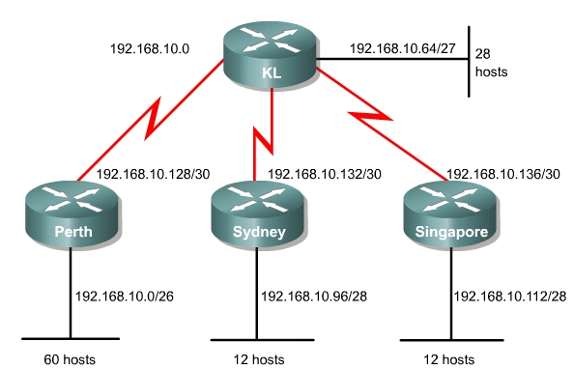
Exercise

Slide 72
Exercise
It is important to remember that only unused subnets can be further subnetted.
If any address from a subnet is used, that subnet cannot be further subnetted.

Slide 73
Question
If you want to distribute 192.168.1.0/24 to these hosts and routers (with NLSM), and divide the network into several subnets using as few addresses as you can, please give the result. (zero subnet is allowed)
192.168.1.96/27
192.168.1.128/28
192.168.1.144/30
RTA
RTB
12 hosts
RTC
25 hosts
192.168.1.148/30
29 hosts
31 hosts
192.168.1.0/26
192.168.1.64/27

Slide 74
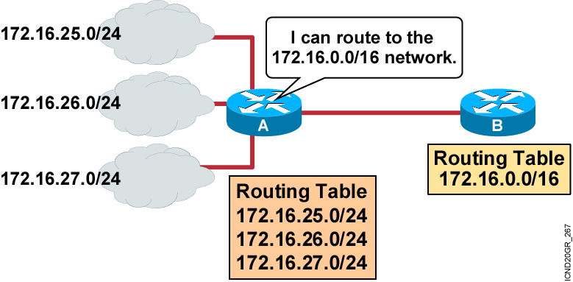
Route Aggregation
The use of Classless InterDomain Routing (CIDR) and VLSM not only prevents address waste, but also promotes route aggregation, or summarization.

Slide 75
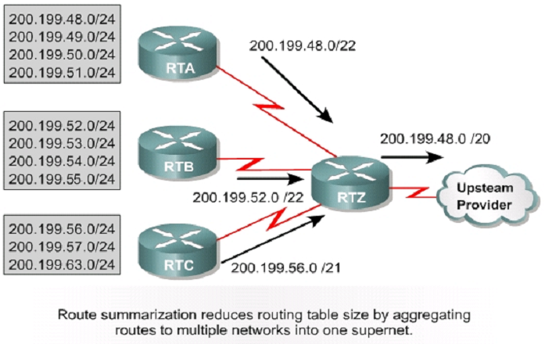
Route Summarization Sample

Slide 76
Working it out
200.199.48.0 /24
200.199.001100 00.hhhhhhhh
200.199.49.0 /24
200.199.50.0 /24
200.199.51.0 /24
200.199.001100 01.hhhhhhhh
200.199.001100 10.hhhhhhhh
200.199.001100 11.hhhhhhhh
255.255.111111 00.00000000
Summarized Address 200.199.48.0 / 22

Slide 77
Route Aggregation
Advantages:
Reduction of the number of Routing Table entries.
May be used to isolate Topological changes
For aggregation to work properly, carefully assign addresses in a hierarchical fashion so that summarized addresses will share the same high-order bits.
VLSM allows for the aggregation of routes and increases flexibly by basing the aggregation entirely on the higher-order bits shared on the left, even if the networks are not contiguous.

Slide 78
Exercise
What are the best aggregated routes sent on the link A, B, C, D, E? And why?
202.102.32.32/27
A
202.102.32.64/28
202.102.32.96/28
B
202.102.32.136/29
E
202.102.32.144/29
D
C
202.102.32.152/29

Slide 79
不连续子网
源于同一主类的网络，被属于不同主类网络的子网隔开
RIPv1
RIPv2和EIGRP：主类别边界上的路由归纳
no auto –summary

Slide 80
IP Unnumbered
点对点串行线路
避免不连续子网问题
另外两端属于一个网段
无法ping，安全控制
Interface e0
Ip add 168.71.5.1 255.255.255.0
Interface s0
Ip unnumbered e0
Notes:
另外两端属于一个网段：同长度的子网
或者直接是不同主类

