Slide 1




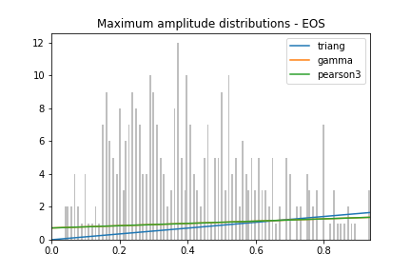
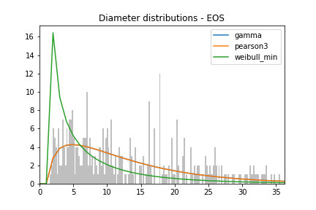
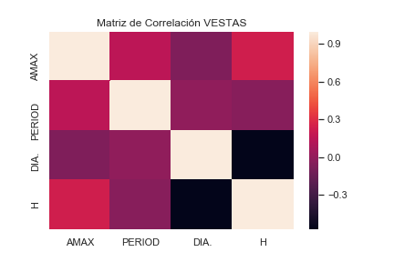
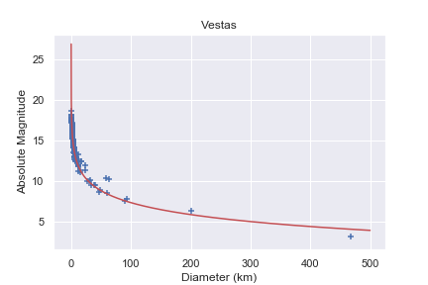
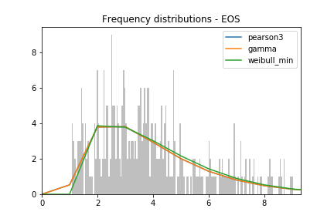
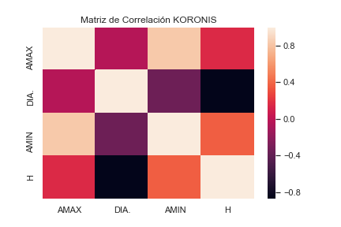
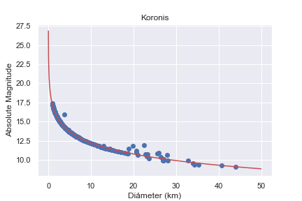
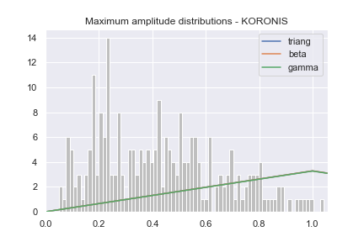
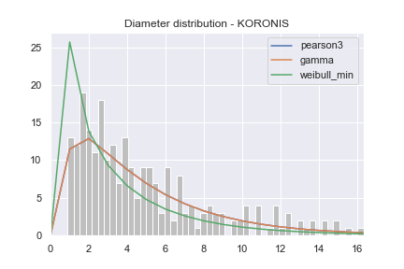
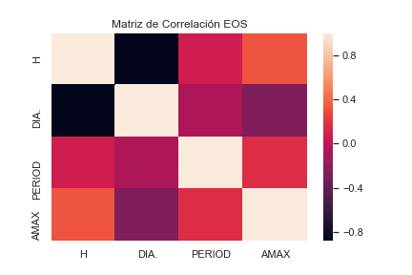
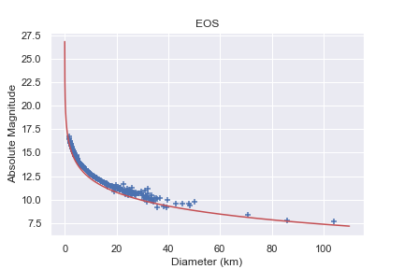
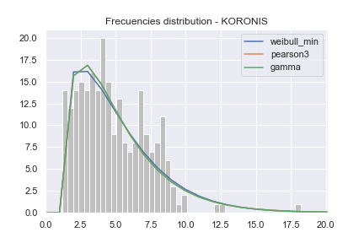
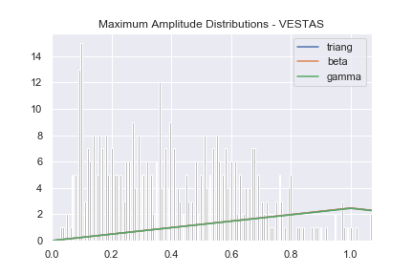
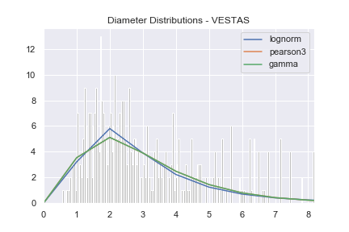
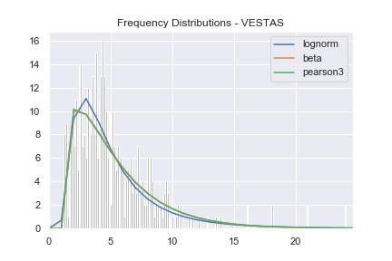

XVIII Meeting of Physics Lima
August 15th - 16th, 2019, Faculty of Sciences, National University of Engineering (UNI), Lima, Peru
A statistical study of ancient families of asteroids: Koronis, Eos and Vestas
Ricardo Quispe^{1,2(*)}, Jorge Gonzales¹
1. INTRODUCTION
Koronis, Eos and Vestas are into the most prominent and oldest asteroids of the main belt.
The dataset used is provided by the Light Curve Data Base (LCDB)-version 31/January/2019¹
The machine learning methods to this research haves a fundamental role for treatment of the data. ²
2. METHOD
We use the data set called “LC_SUM_PUB.txt”, so we needed to clean and transform this data into a csv format.
3. RESULTS
4. CONCLUSIONS
The absolute magnitude is highly correlated with Diameter, thus checking the theoretical relationship.
To find the distributions we used the KS-Test which is very efficient because we calculated a p-value > 0,5 for several distributions and anyone haves
Distribution pearson3 for frequencies chi_square= 23,281012; p_value=0,69983
Distribution Gamma for Diameters chi_square= 25.528662; p_value=0,04970
Distribution Trian for Maximum amplitudes
Chi_square=12,134237; p_value=0,37949
Distribution weilbull_min for frequencies chi_square= 17,073152; p_value=0,23178
Distribution pearson3 for Diameters chi_square= 5.907148; p_value=0,96319
Distribution Trian for Maximum amplitudes
Chi_square=12,652892; p_value=0,52322
Total Data in csv format
Eos Family
Koronis Family
Vestas Family
Missing data indetifier
Kolmogorov – Smirnov (KS)
Distribution lognorm for frequencies chi_square= 25,241139; p_value=0,50722
Distribution lognorm for Diameters chi_square= 12,578557; p_value=0,64024
Distribution Tring for Maximum amplitudes
Chi_square=12,578557; p_value=0,64024
Eos
Maximum Aplitude
Frecuency
Diameter
Koronis
Maximum Aplitude
Frecuency
Diameter
Vestas
Maximum Aplitude
Frecuency
Diameter
5. REFERENCES
[1] LCDB; Warner et al., 2009, Icarus 202, 134-146
[2] Pankaj Mehta, Ching-Hao Wang et al. (2019) A high-bias,
low-variance introduction to Machine Learning for physicists.
[3] Pravec P., Harris A. W., and Michalowski T. (2002) Asteroid rotations.
Machine Learning methods are more efficient than a human visual approach of distributions.
¹Faculty of Physical Sciences, National University of San Marcos (UNMSM)
²Permanente Seminar of Astronomy and Space Sciences , UNMSM
*E-mail: ricardo.quispe5@unmsm.edu.pe
Take a picture to download the poster and see the algorithm on GitHub

