Slide 1
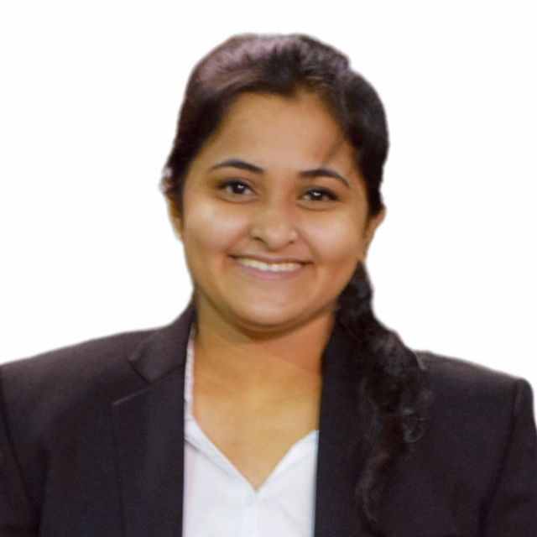



Bakul Yenarkar
Analyst/Software Engineer
Bachelor of Engineering
Electrical Engineering: 2017 - 2021
Skills
Java 8 | Java Basics, OOPS, Generics, Collections, Arrays, Loops, Lambda Exp, Stream API, Junit, Mockito, Servlets
Spring core | IOC & Dependency Injection, Autowire
Spring REST | REST controllers, Implementation of GET, POST, PUT & DELETE, Bean Validation & Exception Handling, Testing Services, Controller & Repository layer
Spring Data JPA | Implement DAO layer using spring Data repositories, Transaction Management
Spring Boot Microservices | Spring Boot Starters, annotations, Messaging Service, Swagger API documents
Angular | Components, Services, Modules, Routing, Forms & Validation, Testing
Database | MongoDB No SQL Basics MySQL RDBMS Basics
UI Tech | HTML 5 & CSS 3,JavaScript, TypeScript Reusable templates, Optimized UI Designed
Tools | Git, Postman, Maven, Eclipse
Add On skills | Communications, Team management. Peer learning, problem solving
Mumbai
bakul.yenarkar@capgemini.com
+91 7588765088
A4
Full Stack Developer
Proficient in creating Single page Web Application in Angular with Authentication with route guards, Angular reactive forms, angular routing, CSS,HTML.
Hands on experience in creating microservices with Springboot, Spring Security, Spring Cloud API Gateway, Eureka server.
Hands on experience in implementing Angular and spring boot.
Experience in creating documentation with Java docs and swagger and in unit testing using Junit, Mockito
Experience in MongoDB NoSQL database along with MySQL database.
On demand car wash system
Developed an online on demand car wash system using spring microservices and AngularJs with MongoDB as database in agile methodology of software development model.
Programming in C++: Online course by IIT Kharagpur, mentored by Prof. Partha Pratim Das.
Python specialization: An online non-credit course authorized by University of Michigan and offered through Coursera, mentored by Prof. Charles Severance.
https://github.com/Byenarkar/Case-Study.git

