Slide 1
Multi-Modal Semantic Communication Through Transformer-Aided Compression Yoonkyo Jung | ECE Ph.D. Student April 2, 2025

Slide 2
Contents
Introduction
Background
System Model
Results
Conclusion

Slide 3
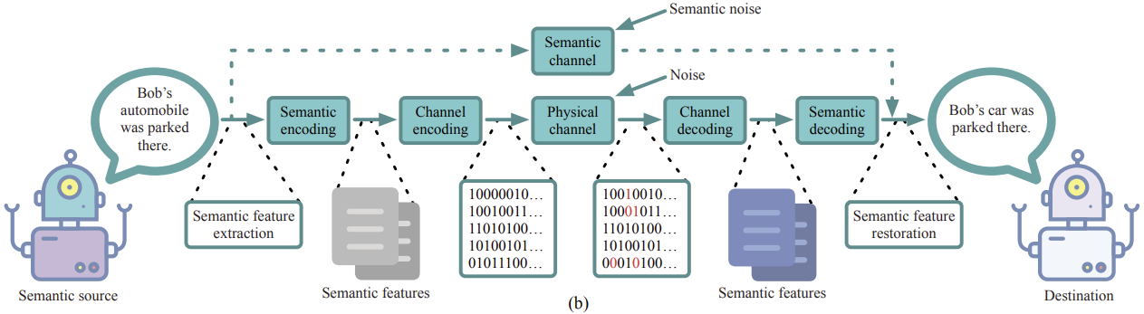
Introduction
Semantic communications is to extract the “meanings” or “features” of sent information from a source and “interpret” the semantic information at a destination.
Notes:
Traditional communication systems aim to offer a high data transmission rate and a low symbol (bit) error rate.
Semantic communications is to extract the “meanings” or “features” of sent information from a source and “interpret” the semantic information at a destination.

Slide 4
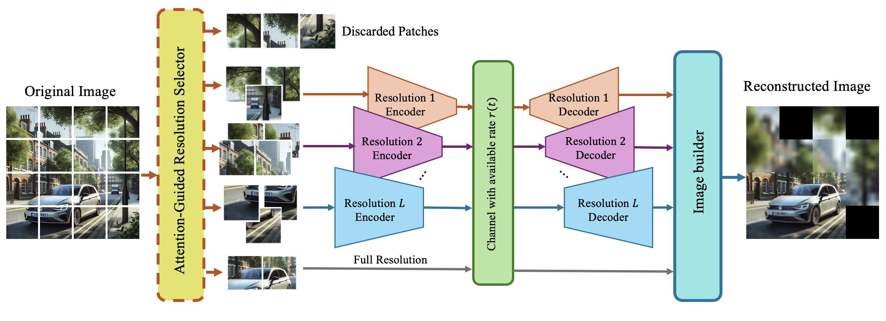
Introduction
Goal: Transmit multi-resolution data in limited bandwidth conditions.
Developed a transformer-based framework for channel-adaptive communication.
Notes:
This research developed a framework based on the transformer to communicate adaptive

Slide 5




car
road
…
bike
Open-Vocabulary Semantic Segmentation
car
road

Slide 6
Background

Slide 7
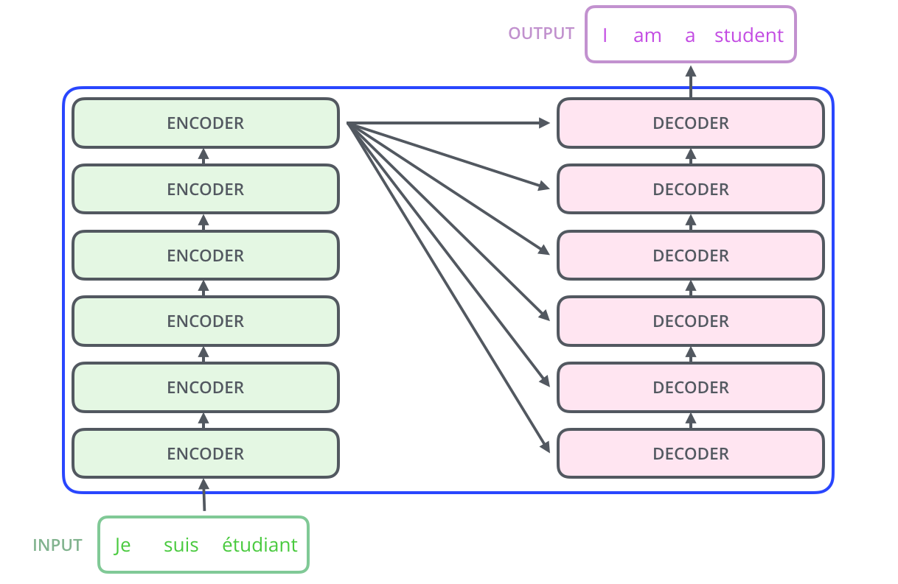
Background (Transformer)
Transformer Overview:
Notes:
Explain only Transformer: The model consists of encoder-decoder layers, where the encoder processes inputs and the decoder generates outputs.

Slide 8
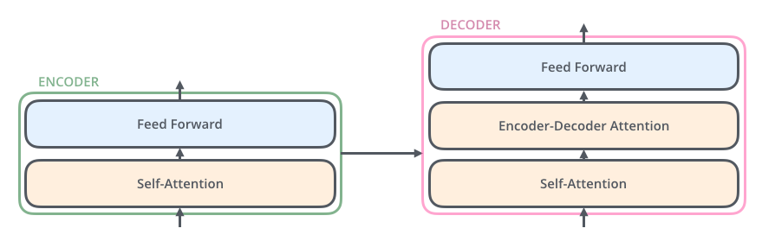
Background (Transformer)
Transformer Overview:
A deep learning architecture with self-attention mechanisms.
Enables focus on key elements in complex data.
Notes:
Each encoder is broken down in two sub-layers, and each decoder consists of three sub-layers.
It uses self-attention to weigh the importance of different input elements and positional encoding to retain sequence order information.

Slide 9
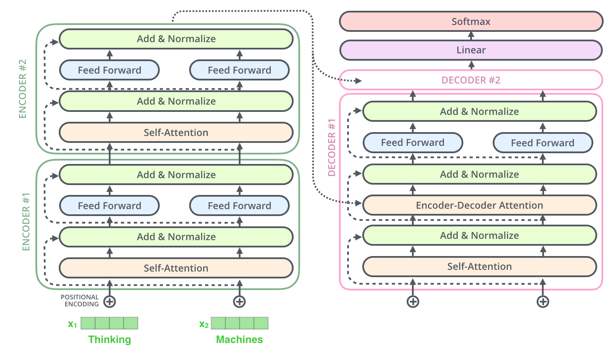
Notes:
The Encoder processes input sequences through multiple layers, where each layer includes self-attention (to capture relationships between tokens) and feed-forward neural networks. Positional encodings are added to input embeddings to retain sequence order.
The Decoder mirrors the encoder structure, with an added encoder-decoder attention mechanism that focuses on relevant parts of the encoder output while processing its input.
Both encoder and decoder layers use residual connections and normalization to stabilize training and enhance performance.
The output from the final decoder layer is passed through a linear layer and a softmax function to generate the final sequence (e.g., translated text or predictions).

Slide 10
Background (Transformer)
Key Features:
Multi-head attention
Positional encodings
Encoder-decoder structure
Application for the paper:
Image patches encoded and compressed based on semantic content.
Notes:
Explain only Transformer

Slide 11
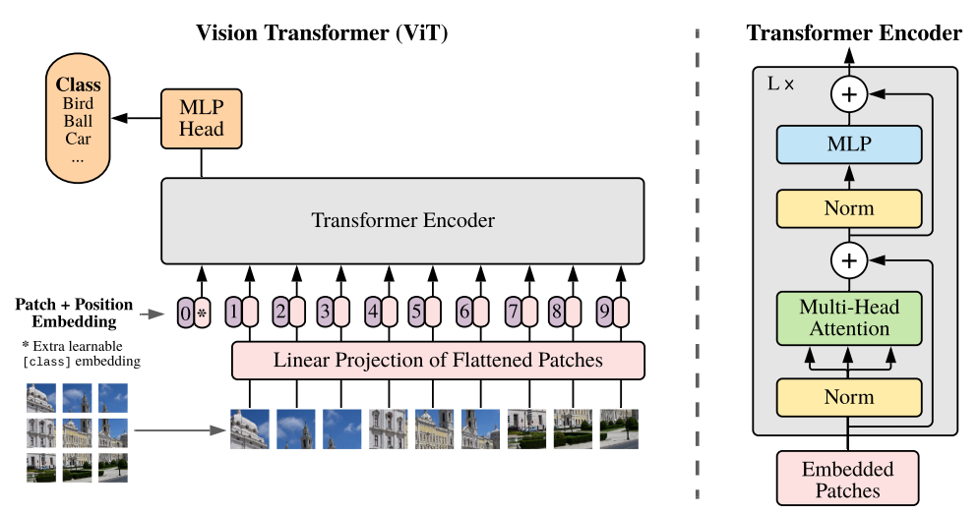
Background (Vision Transformer)
Vision Transformer (ViT)
Notes:
The Vision Transformer (ViT) applies the Transformer architecture to image data by splitting images into fixed-size patches and processing them as token embeddings.

Slide 12
Background (Vision Transformer)
Vision Transformer (ViT):
Image Patching: The input image is divided into fixed-size patches, typically 16x16 pixels.
Patch Embedding: Each patch is flattened and linearly embedded into a lower-dimensional vector.
Positional Encoding: Positional embeddings are added to retain spatial information.
Transformer Encoder: The sequence of patch embeddings is processed by a standard Transformer encoder.
Classification: A special "classification token" is added to the sequence for final prediction
Notes:
Figure 1: Model overview. We split an image into fixed-size patches, linearly embed each of them, add position embeddings, and feed the resulting sequence of vectors to a standard Transformer encoder. In order to perform classification, we use the standard approach of adding an extra learnable “classification token” to the sequence. The illustration of the Transformer encoder was inspired by Vaswani et al.
1 Image Patching: The input image is divided into fixed-size patches, typically 16x16 pixels.
2 Patch Embedding: Each patch is flattened and linearly embedded into a lower-dimensional vector.
3 Positional Encoding: Positional embeddings are added to retain spatial information.
4 Transformer Encoder: The sequence of patch embeddings is processed by a standard Transformer encoder.
5 Classification: A special "classification token" is added to the sequence for final prediction

Slide 13
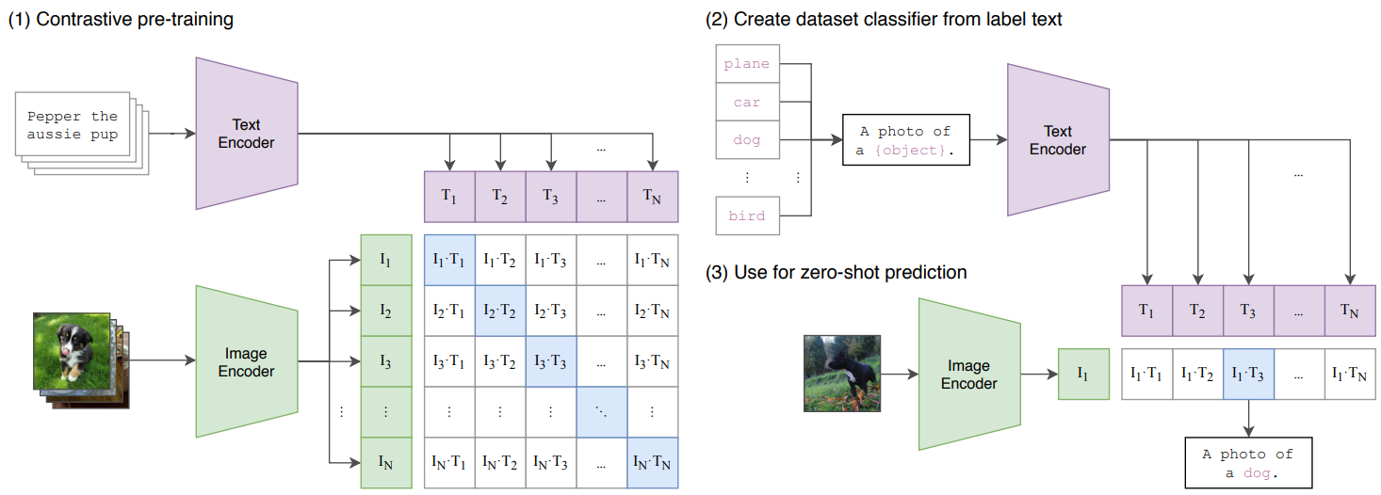
Background (CLIP)
Contrastive Language–Image Pretraining (CLIP)
A model that predicts image-text similarity
Notes:
It jointly trains an image encoder and a text encoder using a contrastive learning objective, where it maximizes similarity between matching image-text pairs while minimizing mismatches
https://creatis-myriad.github.io/2023/06/05/CLIP.html Contrastive Language–Image Pretraining (CLIP)
Is trained with a simple pre-training task
Use data abundantly available on the internet
Can be used in many other visual tasks with a zero-shot approach
Scaling up the data is sufficient to achieve competitive performance

Slide 14
System Model

Slide 15
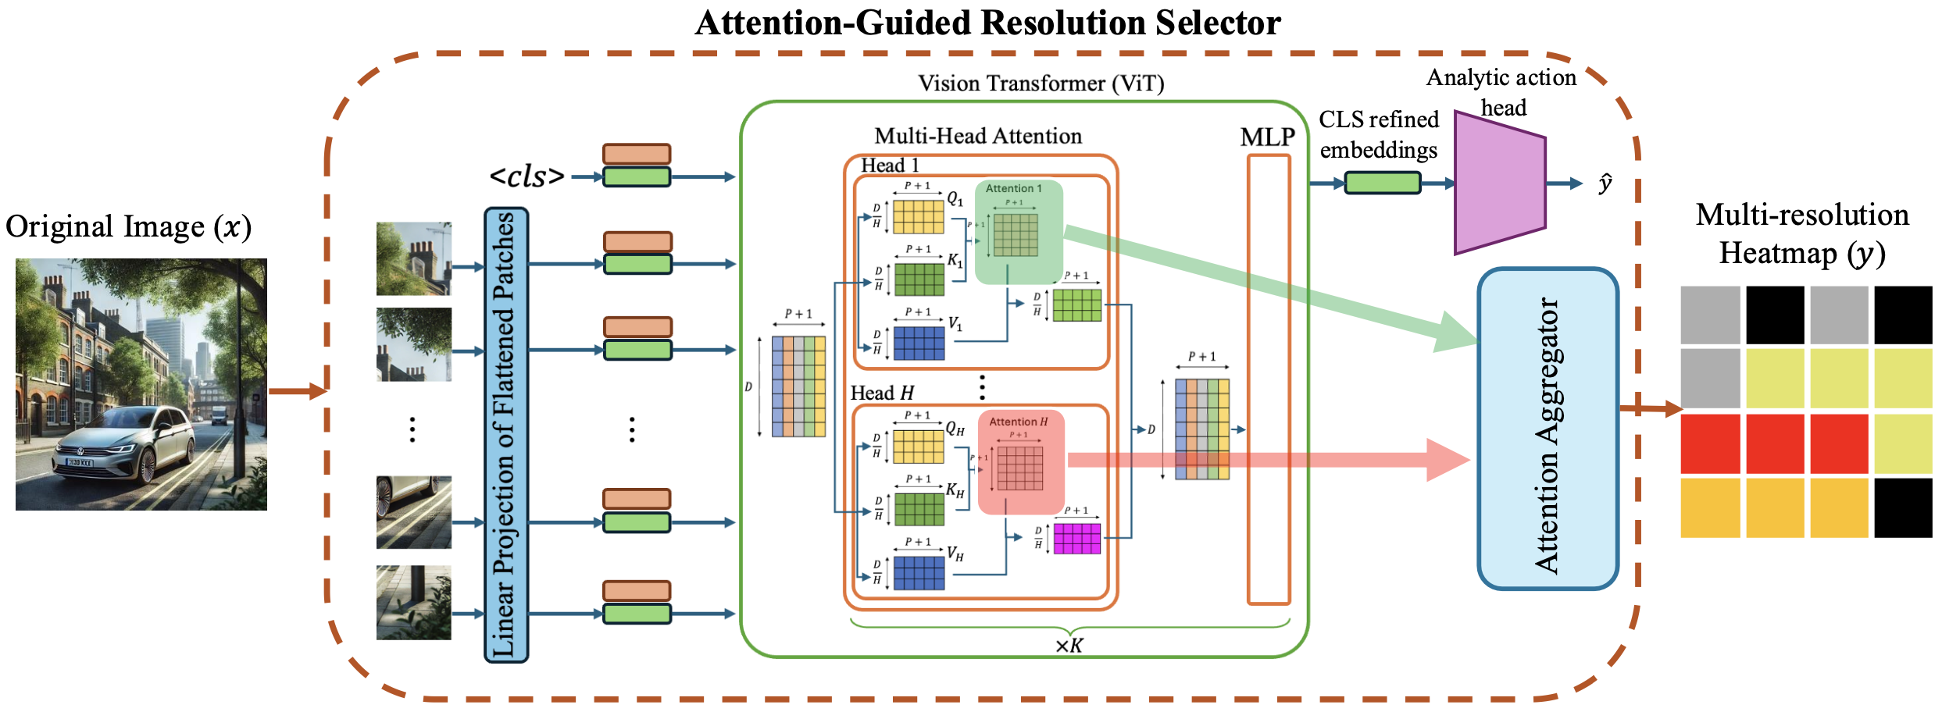
System Model
Attention-Guided Resolution Selector determines the encoding resolution for each patch based on its semantic importance and available channel rate.

Slide 16
System Model
Open-vocabulary segmentation framework find an attention score of images based on the text input
car
road
…
bike
Open-Vocabulary Semantic Segmentation
car
road

Slide 17
System Model
Key contributions:
Multi-resolution encoding for preserving semantic fidelity.
Dynamic adaptation to varying channel conditions.
Results:
Optimized bandwidth utilization.
Maintained high task accuracy and data quality.

Slide 18
Results

Slide 19
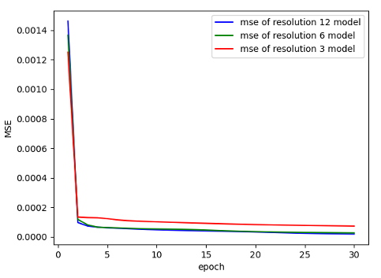
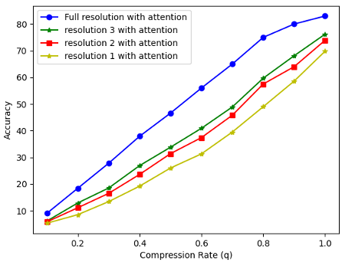
Results
<Reconstruction result for three medium resolutions.>
<Accuracy result for three medium resolutions.>
Notes:
3. They proposed a machine learning system that dynamically adjusts its weights to adapt to various tasks:
- The model analyzes the incoming task to understand its requirements.
- Then, it applies task-specific adaptations to generate optimal results.

Slide 20
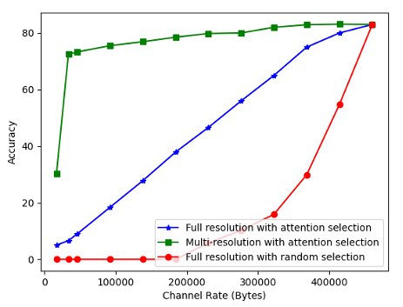
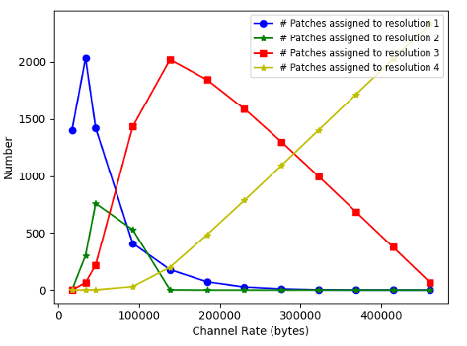
Results
<Accuracy result for adaptive multi-resolution semantic communication framework in various channel rates.>
<Resolution assignment to patches in different channel rate.>
Notes:
3. They proposed a machine learning system that dynamically adjusts its weights to adapt to various tasks:
- The model analyzes the incoming task to understand its requirements.
- Then, it applies task-specific adaptations to generate optimal results.

Slide 21
Discussion and Conclusion

Slide 22
Discussion
Potential Directions:
Extend to multimodal data (e.g., text and images together).
Extend to video data with recent techniques in computer vision fields
Develop task-specific optimization techniques for diverse domains (e.g., image anomaly detection).
Key Challenges:
Efficient training of adaptive encoders.
Addressing latency in dynamic channel conditions.

Slide 23
Conclusion
This work proposes a novel semantic communication framework that fuses open-vocabulary vision–language segmentation with transformer-based compression.
We build on recent advances in open-vocabulary segmentation, which leverage large pre-trained vision–language models to break away from fixed label sets and segment arbitrary categories described by text prompts.

