Slide 1
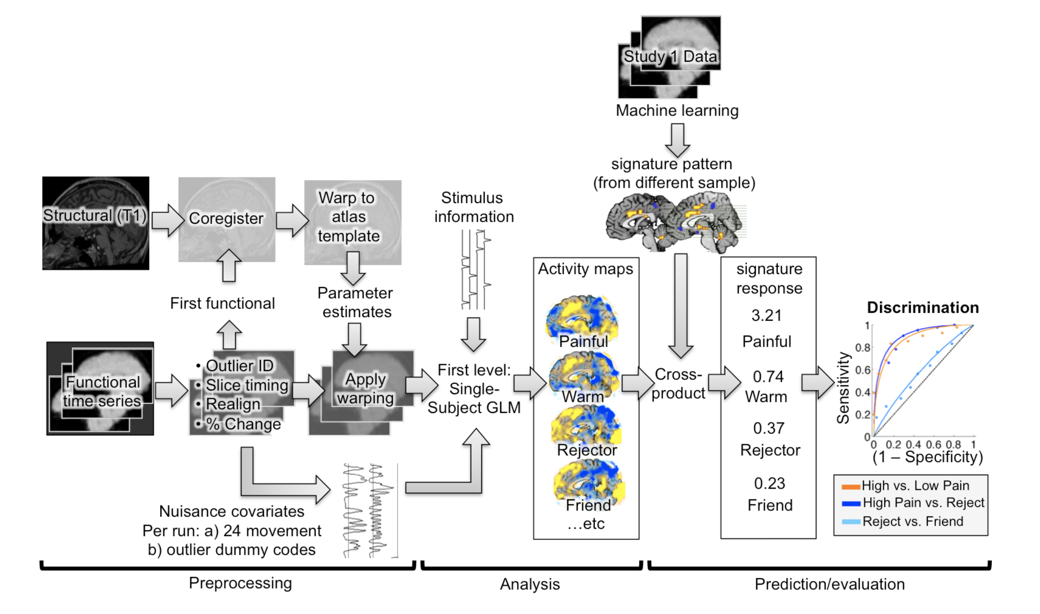
Option 1 (default). T1 normalization
PART 1 (a1-a4)
PART 2 (b1-b4)
PART 4 (b7-b8)
DICOM to NIFTI
in a BIDS format
a1: make directory
a2: Structural
a3: Functional
a4: Fieldmap
Functional images
Distortion correction and QC (outlier detection)
b1: Make directories
b2: distortion correction (using FSL’s topup)
b3: implicit mask and mean images
create an implicit mask image
save mean images and SBRef (before preproc) as png in qc directories
b4: outlier detection
outlier detection based on 1) mahalanobis distance across global mean for slices and spatial STD for slices, as in scn_session_spike_id.m 2) root-mean-square successive differences between images
Structural and functional images
Coregistration, normalization, smoothing
b7: coregistration
coregistration between T1 and mean functional images or SBRef image (you can choose).
b8: normalization
segmentation of the coregistered T1 image using SPM12’s tissue probability map (TPM.nii)
warping segmented (and coregistered) T1 image to MNI template
applying the warping parameter to the functional images
PART 5 (b9-b10)
Functional images
Smoothing and ICA-AROMA
b9: smoothing
smoothing functional images with the FWHM 5 mm smoothing kernel.
b10: ICA-AROMA
A data-driven method to identify and remove motion-related independent components from functional MRI data.
https://github.com/rhr-pruim/ICA-AROMA
PART 3 (b5-b6)
Functional images
Slice timing and motion correction
b5: slice timing correction
It works with multi-band sequence
It reads the actual acquisition timing from dicom header.
b6: motion correction (realignment)
It uses the first functional image or SBRef (you can choose) as a reference.
It saves 6 movement parameters for each run

Slide 2
Option 2. EPI normalization
PART 1 (a1-a4)
PART 2 (b1-b4)
PART 4 (b7-b8)
DICOM to NIFTI
in a BIDS format
a1: make directory
a2: Structural
a3: Functional
a4: Fieldmap
Functional images
Distortion correction and QC (outlier detection)
b1: Make directories
b2: distortion correction (using FSL’s topup)
b3: implicit mask and mean images
create an implicit mask image
save mean images and SBRef (before preproc) as png in qc directories
b4: outlier detection
outlier detection based on 1) mahalanobis distance across global mean for slices and spatial STD for slices, as in scn_session_spike_id.m 2) root-mean-square successive differences between images
Functional images
EPI normalization
SKIP THIS (b7: coregistration)
b8: normalization (use the option, ‘EPInorm’)
segmentation of the realigned functional images using SPM12’s tissue probability map (TPM.nii)
warping the segmented functional images to MNI template
applying the warping parameter to the functional images
PART 5 (b9-b10)
Functional images
Smoothing and ICA-AROMA
b9: smoothing
smoothing functional images with the FWHM 5 mm smoothing kernel.
b10: ICA-AROMA
A data-driven method to identify and remove motion-related independent components from functional MRI data.
https://github.com/rhr-pruim/ICA-AROMA
PART 3 (b5-b6)
Functional images
Slice timing and motion correction
b5: slice timing correction
It works with multi-band sequence
It reads the actual acquisition timing from dicom header.
b6: motion correction (realignment)
It uses the first functional image or SBRef (you can choose) as a reference.
It saves 6 movement parameters for each run

Slide 3
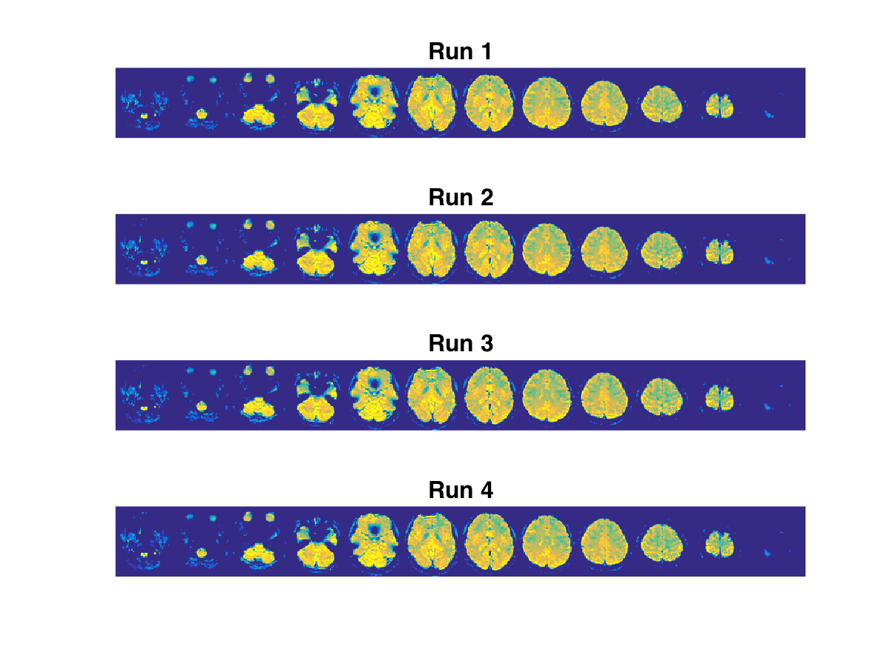
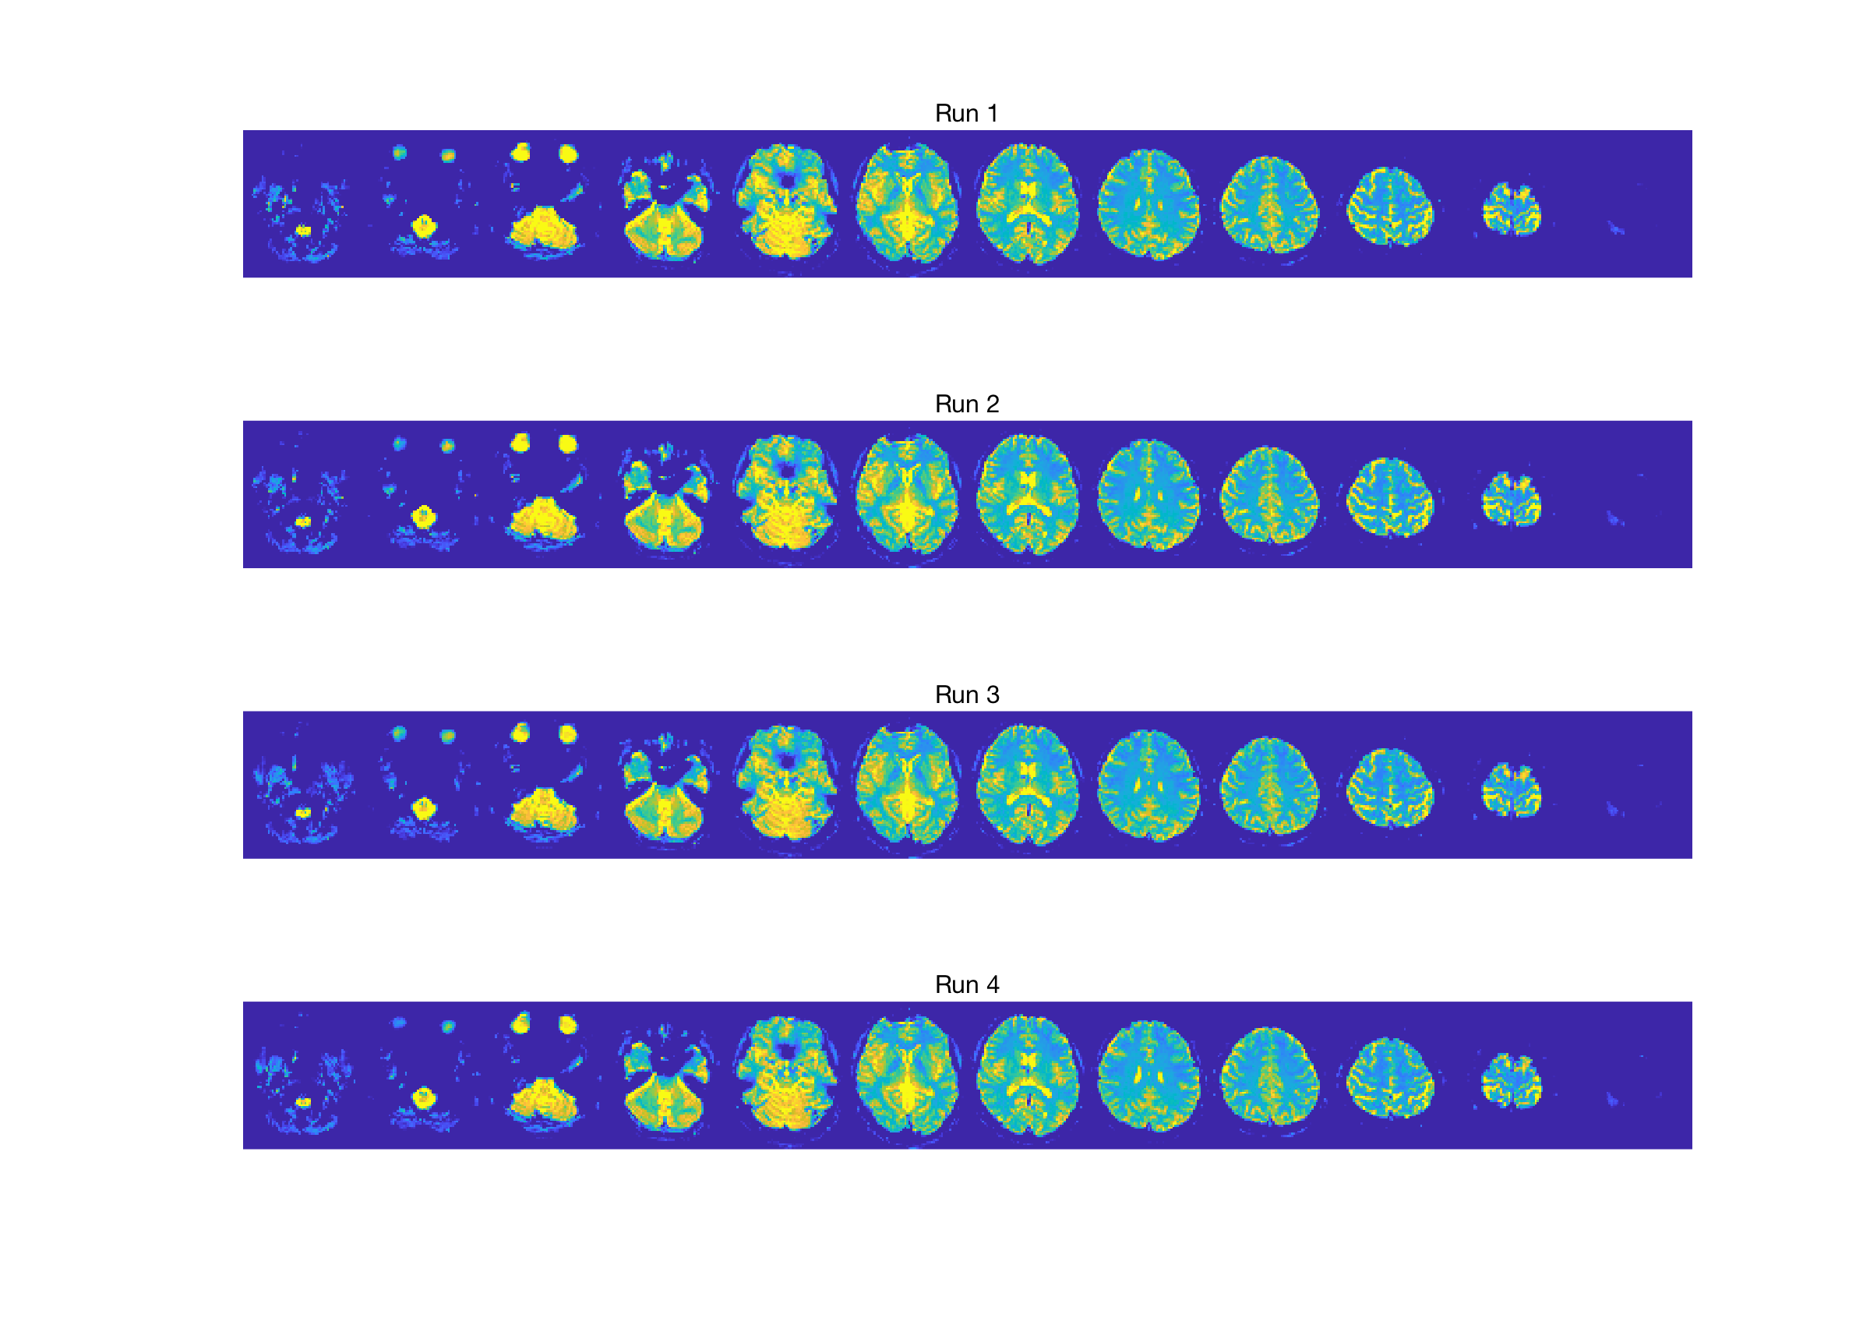
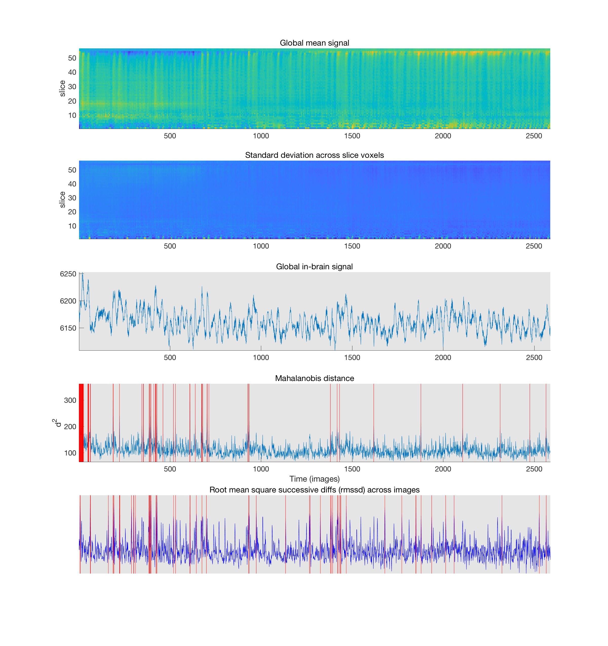
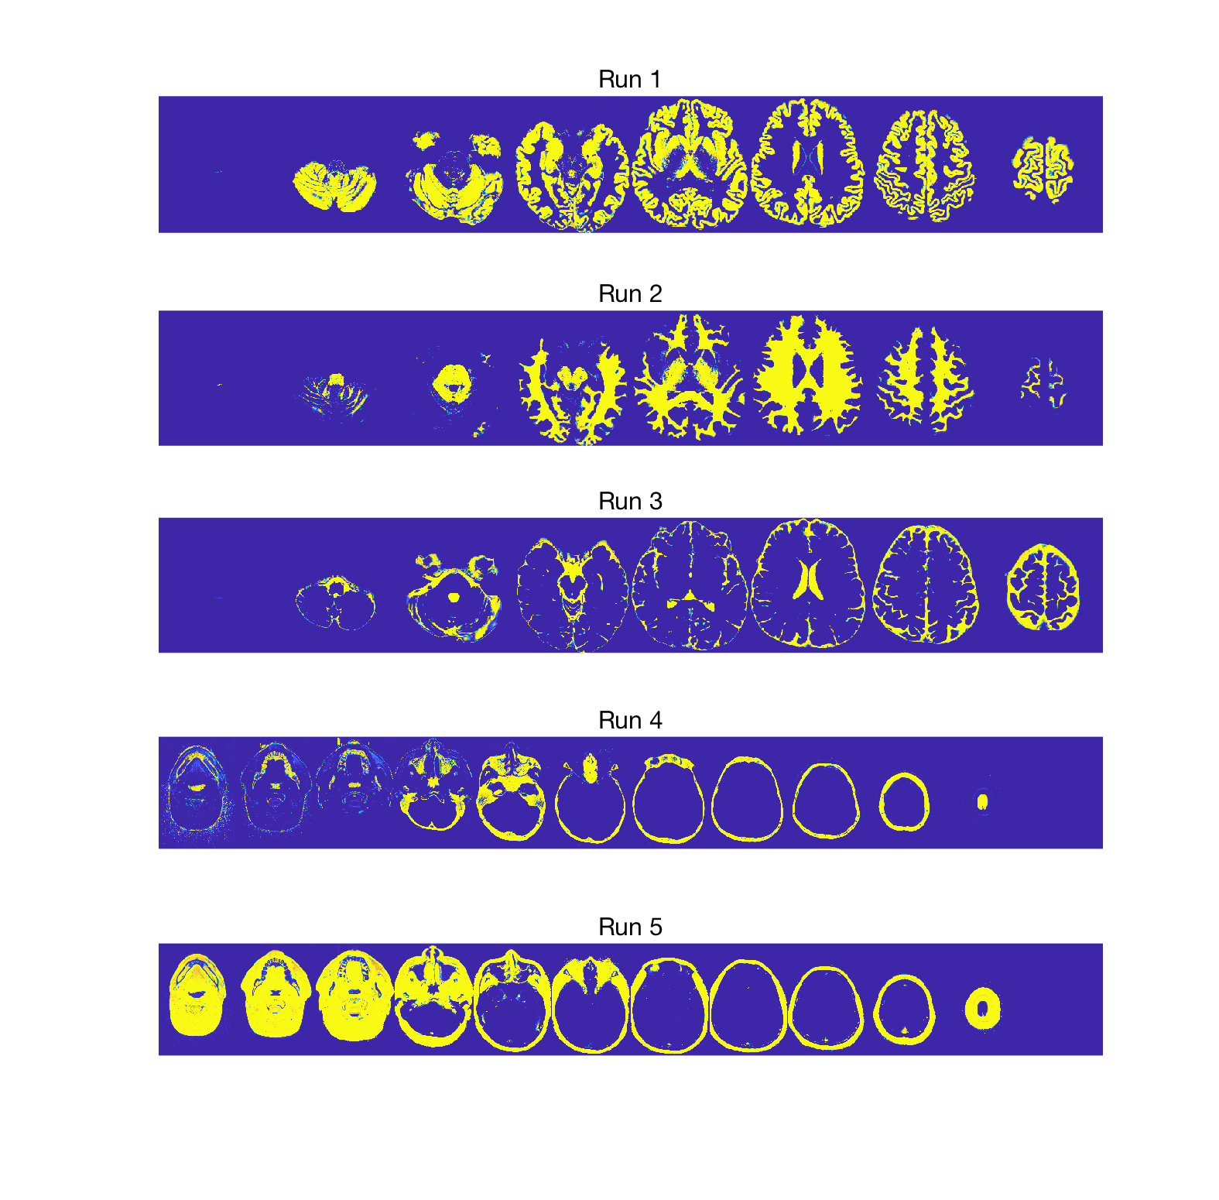
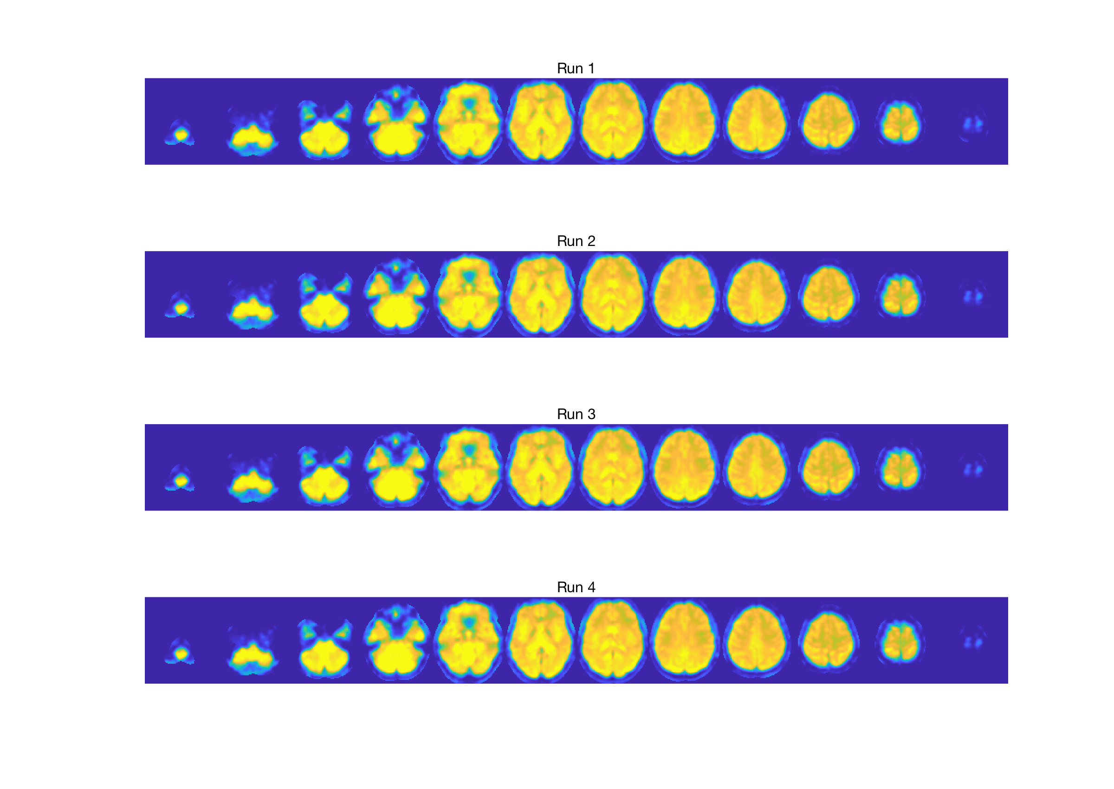
Example QC images
mean_before_preproc.png
dc_func_sbref_files.png
qc_diary_dc_sub-caps003_task-CAPS_run-01_bold.txt
Session 1: 72 Potential outliers
%Spikes: 2.78
Global SNR (Mean/STD): 299.12
Added 72 global/mahal outlier covariates to covariates field.Added 72 global/mahal outlier covariates to covariates field.Outliers in RMSSD images: 0%, 59 imgs.
qc_spike_plot_dc_sub-caps003_task-CAPS_run-01_bold
segmentation.png
mean_swr_func_bold.png

