Slide 1
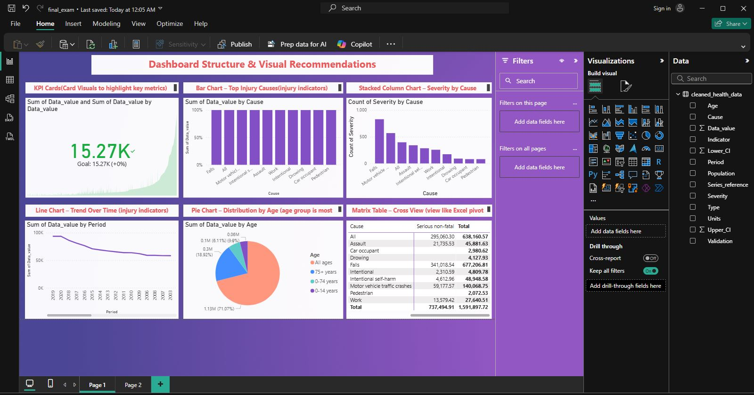
Capstone Project: Predicting Student Injuries & Dropout Risk
Presented by: BYIRINGIRO Urbain Bobola
Course: INSY 8413 - Introduction to Big Data Analytics
Institution: AUCA - Faculty of Information Technology
Date: July 2025

Slide 2
Addressing Student Well-being and Retention
A critical challenge in education is student dropout due to persistent health issues and injuries. This project aims to leverage health data to proactively identify students at higher risk, enabling timely interventions.
Problem Statement
Project Goal
Sector Focus
Many students drop out due to repeated injuries or health-related issues, impacting academic success and institutional retention rates.
Use health data to identify patterns in injury severity, cause, and age that signal higher dropout risk. This bridges the gap between health analytics and educational outcomes.
This interdisciplinary project operates at the intersection of education and health, demonstrating the practical application of data analytics in a real-world context.

Slide 3
Dataset Overview
Key Data Characteristics
Essential Fields
Source: Public injury dataset (non-Kaggle), accessible here.
Period
Timeframe of injury occurrence (e.g., year)
Size: 3,094 rows and 13 columns.
Format: Cleaned and structured CSV.
Status: Ready for advanced analytics.
Cause
Specific reason for injury (e.g., fall, sports)
Severity
Impact level of injury (e.g., minor, severe)
Age
Age group of injured individual
Data_value
Numeric measure of injury frequency/impact
This dataset provides a robust foundation for
identifying critical patterns related to student injuries.
Lower_CI
Lower bound of confidence interval
Upper_CI
Upper bound of confidence interval

Slide 4
Python-based Data Preparation
Our rigorous data preparation process in Python ensured data quality and readiness for machine learning. This phase included detailed exploratory data analysis and feature engineering.
1
Exploratory Data Analysis (EDA)
2
Feature Encoding
Conducted descriptive statistics, visualized data distributions, and used heatmaps to uncover correlations and initial insights into the dataset.
Applied one-hot encoding to convert categorical variables (e.g., 'Cause', 'Severity') into a numerical format suitable for model input, preventing misinterpretation by algorithms.
3
Feature Scaling
4
Outlier Handling & Engineering
Utilized StandardScaler to normalize numeric features, ensuring all variables contribute equally to model training and improving convergence for gradient-based algorithms.
Identified and addressed outliers to enhance model robustness. Engineered new features to capture complex relationships and improve predictive power.

Slide 5
Machine Learning Approaches
We employed both supervised and unsupervised learning techniques to predict dropout risk and identify inherent patterns within the injury data.
Supervised Learning
Unsupervised Learning
Logistic Regression: A foundational model for binary classification, providing interpretable insights into feature importance.
KMeans Clustering: Applied with k=3 to group similar injury profiles, revealing distinct student segments. This helps categorize risk levels.
Random Forest: An ensemble method offering high accuracy and robustness against overfitting, crucial for complex datasets.
PCA Visualization: Principal Component Analysis was used to reduce dimensionality and visualize clusters in 2D or 3D space, making patterns more discernible.
Target Variable: 'Data_value' was binarized (0 or 1) based on its median, indicating higher or lower injury impact, a proxy for dropout risk.

Slide 6



Model Performance & Insights
Our models were rigorously evaluated using key metrics and visualization tools to ensure reliability and identify the most influential predictors of dropout risk.
Evaluation Metrics
Assessed accuracy, precision, recall, and F1-score to gauge model effectiveness across various performance dimensions, especially concerning false positives and negatives.
Diagnostic Tools
Utilized confusion matrices for a detailed breakdown of true/false positives/negatives, and feature importance plots to pinpoint the most impactful variables.
Key Predictors
Identified 'Cause' (e.g., type of injury), 'Age' (student's age group), and 'Period' (time of injury) as the most significant factors influencing dropout risk.

Slide 7
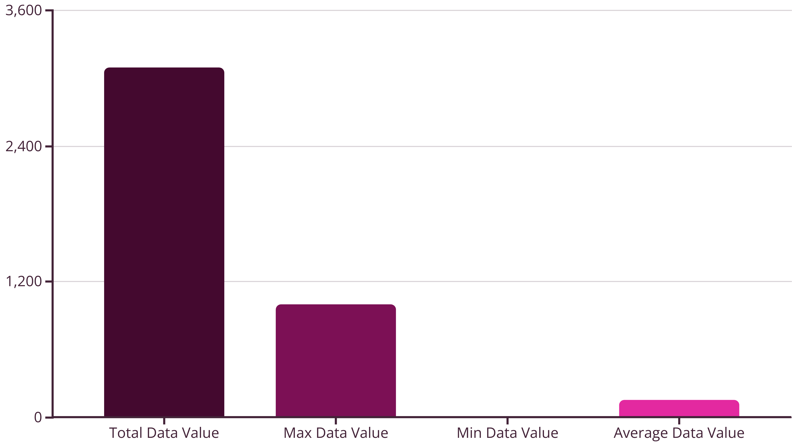
Interactive Power BI Dashboard
The Power BI dashboard offers dynamic visualizations and interactive filters, providing actionable insights into student injury patterns and their potential link to dropout risk.
KPIs: Total, Maximum, Minimum, and Average 'Data_value' for quick assessment.
Visualizations: Line charts for trends over 'Period', bar charts for 'Cause' distribution, donut charts for 'Age' demographics, and matrix visuals for 'Cause x Severity' interactions.
Slicers: Interactive filters by 'Age', 'Cause', 'Severity', and 'Period' allow for granular data exploration and targeted analysis.

Slide 8



Strategic Recommendations
Based on our findings, we propose targeted interventions and continuous monitoring strategies to mitigate dropout risk associated with student injuries.
Early Intervention
Dashboard Monitoring
Model Retraining
Implement proactive support for students identified with high-severity injuries or recurring health issues, connecting them with medical and counseling resources.
Utilize the Power BI dashboard as a real-time tool for administrators and health services to track injury trends and identify emerging risk patterns.
Conduct annual retraining of machine learning models with fresh data to ensure their predictive accuracy and relevance remain high, adapting to evolving student health patterns.

Slide 9




Future Research Directions
This project lays the groundwork for more comprehensive predictive analytics in student retention, incorporating diverse data sources and advanced modeling techniques.
Data Expansion
Deployment
Model Advancement
Academic Data Integration: Incorporate academic performance, attendance, and course engagement data to build a more holistic dropout prediction model.
Socioeconomic Factors: Merge with socioeconomic datasets to understand broader environmental influences on student health and retention.
Advanced ML Models: Explore XGBoost and Deep Learning architectures (e.g., LSTMs for time-series data) for improved predictive accuracy.
Online Dashboard Deployment: Deploy the Power BI dashboard online for wider accessibility and real-time insights for university stakeholders.

Slide 10
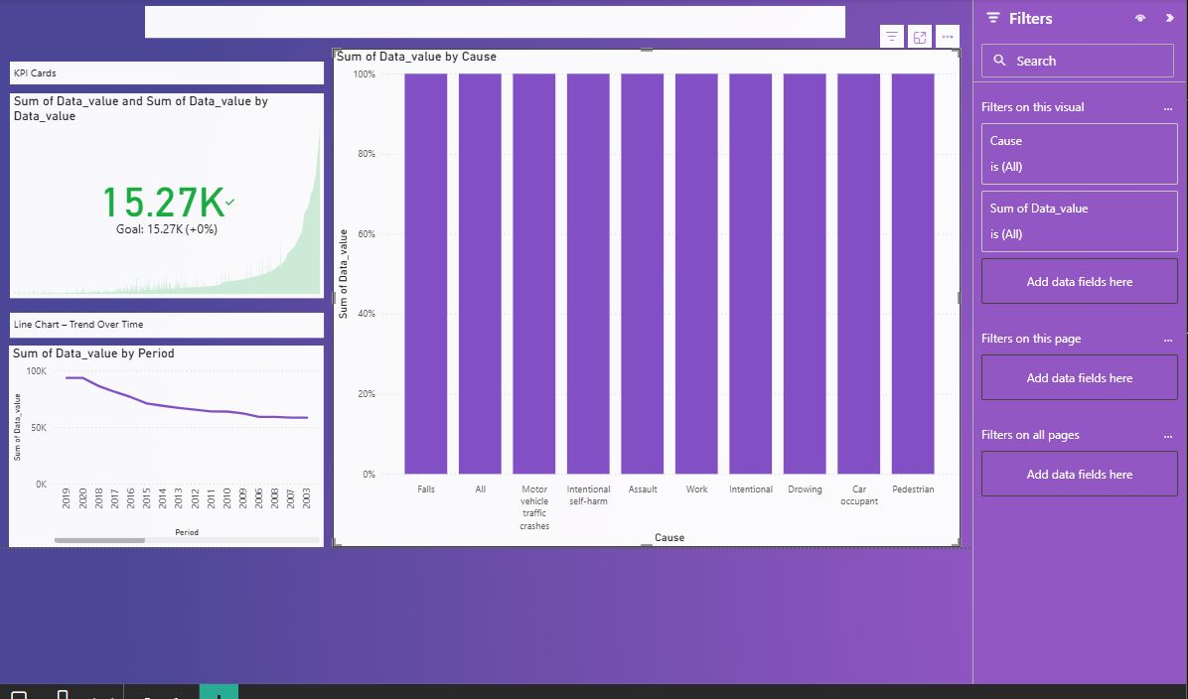
Acknowledgment & Academic Integrity
Special thanks to Mr. Eric Maniraguha, our esteemed lecturer, for his guidance throughout this project.
Institution: AUCA, Rwanda.
All work presented herein is original and strictly adheres to AUCA's academic integrity policies. Our code and supporting materials are available on GitHub: GitHub Repository.
Colossians 3:23 - "Whatever you do, work at it with all your heart, as working for the Lord, not for human masters."

