Slide 1
Computer Architecture and Operating Systems Lecture 1: Introduction
Andrei Tatarnikov
andrewt0301@gmail.com
@andrewt0301

Slide 2
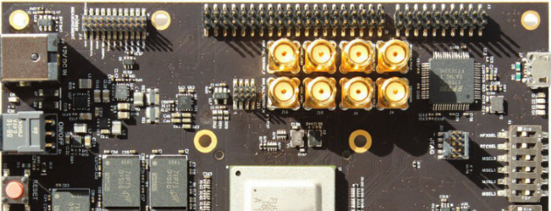
Course Resources
Website
https://andrewt0301.github.io/hse-acos-course/
Wiki
http://wiki.cs.hse.ru/ACOS_DSBA_2023/24
http://wiki.cs.hse.ru/ACOS_COMPDS_2023/2024
Telegram
https://t.me/+LbeE_5yrTQEzYjQy (DSBA)
https://t.me/+OAQIO_59VjZhY2U6 (COMPDS/EAD)

Slide 3
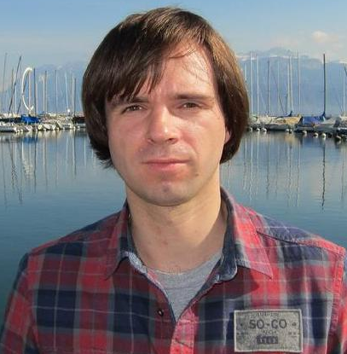


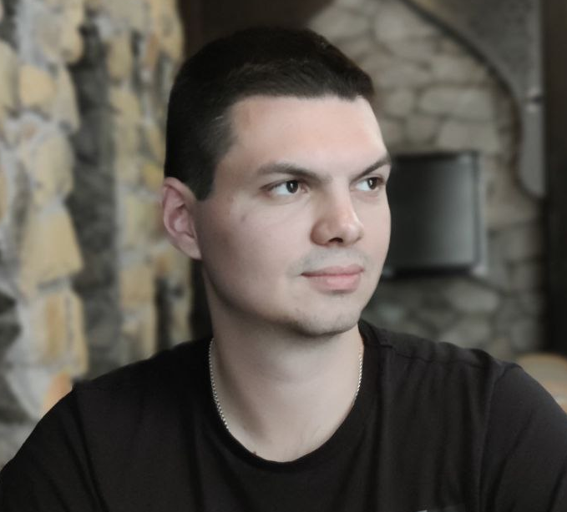
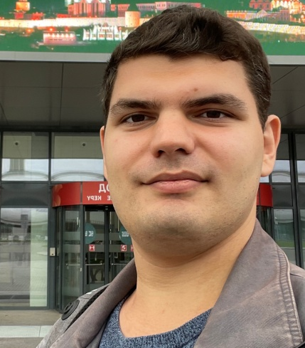



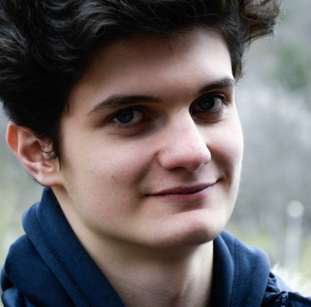

DSBA Course Team
Instructors
Andrei Tatarnikov
Alexey Kanakhin
Roman Stolyarov
Artem Viktorov
Alexander Makhov
Assistants
Fedor Pakhurov
Oleg Malchenko
Vladislav Kirichok
Pavel Nedbay
Artem Borisov

Slide 4

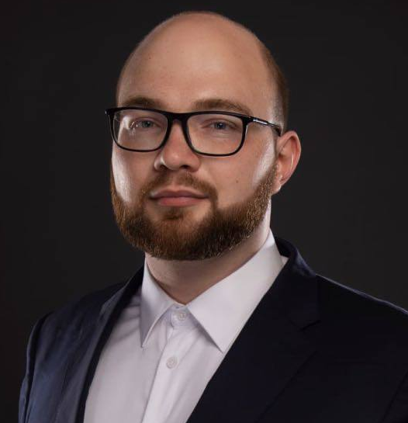

COMPDS/EAD Course Team
Instructors
Andrei Tatarnikov
Alexandra Borisova
Boris Galitsky
Nikita Golovanov
Assistants
First Last
First Last
Pavel Nedbay
First Last
First Last

Slide 5
Course Outline
Syllabus (see the web site for details)
Module 3: Computer Architecture
Computer architecture
Assembly language programming (RISC-V)
Home works, quizzes, and test
Module 4: Operating Systems
Operating System Architecture (Linux)
System programming in C
Home works, quizzes, and test
Final Exam

Slide 6
Course Motivation
Increase your computer literacy
Have an idea how computers under the hood
Better understand performance
Be familiar with system programming
Be familiar with system tools

Slide 7
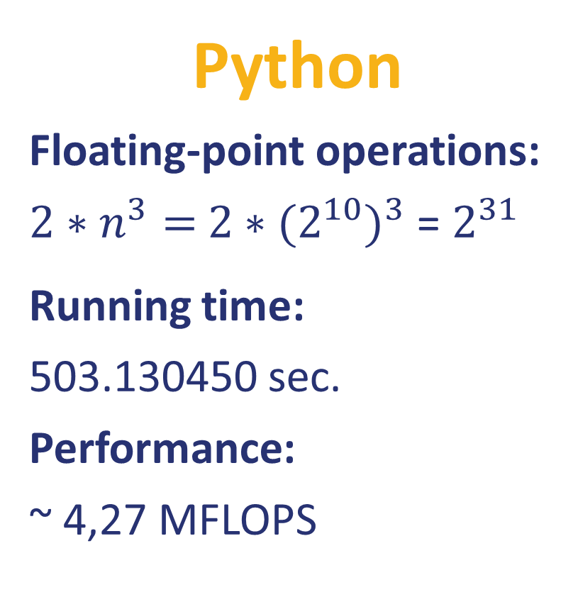
Example: Matrix Multiplication (part 1)
Python
Floating-point operations:
${2∗n}^{3}=$ ${2∗(2^{10})}^{3}$ = $2^{31}$
Running time:
503.130450 sec.
Performance:
~ 4,27 MFLOPS
import random from time import time n = 1024
A = [[random.random() for row in range(n)] for col in range(n)] B = [[random.random() for row in range(n)] for col in range(n)] C = [[0 for row in range(n)] for col in range(n)] start = time() for i in range(n): for j in range(n): for k in range(n): C[i][j] += A[i][k] * B[k][j] end = time() print('%0.6f' % (end - start))

Slide 8
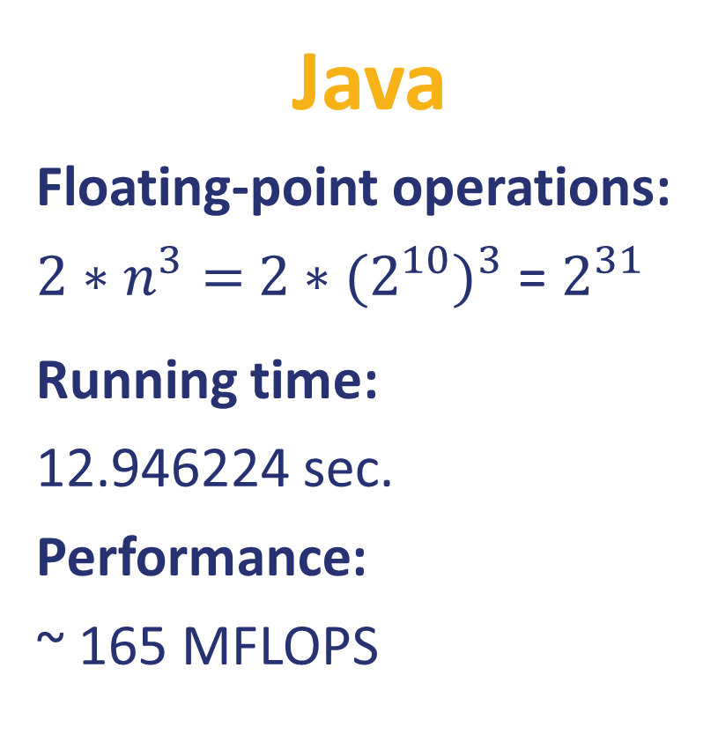
Example: Matrix Multiplication (part 2)
Java
Floating-point operations:
${2∗n}^{3}=$ ${2∗(2^{10})}^{3}$ = $2^{31}$
Running time:
12.946224 sec.
Performance:
~ 165 MFLOPS
public class Matrix { static int n = 1024; static double[][] A = new double[n][n]; static double[][] B = new double[n][n]; static double[][] C = new double[n][n];
public static void main(String[] args) { java.util.Random r = new java.util.Random(); for (int i = 0; i < n; i++) { for (int j = 0; j < n; j++) { A[i][j] = r.nextDouble(); B[i][j] = r.nextDouble(); C[i][j] = 0; } } long start = System.nanoTime(); for (int i = 0; i < n; i++) { for (int j = 0; j < n; j++) { for (int k = 0; k < n; k++) { C[i][j] += A[i][k] * B[k][j]; } } } long stop = System.nanoTime(); System.out.println((stop - start) * 1e-9); } }

Slide 9
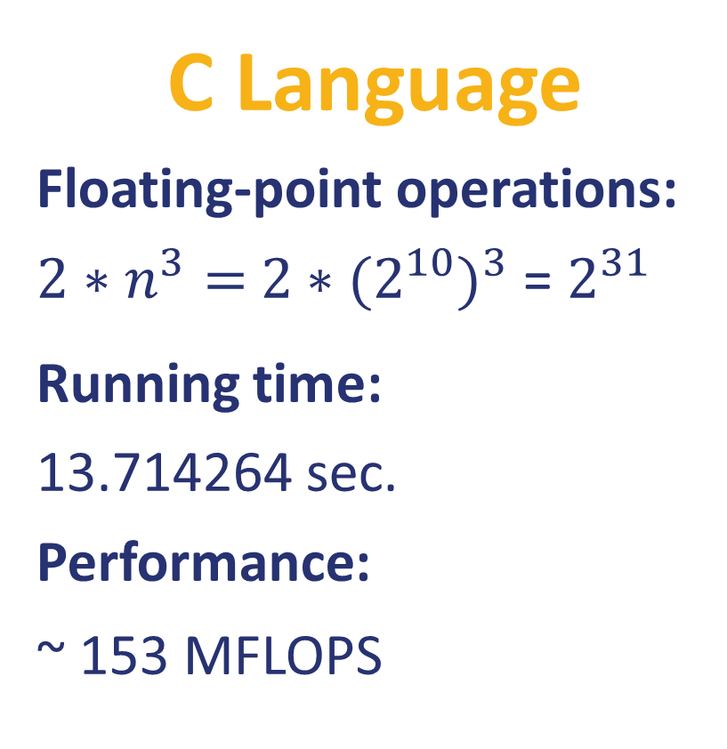
Example: Matrix Multiplication (part 3)
C Language
Floating-point operations:
${2∗n}^{3}=$ ${2∗(2^{10})}^{3}$ = $2^{31}$
Running time:
13.714264 sec.
Performance:
~ 153 MFLOPS
#include <stdlib.h> #include <stdio.h> #include <sys/time.h>
#define n 1024 double A[n][n]; double B[n][n]; double C[n][n];
float tdiff(struct timeval *start, struct timeval *end) { return (end->tv_sec - start->tv_sec) +
1e-6*(end->tv_usec - start->tv_usec); } int main(int argc, const char *argv[]) { for (int i = 0; i < n; i++) { for (int j = 0; j < n; j++) { A[i][j] = (double)rand() / (double)RAND_MAX; B[i][j] = (double)rand() / (double)RAND_MAX; C[i][j] = 0; } } struct timeval start, end; gettimeofday(&start, NULL); for (int i = 0; i < n; i++) { for (int j = 0; j < n; j++) { for (int k = 0; k < n; k++) { C[i][j] += A[i][k] * B[k][j]; } } } gettimeofday(&end, NULL); printf("%0.6f\n", tdiff(&start, &end)); return 0; }

Slide 10
Example: Matrix Multiplication (part 4)
C Language: Optimizations
Loop order: i, j, k
for (int i= 0; i < n; i++) { for (int j= 0; j < n; j++) { for (int k= 0; k < n; k++) { C[i][j]+= A[i][k]*B[k][j]; } } }
Loop order: i, k, j
for (int i= 0; i < n; i++) { for (int k= 0; k < n; k++) { for (int j= 0; j < n; j++) { C[i][j]+= A[i][k]*B[k][j]; } } }
Loop order: j, k, i
for (int j= 0; j < n; j++) { for (int k= 0; k < n; k++) { for (int i= 0; i < n; i++) { C[i][j]+= A[i][k]*B[k][j]; } } }
Running time:
13.714264 sec.
Performance:
~ 153 MFLOPS
Running time:
2.739385 sec.
Performance:
~ 795 MFLOPS
Running time:
19.074106 sec.
Performance:
~ 113 MFLOPS

Slide 11

Example: Matrix Multiplication (part 5)
Feature | Specifiction
Model | MacBook Pro 9,1
Processor Name | Quad-Core Intel Core i7
Processor Speed | 2,3 GHz
Number of Processors | 1
Total Number of Cores | 4
Floating-Point Operations per Cycle | 4
L2 Cache (per Core) | 256 KB
L3 Cache: | 6 MB
Hyper-Threading Technology | Enabled
Memory | 8 GB
Peak = (${2.3∗10}^{9}$) * 1 * 4 * 4 = 36 800 MFLOPS

Slide 12
What affects performance?
Hardware/Software Component | How It Affects Performance
Algorithm | Determines both the number of source-level statements and the number of I/O operations executed
Programming Language, Compiler, and Architecture | Determines the number of computer instructions for each source-level statement
Processor and Memory System | Determines how fast instructions can be executed
I/O System (Hardware and Operating System) | Determines how fast I/O operations may be executed

Slide 13
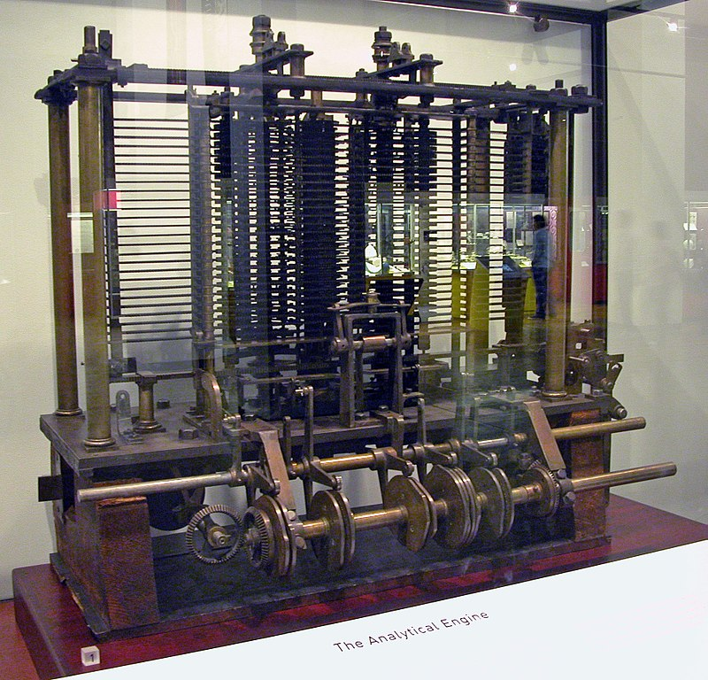
History: 0th Generation – Mechanical
1834–71: Analytical Engine designed by Charles Babbage
Mechanical gears, where each gear represented a discrete value (0-9)
Programs provided as punched cards
Never finished due to technological restrictions

Slide 14
History: 1st Generation - Vacuum Tubes
1945–55: first machines were created (Atanasoff–Berry, Z3, Colossus, ENIAC)
All programming in pure machine language
Connecting boards and wires, punched cards (later)
Stored program concept
Input
Memory
Arithmetical / Logic Unit
Control Unit
Output

Slide 15
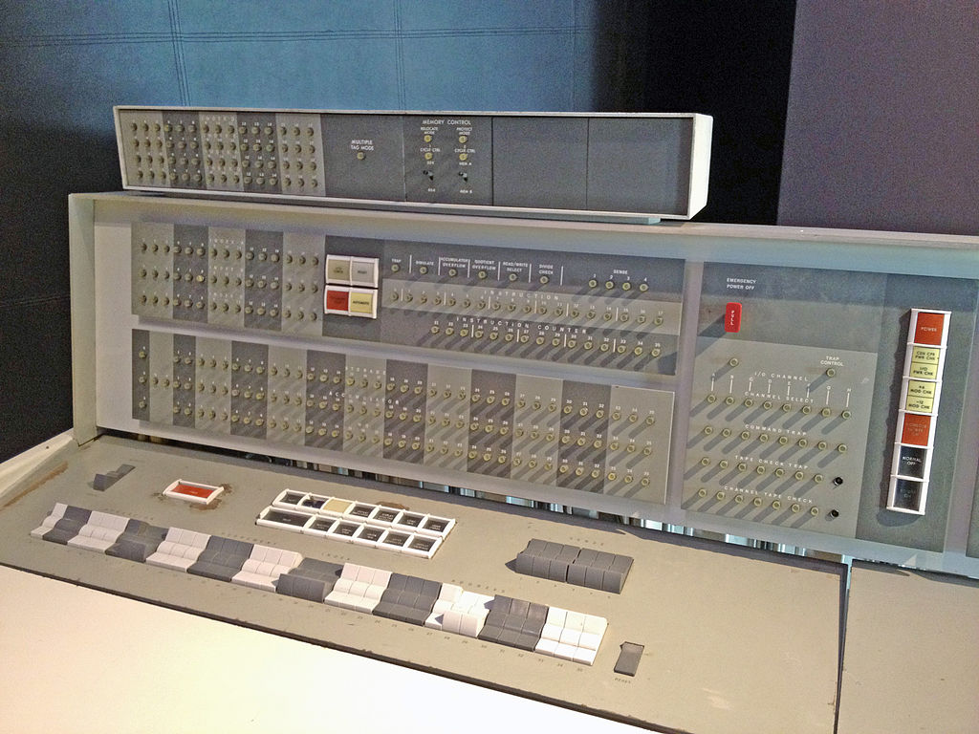
History: 2nd Generation - Transistors
1955–65: era of mainframes (e.g. IBM 7094) used in large companies
Programming in assembly language and FORTRAN
Batch systems (IO was separated from calculations)
Punched cards and magnetic tape
Loaders (OS ancestors)

Slide 16
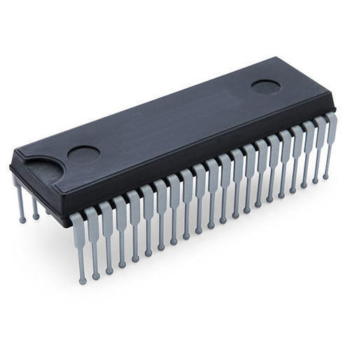
History: 3rd Generation – Integrated Circuits
1965–1980: computer lines using the same instruction set architecture (e.g. IBM 360)
First operating systems (e.g. OS/360, MULTICS)
Multiprogramming and timesharing
Computer as utility
Programming languages and compilers (LISP, BASIC, C)
Job 3
Memory Partitions
Job 2
Job 1
Operating
System

Slide 17
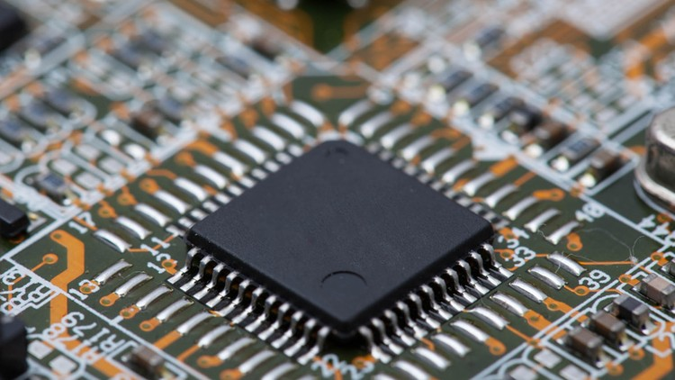
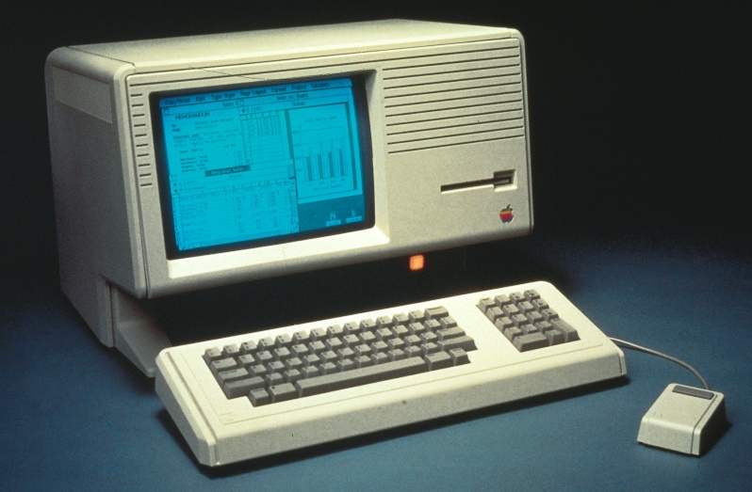
History: 4th Generation – VLSI and PC
1980–Present: personal computers, laptops, servers (Apple, IBM, etc.)
Architectures: x86-64, Itanium, ARM, MIPS, PowerPC, SPARC, RISC-V, etc.
Operating systems: UNIX (System V and BSD), MINIX, Linux, MacOS, DOS, Windows (NT)
ISA (CISC, RISC, VLIW), caches, pipelines, SIMD, vectors, hyperthreading, multicore

Slide 18

History: 5th Generation – Mobile devices
1990–Present: mobile devices, embedded systems, IoT devices
Custom processors and FPGAs
Mobile operating systems: Symbian, iOS, Android, Windows Mobile
Real-time operating systems

Slide 19
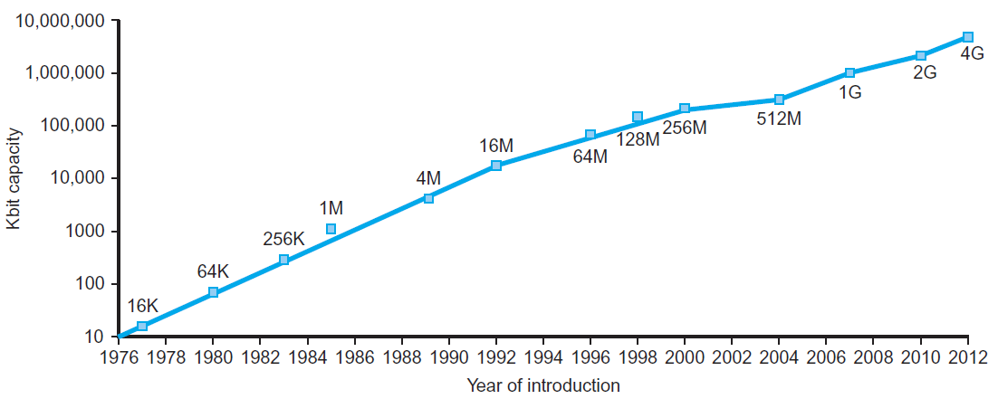
Technology Trends
Electronics technology continues to evolve
Increased capacity and performance
Reduced cost
Memory capacity
Year | Technology | Relative performance/cost
1951 | Vacuum tube | 1
1965 | Transistor | 35
1975 | Integrated circuit (IC) | 900
1995 | Very large scale IC (VLSI) | 2,400,000
2013 | Ultra large scale IC | 250,000,000,000

Slide 20
Moore’s Law
Gordon Moore (1929-...) cofounded Intel in 1968 with Robert Noyce
Moore’s Law: number of transistors on a computer chip doubles every year (observed in 1965)
Limited by power consumption
Slowed down since 2010

Slide 21
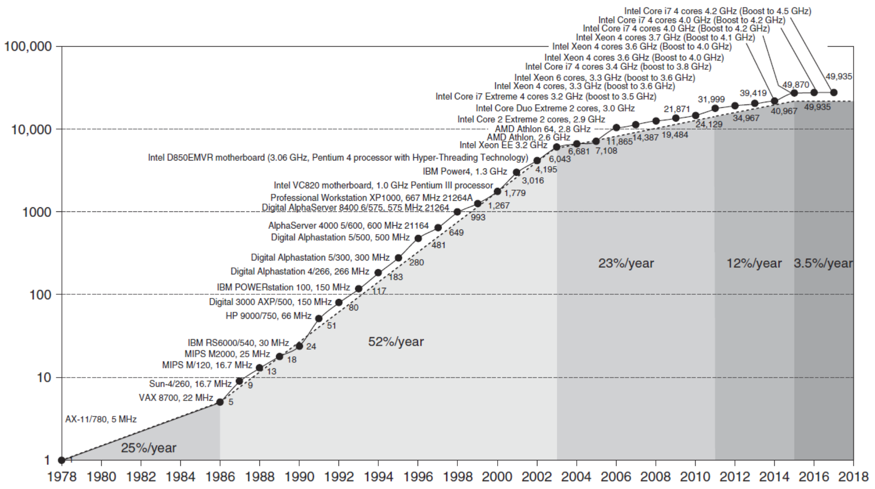
Single Core Performance
Move to multicore
Constrained by power, instruction-level parallelism, memory latency

Slide 22
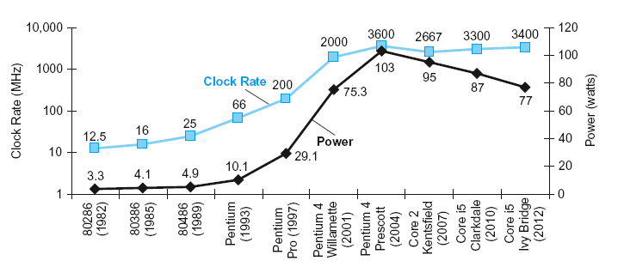
Power Trends

Slide 23
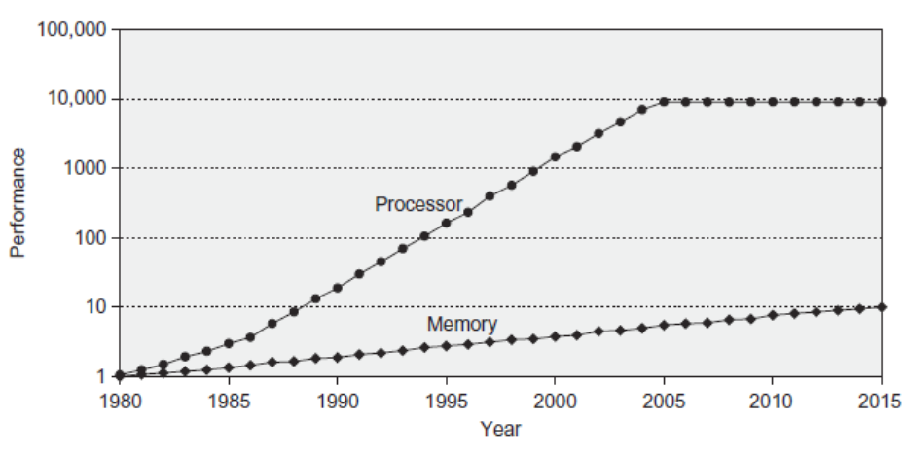
Memory Performance Gap

Slide 24
Current Challenges
Single core performance improvement has ended
More powerful microprocessor might not help
Memory-efficient programming
Temporal locality
Spatial locality
Parallelism to improve performance
Data-level parallelism
Thread-level parallelism
Request-level parallelism
Performance tuning require changes in the application

Slide 25
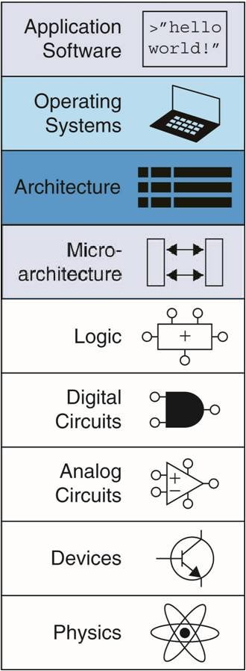
Concluding Remarks
To create software that efficiently deals with big data, we need to understand how hardware is organized and managed by operating system
Computer architecture
Assembly language
Compiler basics
Operating systems
Focus
of this course

Slide 26
Any Questions?
.text
__start: addi t1, zero, 0x18
addi t2, zero, 0x21
cycle: beq t1, t2, done
slt t0, t1, t2
bne t0, zero, if_less
nop
sub t1, t1, t2
j cycle
nop
if_less: sub t2, t2, t1
j cycle
done: add t3, t1, zero

