Slide 1
Computer Architecture and Operating Systems Lecture 10: Exceptions
Andrei Tatarnikov
atatarnikov@hse.ru
@andrewt0301

Slide 2
Exceptions and Interrupts
Exception is an unscheduled event that disrupts program execution
Arises within the CPU
e.g., undefined opcode, system call, …
Interrupt is an exception that comes from outside of the processor
From an external I/O controller
Some architectures use the term interrupt for all exceptions
Exceptions require special system instructions and registers
Dealing with exceptions without sacrificing performance is hard

Slide 3
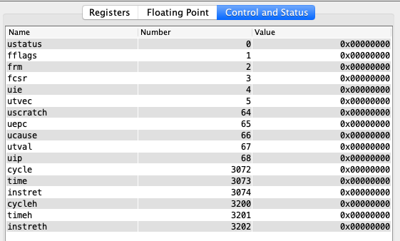
Control and Status Registers
Control and Status Registers (CSRs) are system registers provided by RISC-V to control monitor system states
CSR’s can be read, written and bits can be set/cleared
Each CSR has a special name and is assigned a unique function.
In this course, we focus on the user privilege level
We will use user-level CSRs to handle user-level exceptions

Slide 4
Main CSR Registers
User Trap Setup
ustatus – User status register
uie – User interrupt-enable register
utvec – User trap handler base address
User Trap Handling
uscratch – Scratch register for user trap handlers
uepc – User exception program counter
ucause – User trap cause
utval – User bad address or instruction
uip – User interrupt pending

Slide 5
System Instructions
ebreak – Pause execution (at a breakpoint)
ecall – Execute a system call specified by value in a7
uret – Return from handling an interrupt (to uepc)
wfi – Wait for interrupt
csrrc, csrrci, csrrs, csrrsi, csrrw, csrrwi – Read/write CSR

Slide 6
Handling Exceptions in CPU
Save PC of offending (or interrupted) instruction
In RISC-V: User Exception Program Counter (UEPC)
Save indication of the problem
In RISC-V: User Exception Cause Register (UCAUSE)
32 bits, but most bits unused
Exception code field: 2 for undefined opcode, 12 for hardware malfunction, …
Jump to handler
Assume at 1C09 0000_{hex}

Slide 7
Handling Vectored Exceptions in CPU
Alternate Mechanism: Vectored Interrupts
Handler address determined by the cause
Exception vector address to be added to a vector table base register:
Undefined opcode 00 0100 0000_{two}
Hardware malfunction: 01 1000 0000_{two}
…: …
Handler instructions either
Deal with the interrupt, or
Jump to real handler

Slide 8
Handler Actions
Read cause, and transfer to relevant handler
Determine action required
If restartable
Take corrective action
Use UEPC to return to program
Otherwise
Terminate program
Report error using UEPC, UCAUSE, …

Slide 9
Trivial Exception Handler
# Example with a trivial exception handler that just returns to the next instruction.
.text
j main
handler:
# Just ignore it by moving uepc to the next instruction
csrrw t0, uepc, zero # load exception PC into t0
addi t0, t0, 4 # increment t0
csrrw zero, uepc, t0 # update exception PC
uret # return to uepc
main:
la t0, handler
csrrw zero, utvec, t0 # set utvec (5) to the handlers address
csrrsi zero, ustatus, 1 # set interrupt enable bit in ustatus (0)
lw zero, 0(zero) # trigger trap for Load access fault
li a7, 10
ecall

Slide 10
Exceptions in a Pipeline
Another form of control hazard
Consider malfunction on add in EX stage
add x1, x2, x1
Prevent x1 from being clobbered
Complete previous instructions
Flush add and subsequent instructions
Set SEPC and SCAUSE register values
Transfer control to handler
Similar to mispredicted branch
Use much of the same hardware

Slide 11
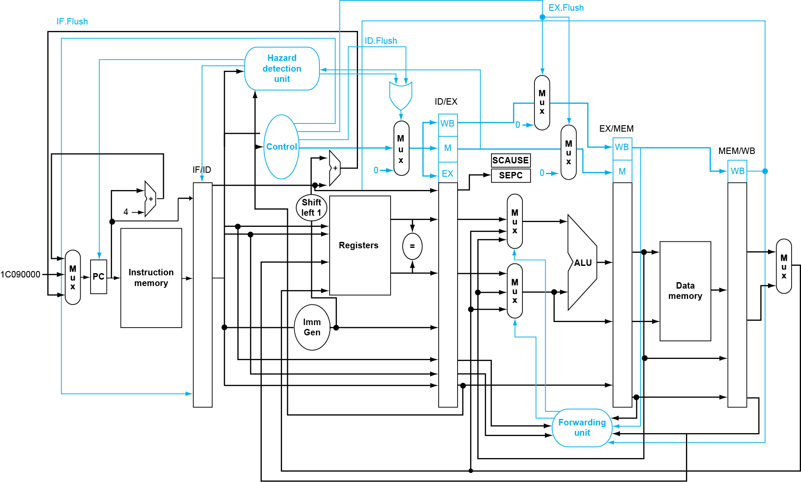
Pipeline with Exceptions

Slide 12
Exception Properties
Restartable exceptions
Pipeline can flush the instruction
Handler executes, then returns to the instruction
Refetched and executed from scratch
PC saved in SEPC register
Identifies causing instruction

Slide 13
Exception Example
Exception on add in
40 sub x11, x2, x4 44 and x12, x2, x5 48 orr x13, x2, x6 4c add x1, x2, x1 50 sub x15, x6, x7 54 ld x16, 100(x7) …
Handler
1C090000 sd x26, 1000(x10) 1c090004 sd x27, 1008(x10) …

Slide 14
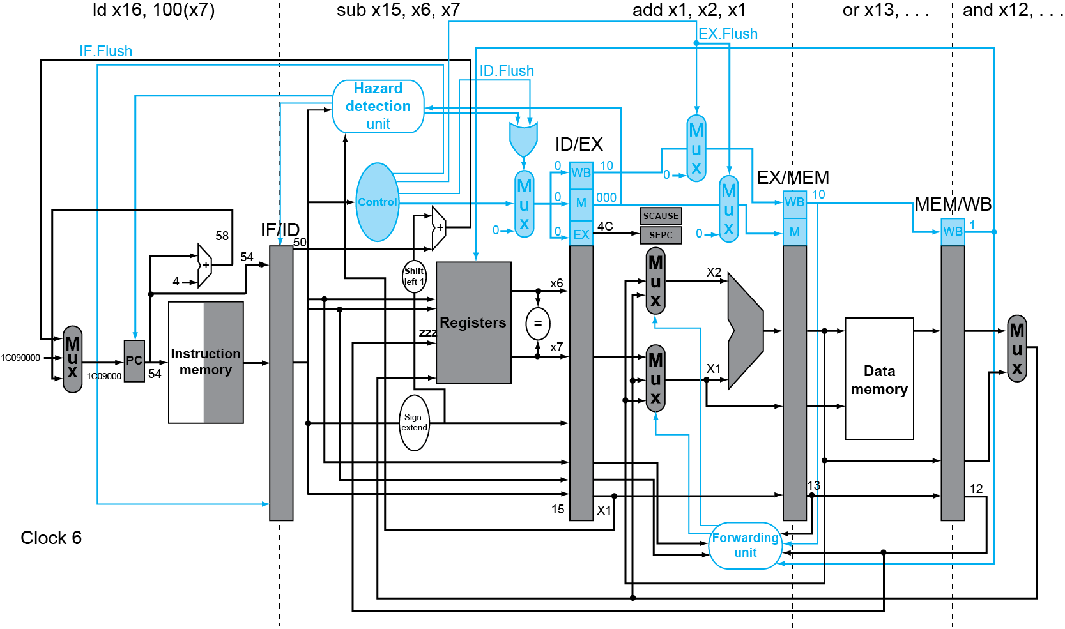
Exception Example

Slide 15
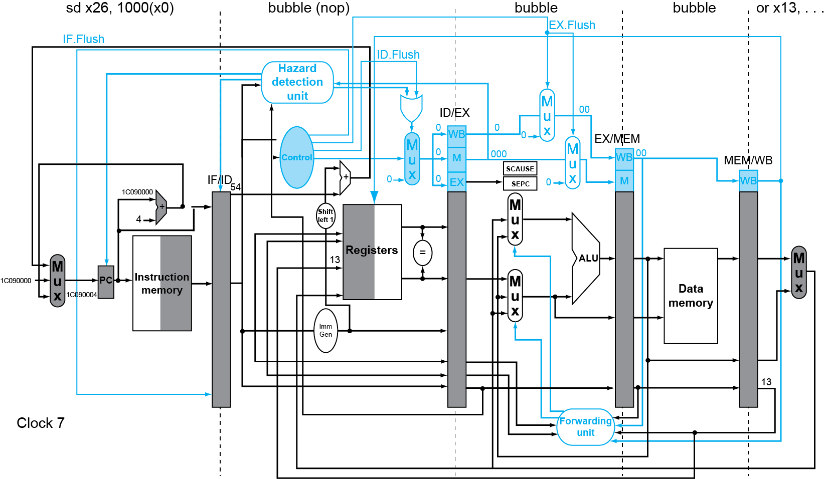
Exception Example

Slide 16
Multiple Exceptions
Pipelining overlaps multiple instructions
Could have multiple exceptions at once
Simple approach: deal with exception from earliest instruction
Flush subsequent instructions
“Precise” exceptions
In complex pipelines
Multiple instructions issued per cycle
Out-of-order completion
Maintaining precise exceptions is difficult!

Slide 17
Imprecise Exceptions
Just stop pipeline and save state
Including exception cause(s)
Let the handler work out
Which instruction(s) had exceptions
Which to complete or flush
May require “manual” completion
Simplifies hardware, but more complex handler software
Not feasible for complex multiple-issue out-of-order pipelines

Slide 18
Any Questions?
.text
__start: addi t1, zero, 0x18
addi t2, zero, 0x21
cycle: beq t1, t2, done
slt t0, t1, t2
bne t0, zero, if_less
nop
sub t1, t1, t2
j cycle
nop
if_less: sub t2, t2, t1
j cycle
done: add t3, t1, zero

