Slide 1
Computer Architecture and Operating Systems Lecture 12: Virtual Memory
Andrei Tatarnikov
atatarnikov@hse.ru
@andrewt0301

Slide 2
Virtual Memory
Use main memory as a “cache” for secondary (disk) storage
Managed jointly by CPU hardware and the operating system (OS)
Programs share main memory
Each gets a private virtual address space holding its frequently used code and data
Protected from other programs
CPU and OS translate virtual addresses to physical addresses
VM “block” is called a page
VM translation “miss” is called a page fault

Slide 3
Virtual Address Space
Virtual addresses
Programs use virtual addresses
Entire virtual address space stored on a hard drive
Subset of virtual address data in DRAM
CPU translates virtual addresses into physical addresses (DRAM addresses)
Data not in DRAM fetched from hard drive
Memory Protection
Each program has own virtual to physical mapping
Two programs can use same virtual address for different data
Programs don’t need to be aware others are running
One program (or virus) can’t corrupt memory used by another

Slide 4
Cache/Virtual Memory Analogues
Physical memory acts as cache for virtual memory
Cache | Virtual Memory
Block | Page
Block Size | Page Size
Block Offset | Page Offset
Miss | Page Fault
Tag | Virtual Page Number

Slide 5
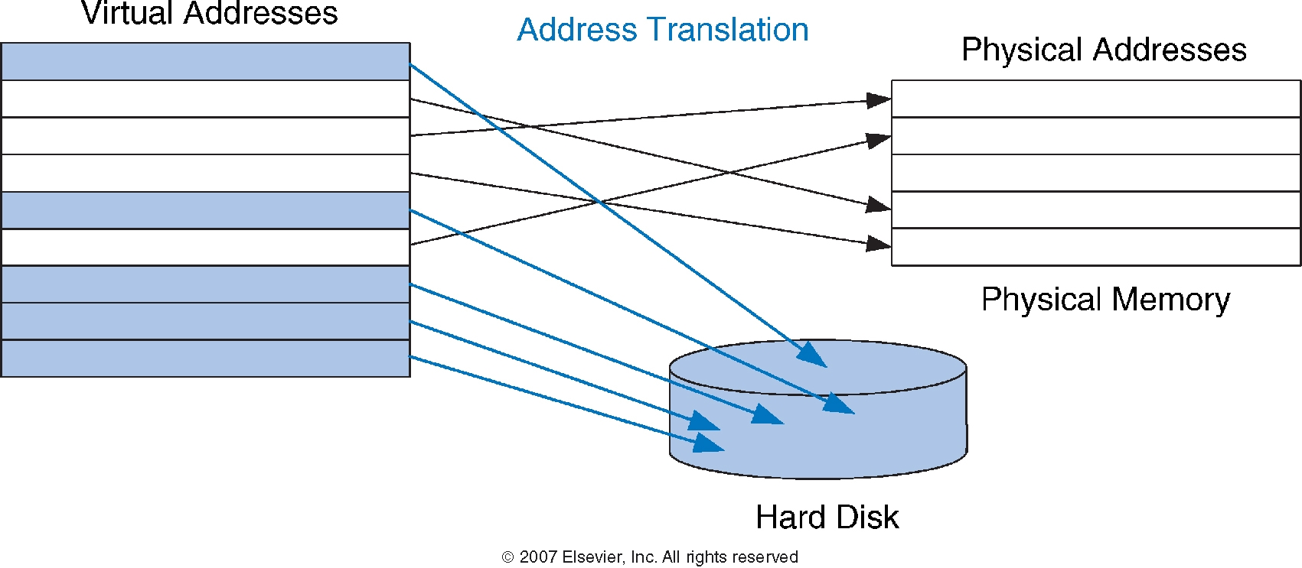
Virtual and Physical Addresses
Most accesses hit in physical memory
But programs have a large capacity of virtual memory

Slide 6
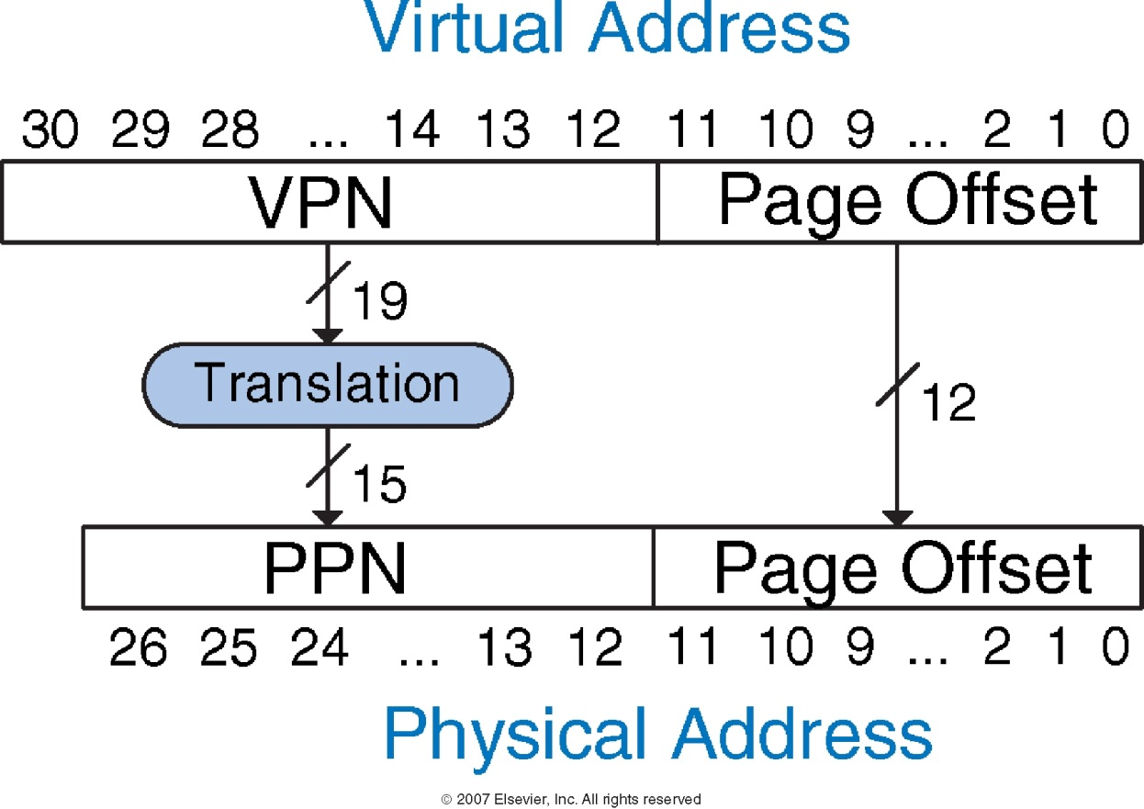
Address Translation
Fixed-size pages (e.g., 4K)

Slide 7
Virtual Memory Example
System
Virtual memory size: 2 GB = 2³¹ bytes
Physical memory size: 128 MB = 2²⁷ bytes
Page size: 4 KB = 2¹² bytes
Organization
Virtual address: 31 bits
Physical address: 27 bits
Page offset: 12 bits
# Virtual pages = 2³¹/2¹² = 2¹⁹ (VPN = 19 bits)
# Physical pages = 2²⁷/2¹² = 2¹⁵ (PPN = 15 bits)

Slide 8
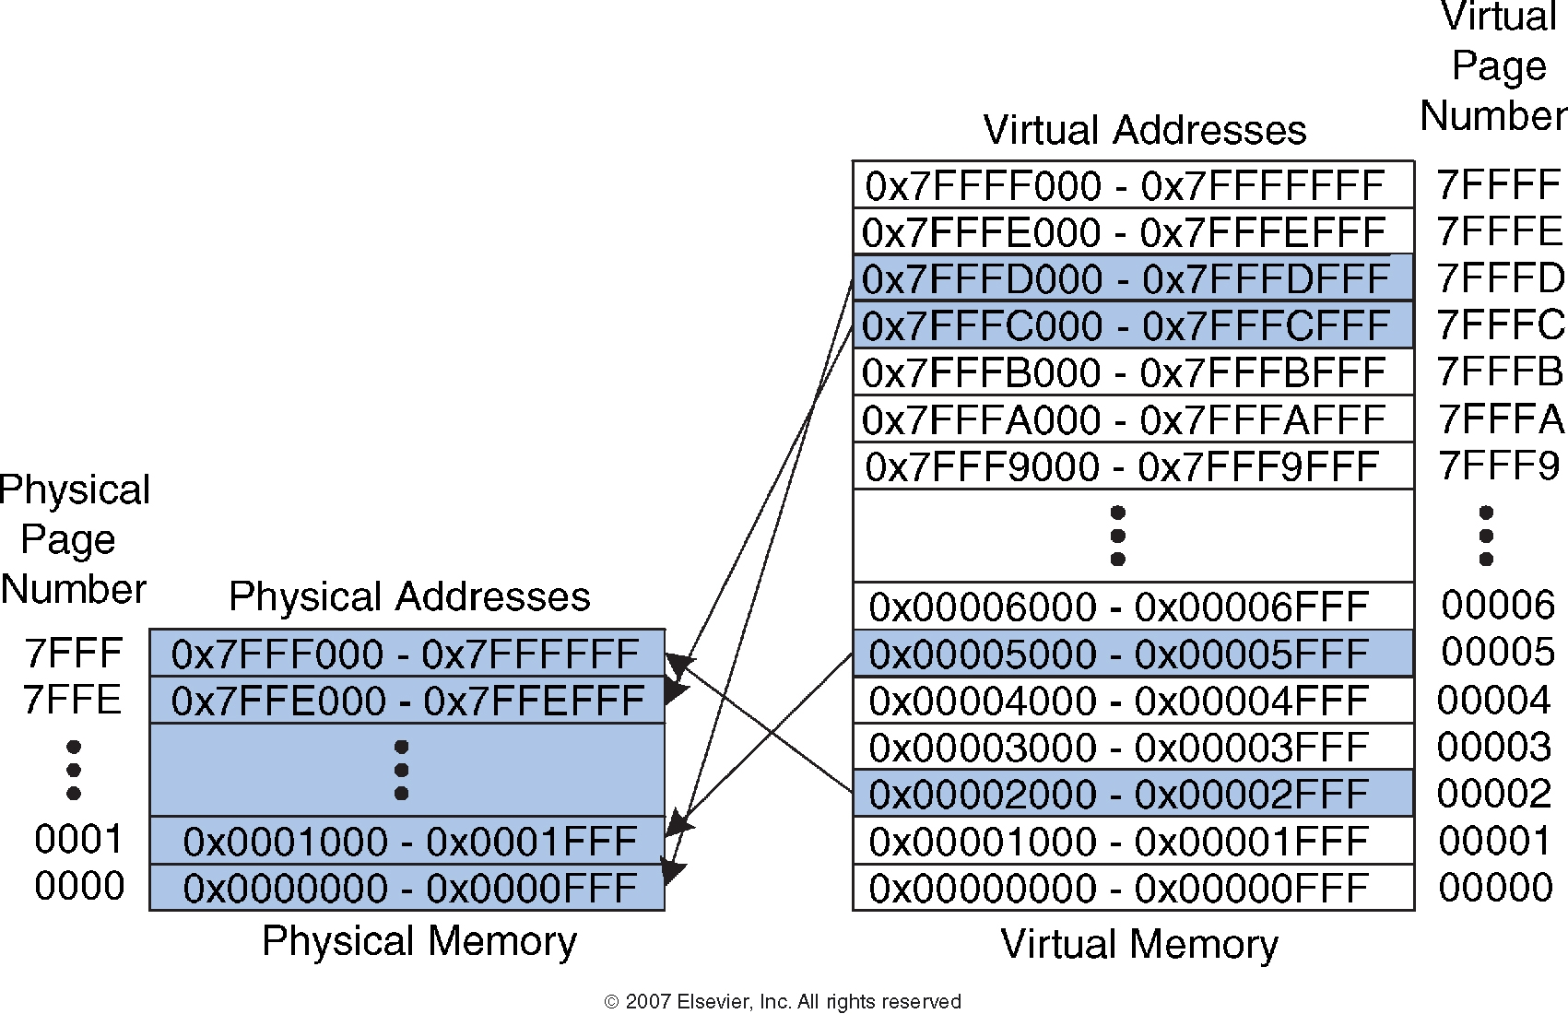
Virtual Memory Example
What is the physical address of virtual address 0x247C?
VPN = 0x2
VPN 0x2 maps to PPN 0x7FFF
12-bit page offset: 0x47C
Physical address = 0x7FFF47C

Slide 9
Page Table
Used to perform address translation
Stores placement information
Array of page table entries, indexed by virtual page number
Page table register in CPU points to page table in physical memory
If page is present in memory
PTE stores the physical page number
Plus other status bits (referenced, dirty, …)
If page is not present
PTE can refer to location in swap space on disk

Slide 10
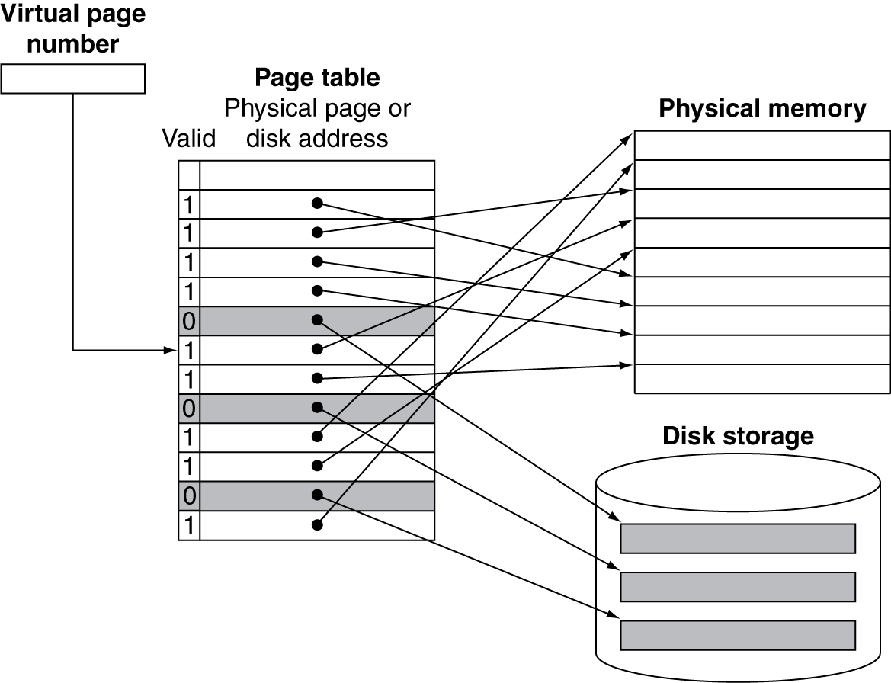
Page Mapping

Slide 11
Page Fault Penalty
On page fault, the page must be fetched from disk
Takes millions of clock cycles
Handled by OS code
Try to minimize page fault rate
Fully associative placement
Smart replacement algorithms

Slide 12
Replacement and Writes
To reduce page fault rate, prefer least-recently used (LRU) replacement
Reference bit (aka use bit) in PTE set to 1 on access to page
Periodically cleared to 0 by OS
A page with reference bit = 0 has not been used recently
Disk writes take millions of cycles
Block at once, not individual locations
Write through is impractical
Use write-back
Dirty bit in PTE set when page is written

Slide 13
Fast Translation Using a TLB
Address translation would appear to require extra memory references
One to access the PTE
Then the actual memory access
But access to page tables has good locality
So use a fast cache of PTEs within the CPU
Called a Translation Look-aside Buffer (TLB)
Typical: 16–512 PTEs, 0.5–1 cycle for hit, 10–100 cycles for miss, 0.01%–1% miss rate
Misses could be handled by hardware or software

Slide 14
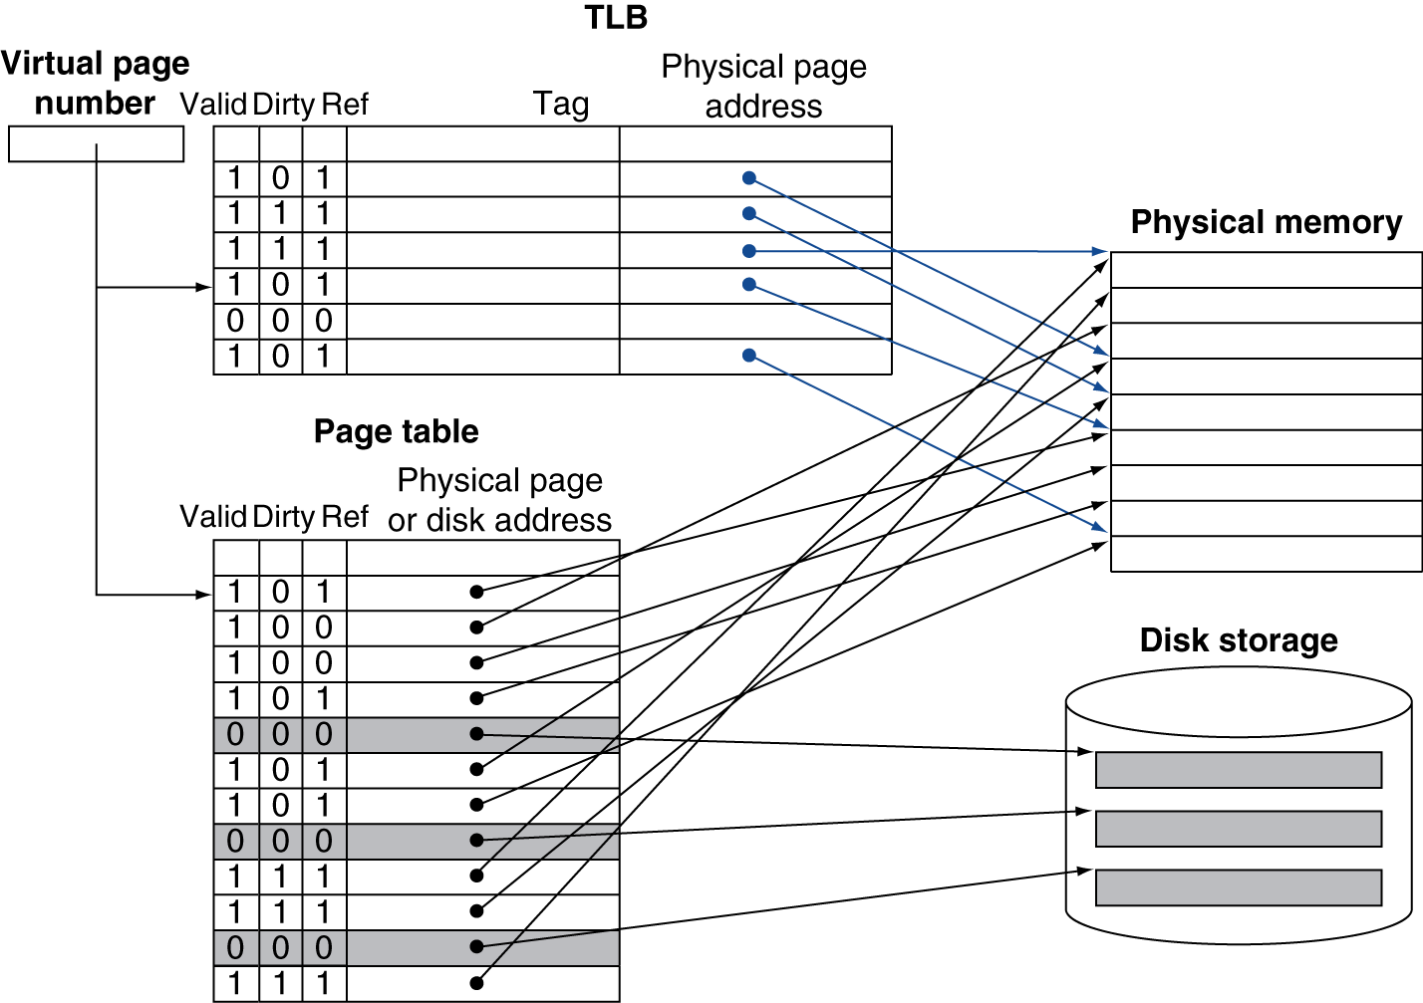
Fast Translation Using a TLB

Slide 15
TLB Misses
If page is in memory
Load the PTE from memory and retry
Could be handled in hardware
Can get complex for more complicated page table structures
Or in software
Raise a special exception, with optimized handler
If page is not in memory (page fault)
OS handles fetching the page and updating the page table
Then restart the faulting instruction

Slide 16
TLB Miss Handler
TLB miss indicates
Page present, but PTE not in TLB
Page not preset
Must recognize TLB miss before destination register overwritten
Raise exception
Handler copies PTE from memory to TLB
Then restarts instruction
If page not present, page fault will occur

Slide 17
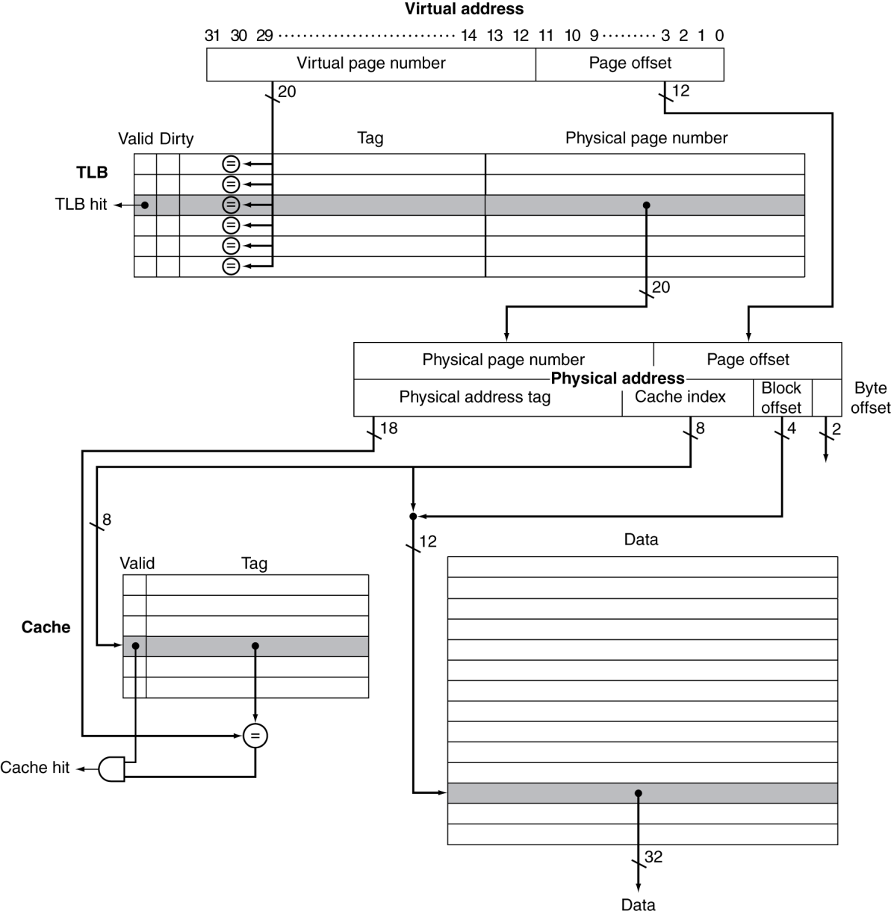
TLB and Cache Interaction
If cache tag uses physical address
Need to translate before cache lookup
Alternative: use virtual address tag
Complications due to aliasing
Different virtual addresses for shared physical address

Slide 18
Memory Protection
Different tasks can share parts of their virtual address spaces
But need to protect against errant access
Requires OS assistance
Hardware support for OS protection
Privileged supervisor mode (aka kernel mode)
Privileged instructions
Page tables and other state information only accessible in supervisor mode
System call exception (e.g., ecall in RISC-V)

Slide 19
Virtual Memory Summary
Virtual memory increases capacity
A subset of virtual pages in physical memory
Page table maps virtual pages to physical pages – address translation
TLB speeds up address translation
Different page tables for different programs provides memory protection

Slide 20
Any Questions?
.text
__start: addi t1, zero, 0x18
addi t2, zero, 0x21
cycle: beq t1, t2, done
slt t0, t1, t2
bne t0, zero, if_less
nop
sub t1, t1, t2
j cycle
nop
if_less: sub t2, t2, t1
j cycle
done: add t3, t1, zero

