Slide 1
Computer Architecture and Operating Systems Lecture 13: Data-level parallelism: Vector, SIMD, GPU
Andrei Tatarnikov
atatarnikov@hse.ru
@andrewt0301

Slide 2
Data-Level Parallelism
Data-level parallelism is parallelism achieved by performing the same operation on independent data
Best in dealing with arrays in for loops and processing other kinds of identically structured data
Unsuitable for control flow structures

Slide 3
Instruction and Data Streams
An alternate classification
SPMD: Single Program Multiple Data
A parallel program on a MIMD computer
Conditional code for different processors
 |  | Data Streams
 |  | Single | Multiple
Instruction Streams | Single | SISD: Intel Pentium 4 | SIMD: SSE instructions of x86
 | Multiple | MISD: No examples today | MIMD: Intel Xeon e5345

Slide 4
Types of Parallel Processing
Single instruction, single data (SISD) stream: A single processor executes a single instruction stream to operate on data stored in a single memory. Uniprocessors fall into this category.
Single instruction, multiple data (SIMD) stream: A single machine instruction controls the simultaneous execution of a number of processing elements on a lockstep basis. Each has an associated data memory, so that instructions are executed on different sets of data by different processors. Vector and array processors fall into this category.
Multiple instruction, single data (MISD) stream: A sequence of data is transmitted to a set of processors, each of which executes a different instruction sequence. Not commercially implemented.
Multiple instruction, multiple data (MIMD) stream: A set of processors simultaneously execute different instruction sequences on different data sets. SMPs, clusters, and NUMA systems fit into this category.

Slide 5
Vector Processors
Highly pipelined function units
Stream data from/to vector registers to units
Data collected from memory into registers
Results stored from registers to memory
Example: Vector extension to RISC-V
v0 to v31: 32 × 64-element registers, (64-bit elements)
Vector instructions
fld.v, fsd.v: load/store vector
fadd.d.v: add vectors of double
fadd.d.vs: add scalar to each element of vector of double
Significantly reduces instruction-fetch bandwidth

Slide 6
Example: DAXPY (Y = a × X + Y)
Conventional RISC-V code:
fld f0,a(x3) # load scalar a
addi x5,x19,512 # end of array X
loop: fld f1,0(x19) # load x[i]
fmul.d f1,f1,f0 # a * x[i]
fld f2,0(x20) # load y[i]
fadd.d f2,f2,f1 # a * x[i] + y[i]
fsd f2,0(x20) # store y[i]
addi x19,x19,8 # increment index to x
addi x20,x20,8 # increment index to y
bltu x19,x5,loop # repeat if not done
Vector RISC-V code:
fld f0,a(x3) # load scalar a
fld.v v0,0(x19) # load vector x
fmul.d.vs v0,v0,f0 # vector-scalar multiply
fld.v v1,0(x20) # load vector y
fadd.d.v v1,v1,v0 # vector-vector add
fsd.v v1,0(x20) # store vector y

Slide 7
Vector vs. Scalar
Vector architectures and compilers
Simplify data-parallel programming
Explicit statement of absence of loop-carried dependences
Reduced checking in hardware
Regular access patterns benefit from interleaved and burst memory
Avoid control hazards by avoiding loops
More general than ad-hoc media extensions (such as MMX, SSE)
Better match with compiler technology

Slide 8
SIMD
Operate elementwise on vectors of data
E.g., MMX and SSE instructions in x86
Multiple data elements in 128-bit wide registers
All processors execute the same instruction at the same time
Each with different data address, etc.
Simplifies synchronization
Reduced instruction control hardware
Works best for highly data-parallel applications

Slide 9
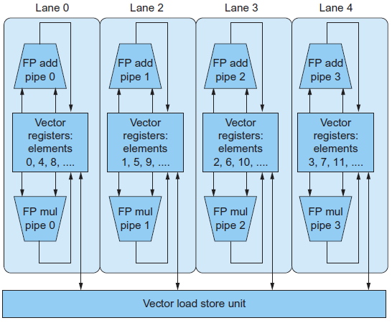
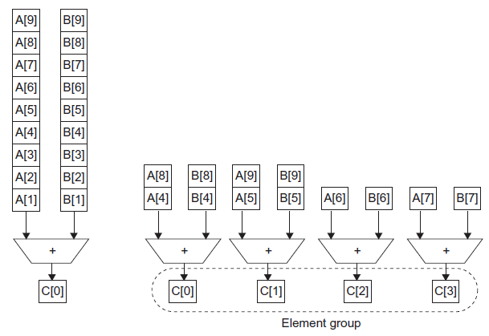
Vector vs. Multimedia Extensions
Vector instructions have a variable vector width, multimedia extensions have a fixed width
Vector instructions support strided access, multimedia extensions do not
Vector units can be combination of pipelined and arrayed functional units:

Slide 10
GPU Architectures
Processing is highly data-parallel
GPUs are highly multithreaded
Use thread switching to hide memory latency
Less reliance on multi-level caches
Graphics memory is wide and high-bandwidth
Trend toward general purpose GPUs
Heterogeneous CPU/GPU systems
CPU for sequential code, GPU for parallel code
Programming languages/APIs
DirectX, OpenGL
C for Graphics (Cg), High Level Shader Language (HLSL)
Compute Unified Device Architecture (CUDA)

Slide 11
History of GPUs
Early video cards
Frame buffer memory with address generation for video output
3D graphics processing
Originally high-end computers (e.g., SGI)
Moore’s Law ⇒ lower cost, higher density
3D graphics cards for PCs and game consoles
Graphics Processing Units
Processors oriented to 3D graphics tasks
Vertex/pixel processing, shading, texture mapping, rasterization

Slide 12
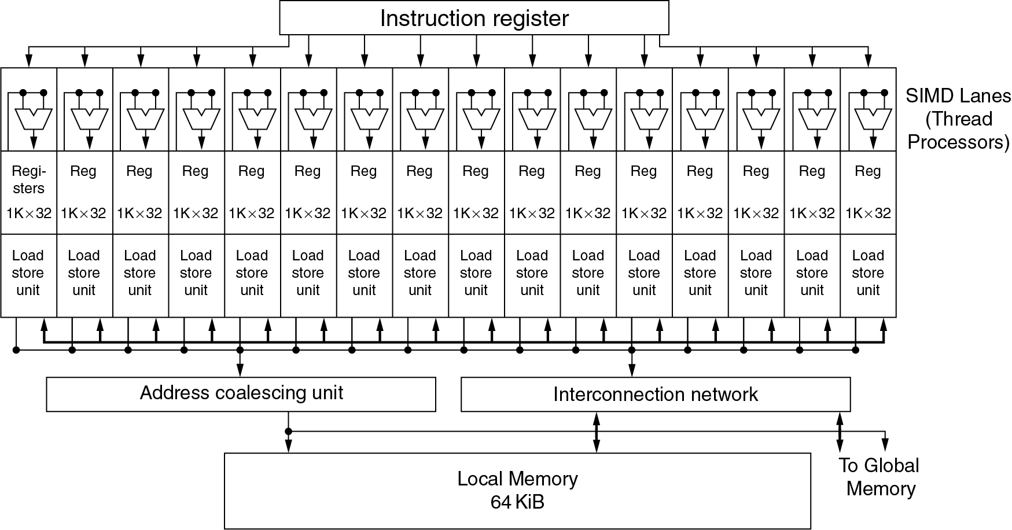
Example: NVIDIA Fermi
Multiple SIMD processors, each as shown:

Slide 13
Example: NVIDIA Fermi
SIMD Processor: 16 SIMD lanes
SIMD instruction
Operates on 32 element wide threads
Dynamically scheduled on 16-wide processor over 2 cycles
32K x 32-bit registers spread across lanes
64 registers per thread context

Slide 14
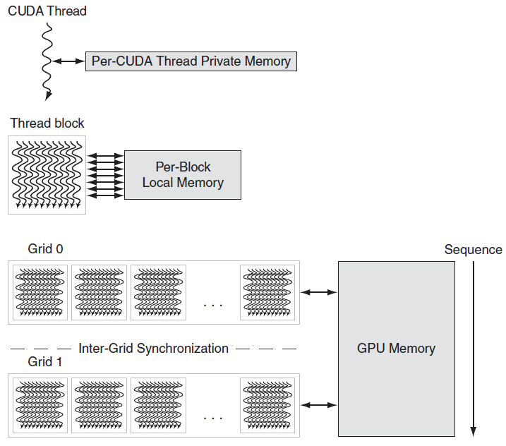
GPU Memory Structures

Slide 15
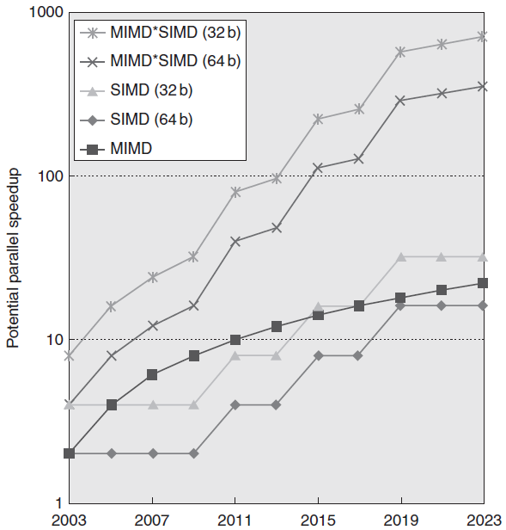
Concluding Remarks
SIMD and vector operations match multimedia applications and are easy to program

Slide 16
Any Questions?
.text
__start: addi t1, zero, 0x18
addi t2, zero, 0x21
cycle: beq t1, t2, done
slt t0, t1, t2
bne t0, zero, if_less
nop
sub t1, t1, t2
j cycle
nop
if_less: sub t2, t2, t1
j cycle
done: add t3, t1, zero

