Slide 1
Computer Architecture and Operating Systems Lecture 11: Memory and Caches
Andrei Tatarnikov
atatarnikov@hse.ru
@andrewt0301

Slide 2
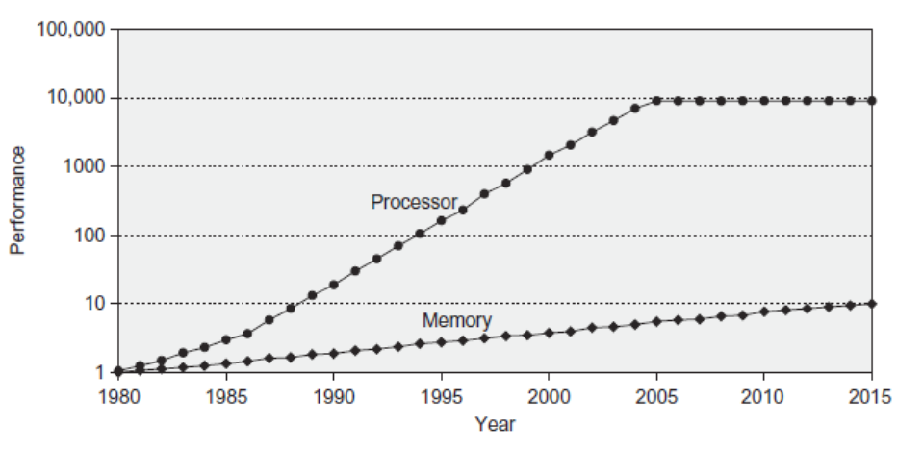
Processor-Memory Performance Gap
Computer performance depends on:
Processor performance
Memory performance

Slide 3
Memory Challenge
Make memory appear as fast as processor
Ideal memory:
Fast
Cheap (inexpensive)
Large (capacity)
But can only choose two!

Slide 4
Memory Technology
Static RAM (SRAM)
0.5ns – 2.5ns, $2000 – $5000 per GB
Dynamic RAM (DRAM)
50ns – 70ns, $20 – $75 per GB
Magnetic disk
5ms – 20ms, $0.20 – $2 per GB
Ideal memory
Access time of SRAM
Capacity and cost/GB of disk

Slide 5
Locality
No need for large memory to access it fast
Just exploit locality
Temporal Locality:
Locality in time
If data used recently, likely to use it again soon
How to exploit: keep recently accessed data in higher levels of memory hierarchy
Spatial Locality:
Locality in space
If data used recently, likely to use nearby data soon
How to exploit: when access data, bring nearby data into higher levels of memory hierarchy too

Slide 6
Taking Advantage of Locality
Memory hierarchy
Store everything on disk
Copy recently accessed (and nearby) items from disk to smaller DRAM memory
Main memory
Copy more recently accessed (and nearby) items from DRAM to smaller SRAM memory
Cache memory attached to CPU

Slide 7
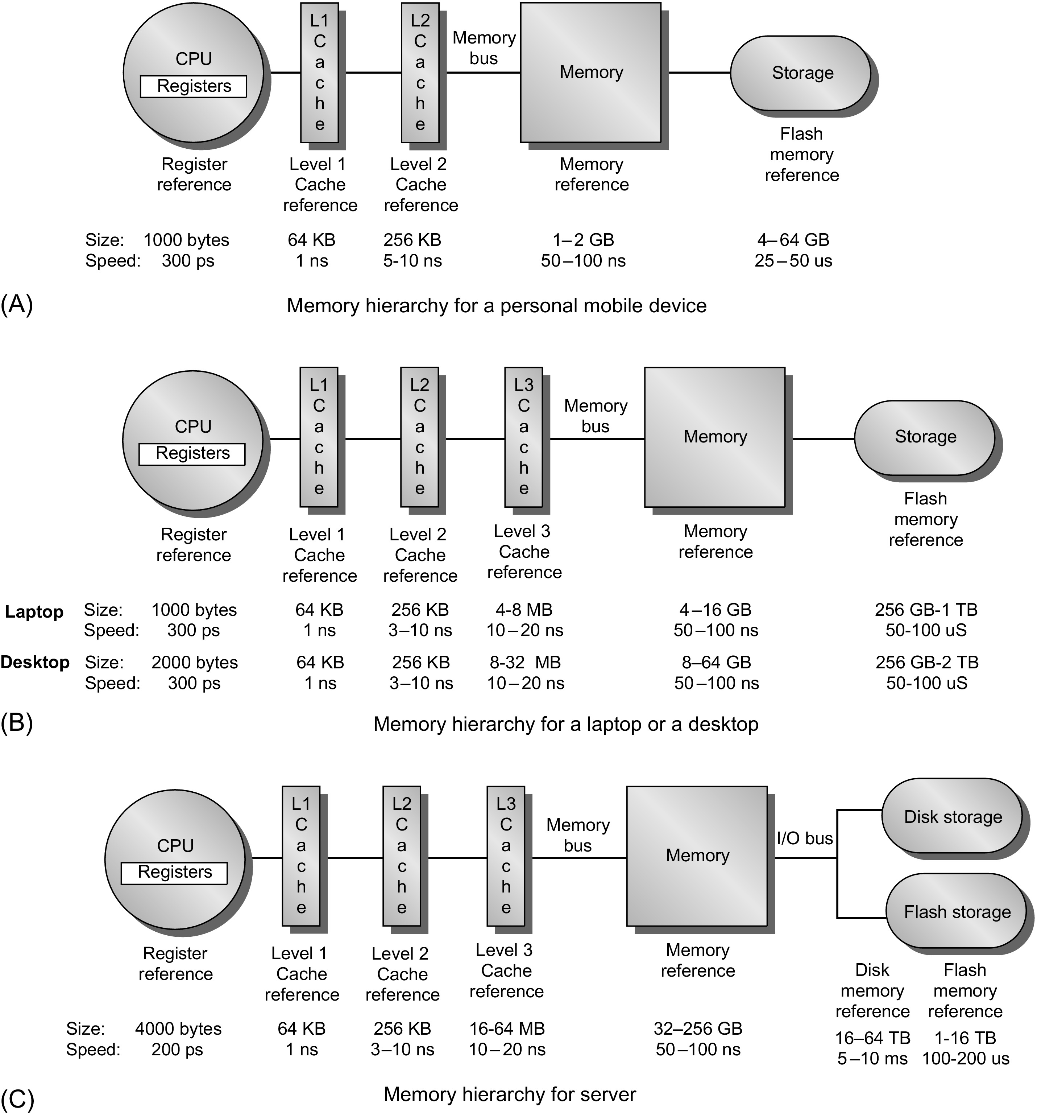
Memory Hierarchy
Personal mobile device
Laptop or desktop
Server

Slide 8
How it works?
Block (aka line): unit of copying
May be multiple words
If accessed data is present in upper level
Hit: access satisfied by upper level
Hit ratio: hits/accesses
If accessed data is absent
Miss: block copied from lower level
Time taken: miss penalty
Miss ratio: misses/accesses = 1 – hit ratio
Then accessed data supplied from upper level
Processor
L1
L2
Memory

Slide 9
Memory Performance
Hit: data found in that level of memory hierarchy
Miss: data not found (must go to next level)
Hit Rate = # hits / # memory accesses = 1 – Miss Rate
Miss Rate = # misses / # memory accesses = 1 – Hit Rate
Average memory access time (AMAT): average time for processor to access data
AMAT = t_{cache} + MR_{cache}[t_{MM} + MR_{MM}(t_{VM})]

Slide 10
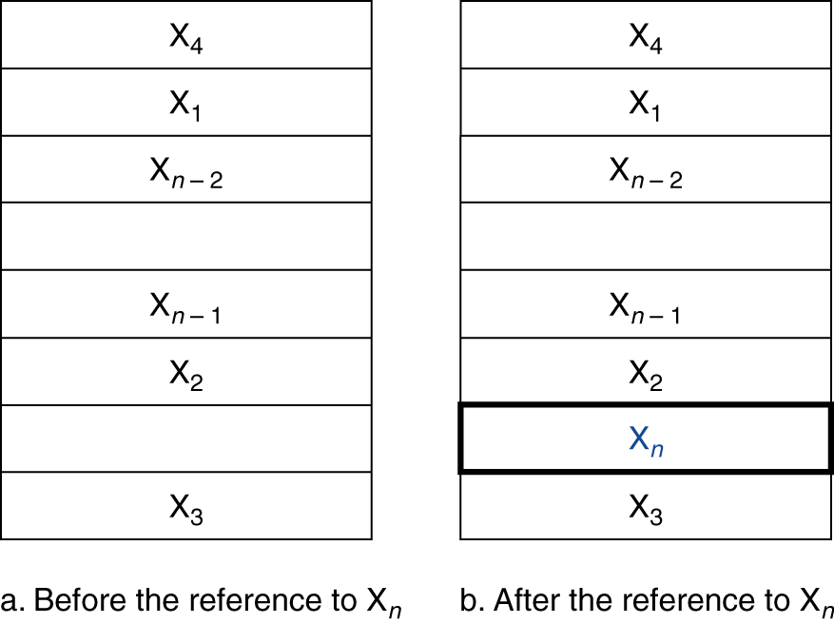
Cache Memory
Cache memory
The level of the memory hierarchy closest to the CPU
Given accesses X₁, …, X_{n–1}, X_{n}
How do we know if the data is present?
Where do we look?

Slide 11
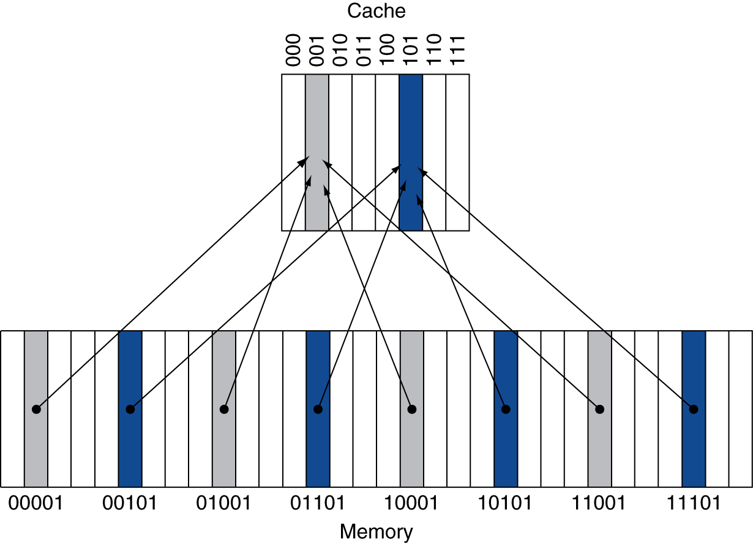
Direct Mapped Cache
Location determined by address
Direct mapped: only one choice
(Block address) modulo (#Blocks in cache)
Cache
#Blocks is a power of 2
Use low-order address bits
Memory

Slide 12
Tags and Valid Bits
How do we know which particular block is stored in a cache location?
Store block address as well as the data
Actually, only need the high-order bits
Called the tag
What if there is no data in a location?
Valid bit: 1 = present, 0 = not present
Initially 0

Slide 13
Direct Mapped Cache Example
8-blocks, 1 word/block, direct mapped
Initial state
Index | V | Tag | Data
000 | N
001 | N
010 | N
011 | N
100 | N
101 | N
110 | N
111 | N

Slide 14
Direct Mapped Cache Example
Word addr | Binary addr | Hit/miss | Cache block
22 | 10 110 | Miss | 110
Index | V | Tag | Data
000 | N
001 | N
010 | N
011 | N
100 | N
101 | N
110 | Y | 10 | Mem[10110]
111 | N

Slide 15
Direct Mapped Cache Example
Word addr | Binary addr | Hit/miss | Cache block
26 | 11 010 | Miss | 010
Index | V | Tag | Data
000 | N
001 | N
010 | Y | 11 | Mem[11010]
011 | N
100 | N
101 | N
110 | Y | 10 | Mem[10110]
111 | N

Slide 16
Direct Mapped Cache Example
Word addr | Binary addr | Hit/miss | Cache block
22 | 10 110 | Hit | 110
26 | 11 010 | Hit | 010
Index | V | Tag | Data
000 | N
001 | N
010 | Y | 11 | Mem[11010]
011 | N
100 | N
101 | N
110 | Y | 10 | Mem[10110]
111 | N

Slide 17
Direct Mapped Cache Example
Word addr | Binary addr | Hit/miss | Cache block
16 | 10 000 | Miss | 000
3 | 00 011 | Miss | 011
16 | 10 000 | Hit | 000
Index | V | Tag | Data
000 | Y | 10 | Mem[10000]
001 | N
010 | Y | 11 | Mem[11010]
011 | Y | 00 | Mem[00011]
100 | N
101 | N
110 | Y | 10 | Mem[10110]
111 | N

Slide 18
Direct Mapped Cache Example
Word addr | Binary addr | Hit/miss | Cache block
18 | 10 010 | Miss | 010
Index | V | Tag | Data
000 | Y | 10 | Mem[10000]
001 | N
010 | Y | 10 | Mem[10010]
011 | Y | 00 | Mem[00011]
100 | N
101 | N
110 | Y | 10 | Mem[10110]
111 | N

Slide 19
Any Questions?
.text
__start: addi t1, zero, 0x18
addi t2, zero, 0x21
cycle: beq t1, t2, done
slt t0, t1, t2
bne t0, zero, if_less
nop
sub t1, t1, t2
j cycle
nop
if_less: sub t2, t2, t1
j cycle
done: add t3, t1, zero

