Slide 1
Computer Architecture and Operating Systems Lecture 1: Introduction
Andrei Tatarnikov
atatarnikov@hse.ru
@andrewt0301

Slide 2
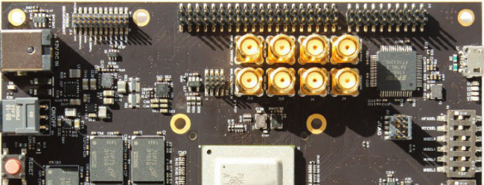
Course Resources
Wiki
http://wiki.cs.hse.ru/ACOS_DSBA_2020/2021
Web site
https://andrewt0301.github.io/hse-acos-course/
Telegram channel
https://t.me/joinchat/AAAAAFDXhCd-WvYYZwBPGQ

Slide 3
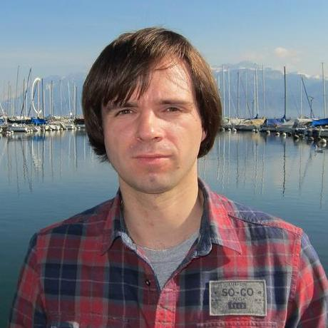
Course Team
Instructors
Andrei Tatarnikov
Assistants
TODO

Slide 4
Course Outline
Syllabus (see details in the web site)
Module 3: Computer Architecture
Computer architecture
Assembly language programming (RISC-V)
Home works, quizzes, and test.
Module 4: Operating Systems
Operating System Architecture (Linux)
System programming in C
Home works, quizzes, and test
Final Exam

Slide 5
Course Motivation

Slide 6
Brief History

Slide 7








Eight Great Ideas
Design for Moore’s Law
Use abstraction to simplify design
Make the common case fast
Performance via parallelism
Performance via pipelining
Performance via prediction
Hierarchy of memories
Dependability via redundancy

Slide 8
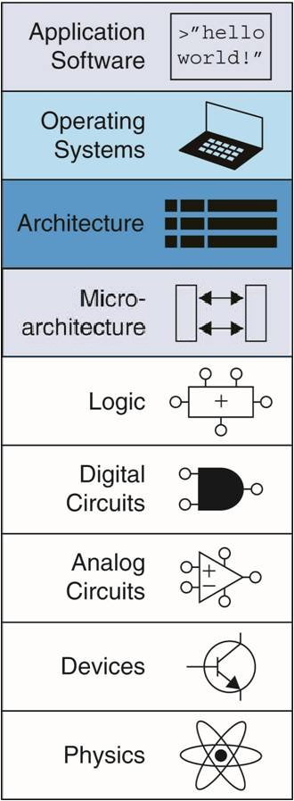
Abstraction
Hiding details when they are not important
Focus
of this course

Slide 9
Any Questions?
.text
__start: addi t1, zero, 0x18
addi t2, zero, 0x21
cycle: beq t1, t2, done
slt t0, t1, t2
bne t0, zero, if_less
nop
sub t1, t1, t2
j cycle
nop
if_less: sub t2, t2, t1
j cycle
done: add t3, t1, zero

