Slide 1
Computer Architecture and Operating Systems Lecture 11: Memory and Caches
Andrei Tatarnikov
atatarnikov@hse.ru
@andrewt0301

Slide 2
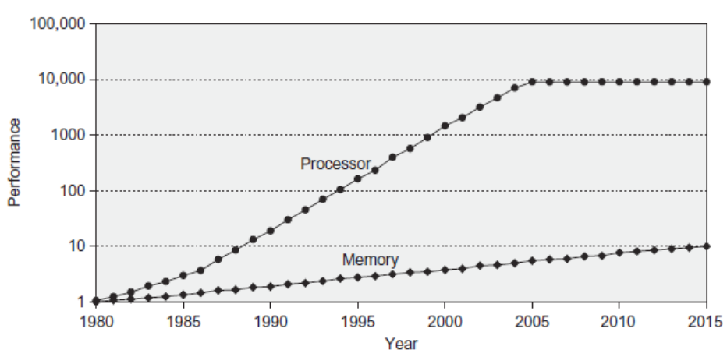
Processor-Memory Performance Gap
Computer performance depends on:
Processor performance
Memory performance

Slide 3
Memory Challenge
Make memory appear as fast as processor
Ideal memory:
Fast
Cheap (inexpensive)
Large (capacity)
But can only choose two!

Slide 4
Memory Technology
Static RAM (SRAM)
0.5ns – 2.5ns, $2000 – $5000 per GB
Dynamic RAM (DRAM)
50ns – 70ns, $20 – $75 per GB
Magnetic disk
5ms – 20ms, $0.20 – $2 per GB
Ideal memory
Access time of SRAM
Capacity and cost/GB of disk

Slide 5
Locality
No need for large memory to access it fast
Just exploit locality
Temporal Locality:
Locality in time
If data used recently, likely to use it again soon
How to exploit: keep recently accessed data in higher levels of memory hierarchy
Spatial Locality:
Locality in space
If data used recently, likely to use nearby data soon
How to exploit: when access data, bring nearby data into higher levels of memory hierarchy too

Slide 6
Taking Advantage of Locality
Memory hierarchy
Store everything on disk
Copy recently accessed (and nearby) items from disk to smaller DRAM memory
Main memory
Copy more recently accessed (and nearby) items from DRAM to smaller SRAM memory
Cache memory attached to CPU

Slide 7
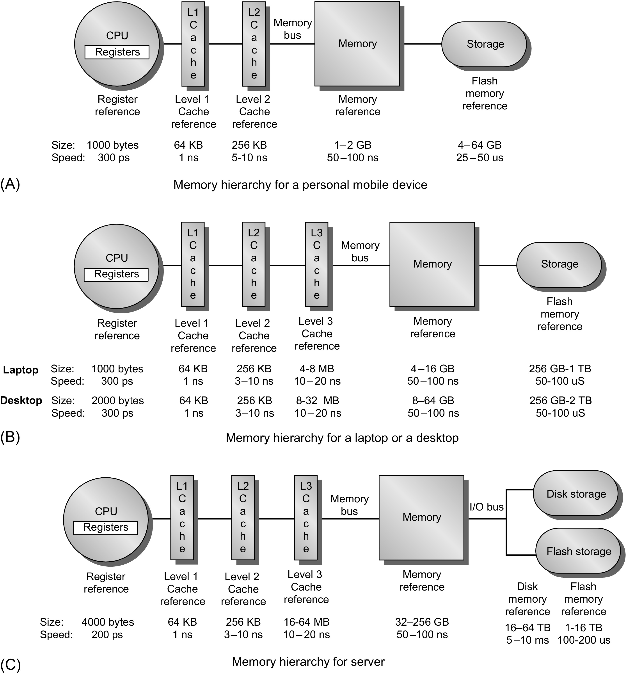
Memory Hierarchy
Personal mobile device
Laptop or desktop
Server

Slide 8
How it works?
Block (aka line): unit of copying
May be multiple words
If accessed data is present in upper level
Hit: access satisfied by upper level
Hit ratio: hits/accesses
If accessed data is absent
Miss: block copied from lower level
Time taken: miss penalty
Miss ratio: misses/accesses = 1 – hit ratio
Then accessed data supplied from upper level
Processor
L1
L2
Memory

Slide 9
Memory Performance
Hit: data found in that level of memory hierarchy
Miss: data not found (must go to next level)
Hit Rate = # hits / # memory accesses = 1 – Miss Rate
Miss Rate = # misses / # memory accesses = 1 – Hit Rate
Average memory access time (AMAT): average time for processor to access data
AMAT = t_{cache} + MR_{cache}[t_{MM} + MR_{MM}(t_{VM})]

Slide 10
Any Questions?
.text
__start: addi t1, zero, 0x18
addi t2, zero, 0x21
cycle: beq t1, t2, done
slt t0, t1, t2
bne t0, zero, if_less
nop
sub t1, t1, t2
j cycle
nop
if_less: sub t2, t2, t1
j cycle
done: add t3, t1, zero

