Slide 1
Computer Architecture and Operating Systems Lecture 3: Computer Organization. Microprocessors
Andrei Tatarnikov
atatarnikov@hse.ru
@andrewt0301

Slide 2
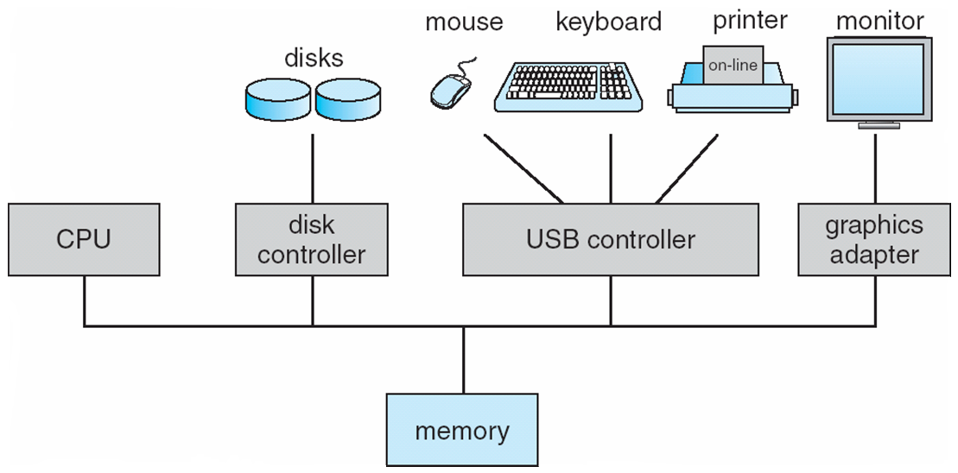
Modern Computer Organization
One or more CPUs and device controllers connect through common bus providing access to shared memory
Concurrent execution of CPUs and devices competing for memory cycles

Slide 3








Eight Great Ideas
Design for Moore’s Law
Use abstraction to simplify design
Make the common case fast
Performance via parallelism
Performance via pipelining
Performance via prediction
Hierarchy of memories
Dependability via redundancy

Slide 4
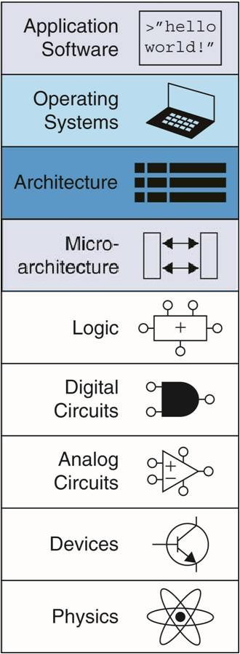
Abstraction
Hiding details when they are not important
Focus
of this course

Slide 5
Any Questions?
.text
__start: addi t1, zero, 0x18
addi t2, zero, 0x21
cycle: beq t1, t2, done
slt t0, t1, t2
bne t0, zero, if_less
nop
sub t1, t1, t2
j cycle
nop
if_less: sub t2, t2, t1
j cycle
done: add t3, t1, zero

