Slide 1
Computer Architecture and Operating Systems Lecture 6: Assembly Programming – Stack
Andrei Tatarnikov
atatarnikov@hse.ru
@andrewt0301

Slide 2
Program Structure and Memory Layout
0x 7FFF EFFC
.text
main:
li a7, 5
ecall
# function call
func(a0)
li a7, 10
ecall
# function
func:
# do something
return a0
Local variables
Temp values
Housekeeping
Stack
Dynamic Data
0x1004 0000
.data
0x 1001 0000
.text
0x 0040 0000
Reserved
0x 0000 0000

Slide 3
Notion of Function
Function (procedure) is a code that performs some task based on the arguments with which it is provided
Caller is a code that calls a function and provides it with the necessary arguments
Callee is a function that executes instructions based on arguments provided by the caller and then returns control to the caller
Return address is a link that allows the callee to return control to the caller
Jump-and-link instruction is an instruction that branches to an address and simultaneously saves the address of the next instruction in to a register

Slide 4
Function Call Steps
Place arguments in registers a0 (x10) to a7 (x17)
Save return address in ra (x1) and jump to function
Allocate stack memory for the function
Perform function's operations
Free stack memory allocated for the function
Place result in register a0 for caller
Return to place of call (address in ra)

Slide 5
RISC-V Register Conventions
Register | Name | Use | Saver
x0 | zero | constant 0 | n/a
x1 | ra | return address | caller
x2 | sp | stack pointer | callee
x3 | gp | global pointer
x4 | tp | thread pointer
x5-x7 | t0-t2 | temporaries | caller
x8 | s0/fp | saved/ frame pointer | callee
x9 | s1 | saved | callee
x10-x17 | a0-a7 | arguments | caller
x18-x27 | s2-s11 | saved | callee
x28-x31 | t3-t6 | temporaries | caller

Slide 6
Jump-and-Link Instructions
Function call: jump and link
jal ra, FunctionLabel (UJ-type)
Address of the next instruction is put in ra (x1)
Jumps to target address
Function return: jump and link register
jalr zero, 0(ra) (I-type)
Like jal, but jumps to 0 + address in ra (x1)
Use zero (x0) as rd (zero cannot be changed)
Can also be used for computed jumps
e.g., for case/switch statements

Slide 7
Jump-and-Link Pseudo Instructions
j label # Jump to label and do not save return address
jal label # Jump to label and set return address to ra
jalr t0 # Jump to address in t0 and set return address to ra
jalr t0, -100 # Jump to address t0-100 and set return address to ra
jr t0 # Jump Register: Jump to address in t0
jr t0, -100 # Jump Register: Jump to address t0-100

Slide 8
Stack
Stack is a data structure for spilling registers organized as a last-in-first-out queue
Dynamic memory for storing data (such as local variables) for function calls is organized as a task
Stack pointer is a value denoting the most recently allocated address on the stack
Push means to add element to stack
Pop means to remove element from stack

Slide 9
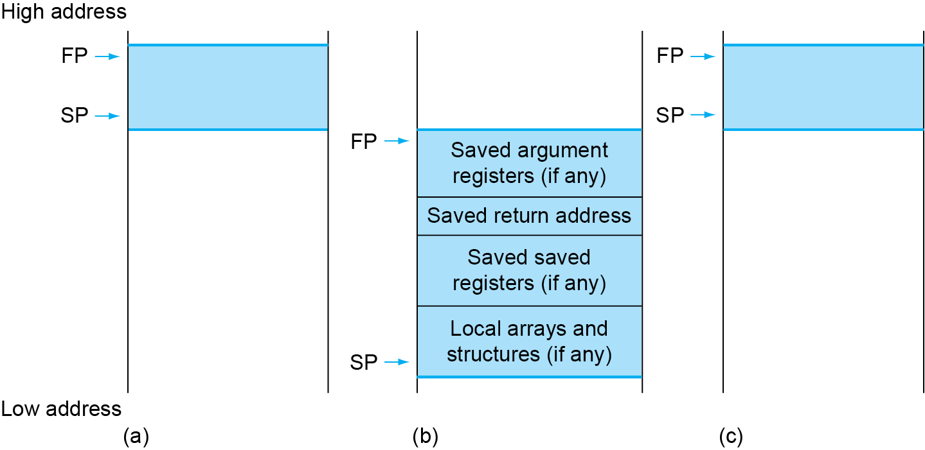
Local Data on Stack
Local data allocated by callee
Local variables, arrays, etc.
Function frame (activation record)
Segment of stack containing function’s saved registers and local variables

Slide 10
Saving Registers
A function can overwrite values of registers. Sometimes is undesirable. There are special rules to handle this issues. They specify who is responsible for saving the registers.
Callee-saved register is a register saved by the routine being called
Caller-saved register is register saved by the routine making a function call

Slide 11
Function Example
int leaf_example (int g, int h, int i, int j) {
int f = (g + h) - (i + j);
return f;
}
Requirements:
﻿arguments g, ..., j in a0 (x10)...a3 (x13)
f in s4 (x20)
temporaries t0 (x5), t1 (x6)
need to save t0, t1, s4 on stack

Slide 12
Function Assembly Code
main:
read_int(t0) # read g
read_int(t1) # read h
read_int(t2) # read i
read_int(t3) # read j
mv a0, t0
mv a1, t1
mv a2, t2
mv a3, t3
jal ra, leaf_example
mv t4, a0
print_int(t0, t1, t2, t3, t4)
li a7, 10
ecall
leaf_example:
addi sp, sp, -12
sw t0, 8(sp)
sw t1, 4(sp)
sw s4, 0(sp)
add t0, a0, a1
add t1, a2, a3
sub s4, t0, t1
mv a0, s4
lw s4, 0(sp)
lw t1, 4(sp)
lw t0, 8(sp)
addi sp, sp, 12
jalr x0, 0(ra)

Slide 13
Preserving Callee-Saved Registers
Preserve registers:
addi sp, sp, -20 # make room on stack for 5 registers
sw ra, 16(sp) # save ra (x1) on stack
sw s1, 12(sp) # save s1 (x9) on stack
sw s2, 8(sp) # save s2 (x18) on stack
sw s3, 4(sp) # save s3 (x19) on stack
sw s4, 0(sp) # save s4 (x20) on stack
Restore registers:
lw s4, 0(sp) # restore s4 (x20) from stack
lw s3, 4(sp) # restore s3 (x19) from stack
lw s2, 8(sp) # restore s2 (x18) from stack
lw s1, 12(sp) # restore s1 (x9) from stack
lw ra, 16(sp) # restore ra (x1) from stack
addi sp, sp, 20 # restore stack pointer
jalr zero, 0(ra) # return to caller

Slide 14
Preserving Caller-Saved Registers
Preserve registers:
addi sp, sp, -16 # make room on stack for 4 registers
sw t0, 12(sp) # save t0 (x5) on stack
sw t1, 8(sp) # save t1 (x6) on stack
sw t2, 4(sp) # save t2 (x7) on stack
sw t3, 0(sp) # save t3 (x28) on stack
Restore registers:
jal ra, callee # jump to callee
lw t3, 0(sp) # restore t3 (x28) from stack
lw t2, 4(sp) # restore t2 (x7) from stack
lw t1, 8(sp) # restore t1 (x6) from stack
lw t0, 12(sp) # restore t0 (x5) from stack
addi sp, sp, 16 # restore stack pointer

Slide 15
Recursive Function Example
fact:
addi t0, a0, -1
bgez t0, fact_else
li a0, 1
jalr zero, 0(ra)
fact_else:
addi sp, sp, -8
sw ra, 4(sp)
sw a0, 0(sp)
addi a0, a0, -1
jal ra, fact
mv t1, a0
lw a0, 0(sp)
lw ra, 4(sp)
addi sp, sp, 8
mul a0, a0, t1
jalr zero, 0(ra)
﻿int fact (int n) {
if (n < 1) {
return 1;
} else {
return n * fact(n - 1);
}
}

Slide 16
Frame Pointer
Frame pointer is a value denoting the location of the saved registers and local variables for a given procedure. Simplifies programming because when stack-pointer changes programmers have to use different offsets to access the same values.

Slide 17
Using Frame Pointer
main:
mv fp, sp
jal ra, func
li a7, 10
ecall
func:
addi sp, sp, -4
li t0, 1
sw t0, 0(sp)
addi sp, sp, -4
li t0, 2
sw t0, 0(sp)
addi sp, sp, -4
li t0, 3
sw t0, 0(sp)
lw t0, 0(fp)
print_int(t0)
lw t0, -4(fp)
print_int(t0)
lw t0, -8(fp)
print_int(t0)
addi sp, sp, 12
jalr zero, 0(ra)
frame pointer initialization
function call
system call “exit”
sp-relative stores
fp-relative loads
return

Slide 18
Any Questions?
.text
__start: addi t1, zero, 0x18
addi t2, zero, 0x21
cycle: beq t1, t2, done
slt t0, t1, t2
bne t0, zero, if_less
nop
sub t1, t1, t2
j cycle
nop
if_less: sub t2, t2, t1
j cycle
done: add t3, t1, zero

