Slide 1
Computer Architecture and Operating Systems Lecture 5: Assembly Programming – Branches and Arrays
Andrei Tatarnikov
atatarnikov@hse.ru
@andrewt0301

Slide 2
Program Structure and Memory Layout
0x 7FFF EFFC
Stack
Dynamic Data
.data
hello:
.string "Hello, world!"
.text
main:
li a7, 4
la a0, hello
ecall
0x1004 0000
.data
0x 1001 0000
.text
0x 0040 0000
Reserved
0x 0000 0000

Slide 3
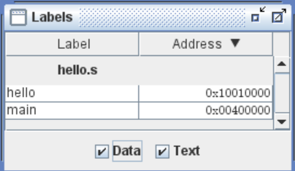
Labels
Labels are symbolic names for addresses (in the .data or .text segment).
Labels are used by control-flow instructions (branches and jumps).
Labels are used by load and store instructions.

Slide 4
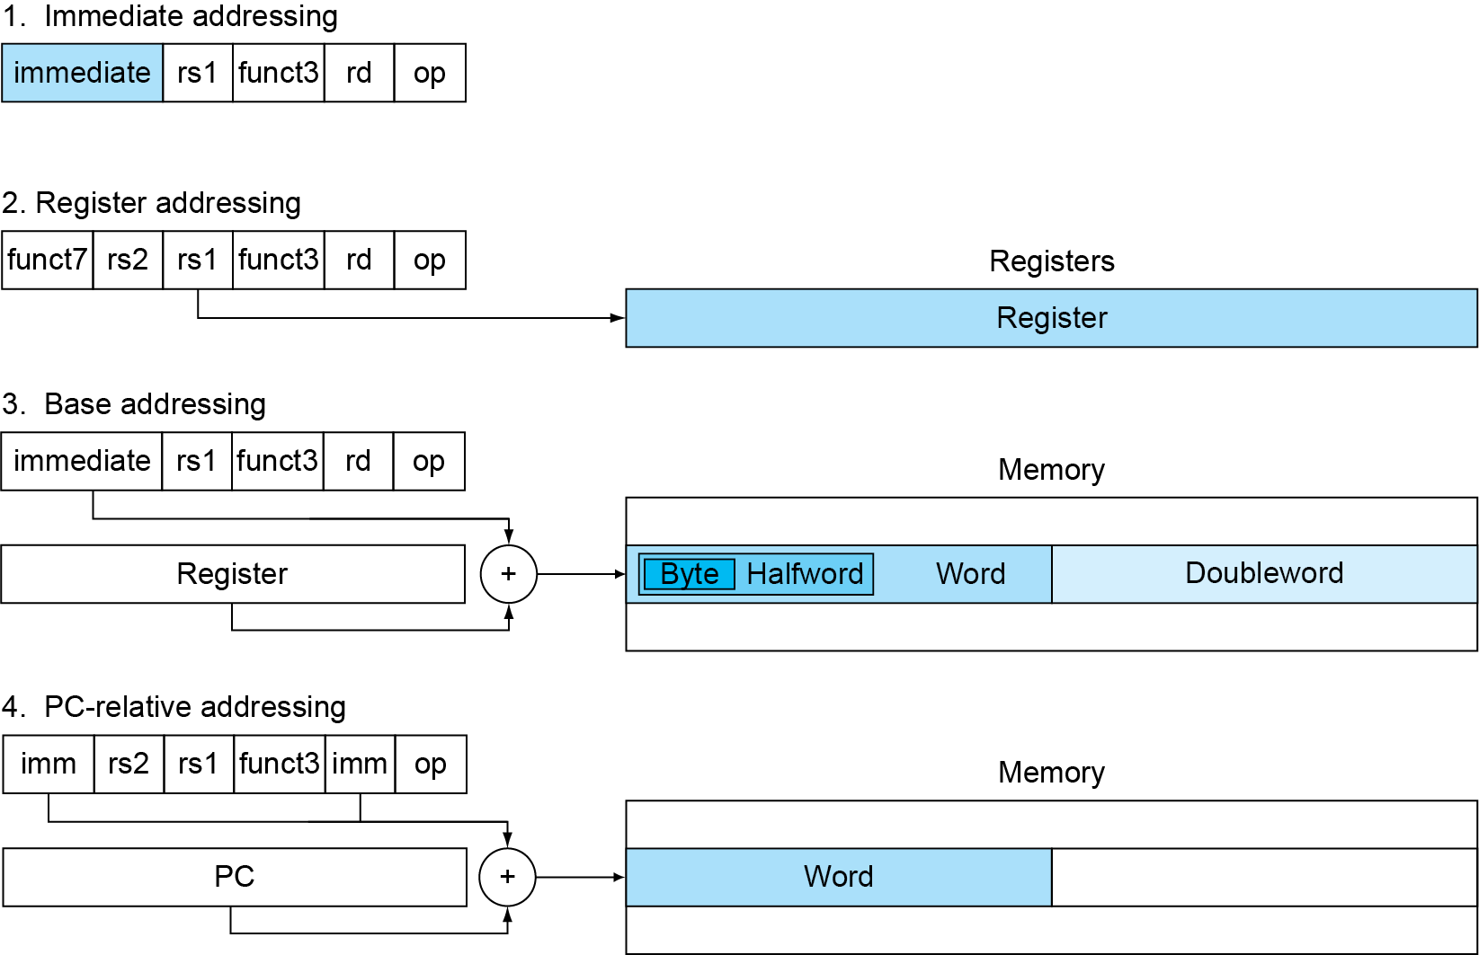
Addressing
Addresses can be represented in several ways

Slide 5
Program Counter
Program Counter (PC) is a special register that stores the address of the currently executed instruction.
When an instruction is executed, the PC is incremented by the size of the instruction (4 bytes) to point to the next instruction.
Branch and jump instructions assign to the PC new addresses to change the control flow.
Branch instructions use PC-relative addresses (increment or decrement current value by an offset).

Slide 6
Branch Instructions
Branch Instructions
Branch = beq rs1, rs2, label
Branch ≠ bne rs1, rs2, label
Branch < blt rs1, rs2, label
Branch ≥ bge rs1, rs2, label
Branch < Unsigned bltu rs1, rs2, label
Branch ≥ Unsigned bgeu rs1, rs2, label

Slide 7
Branch Pseudoinstructions
Branch Pseudoinstructions
Branch unconditionally b label
Branch = 0 beqz rs1, label
Branch ≥ 0 bgez rs1, label
Branch > bgt rs1, rs2, label
Branch > Unsigned bgtu rs1, rs2, label
Branch > 0 bgtz rs1, label
Branch ≤ ble rs1, rs2, label
Branch ≤ Unsigned bleu rs1, rs2, label
Branch ≤ 0 blez rs1, label
Branch < 0 bltz rs1, label
Branch ≠ 0 bnez rs1, label

Slide 8
Any Questions?
.text
__start: addi t1, zero, 0x18
addi t2, zero, 0x21
cycle: beq t1, t2, done
slt t0, t1, t2
bne t0, zero, if_less
nop
sub t1, t1, t2
j cycle
nop
if_less: sub t2, t2, t1
j cycle
done: add t3, t1, zero

