Slide 1
RISC-V: Open-Source Hardware Ecosystem
Andrei Tatarnikov

Slide 2
History Reduced Instruction Set Computing (RISC)
Reduced Instruction Set Computing (RISC) concept was proposed by teams of researches at Stanford University (John Hennessy) and University of California Berkeley (David Paterson) in early 1980s as an alternative of Complex Instruction Set Computing (CISC) dominating at that time.
RISC Principles
All instructions are executed by hardware
Maximize the rate at which instructions are issued
Instructions should be easy to decode
Only loads and stores should reference memory
Provide plenty of registers

Slide 3


RISC-V Development
Research
Innovation
Education
Industry

Slide 4
RISC-V Main Facts
Open and Free Instruction Set Architecture (ISA)
Introduced by University of California Berkeley in 2010
Maintained by RISC-V Foundation (Moved to Switzerland to Avoid U.S. Trade Regulations
Positioned as a Wide-Purpose Configurable ISA (from IoT to mainframes)
Gets a Wide Support from IT Companies and Universities
Open-Source Implementations of RISC-V Designs are Available
First Chips Manufactured by Several Vendors are Available

Slide 5

Community Foundation Members
and many others…
Wide Support of IT Companies (except Intel and ARM) and Universities

Slide 6
RISC-V Instruction Set Architecture
General Information
Load-Store ISA
Fixed instruction size (32 bits or 16 bits)
Support for 32- and 64-bit word size (128-bits are considered)
32 general-purpose registers
Configurable: RV32I, RV64I, RV128I, RV32M, RV64M, RV32A, RV64A, RV32F, RV64F, RV32D, RV64D
Details
https://6004.mit.edu/web/_static/fall20/resources/fa19/L02.pdf
http://riscvbook.com/greencard-20181213.pdf
https://en.wikipedia.org/wiki/RISC-V#Design
https://github.com/riscv/riscv-isa-manual/releases/download/draft-20200727-8088ba4/riscv-spec.pdf
https://github.com/riscv/riscv-isa-manual/releases/download/draft-20200727-8088ba4/riscv-privileged.pdf

Slide 7
RISC-V Software Tools
See https://riscv.org/exchange/software/
GCC, Clang/LLVM , glibs
Linux Kernel
Linux Distributions: Fedora, Debian, OpenMandriva, openSUSE, Gentoo, Parabola, Ataraxia
QEMU
Go
OpenJDK
etc

Slide 8
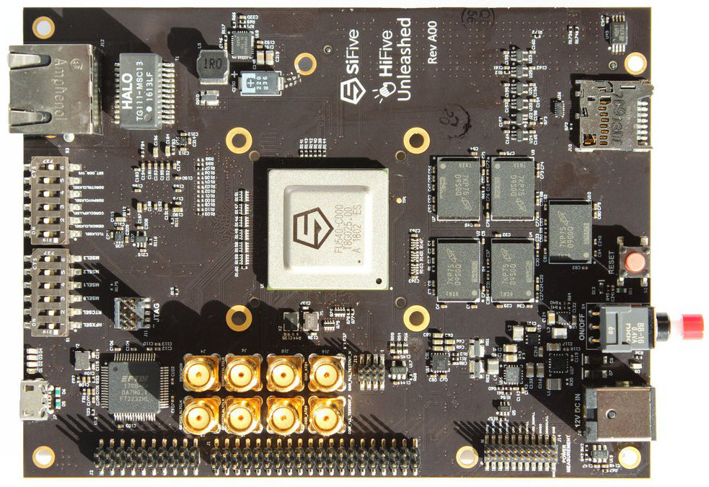
RISC-V Available Cores
See https://riscv.org/exchange/cores-socs/
https://en.wikipedia.org/wiki/RISC-V#Implementations

Slide 9
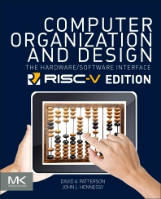
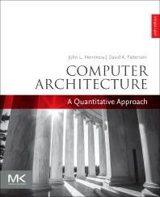

RISC-V За Textbooks
David Patterson, John Hennessy. Computer Organization and Design RISC-V Edition: The Hardware Software Interface. 1st Edition. 2017
John Hennessy David Patterson. Computer Architecture: A Quantitative Approach. 6th Edition. 2017.
David Patterson, Andrew Waterman. The RISC-V Reader: An Open Architecture Atlas. 1st Editions. 2017.

Slide 10
RISC-V References
https://en.wikipedia.org/wiki/RISC-V
https://riscv.org/
https://riscv.org/technical/specifications/
https://github.com/riscv
https://www.sifive.com/
https://pulp-platform.org/
https://github.com/pulp-platform

Slide 11
Thank You! Questions?
.text
__start: addi t1, zero, 0x18
addi t2, zero, 0x21
cycle: beq t1, t2, done
slt t0, t1, t2
bne t0, zero, if_less
nop
sub t1, t1, t2
j cycle
nop
if_less: sub t2, t2, t1
j cycle
done: add t3, t1, zero

