Slide 1
Computer Architecture and Operating Systems Lecture 5: Assembly Programming – Branches and Arrays
Andrei Tatarnikov
atatarnikov@hse.ru
@andrewt0301

Slide 2
Program Structure and Memory Layout
0x 7FFF EFFC
Stack
Dynamic Data
.data
hello:
.string "Hello, world!"
.text
main:
li a7, 4
la a0, hello
ecall
0x1004 0000
.data
0x 1001 0000
.text
0x 0040 0000
Reserved
0x 0000 0000

Slide 3
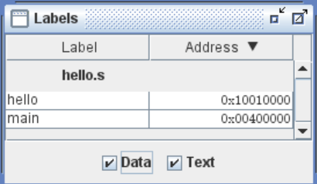
Labels
Labels are symbolic names for addresses (in the .data or .text segment).
Labels are used by control-flow instructions (branches and jumps).
Labels are used by load and store instructions.

Slide 4
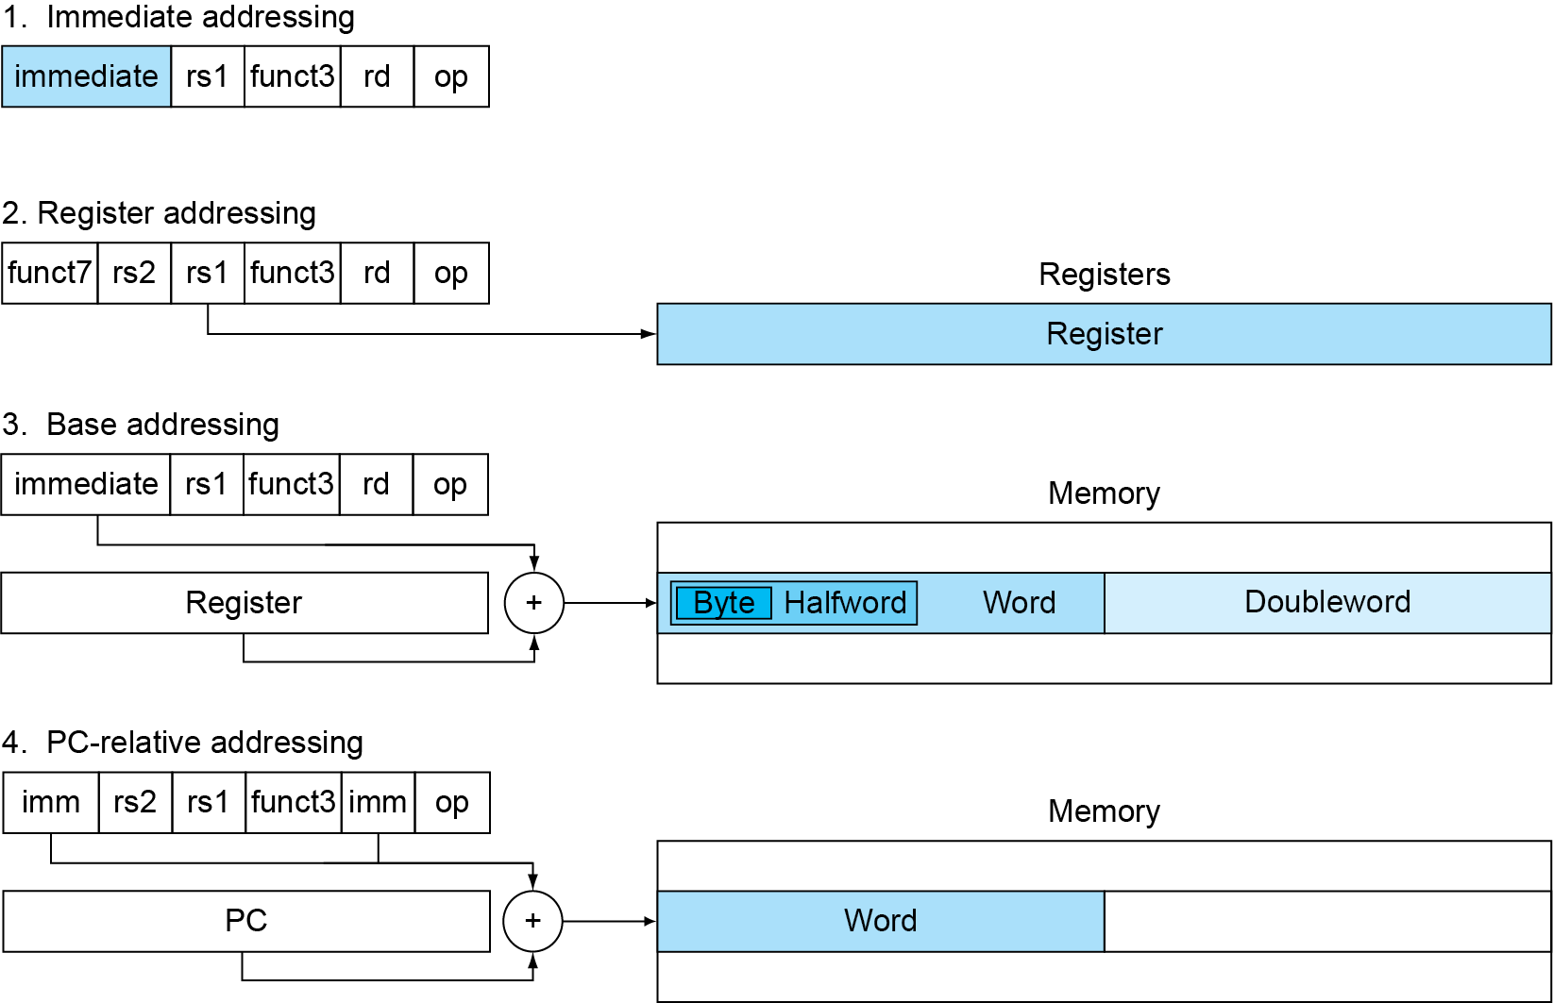
Addressing
Addresses can be represented in several ways

Slide 5
Program Counter
Program Counter (PC) is a special register that stores the address of the currently executed instruction.
When an instruction is executed, the PC is incremented by the size of the instruction (4 bytes) to point to the next instruction.
Branch and jump instructions assign to the PC new addresses to change the control flow.
Branch instructions use PC-relative addresses (increment or decrement current value by an offset).

Slide 6
Branch Instructions
Branch Instructions
Branch = beq rs1, rs2, label
Branch ≠ bne rs1, rs2, label
Branch < blt rs1, rs2, label
Branch ≥ bge rs1, rs2, label
Branch < Unsigned bltu rs1, rs2, label
Branch ≥ Unsigned bgeu rs1, rs2, label

Slide 7
Branch Pseudoinstructions
Branch Pseudoinstructions
Branch unconditionally b label
Branch = 0 beqz t1, label
Branch ≥ 0 bgez t1, label
Branch > bgt t1, t2, label
Branch > Unsigned bgtu t1, t2, label
Branch > 0 bgtz t1, label
Branch ≤ ble t1, t2, label
Branch ≤ Unsigned bleu t1, t2, label
Branch ≤ 0 blez t1, label
Branch < 0 bltz t1, label
Branch ≠ 0 bnez t1, label

Slide 8
How Computer Works
Main Parts:
Control
Datapath
Memory
Input
Output
Computer
CPU
Memory
Devices
Control
“Brain”
Input
Datapath
Registers
Output
Bus

Slide 9
Stored Program Concept
32-bit instructions and data stored in memory
Program is a sequence of instructions
To run a new program:
Simply load the new program into memory
Program Execution:
CPU fetches (reads) instructions from memory in sequence
CPU performs the specified operations

Slide 10
Stored Program Representation
Assembly Code
lw t0, 32 (t1)
add s1, s0, s2
addi t0, s3, -12
sub t0, t3, t5
Machine Code
0x02032283
0x012404B3
0xFF498293
0x41EE02B3
Stored Program
Memory
Address
…
0x00400000
0x00400004
0x00400008
0x0040000С
…
Instructions
…
0x02032283
0x012404B3
0xFF498293
0x41EE02B3
…
Program Counter (PC): keeps track of current instruction

Slide 11
RISC-V Instructions
Name | Description | Version | Status
Base
RVWMO | Weak Memory Ordering | 2.0 | Ratified
RV32I | Base Integer Instruction Set, 32-bit | 2.1 | Ratified
RV64I | Base Integer Instruction Set, 64-bit | 2.1 | Ratified
RV128I | Base Integer Instruction Set, 128-bit | 1.7 | Open
Extensions
M | Standard Extension for Integer Multiplication and Division | 2.0 | Ratified
A | Standard Extension for Atomic Instructions | 2.1 | Ratified
F | Standard Extension for Single-Precision Floating-Point | 2.2 | Ratified
D | Standard Extension for Double-Precision Floating-Point | 2.2 | Ratified
G | Shorthand for the base integer set (I) and above extensions (MAFD) | N/A | N/A
Q | Standard Extension for Quad-Precision Floating-Point | 2.2 | Ratified
C | Standard Extension for Compressed Instructions | 2.0 | Ratified
ZiCSR | Control and Status Register (CSR) | 2.0 | Ratified
Zifencei | Instruction-Fetch Fence | 2.0 | Ratified
And more standard and custom extensions…

Slide 12
Design Principles
Design Principle 1: Simplicity favors regularity
Regularity makes implementation simpler
Simplicity enables higher performance at lower cost
Design Principle 2: Make the common case fast
Most common cases affect the performance the most
Design Principle 3: Smaller is faster
32 registers, fewer instructions
Design Principle 4: Good design demands good compromises
Different formats complicate decoding, but allow 32-bit instructions uniformly
Keep formats as similar as possible

Slide 13
Six Instruction Formats
R-format: instructions using 3 register inputs
add, xor, mul - arithmetic/logical ops
I-format: instructions with immediates, loads
addi, lw, jalr, slli
S-format: store instructions
sw, sb
SB-format: branch instructions
beq, bge
U-format: instructions with upper immediates
lui, auipc - upper immediate is 20-bits
UJ-format: the jump instruction
jal

Slide 14
R-format Instructions
funct7
rs2
rs1
funct3
rd
opcode
7 bits
5 bits
5 bits
3 bits
5 bits
7 bits
add x9, x20, x21
0
21
20
0
9
51
0000000
10101
10100
000
01001
0110011
0000 0001 0101 1010 0000 0100 1011 0011_{two} = 015A04B3₁₆
Arithmetic Instructions
opcode: operation code
rd: destination register number
funct3: 3-bit function code (additional opcode)
rs1 and rs2: first and second source register 5-bit numbers
funct7: 7-bit function code (additional opcode)

Slide 15
I-format Instructions
immediate
rs1
funct3
rd
opcode
12 bits
5 bits
3 bits
5 bits
7 bits
addi t0, t1, 123
0x123
6
0
5
19
000100100011
00110
000
00101
0010011
0001 0010 0011 0011 0000 0010 1001 0011_{two} = 0x12330293₁₆
Immediate arithmetic and load instructions
rs1: source or base address register number
immediate: constant operand, or offset added to base address
2s-complement, sign extended

Slide 16
S-format Instructions
imm[11:5]
rs2
rs1
funct3
imm[4:0]
opcode
7 bits
5 bits
5 bits
3 bits
5 bits
7 bits
sw t0, 4(t1)
0
5
6
2
4
35
0000000
00101
00110
010
00100
100011
0000 0000 0101 0011 0010 0010 0010 0011_{two} = 0x00532223₁₆
Different immediate format for store instructions
rs1: base address register number
rs2: source operand register number
immediate: offset added to base address
Split so that rs1 and rs2 fields always in the same place

Slide 17
SB-format Instructions
imm[10:5]
rs2
rs1
funct3
imm[4:1]
opcode
6 bits
5 bits
5 bits
3 bits
5 bits
7 bits
imm[12]
beq x0, x1, 0x4
imm[11]
1 bit
1 bit
0
0
1
0
0
2
0
99
0
000000
00001
00000
000
0010
0
1100011
0000 0000 0001 0000 0000 0010 0110 0011 _{two} = 00100263 ₁₆
Branch instructions specify
Opcode, two registers, target address
Most branch targets are near branch
Branch range is +/- 4KB
PC-relative addressing
Target address = PC + immediate × 2

Slide 18
U-format Instructions
imm[31:12]
rd
opcode
20 bits
5 bits
lui x5, 0x12345
0x12345
5
55
0001 0010 0011 0100 0101
00101
0110111
0001 0010 0011 0100 0101 0010 1011 0111_{two} = 123452b7₁₆
Upper-immediate values: 20-bit values shifted left by 12 bits
opcode: operation code
rd: destination register number
imm: 20-bit immediate value

Slide 19
UJ-format Instructions
imm[10:1]
imm[19:12]
rd
opcode
imm[20]
10 bits
imm[11]
8 bits
5 bits
7 bits
1 bit
1 bit
jal x5, 0x4
0
2
0
0
5
111
0
0000000010
0
00000000
00101
1101111
0000 0000 0100 0000 0000 0010 1110 1111_{two} = 004002ef₁₆
Jump instructions
opcode: operation code
rd: destination link register
imm: signed offset in multiples of 2 bytes added to PC
Target address = PC + immediate × 2
Jump range is +/- 1MB

Slide 20
RISC-V Addressing Summary

Slide 21
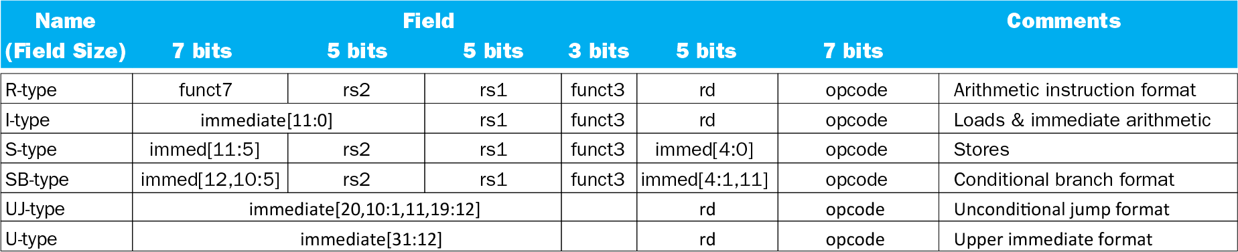
Macros

Slide 22
Any Questions?
.text
__start: addi t1, zero, 0x18
addi t2, zero, 0x21
cycle: beq t1, t2, done
slt t0, t1, t2
bne t0, zero, if_less
nop
sub t1, t1, t2
j cycle
nop
if_less: sub t2, t2, t1
j cycle
done: add t3, t1, zero

