Slide 1
Computer Architecture and Operating Systems Lecture 10: Exceptions. Multiple Issue.
Andrei Tatarnikov
atatarnikov@hse.ru
@andrewt0301

Slide 2
Exceptions and Interrupts
“Unexpected” events requiring change in flow of control
Different ISAs use the terms differently
Exception
Arises within the CPU
e.g., undefined opcode, syscall, …
Interrupt
From an external I/O controller
Dealing with them without sacrificing performance is hard

Slide 3
Handling Exceptions
Save PC of offending (or interrupted) instruction
In RISC-V: Supervisor Exception Program Counter (SEPC)
Save indication of the problem
In RISC-V: Supervisor Exception Cause Register (SCAUSE)
64 bits, but most bits unused
Exception code field: 2 for undefined opcode, 12 for hardware malfunction, …
Jump to handler
Assume at 0000 0000 1C09 0000_{hex}

Slide 4
An Alternate Mechanism
Vectored Interrupts
Handler address determined by the cause
Exception vector address to be added to a vector table base register:
Undefined opcode 00 0100 0000_{two}
Hardware malfunction: 01 1000 0000_{two}
…: …
Instructions either
Deal with the interrupt, or
Jump to real handler

Slide 5
Handler Actions
Read cause, and transfer to relevant handler
Determine action required
If restartable
Take corrective action
Use SEPC to return to program
Otherwise
Terminate program
Report error using SEPC, SCAUSE, …

Slide 6
Exceptions in a Pipeline
Another form of control hazard
Consider malfunction on add in EX stage
add x1, x2, x1
Prevent x1 from being clobbered
Complete previous instructions
Flush add and subsequent instructions
Set SEPC and SCAUSE register values
Transfer control to handler
Similar to mispredicted branch
Use much of the same hardware

Slide 7
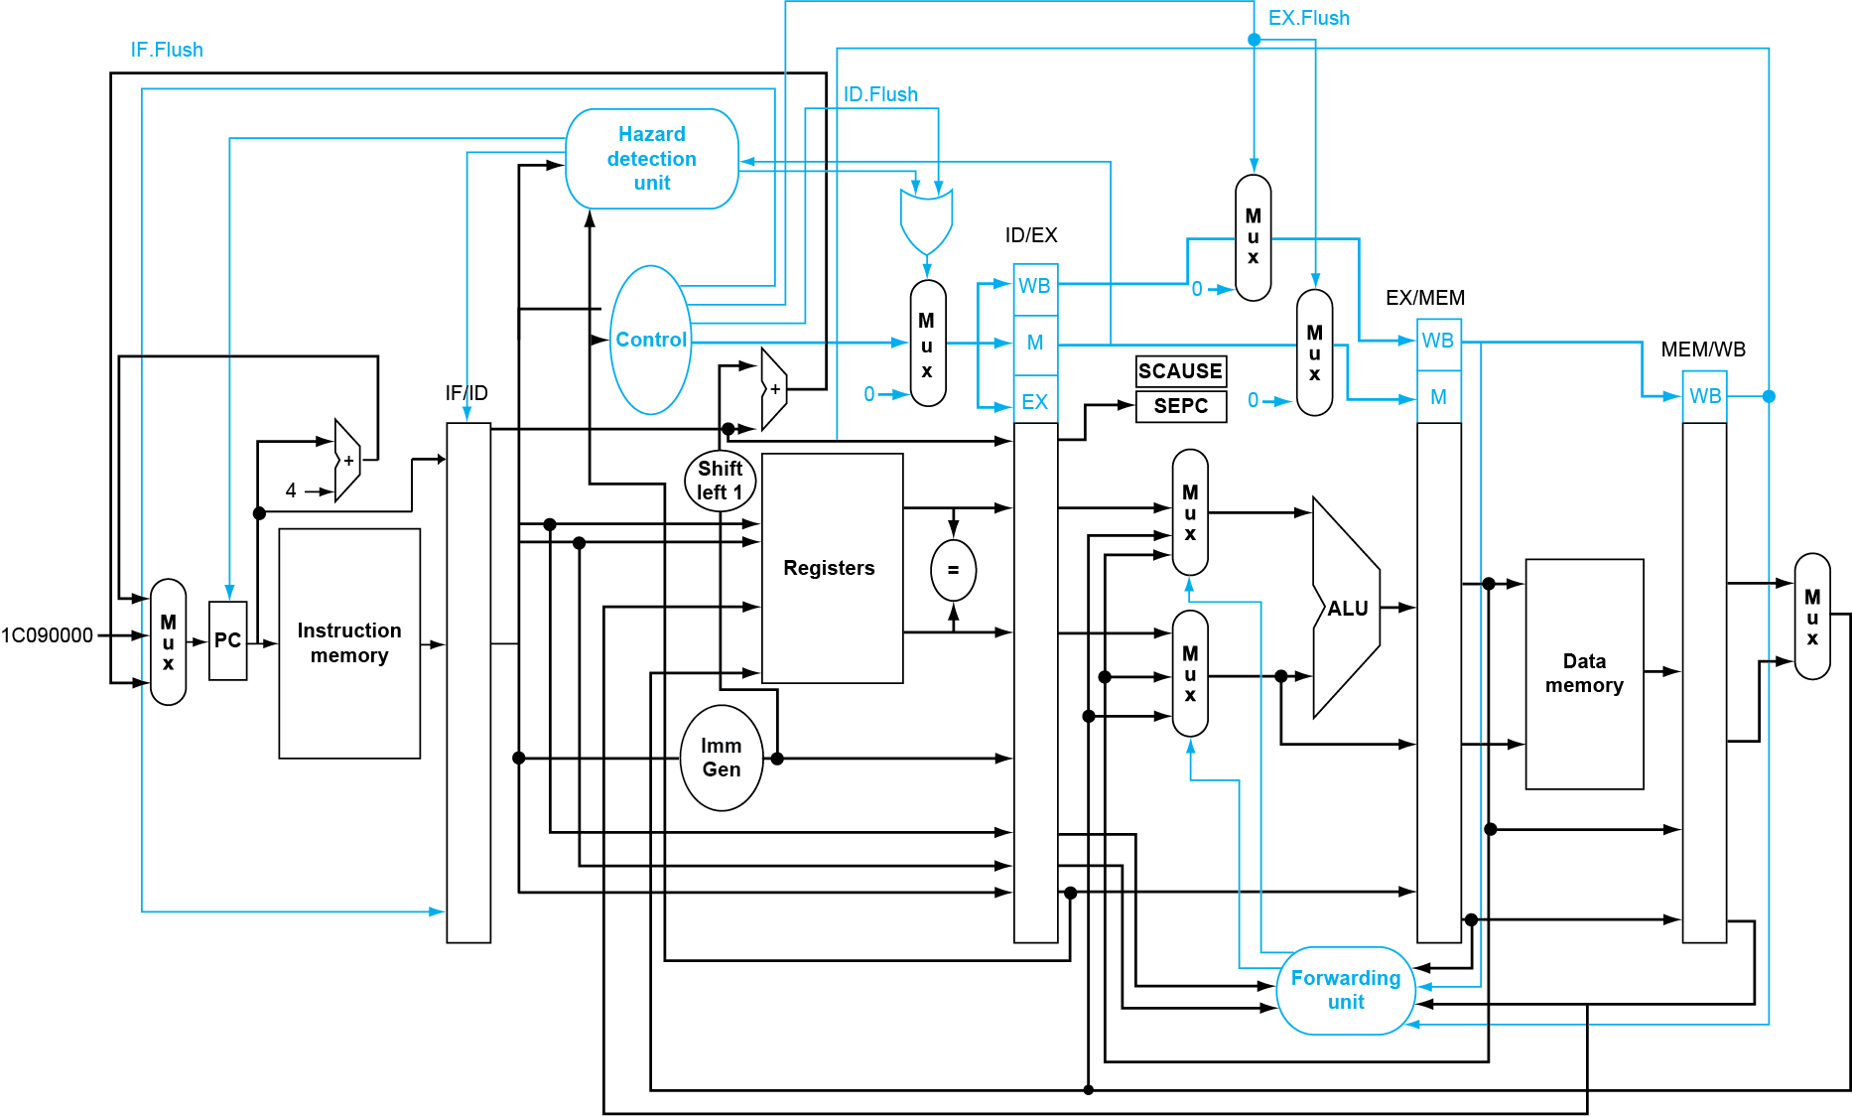
Pipeline with Exceptions

Slide 8
Exception Properties
Restartable exceptions
Pipeline can flush the instruction
Handler executes, then returns to the instruction
Refetched and executed from scratch
PC saved in SEPC register
Identifies causing instruction

Slide 9
Exception Example
Exception on add in
40 sub x11, x2, x4 44 and x12, x2, x5 48 orr x13, x2, x6 4c add x1, x2, x1 50 sub x15, x6, x7 54 ld x16, 100(x7) …
Handler
1C090000 sd x26, 1000(x10) 1c090004 sd x27, 1008(x10) …

Slide 10
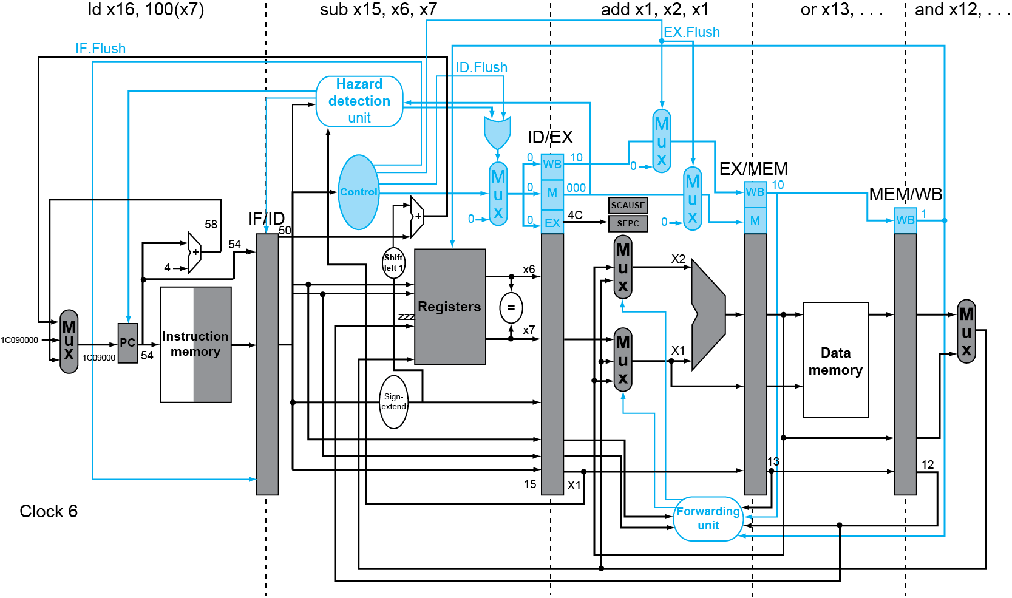
Exception Example

Slide 11
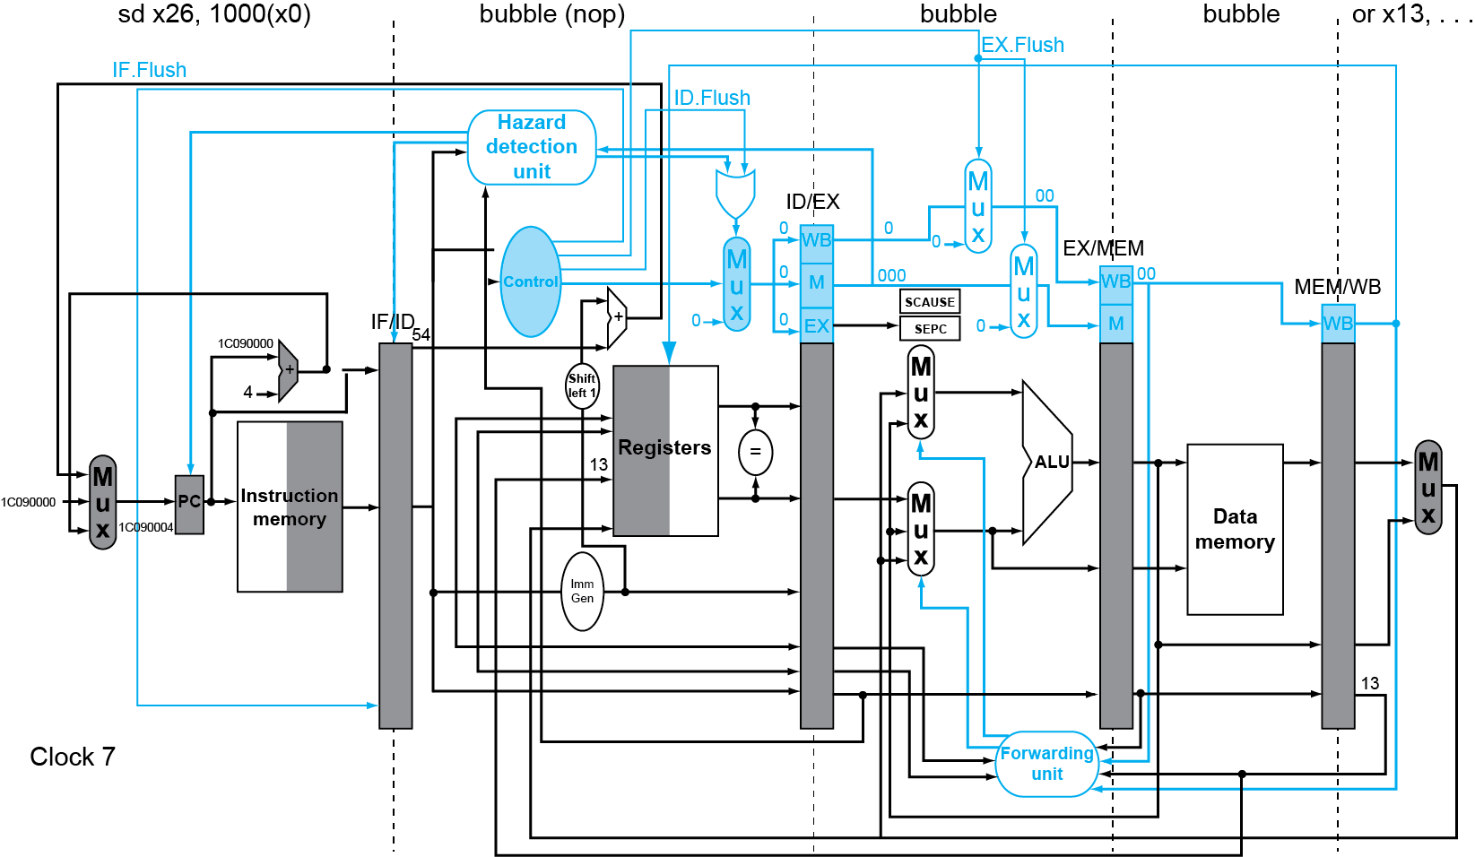
Exception Example

Slide 12
Multiple Exceptions
Pipelining overlaps multiple instructions
Could have multiple exceptions at once
Simple approach: deal with exception from earliest instruction
Flush subsequent instructions
“Precise” exceptions
In complex pipelines
Multiple instructions issued per cycle
Out-of-order completion
Maintaining precise exceptions is difficult!

Slide 13
Imprecise Exceptions
Just stop pipeline and save state
Including exception cause(s)
Let the handler work out
Which instruction(s) had exceptions
Which to complete or flush
May require “manual” completion
Simplifies hardware, but more complex handler software
Not feasible for complex multiple-issue out-of-order pipelines

Slide 14
Instruction-Level Parallelism (ILP)
Pipelining: executing multiple instructions in parallel
To increase ILP
Deeper pipeline
Less work per stage ⇒ shorter clock cycle
Multiple issue
Replicate pipeline stages ⇒ multiple pipelines
Start multiple instructions per clock cycle
CPI < 1, so use Instructions Per Cycle (IPC)
E.g., 4GHz 4-way multiple-issue
16 BIPS, peak CPI = 0.25, peak IPC = 4
But dependencies reduce this in practice

Slide 15
Multiple Issue
Static multiple issue
Compiler groups instructions to be issued together
Packages them into “issue slots”
Compiler detects and avoids hazards
Dynamic multiple issue
CPU examines instruction stream and chooses instructions to issue each cycle
Compiler can help by reordering instructions
CPU resolves hazards using advanced techniques at runtime

Slide 16
Speculation
“Guess” what to do with an instruction
Start operation as soon as possible
Check whether guess was right
If so, complete the operation
If not, roll-back and do the right thing
Common to static and dynamic multiple issue
Examples
Speculate on branch outcome
Roll back if path taken is different
Speculate on load
Roll back if location is updated

Slide 17
Compiler/Hardware Speculation
Compiler can reorder instructions
e.g., move load before branch
Can include “fix-up” instructions to recover from incorrect guess
Hardware can look ahead for instructions to execute
Buffer results until it determines they are actually needed
Flush buffers on incorrect speculation

Slide 18
Static Multiple Issue
Compiler groups instructions into “issue packets”
Group of instructions that can be issued on a single cycle
Determined by pipeline resources required
Think of an issue packet as a very long instruction
Specifies multiple concurrent operations
⇒ Very Long Instruction Word (VLIW)

Slide 19
Scheduling Static Multiple Issue
Compiler must remove some/all hazards
Reorder instructions into issue packets
No dependencies with a packet
Possibly some dependencies between packets
Varies between ISAs; compiler must know!
Pad with nop if necessary

Slide 20
RISC-V with Static Dual Issue
Two-issue packets
One ALU/branch instruction
One load/store instruction
64-bit aligned
ALU/branch, then load/store
Pad an unused instruction with nop
Address | Instruction type | Pipeline Stages
n | ALU/branch | IF | ID | EX | MEM | WB
n + 4 | Load/store | IF | ID | EX | MEM | WB
n + 8 | ALU/branch |  | IF | ID | EX | MEM | WB
n + 12 | Load/store |  | IF | ID | EX | MEM | WB
n + 16 | ALU/branch |  |  | IF | ID | EX | MEM | WB
n + 20 | Load/store |  |  | IF | ID | EX | MEM | WB

Slide 21
Dynamic Multiple Issue
“Superscalar” processors
CPU decides whether to issue 0, 1, 2, … each cycle
Avoiding structural and data hazards
Avoids the need for compiler scheduling
Though it may still help
Code semantics ensured by the CPU

Slide 22
Dynamic Pipeline Scheduling
Allow the CPU to execute instructions out of order to avoid stalls
But commit result to registers in order
Example
ld x31,20(x21) add x1,x31,x2 sub x23,x23,x3 andi x5,x23,20
Can start sub while add is waiting for ld

Slide 23
Why Do Dynamic Scheduling?
Why not just let the compiler schedule code?
Not all stalls are predicable
e.g., cache misses
Can’t always schedule around branches
Branch outcome is dynamically determined
Different implementations of an ISA have different latencies and hazards

Slide 24
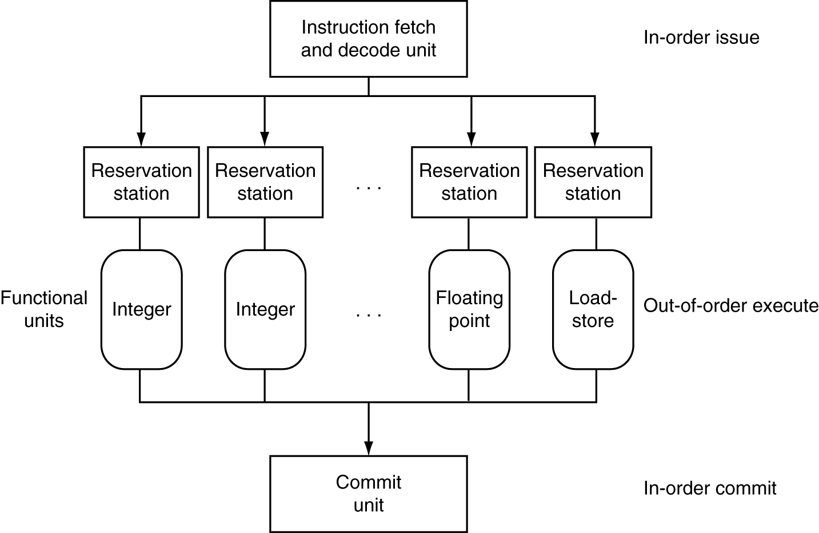
Dynamically Scheduled CPU
Preserves dependencies
Hold pending operands
Results also sent to any waiting reservation stations
Reorders buffer for register writes
Can supply operands for issued instructions

Slide 25
Does Multiple Issue Work?
Yes, but not as much as we’d like
Programs have real dependencies that limit ILP
Some dependencies are hard to eliminate
e.g., pointer aliasing
Some parallelism is hard to expose
Limited window size during instruction issue
Memory delays and limited bandwidth
Hard to keep pipelines full
Speculation can help if done well

Slide 26
Conclusion
ISA influences design of datapath and control
Datapath and control influence design of ISA
Pipelining improves instruction throughput using parallelism
More instructions completed per second
Latency for each instruction not reduced
Hazards: structural, data, control
Multiple issue and dynamic scheduling (ILP)
Dependencies limit achievable parallelism
Complexity leads to the power wall

Slide 27
Any Questions?
.text
__start: addi t1, zero, 0x18
addi t2, zero, 0x21
cycle: beq t1, t2, done
slt t0, t1, t2
bne t0, zero, if_less
nop
sub t1, t1, t2
j cycle
nop
if_less: sub t2, t2, t1
j cycle
done: add t3, t1, zero

