Slide 1
Computer Architecture and Operating Systems Lecture 1: Introduction
Andrei Tatarnikov
atatarnikov@hse.ru
@andrewt0301

Slide 2
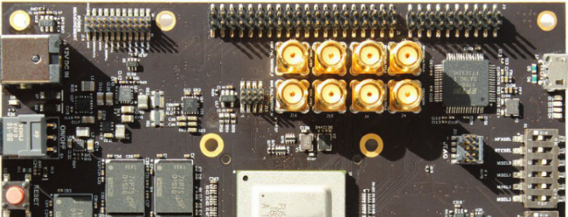
Course Resources
Wiki
http://wiki.cs.hse.ru/ACOS_DSBA_2020/2021
Web site
https://andrewt0301.github.io/hse-acos-course/
Telegram channel
https://t.me/joinchat/AAAAAFDXhCd-WvYYZwBPGQ

Slide 3
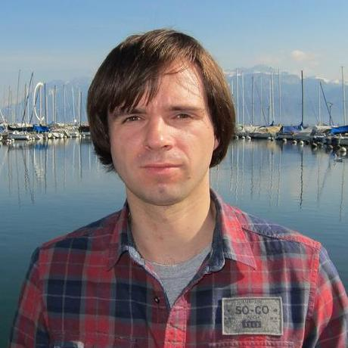
Course Team
Instructors
Andrei Tatarnikov
Assistants
TODO

Slide 4
Course Outline
Syllabus (see the web site for details)
Module 3: Computer Architecture
Computer architecture
Assembly language programming (RISC-V)
Home works, quizzes, and test
Module 4: Operating Systems
Operating System Architecture (Linux)
System programming in C
Home works, quizzes, and test
Final Exam

Slide 5
Course Motivation
Increase your computer literacy
Have an idea how computers under the hood
Better understand performance
Be familiar with system programming
Be familiar with system tools

Slide 6
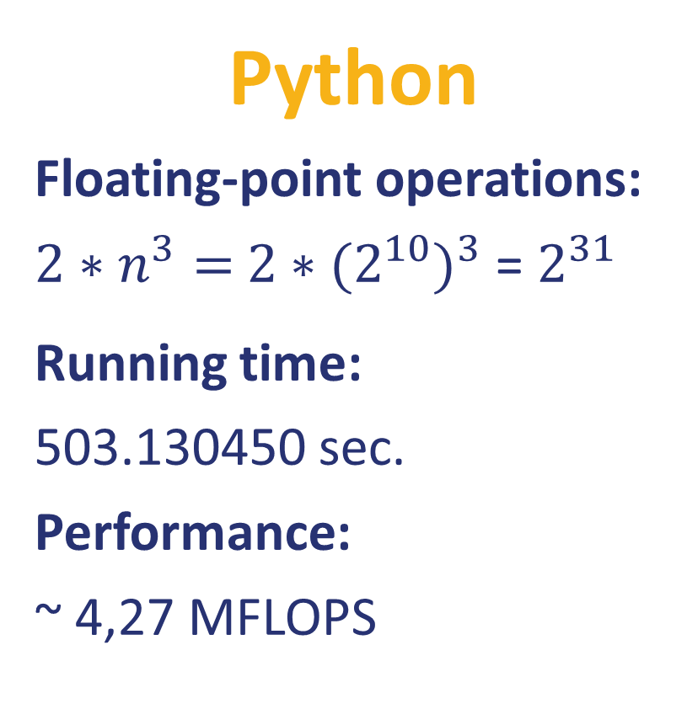
Example: Matrix Multiplication (part 1)
Python
Floating-point operations:
${2∗n}^{3}=$ ${2∗(2^{10})}^{3}$ = $2^{31}$
Running time:
503.130450 sec.
Performance:
~ 4,27 MFLOPS
import random from time import time n = 1024
A = [[random.random() for row in range(n)] for col in range(n)] B = [[random.random() for row in range(n)] for col in range(n)] C = [[0 for row in range(n)] for col in range(n)] start = time() for i in range(n): for j in range(n): for k in range(n): C[i][j] += A[i][k] * B[k][j] end = time() print('%0.6f' % (end - start))

Slide 7
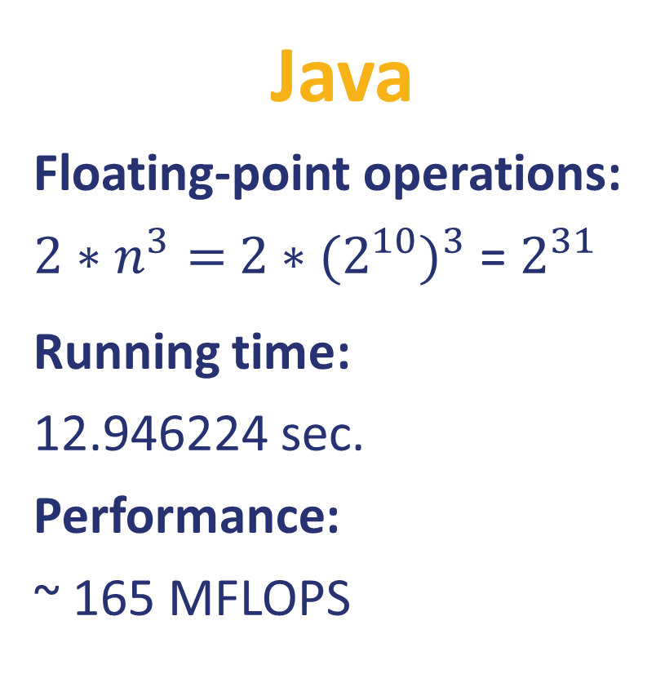
Example: Matrix Multiplication (part 2)
Java
Floating-point operations:
${2∗n}^{3}=$ ${2∗(2^{10})}^{3}$ = $2^{31}$
Running time:
12.946224 sec.
Performance:
~ 165 MFLOPS
public class Matrix { static int n = 1024; static double[][] A = new double[n][n]; static double[][] B = new double[n][n]; static double[][] C = new double[n][n];
public static void main(String[] args) { java.util.Random r = new java.util.Random(); for (int i = 0; i < n; i++) { for (int j = 0; j < n; j++) { A[i][j] = r.nextDouble(); B[i][j] = r.nextDouble(); C[i][j] = 0; } } long start = System.nanoTime(); for (int i = 0; i < n; i++) { for (int j = 0; j < n; j++) { for (int k = 0; k < n; k++) { C[i][j] += A[i][k] * B[k][j]; } } } long stop = System.nanoTime(); System.out.println((stop - start) * 1e-9); } }

Slide 8
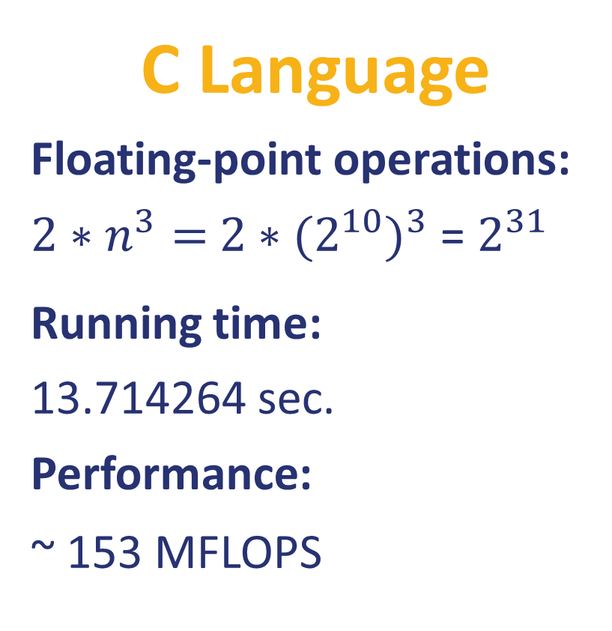
Example: Matrix Multiplication (part 3)
C Language
Floating-point operations:
${2∗n}^{3}=$ ${2∗(2^{10})}^{3}$ = $2^{31}$
Running time:
13.714264 sec.
Performance:
~ 153 MFLOPS
#include <stdlib.h> #include <stdio.h> #include <sys/time.h>
#define n 1024 double A[n][n]; double B[n][n]; double C[n][n];
float tdiff(struct timeval *start, struct timeval *end) { return (end->tv_sec - start->tv_sec) +
1e-6*(end->tv_usec - start->tv_usec); } int main(int argc, const char *argv[]) { for (int i = 0; i < n; i++) { for (int j = 0; j < n; j++) { A[i][j] = (double)rand() / (double)RAND_MAX; B[i][j] = (double)rand() / (double)RAND_MAX; C[i][j] = 0; } } struct timeval start, end; gettimeofday(&start, NULL); for (int i = 0; i < n; i++) { for (int j = 0; j < n; j++) { for (int k = 0; k < n; k++) { C[i][j] += A[i][k] * B[k][j]; } } } gettimeofday(&end, NULL); printf("%0.6f\n", tdiff(&start, &end)); return 0; }

Slide 9
Example: Matrix Multiplication (part 4)
C Language: Optimizations
Loop order: i, j, k
for (int i= 0; i < n; i++) { for (int j= 0; j < n; j++) { for (int k= 0; k < n; k++) { C[i][j]+= A[i][k]*B[k][j]; } } }
Loop order: i, k, j
for (int i= 0; i < n; i++) { for (int k= 0; k < n; k++) { for (int j= 0; j < n; j++) { C[i][j]+= A[i][k]*B[k][j]; } } }
Loop order: k, j, i
for (int i= 0; i < n; i++) { for (int j= 0; j < n; j++) { for (int k= 0; k < n; k++) { C[i][j]+= A[i][k]*B[k][j]; } } }
Running time:
13.714264 sec.
Performance:
~ 153 MFLOPS
Running time:
2.739385 sec.
Performance:
~ 795 MFLOPS
Running time:
19.074106 sec.
Performance:
~ 113 MFLOPS

Slide 10

Example: Matrix Multiplication (part 5)
Feature | Specifiction
Model | MacBook Pro 9,1
Processor Name | Quad-Core Intel Core i7
Processor Speed | 2,3 GHz
Number of Processors | 1
Total Number of Cores | 4
Floating-Point Operations per Cycle | 4
L2 Cache (per Core) | 256 KB
L3 Cache: | 6 MB
Hyper-Threading Technology | Enabled
Memory | 8 GB
Peak = (${2.3∗10}^{9}$) * 1 * 4 * 4 = 36 800 MFLOPS

Slide 11
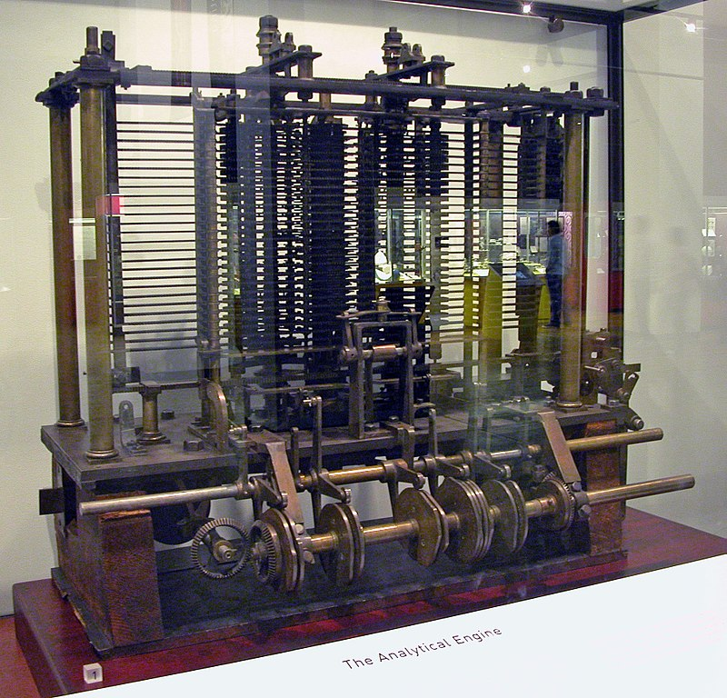
History: 0th Generation – Mechanical
1834 –71: Analytical Engine designed by Charles Babbage
Mechanical gears, where each gear represented a discrete value (0-9)
Programs provided as punched cards
Never finished due to technological restrictions

Slide 12
History: 1st Generation - Vacuum Tubes
1945–55: first machines were created (Atanasoff–Berry, Z3, Colossus, ENIAC)
All programming in pure machine language
Connecting boards and wires, punched cards (later)
Stored program concept
Input
Memory
Arithmetical / Logic Unit
Control Unit
Output

Slide 13
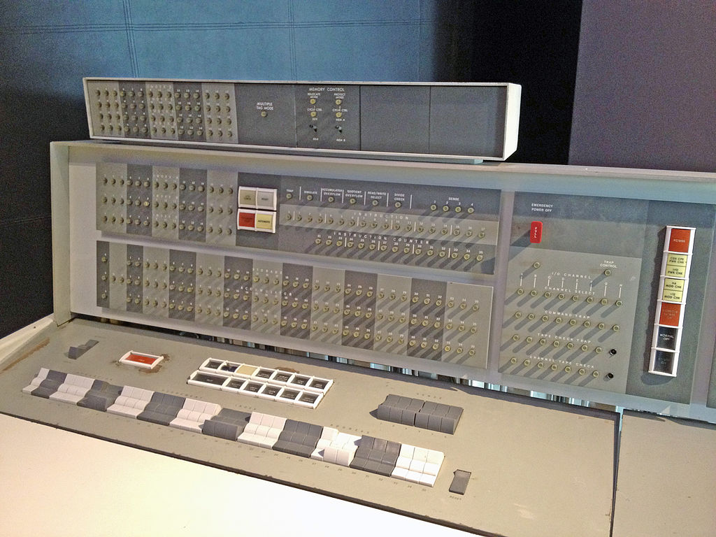
History: 2nd Generation - Transistors
1955-65: era of mainframes (e.g. IBM 7094) used in large companies
Programming in assembly language and FORTRAN
Batch systems (IO was separated from calculations)
Punched cards and magnetic tape
Loaders (OS ancestors)

Slide 14
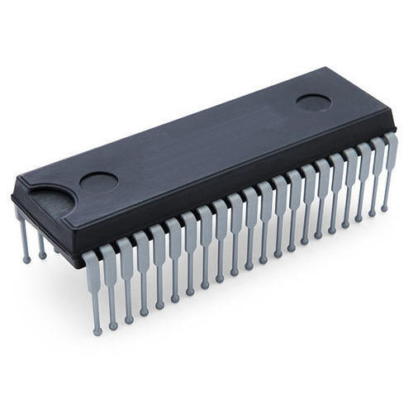
History: 3rd Generation – Integrated Circuits
1965–1980: computer lines using the same instruction set architecture (e.g. IBM 360)
First operating systems (e.g. OS/360, MULTICS)
Multiprogramming and timesharing
Computer as utility
Programming languages and compilers (LISP, BASIC, C)
Job 3
Memory Partitions
Job 2
Job 1
Operating
System

Slide 15
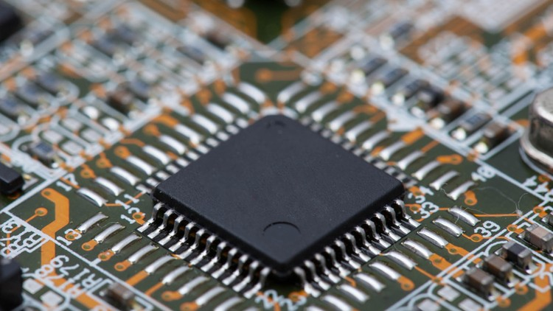
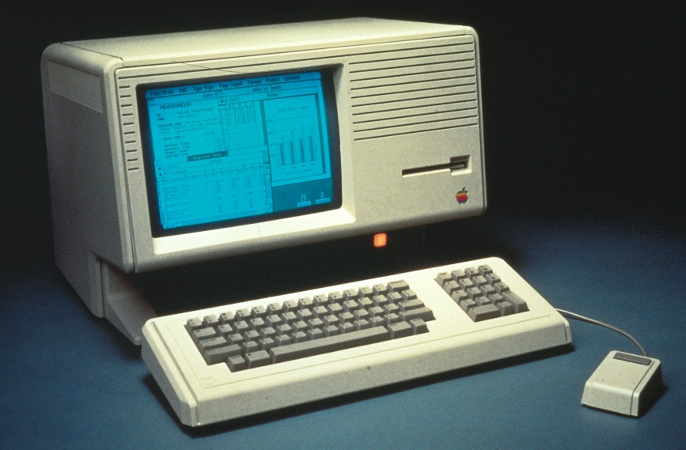
History: 4th Generation – VLSI and PC

Slide 16
History: 5th Generation – Mobile devices

Slide 17
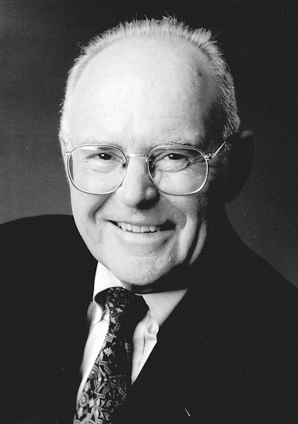
Gordon Moore
Cofounded Intel in 1968 with Robert Noyce.
Moore’s Law: number of transistors on a computer chip doubles every year (observed in 1965)
Since 1975, transistor counts have doubled every two years.

Slide 18
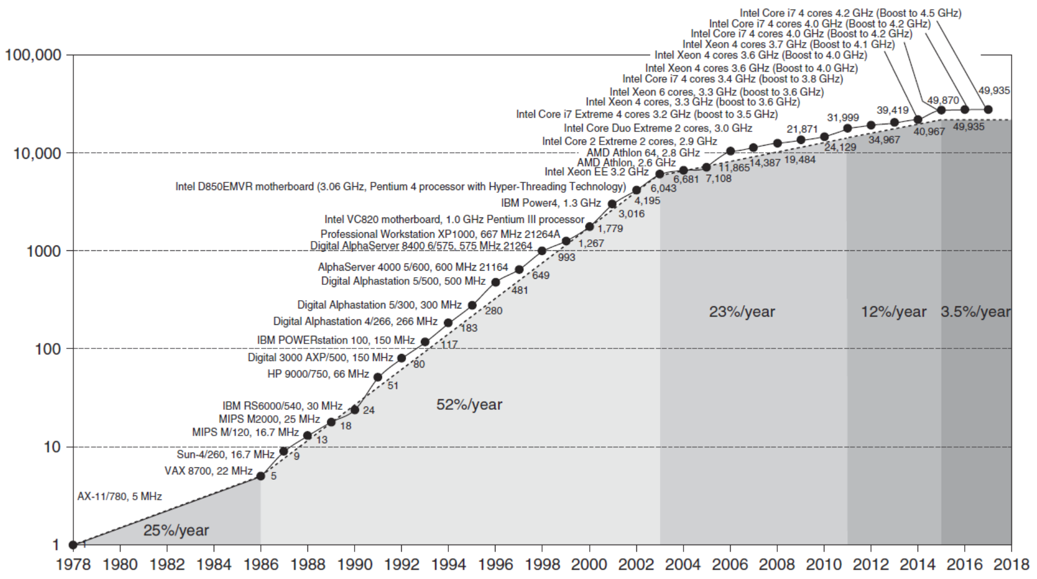
Single Core Performance
Constrained by power, instruction-level parallelism, memory latency

Slide 19
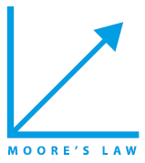







Eight Great Ideas
Design for Moore’s Law
Use abstraction to simplify design
Make the common case fast
Performance via parallelism
Performance via pipelining
Performance via prediction
Hierarchy of memories
Dependability via redundancy

Slide 20
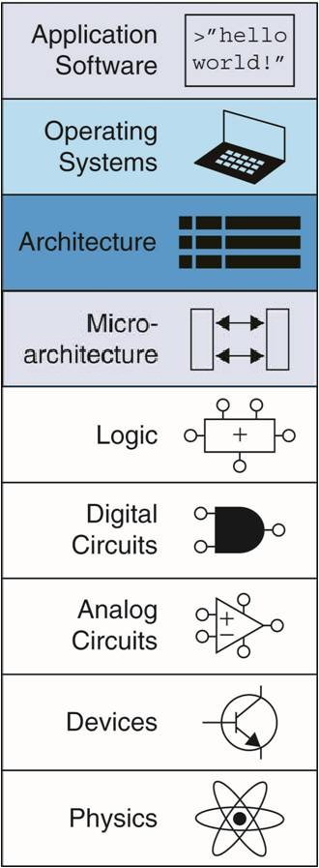
Abstraction
Hiding details when they are not important
Focus
of this course

Slide 21
Any Questions?
.text
__start: addi t1, zero, 0x18
addi t2, zero, 0x21
cycle: beq t1, t2, done
slt t0, t1, t2
bne t0, zero, if_less
nop
sub t1, t1, t2
j cycle
nop
if_less: sub t2, t2, t1
j cycle
done: add t3, t1, zero

