Slide 1
Computer Architecture and Operating Systems Lecture 1: Introduction
Andrei Tatarnikov
atatarnikov@hse.ru
@andrewt0301

Slide 2
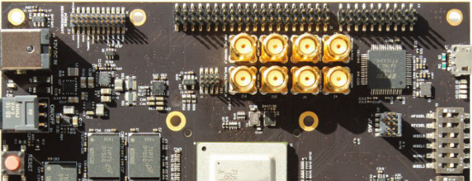
Course Information
Wiki
http://wiki.cs.hse.ru/ACOS_DSBA_2020/2021
Web site
https://andrewt0301.github.io/hse-acos-course/
Telegram channel
https://t.me/joinchat/AAAAAFDXhCd-WvYYZwBPGQ

Slide 3
Course Team
Instructors
TODO
Assistants
TODO

Slide 4
Course Outline
Module 3: Computer Architecture
ssss
Module 4: Operating Systems
ssss

Slide 5
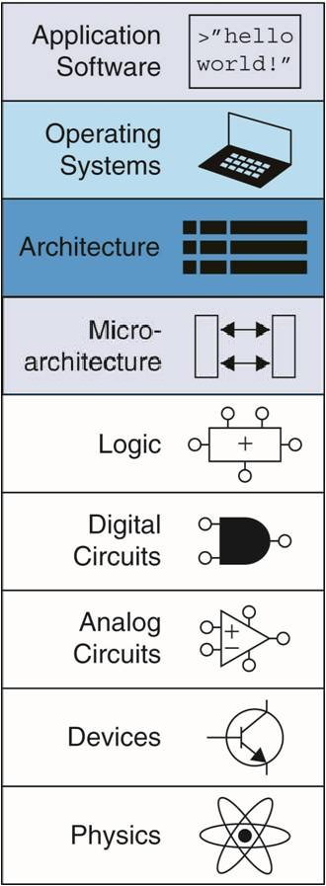
Abstraction
Hiding details when they are not important
Focus
of this course

Slide 6
Any Questions?
.text
__start: addi t1, zero, 0x18
addi t2, zero, 0x21
cycle: beq t1, t2, done
slt t0, t1, t2
bne t0, zero, if_less
nop
sub t1, t1, t2
j cycle
nop
if_less: sub t2, t2, t1
j cycle
done: add t3, t1, zero

