Slide 1
Computer Architecture
A Quantitative Approach, Fifth Edition
Chapter 3
Instruction-Level Parallelism and Its Exploitation

Slide 2
Introduction
Introduction
Pipelining become universal technique in 1985
Overlaps execution of instructions
Exploits “Instruction Level Parallelism”
Beyond this, there are two main approaches:
Hardware-based dynamic approaches
Used in server and desktop processors
Not used as extensively in PMP processors
Compiler-based static approaches
Not as successful outside of scientific applications

Slide 3
Instruction-Level Parallelism
Introduction
When exploiting instruction-level parallelism, goal is to maximize CPI
Pipeline CPI =
Ideal pipeline CPI +
Structural stalls +
Data hazard stalls +
Control stalls
Parallelism with basic block is limited
Typical size of basic block = 3-6 instructions
Must optimize across branches

Slide 4
Data Dependence
Introduction
Loop-Level Parallelism
Unroll loop statically or dynamically
Use SIMD (vector processors and GPUs)
Challenges:
Data dependency
Instruction j is data dependent on instruction i if
Instruction i produces a result that may be used by instruction j
Instruction j is data dependent on instruction k and instruction k is data dependent on instruction i
Dependent instructions cannot be executed simultaneously

Slide 5
Data Dependence
Introduction
Dependencies are a property of programs
Pipeline organization determines if dependence is detected and if it causes a stall
Data dependence conveys:
Possibility of a hazard
Order in which results must be calculated
Upper bound on exploitable instruction level parallelism
Dependencies that flow through memory locations are difficult to detect

Slide 6
Name Dependence
Introduction
Two instructions use the same name but no flow of information
Not a true data dependence, but is a problem when reordering instructions
Antidependence: instruction j writes a register or memory location that instruction i reads
Initial ordering (i before j) must be preserved
Output dependence: instruction i and instruction j write the same register or memory location
Ordering must be preserved
To resolve, use renaming techniques

Slide 7
Other Factors
Introduction
Data Hazards
Read after write (RAW)
Write after write (WAW)
Write after read (WAR)
Control Dependence
Ordering of instruction i with respect to a branch instruction
Instruction control dependent on a branch cannot be moved before the branch so that its execution is no longer controller by the branch
An instruction not control dependent on a branch cannot be moved after the branch so that its execution is controlled by the branch

Slide 8
Examples
Introduction
Example 1:
DADDU R1,R2,R3
BEQZ R4,L
DSUBU R1,R1,R6
L: …
OR R7,R1,R8
Example 2:
DADDU R1,R2,R3
BEQZ R12,skip
DSUBU R4,R5,R6
DADDU R5,R4,R9
skip:
OR R7,R8,R9
OR instruction dependent on DADDU and DSUBU
Assume R4 isn’t used after skip
Possible to move DSUBU before the branch

Slide 9
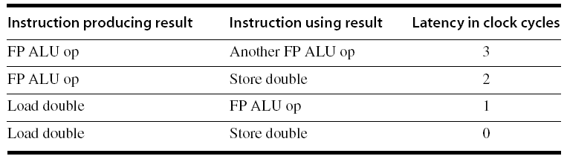
Compiler Techniques for Exposing ILP
Compiler Techniques
Pipeline scheduling
Separate dependent instruction from the source instruction by the pipeline latency of the source instruction
Example:
for (i=999; i>=0; i=i-1)
x[i] = x[i] + s;

Slide 10
Pipeline Stalls
Compiler Techniques
Loop: L.D F0,0(R1)
stall
ADD.D F4,F0,F2
stall
stall
S.D F4,0(R1)
DADDUI R1,R1,#-8
stall (assume integer load latency is 1)
BNE R1,R2,Loop

Slide 11
Pipeline Scheduling
Compiler Techniques
Scheduled code:
Loop: L.D F0,0(R1)
DADDUI R1,R1,#-8
ADD.D F4,F0,F2
stall
stall
S.D F4,8(R1)
BNE R1,R2,Loop

Slide 12
Loop Unrolling
Compiler Techniques
Loop unrolling
Unroll by a factor of 4 (assume # elements is divisible by 4)
Eliminate unnecessary instructions
Loop: L.D F0,0(R1)
ADD.D F4,F0,F2
S.D F4,0(R1) ;drop DADDUI & BNE
L.D F6,-8(R1)
ADD.D F8,F6,F2
S.D F8,-8(R1) ;drop DADDUI & BNE
L.D F10,-16(R1)
ADD.D F12,F10,F2
S.D F12,-16(R1) ;drop DADDUI & BNE
L.D F14,-24(R1)
ADD.D F16,F14,F2
S.D F16,-24(R1)
DADDUI R1,R1,#-32
BNE R1,R2,Loop
note: number of live registers vs. original loop

Slide 13
Loop Unrolling/Pipeline Scheduling
Compiler Techniques
Pipeline schedule the unrolled loop:
Loop: L.D F0,0(R1)
L.D F6,-8(R1)
L.D F10,-16(R1)
L.D F14,-24(R1)
ADD.D F4,F0,F2
ADD.D F8,F6,F2
ADD.D F12,F10,F2
ADD.D F16,F14,F2
S.D F4,0(R1)
S.D F8,-8(R1)
DADDUI R1,R1,#-32
S.D F12,16(R1)
S.D F16,8(R1)
BNE R1,R2,Loop

Slide 14
Strip Mining
Compiler Techniques
Unknown number of loop iterations?
Number of iterations = n
Goal: make k copies of the loop body
Generate pair of loops:
First executes n mod k times
Second executes n / k times
“Strip mining”

Slide 15
Branch Prediction
Branch Prediction
Basic 2-bit predictor:
For each branch:
Predict taken or not taken
If the prediction is wrong two consecutive times, change prediction
Correlating predictor:
Multiple 2-bit predictors for each branch
One for each possible combination of outcomes of preceding n branches
Local predictor:
Multiple 2-bit predictors for each branch
One for each possible combination of outcomes for the last n occurrences of this branch
Tournament predictor:
Combine correlating predictor with local predictor

Slide 16
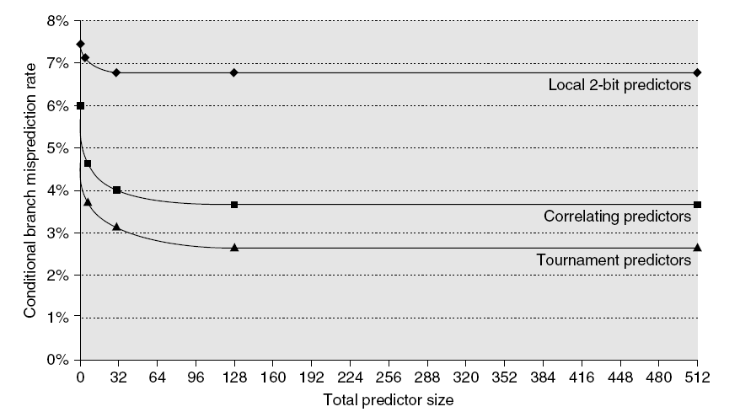
Branch Prediction Performance
Branch Prediction
Branch predictor performance

Slide 17
Dynamic Scheduling
Branch Prediction
Rearrange order of instructions to reduce stalls while maintaining data flow
Advantages:
Compiler doesn’t need to have knowledge of microarchitecture
Handles cases where dependencies are unknown at compile time
Disadvantage:
Substantial increase in hardware complexity
Complicates exceptions

Slide 18
Dynamic Scheduling
Branch Prediction
Dynamic scheduling implies:
Out-of-order execution
Out-of-order completion
Creates the possibility for WAR and WAW hazards
Tomasulo’s Approach
Tracks when operands are available
Introduces register renaming in hardware
Minimizes WAW and WAR hazards

Slide 19
Register Renaming
Branch Prediction
Example:
DIV.D F0,F2,F4
ADD.D F6,F0,F8
S.D F6,0(R1)
SUB.D F8,F10,F14
MUL.D F6,F10,F8
+ name dependence with F6
antidependence
antidependence

Slide 20
Register Renaming
Branch Prediction
Example:
DIV.D F0,F2,F4
ADD.D S,F0,F8
S.D S,0(R1)
SUB.D T,F10,F14
MUL.D F6,F10,T
Now only RAW hazards remain, which can be strictly ordered

Slide 21
Register Renaming
Branch Prediction
Register renaming is provided by reservation stations (RS)
Contains:
The instruction
Buffered operand values (when available)
Reservation station number of instruction providing the operand values
RS fetches and buffers an operand as soon as it becomes available (not necessarily involving register file)
Pending instructions designate the RS to which they will send their output
Result values broadcast on a result bus, called the common data bus (CDB)
Only the last output updates the register file
As instructions are issued, the register specifiers are renamed with the reservation station
May be more reservation stations than registers

Slide 22
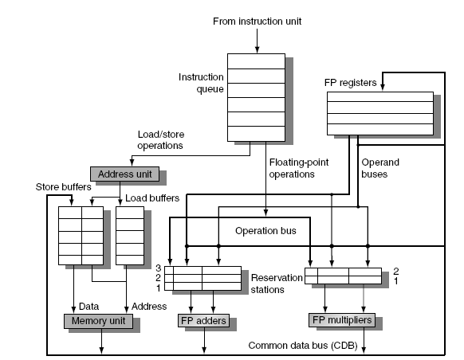
Tomasulo’s Algorithm
Branch Prediction
Load and store buffers
Contain data and addresses, act like reservation stations
Top-level design:

Slide 23
Tomasulo’s Algorithm
Branch Prediction
Three Steps:
Issue
Get next instruction from FIFO queue
If available RS, issue the instruction to the RS with operand values if available
If operand values not available, stall the instruction
Execute
When operand becomes available, store it in any reservation stations waiting for it
When all operands are ready, issue the instruction
Loads and store maintained in program order through effective address
No instruction allowed to initiate execution until all branches that proceed it in program order have completed
Write result
Write result on CDB into reservation stations and store buffers
(Stores must wait until address and value are received)

Slide 24
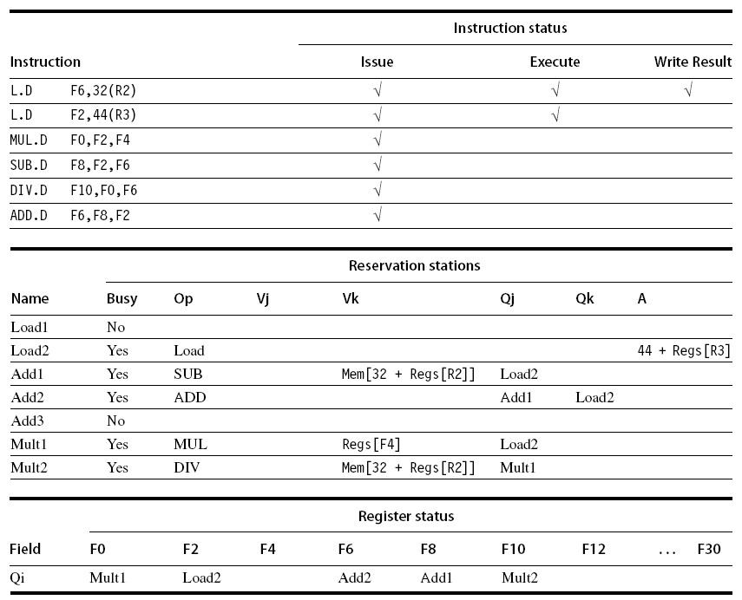
Example
Branch Prediction

Slide 25
Hardware-Based Speculation
Branch Prediction
Execute instructions along predicted execution paths but only commit the results if prediction was correct
Instruction commit: allowing an instruction to update the register file when instruction is no longer speculative
Need an additional piece of hardware to prevent any irrevocable action until an instruction commits
I.e. updating state or taking an execution

Slide 26
Reorder Buffer
Branch Prediction
Reorder buffer – holds the result of instruction between completion and commit
Four fields:
Instruction type: branch/store/register
Destination field: register number
Value field: output value
Ready field: completed execution?
Modify reservation stations:
Operand source is now reorder buffer instead of functional unit

Slide 27
Reorder Buffer
Branch Prediction
Register values and memory values are not written until an instruction commits
On misprediction:
Speculated entries in ROB are cleared
Exceptions:
Not recognized until it is ready to commit

Slide 28
Multiple Issue and Static Scheduling
To achieve CPI < 1, need to complete multiple instructions per clock
Solutions:
Statically scheduled superscalar processors
VLIW (very long instruction word) processors
dynamically scheduled superscalar processors
Multiple Issue and Static Scheduling

Slide 29
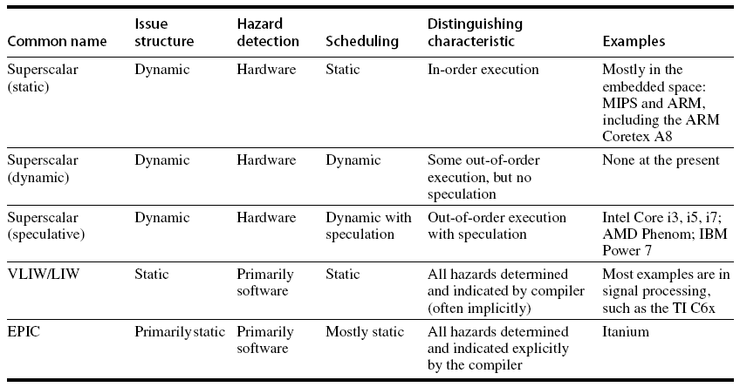
Multiple Issue
Multiple Issue and Static Scheduling

Slide 30
VLIW Processors
Package multiple operations into one instruction
Example VLIW processor:
One integer instruction (or branch)
Two independent floating-point operations
Two independent memory references
Must be enough parallelism in code to fill the available slots
Multiple Issue and Static Scheduling

Slide 31
VLIW Processors
Disadvantages:
Statically finding parallelism
Code size
No hazard detection hardware
Binary code compatibility
Multiple Issue and Static Scheduling

Slide 32
Dynamic Scheduling, Multiple Issue, and Speculation
Modern microarchitectures:
Dynamic scheduling + multiple issue + speculation
Two approaches:
Assign reservation stations and update pipeline control table in half clock cycles
Only supports 2 instructions/clock
Design logic to handle any possible dependencies between the instructions
Hybrid approaches
Issue logic can become bottleneck
Dynamic Scheduling, Multiple Issue, and Speculation

Slide 33
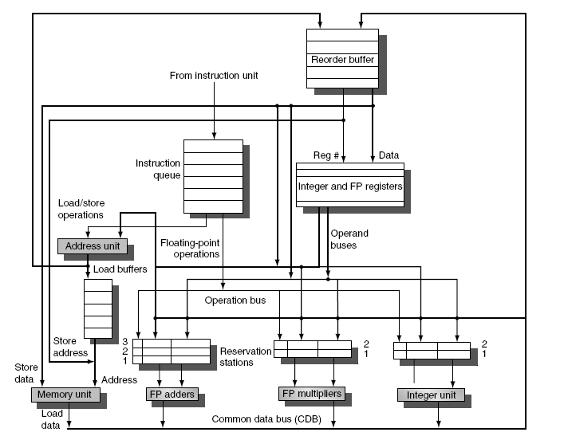
Overview of Design
Dynamic Scheduling, Multiple Issue, and Speculation

Slide 34
Multiple Issue
Limit the number of instructions of a given class that can be issued in a “bundle”
I.e. on FP, one integer, one load, one store
Examine all the dependencies amoung the instructions in the bundle
If dependencies exist in bundle, encode them in reservation stations
Also need multiple completion/commit
Dynamic Scheduling, Multiple Issue, and Speculation

Slide 35
Example
Loop: LD R2,0(R1) ;R2=array element
DADDIU R2,R2,#1 ;increment R2
SD R2,0(R1) ;store result
DADDIU R1,R1,#8 ;increment pointer
BNE R2,R3,LOOP ;branch if not last element
Dynamic Scheduling, Multiple Issue, and Speculation

Slide 36
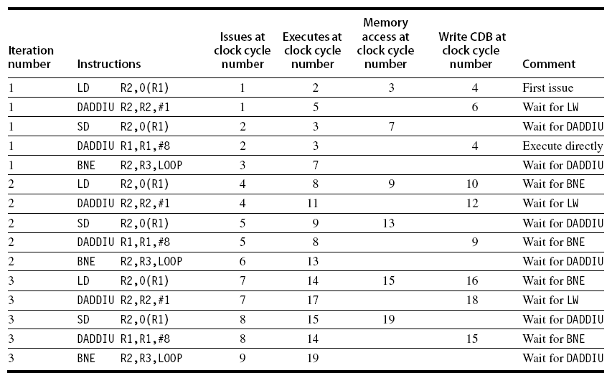
Example (No Speculation)
Dynamic Scheduling, Multiple Issue, and Speculation

Slide 37
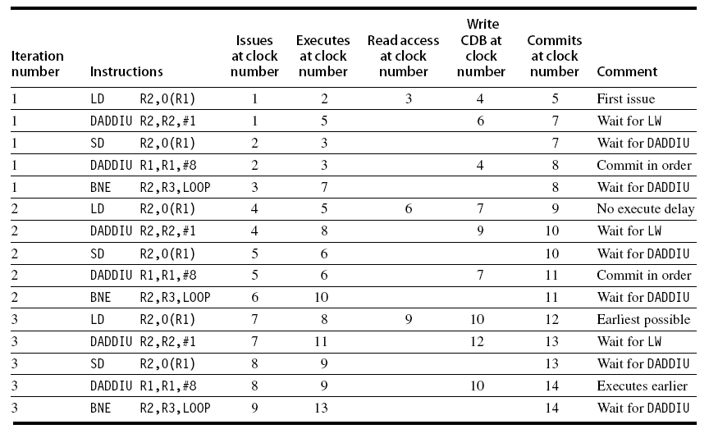
Example
Dynamic Scheduling, Multiple Issue, and Speculation

Slide 38
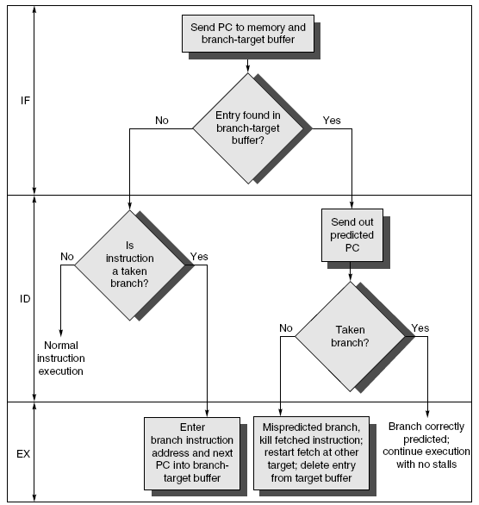
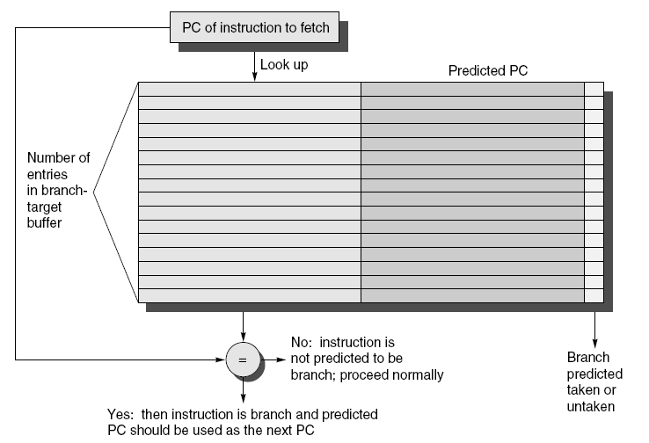
Branch-Target Buffer
Need high instruction bandwidth!
Branch-Target buffers
Next PC prediction buffer, indexed by current PC
Adv. Techniques for Instruction Delivery and Speculation

Slide 39
Branch Folding
Optimization:
Larger branch-target buffer
Add target instruction into buffer to deal with longer decoding time required by larger buffer
“Branch folding”
Adv. Techniques for Instruction Delivery and Speculation

Slide 40
Return Address Predictor
Most unconditional branches come from function returns
The same procedure can be called from multiple sites
Causes the buffer to potentially forget about the return address from previous calls
Create return address buffer organized as a stack
Adv. Techniques for Instruction Delivery and Speculation

Slide 41
Integrated Instruction Fetch Unit
Design monolithic unit that performs:
Branch prediction
Instruction prefetch
Fetch ahead
Instruction memory access and buffering
Deal with crossing cache lines
Adv. Techniques for Instruction Delivery and Speculation

Slide 42
Register Renaming
Register renaming vs. reorder buffers
Instead of virtual registers from reservation stations and reorder buffer, create a single register pool
Contains visible registers and virtual registers
Use hardware-based map to rename registers during issue
WAW and WAR hazards are avoided
Speculation recovery occurs by copying during commit
Still need a ROB-like queue to update table in order
Simplifies commit:
Record that mapping between architectural register and physical register is no longer speculative
Free up physical register used to hold older value
In other words: SWAP physical registers on commit
Physical register de-allocation is more difficult
Adv. Techniques for Instruction Delivery and Speculation

Slide 43
Integrated Issue and Renaming
Combining instruction issue with register renaming:
Issue logic pre-reserves enough physical registers for the bundle (fixed number?)
Issue logic finds dependencies within bundle, maps registers as necessary
Issue logic finds dependencies between current bundle and already in-flight bundles, maps registers as necessary
Adv. Techniques for Instruction Delivery and Speculation

Slide 44
How Much?
How much to speculate
Mis-speculation degrades performance and power relative to no speculation
May cause additional misses (cache, TLB)
Prevent speculative code from causing higher costing misses (e.g. L2)
Speculating through multiple branches
Complicates speculation recovery
No processor can resolve multiple branches per cycle
Adv. Techniques for Instruction Delivery and Speculation

Slide 45
Energy Efficiency
Speculation and energy efficiency
Note: speculation is only energy efficient when it significantly improves performance
Value prediction
Uses:
Loads that load from a constant pool
Instruction that produces a value from a small set of values
Not been incorporated into modern processors
Similar idea--address aliasing prediction--is used on some processors
Adv. Techniques for Instruction Delivery and Speculation

