Slide 1
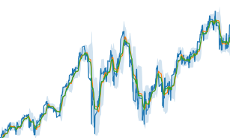
Stock price report
USTEC price, 20SMA, 20EMA,
20Bollinger bands etc.… (11 data)
US
JP
EU
CH
GL
4 weeks
US
JP
EU
CH
GL
US
JP
EU
CH
GL
US
JP
EU
CH
GL
BERT
BERT
BERT
BERT
BERT
4 weeks
BERT
BERT
BERT
BERT
BERT
BERT
BERT
BERT
BERT
BERT
BERT
BERT
BERT
BERT
BERT
[4, 11, 31]
[4, 5, 768]
Transformer
FC
FC
FC
FC
FC
FC
FC
FC
FC
FC
FC
FC
FC
FC
FC
FC
FC
FC
FC
FC
[4, 5, 32]
[1, 256]
FC
FC
Text
Price
[1, 640]
Multi-modal
[1, 128]
True data
Generator
Discriminator
・20 SMA, Bollinger bands.
・Data for the future 80 hours in a 4-hour chart.
Fake data
[20, 3]

Slide 2
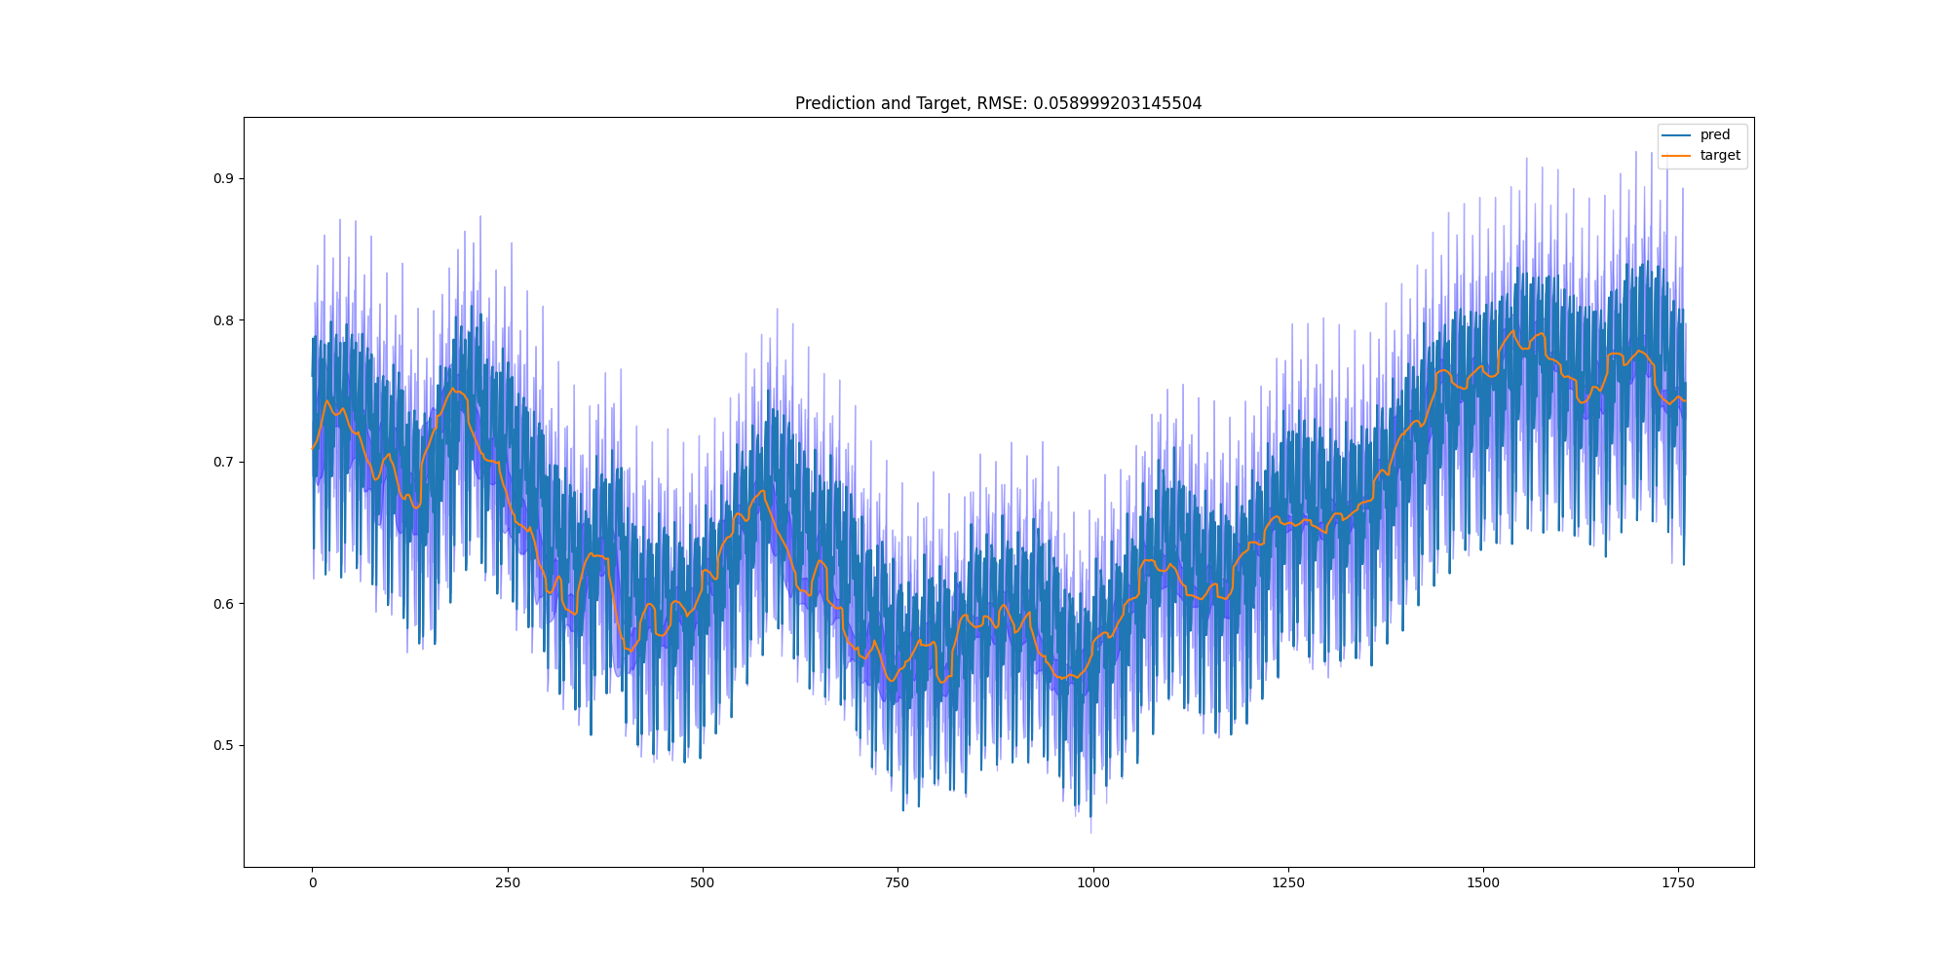
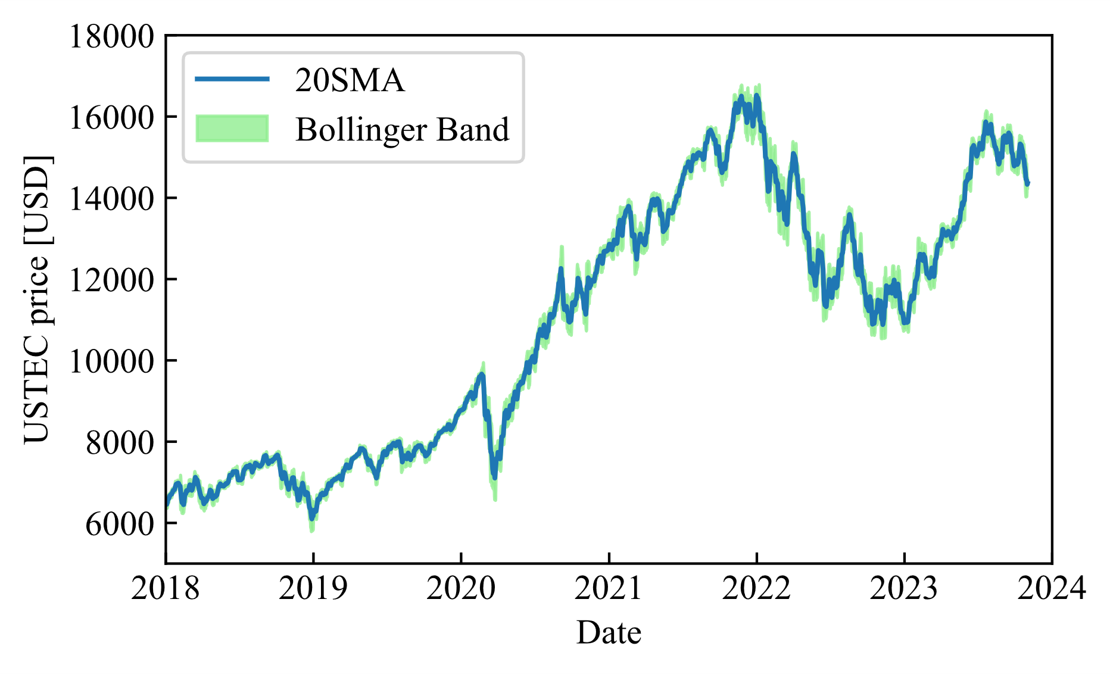
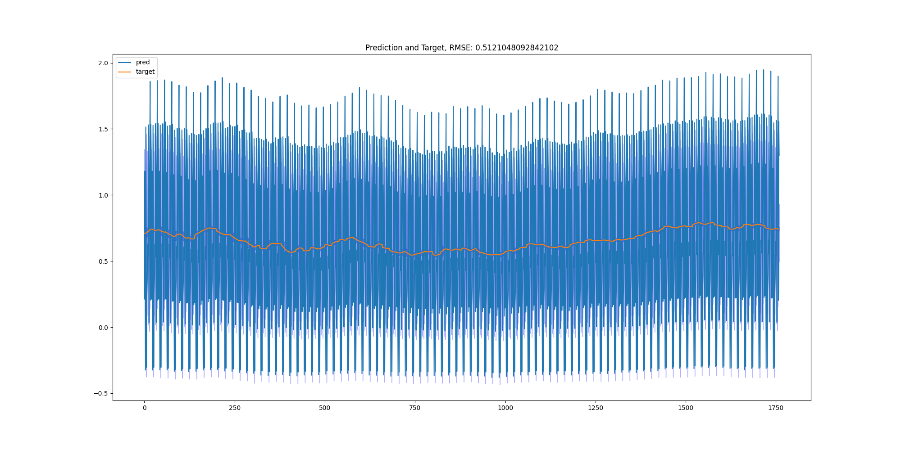
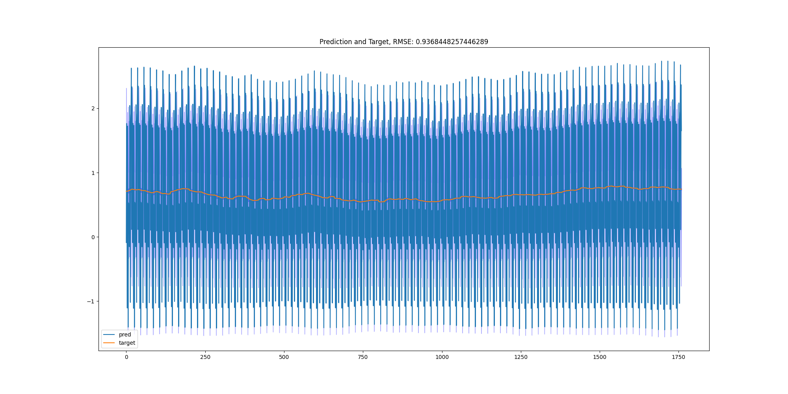
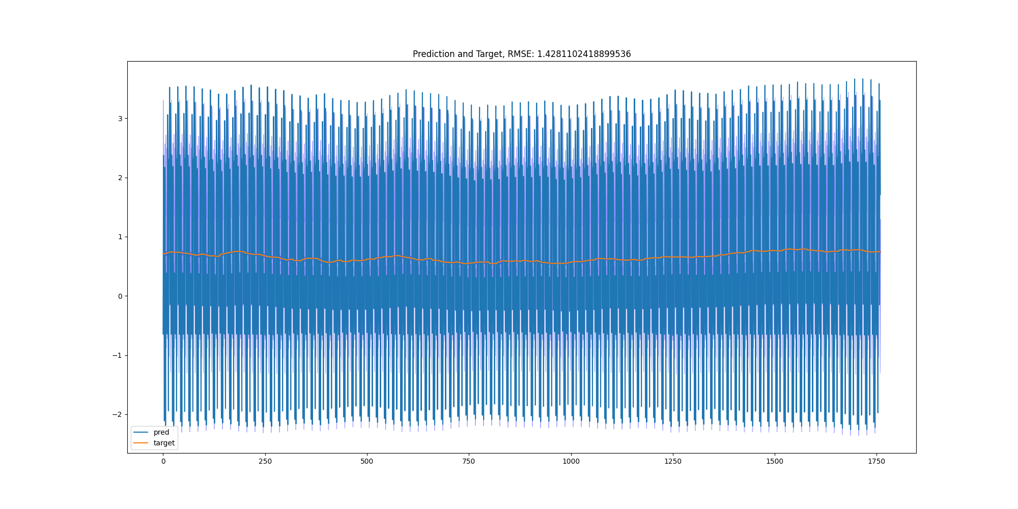
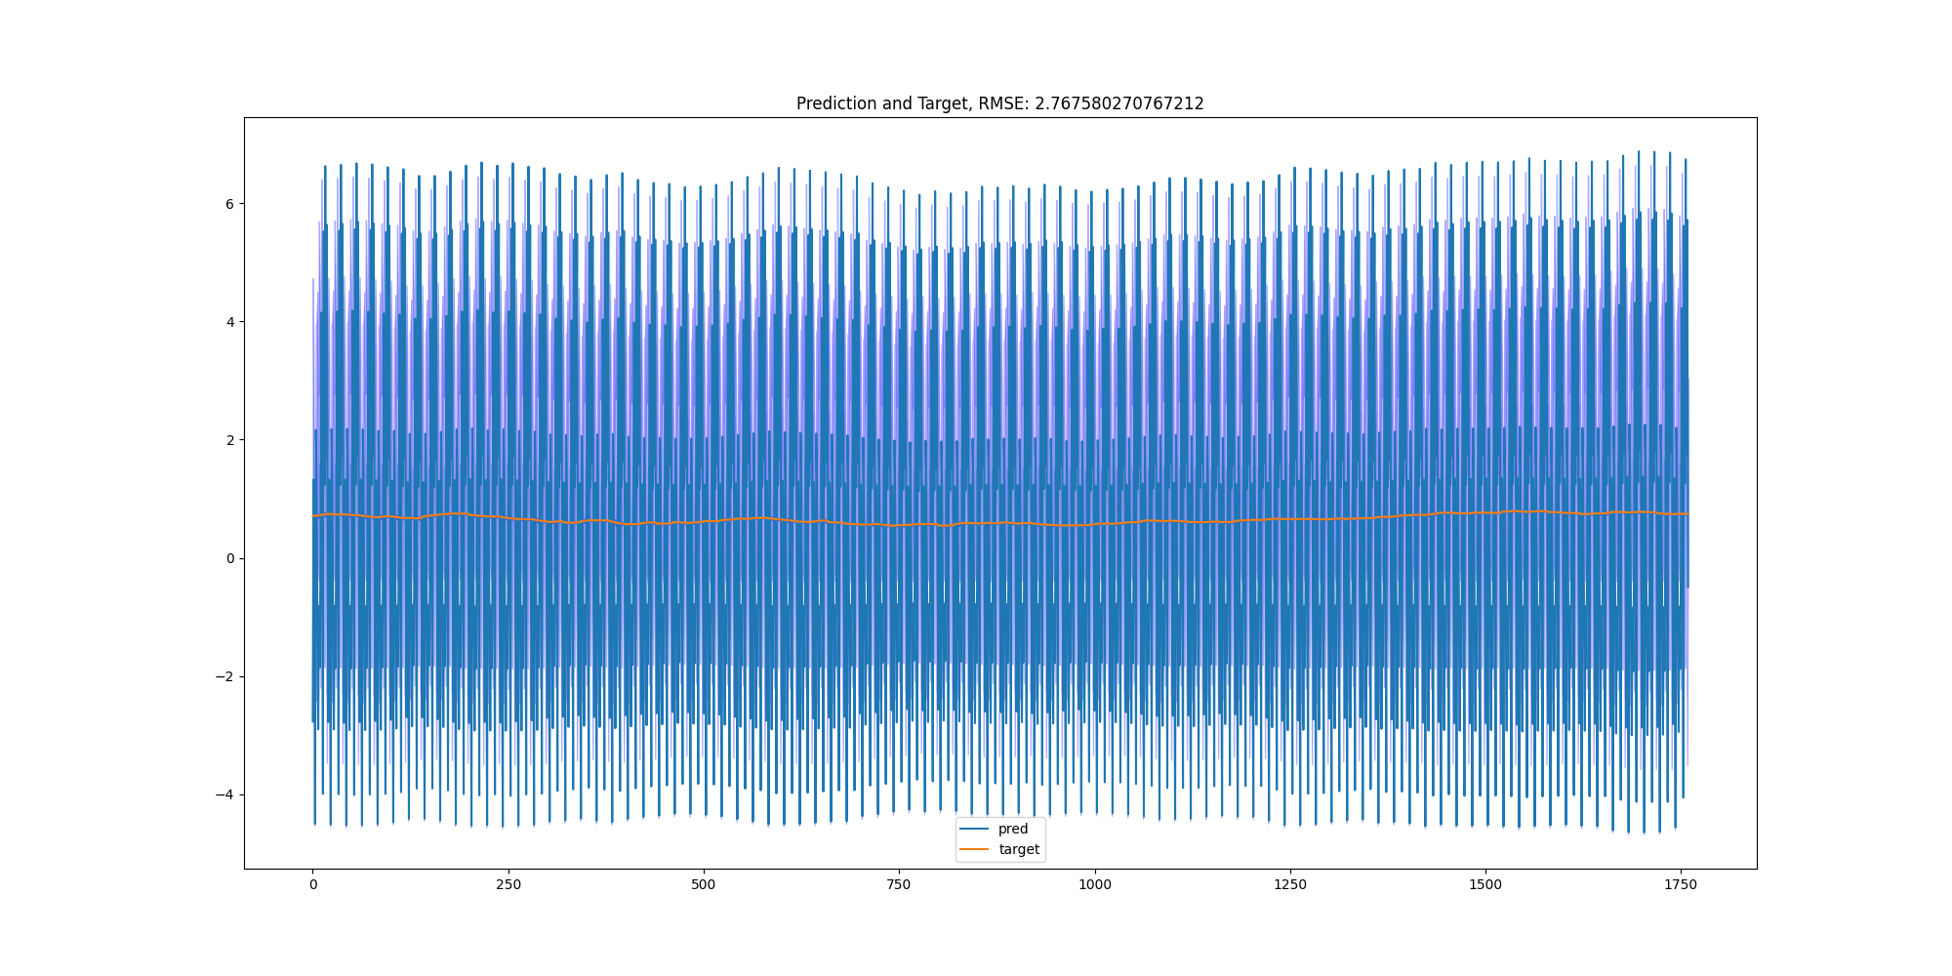
0 epoch
Train
Validation
10 epoch
20 epoch
30 epoch
40 epoch

