Slide 1
Software Architecture Term Project
Group Members: Byron Hodel, Alex Parsons

Slide 2
Demo

Slide 3
Design Explanation - Backend (Server + Database)
Created using Node.js, Express, and Sequelize
Database: PostgreSQL
Routes:
userRoutes
vaultRoutes
Controllers:
userController
vaultController
Models (Tables):
Users
Vault
Notes:
Alex

Slide 4
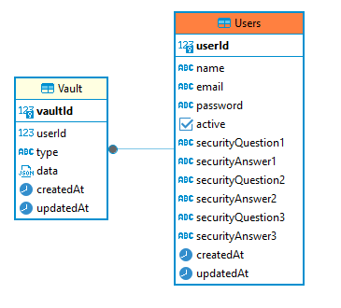
Database Entity Relationship Diagram
Tried to keep it simple:
Table for Users
Table for Vault Entries
Users Passwords are encrypted in the Users table.
With bcrypt.js its very easy to encrypt data
Kept other things unencrypted so it was easy for us to check if things were being properly modified from the frontend to the backend to the DB.
Notes:
Alex

Slide 5
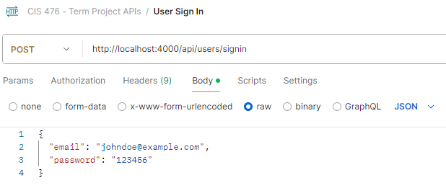
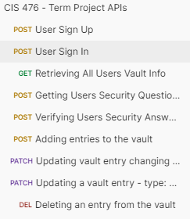
API Testing - Postman
Created various API tests to ensure backend functionality with Postman
Example: User Sign In
Notes:
Alex

Slide 6
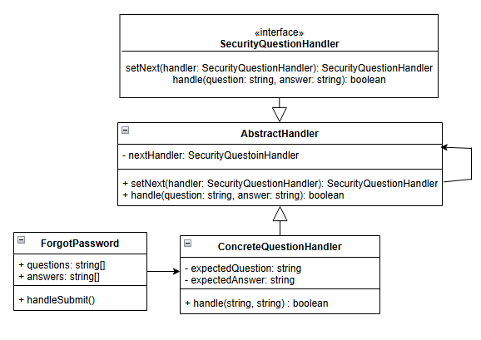
Design Explanation - Master Password Recovery
Master Password Recovery:
Apply the Chain of Responsibility pattern to create a secure process (using three security questions to build the chain) for recovering a forgotten master password.
ForgotPassword.tsx, ConcreteQuetionHandler.ts, and SecurityQuestionHandler.ts
Notes:
Alex

Slide 7
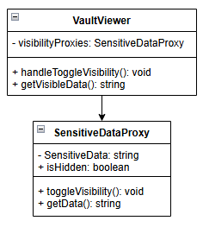


Design Explanation - Data Masking
Data Mask and Unmask:
Implement the Proxy pattern to mask and unmask sensitive data.
SensitiveDataProxy.ts, and VaultViewer.tsx
Notes:
Alex

Slide 8
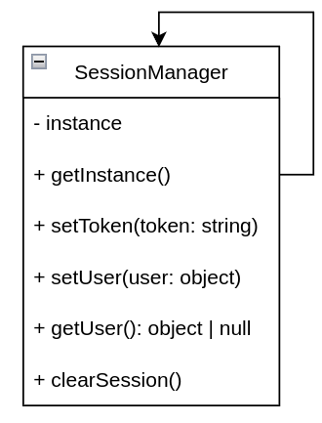
Design Explanation - User Authentication & Encryption
User Authentication and Encryption:
Uses singleton design pattern to manage the user’s session.
Sign-in uses SessionManager.ts
Notes:
Byron

Slide 9
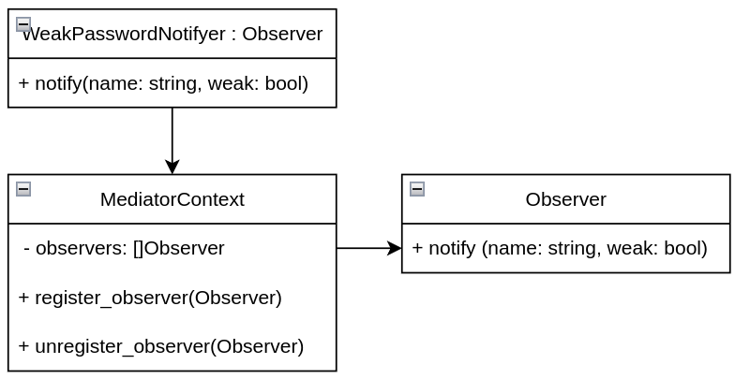
Design Explanation - Password Storage & Management
Password Storage and Management:
Observer callbacks used to notify when passwords are modified, used to determine if there is a weak password.
Notes:
Byron

Slide 10
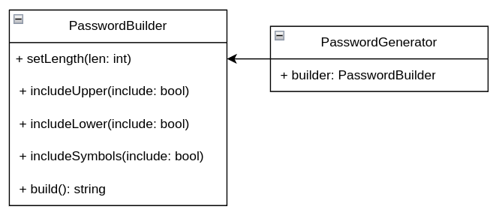
Design Explanation - Password Generator
Password Generation:
Implemented Builder pattern to generate passwords
Password generator component calls into the builder class.
Notes:
Byron

Slide 11
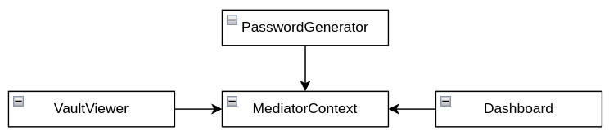
Design Explanation - User Interface & Interaction
User Interface and Interaction:
Uses mediator design pattern to stand between the dashboard and user interface components.
Mediator Context uses password generator and vault viewer while the dashboard uses the mediator context.
Notes:
Byron

Slide 12
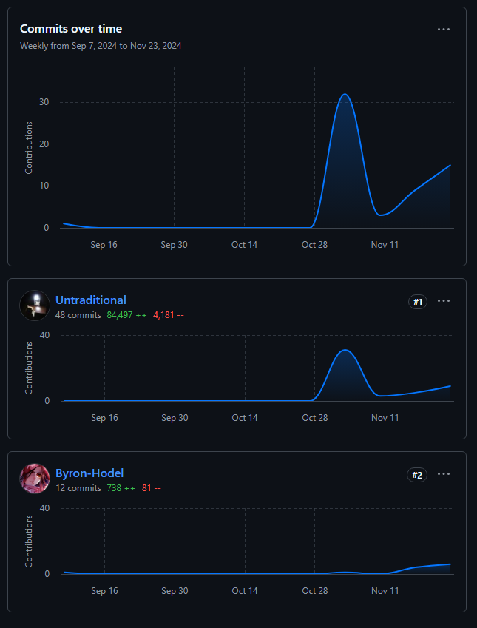
Group Contributions
Alex 80,000+ LOC
Byron 700+ LOC
Initializing npm packages accounts for 90% of the code

Slide 13
Task Summary - Alex
Backend Server + PostgreSQL DB hosting
Created all of the backend server and connecting it to the database properly
Sign-in, Sign-up, Forgot Password, Vault Viewer
Implemented the Next.js template for Sign-in, Sign-up and forgot Password for styling
Dashboard
Not really much to say there, it's pretty simple as it just holds the components
axiosInterceptor.ts
For making API calls to the backend, and including the JWT token automatically
SessionManager.ts
For managing the JWT and Singleton creation

Slide 14
Task Summary - Byron
Password Generator
Implemented the builder pattern and designed the user interface for generating passwords.
Vault Viewer
Implemented functionality to add, modify and delete vault entries.
Dashboard
Added some components to the dashboard
Weak password notifier
Implemented the observer pattern to notify the user of a weak password in the vault

