Slide 1
Natural Sciences: Photosynthesis Learning Pack
Natural Sciences 7 Term 1: Photosynthesis and plant nutrition Grade 7 learners and educators
DIO-FORMAT-GOLDEN-001

Slide 2
Learning Objective
Explain how green plants use light energy, carbon dioxide and water to produce glucose and oxygen.
DIO-FORMAT-GOLDEN-001

Slide 3
1. Core concept
1. Core concept
DIO-FORMAT-GOLDEN-001

Slide 4
Paragraph
Photosynthesis is the process by which chlorophyll-containing plants convert light energy into stored chemical energy. The process takes place mainly in the leaves.
DIO-FORMAT-GOLDEN-001

Slide 5
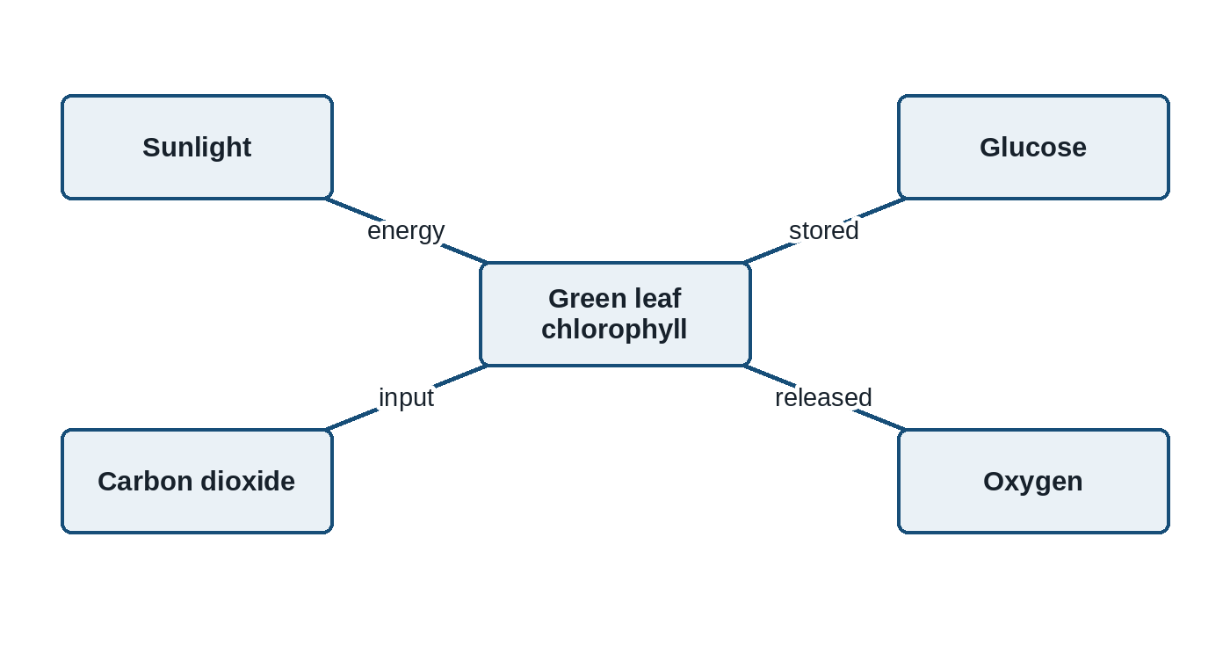
Diagram
Figure 1: Inputs and products of photosynthesis
DIO-FORMAT-GOLDEN-001

Slide 6
Equation
carbon dioxide + water -> glucose + oxygen (in the presence of light and chlorophyll)
DIO-FORMAT-GOLDEN-001

Slide 7
2. Guided investigation
2. Guided investigation
DIO-FORMAT-GOLDEN-001

Slide 8
Teacher Instruction
Prepare one destarched plant and demonstrate the iodine test using the school's approved laboratory safety procedure.
DIO-FORMAT-GOLDEN-001

Slide 9
Learner Instruction
Record the colour observed before and after iodine is added. Do not handle hot ethanol or an open flame.
DIO-FORMAT-GOLDEN-001

Slide 10
Investigation observations
Leaf area | Light exposure | Colour after iodine | Starch present?
Covered section | No direct light | Yellow-brown | No
Exposed section | Direct light | Blue-black | Yes
DIO-FORMAT-GOLDEN-001

Slide 11
Question
Identify the independent variable in this investigation. Marks: 1
DIO-FORMAT-GOLDEN-001

Slide 12
Question
Use the observations to explain why light is necessary for starch production in the leaf. Marks: 3
DIO-FORMAT-GOLDEN-001

Slide 13
3. Assessment rubric
3. Assessment rubric
DIO-FORMAT-GOLDEN-001

Slide 14
Explanation rubric
Criterion | 2 marks | 1 mark | 0 marks
Evidence | Uses both observed colours accurately | Uses one relevant observation | No relevant observation
Reasoning | Links light to starch production | States a partial link | No valid scientific link
DIO-FORMAT-GOLDEN-001

Slide 15
Annexure
Annexure A: Educator memorandum
DIO-FORMAT-GOLDEN-001

Slide 16
Expected Response
2.1 Light exposure. 2.2 Only the exposed area turned blue-black, showing that starch formed where light was available.
DIO-FORMAT-GOLDEN-001

Slide 17
Transcript
Plants do not absorb food from soil. They manufacture glucose through photosynthesis.
DIO-FORMAT-GOLDEN-001

