Slide 1
Marketing Mix Modelling Summary & Recommendations
Byron Han

Slide 2
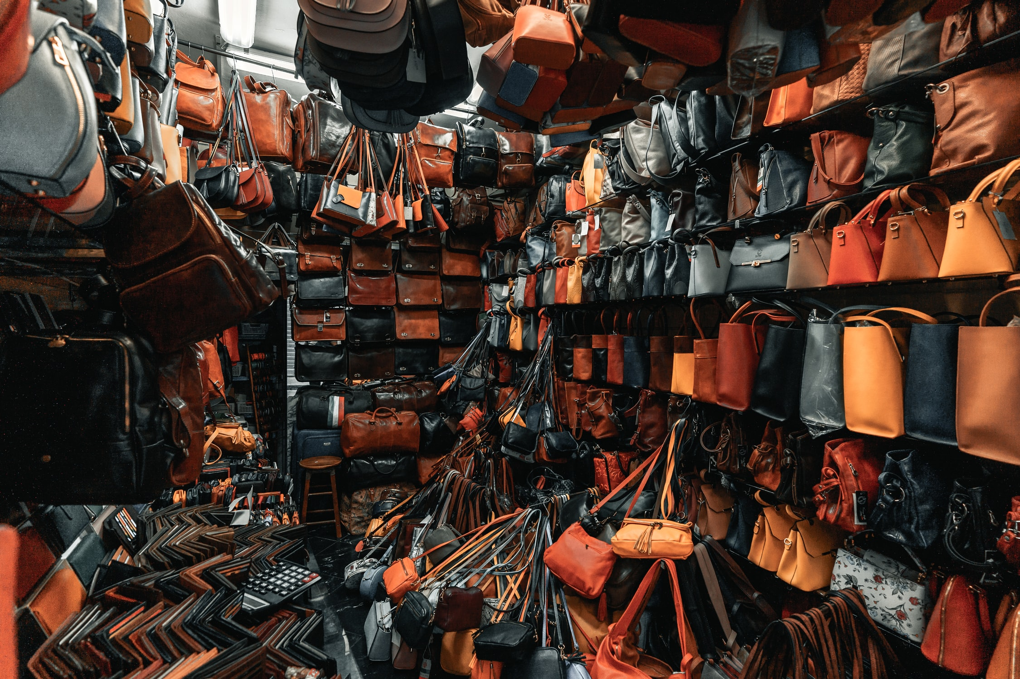
Our client is a US leather good fashion design brand Data are sales, marketing and spending activities from 2014 to 2017

Slide 3
TLDR
In 2017, marketing contributed to 34% of total sales
Traditional channels contributed to 1/3, social media contributed to 1/5.
Overall sales dropped by $395K (-3%), marketing sales dropped by $313K (-6.58%) compared to 2016.
Facebook is the main reason of loss (-$313K, -37%), WeChat performed better (+$73K, 17%).
We spent less on Facebook (-36%), more on WeChat (+17%), Magazine is 50% more expensive.
Facebook Other is more effective and efficiency, we should continue spent more.
In 2018, we can optimize our spending to increase ROI and marketing sales by 36%(+$1.3m) !

Slide 4
Summary of Marketing Performance in 2017 Plan for 2018 Other recommendations
What are the impacts of different marketing channels on our sales?
What are the effectiveness and efficiency (ROI) for each channel?
How should we optimize spending on difference marketing channels in 2018?
What will the predicted sales be in 2018?
How are the marketing channels performing in 2017 compared to 2016?

Slide 5
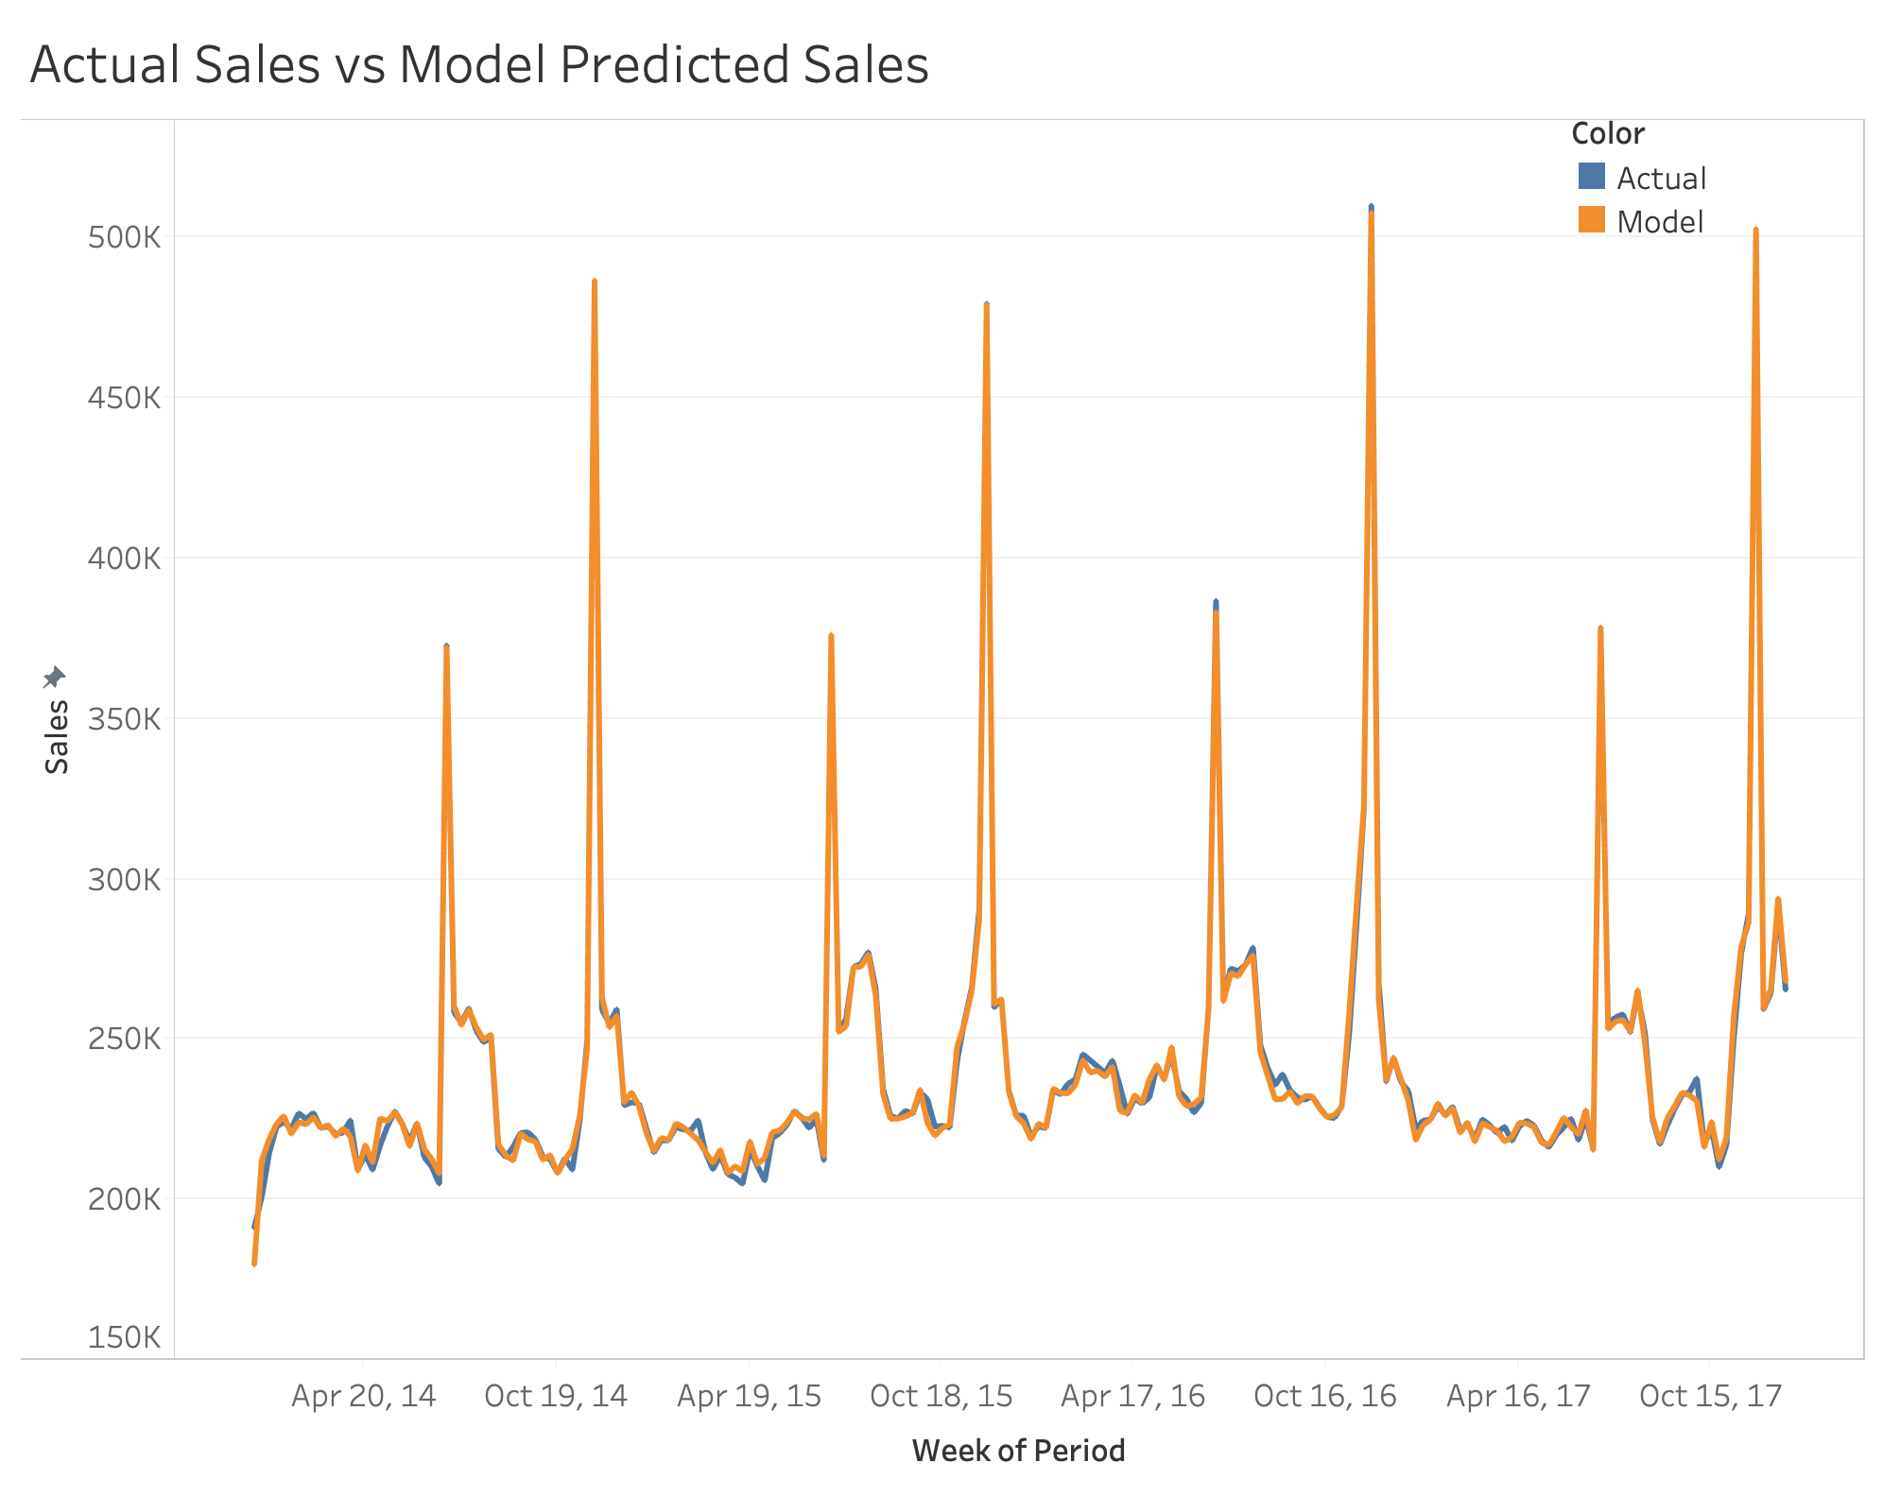
Overall model captured 99.5% of sales variations MAPE: ~0.78% All variables strongly significant (p-value< 0.01) Model statistical details In Appendix

Slide 6
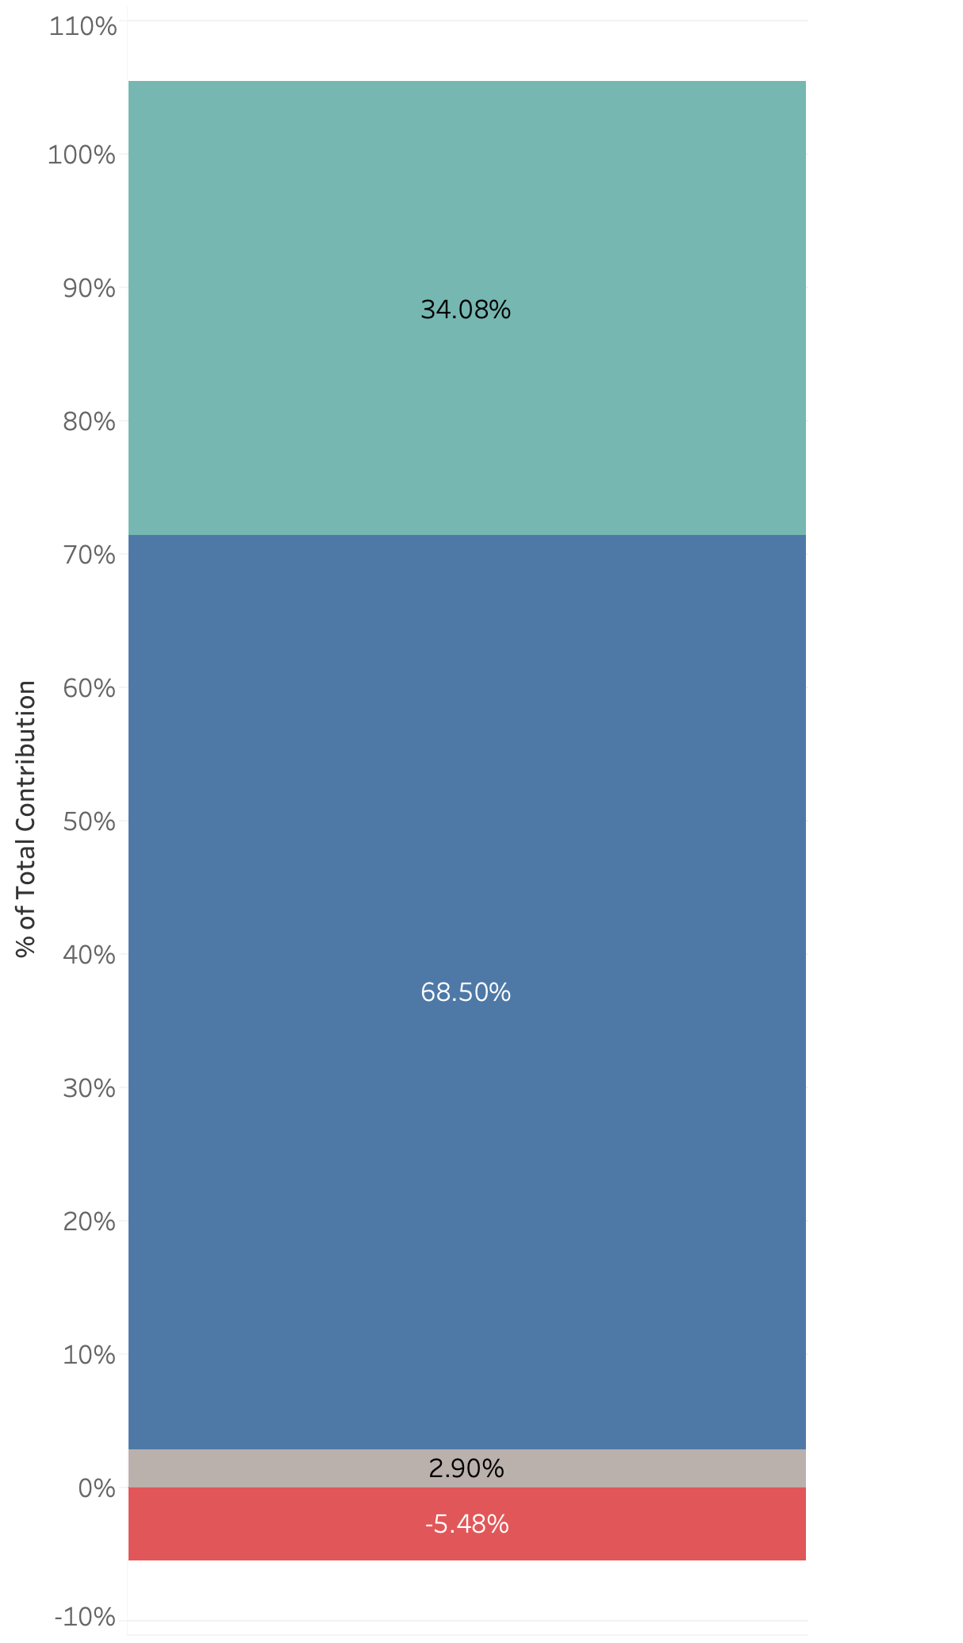
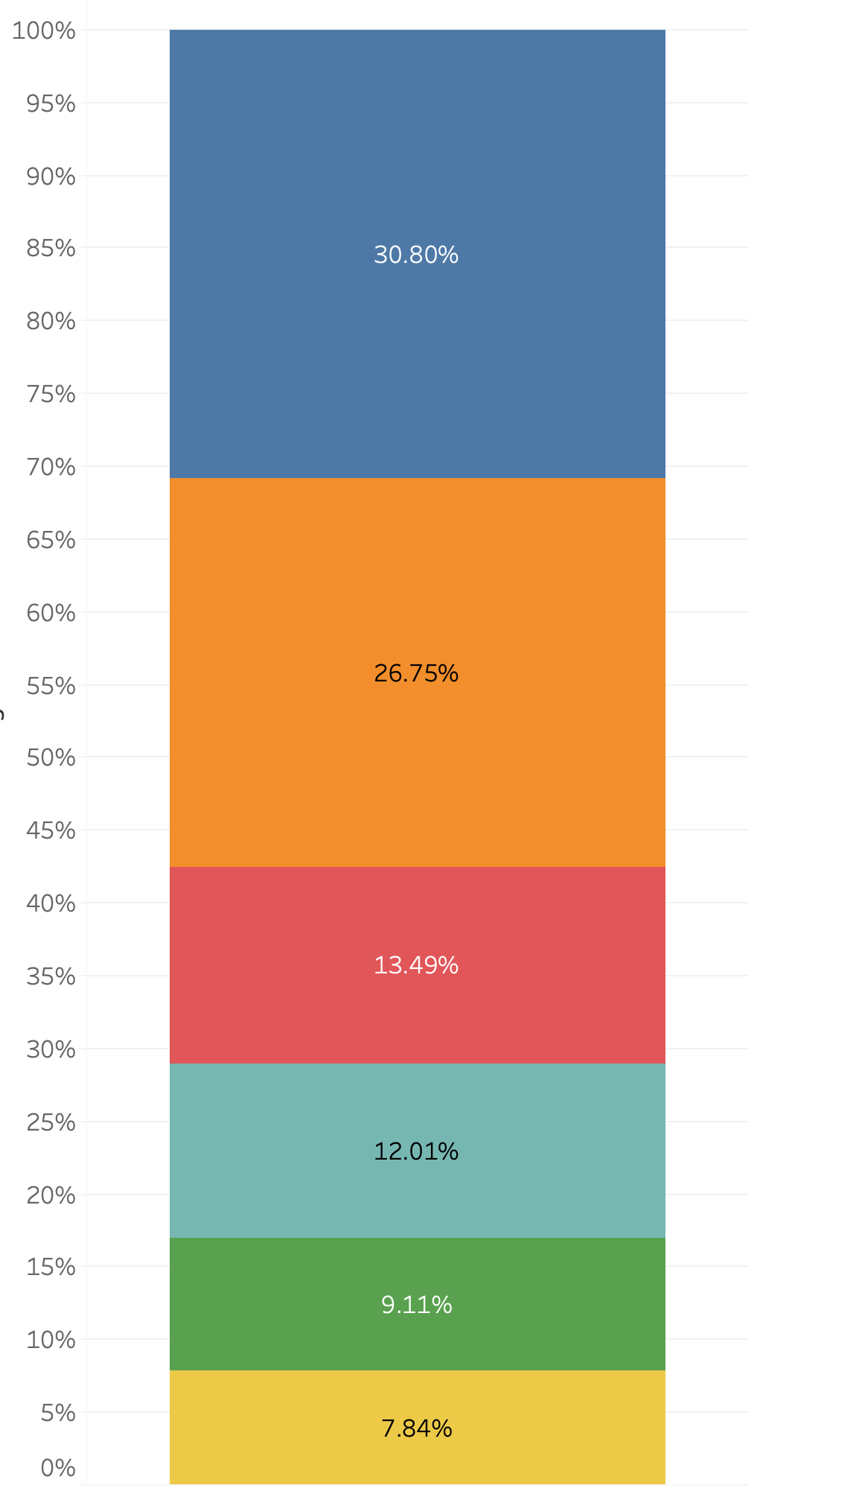
What were the impacts of marketing channels in 2017 sales? Marketing contributed to 1/3 of our total sales Social media 1/5, TV & Magazine 1/3 of marketing sales
Marketing
Display
National TV
Organic & Non-Marketing
Paid Search
Facebook
WeChat
Magazine
Sales Event
Competitor

Slide 7
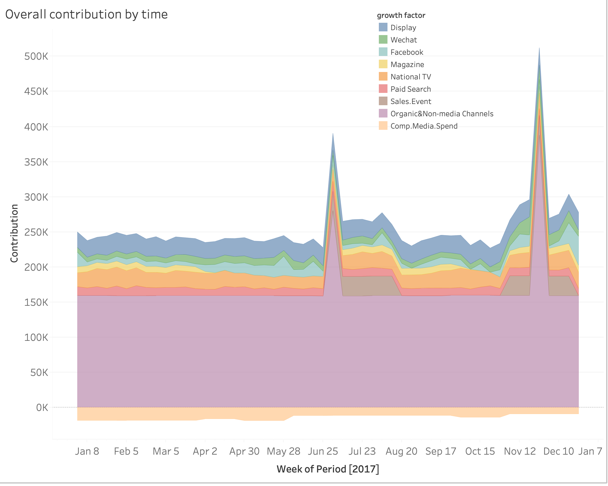
How were the impacts of marketing channels distributed throughout 2017? Marketing factors evenly distributed across 2017 Non-marketing factors dominated during holiday season

Slide 8
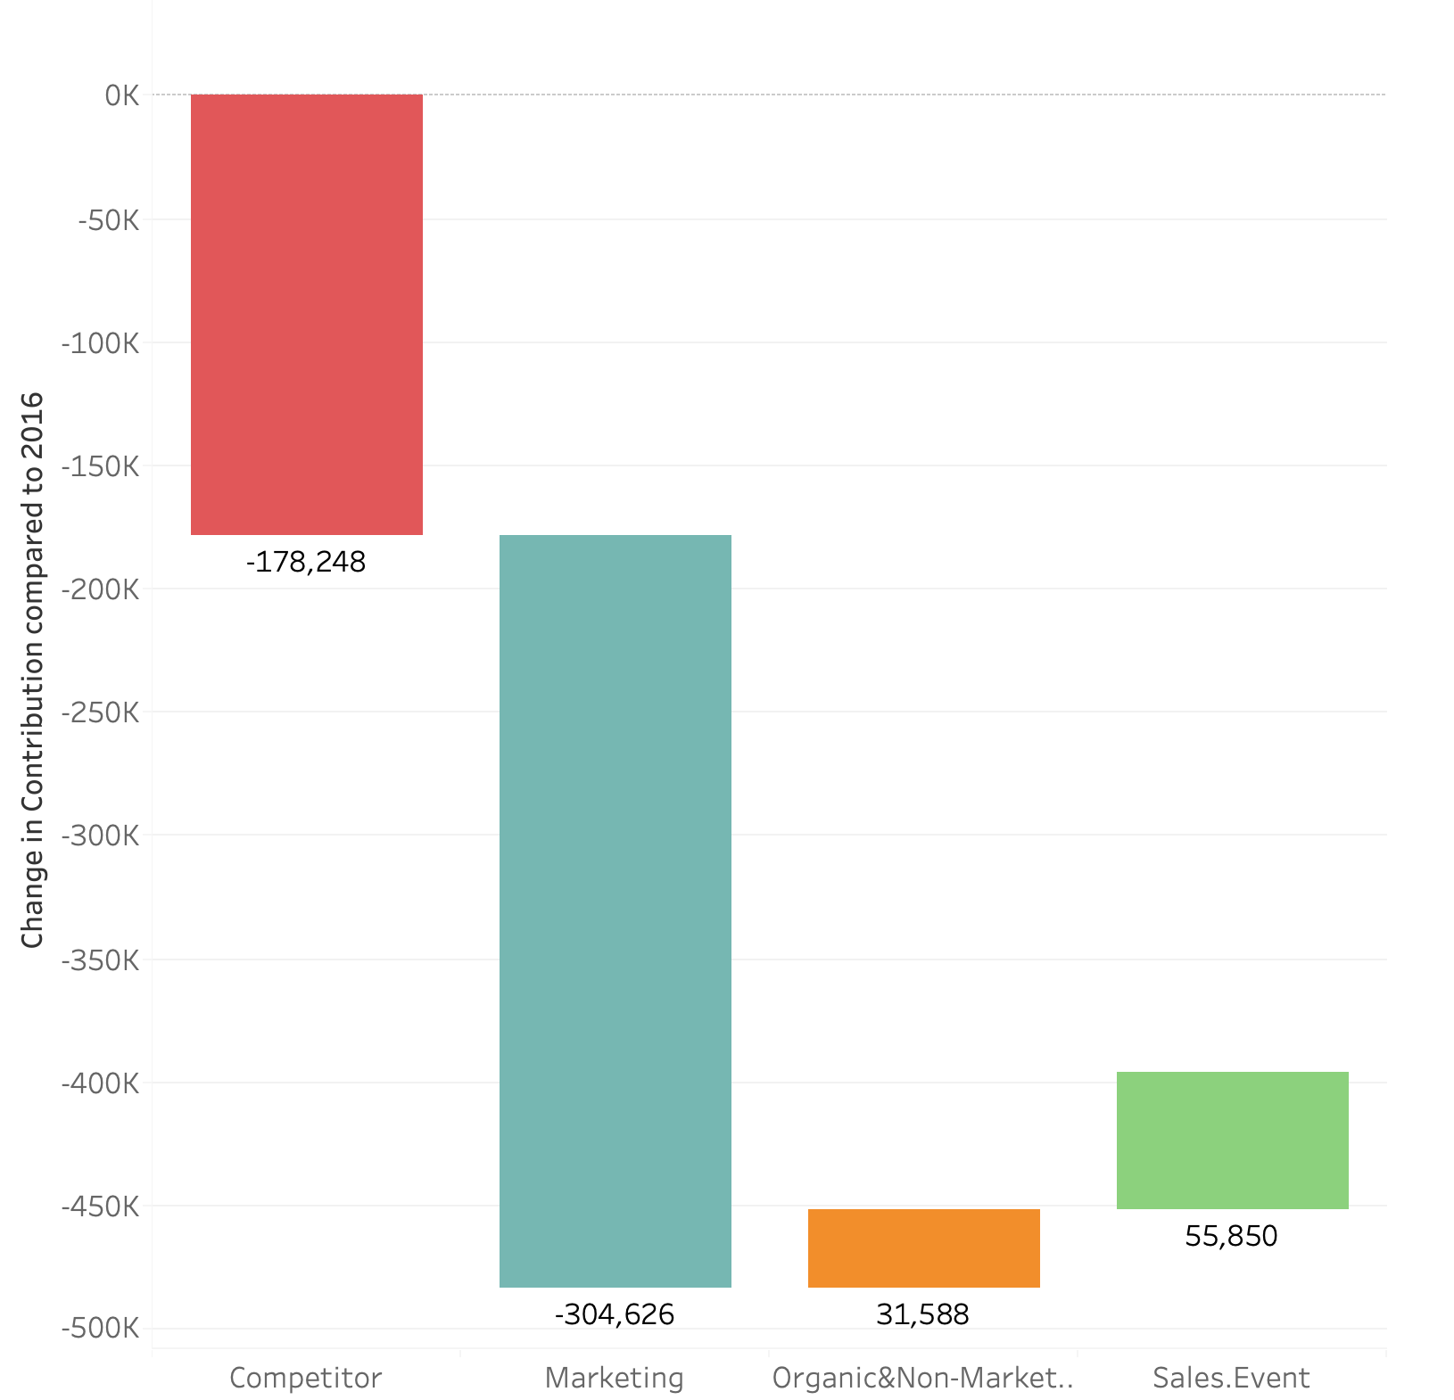
How did marketing channels perform comparing to 2016? Overall sales -395K -3.05% Marketing decreases -305K -6.58% Competitor (-) neutralized organic (+) & sales event (+)

Slide 9
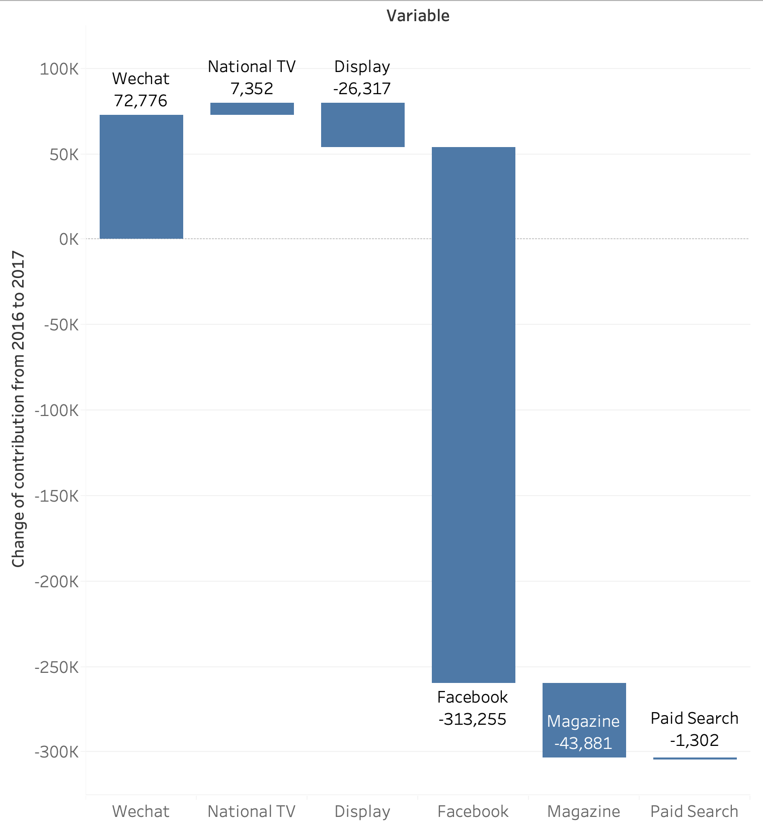
Where did the -$305K performance come from? Facebook was the main reason of most marketing loss (-$313k) WeChat contribution increased (+$73k)

Slide 10
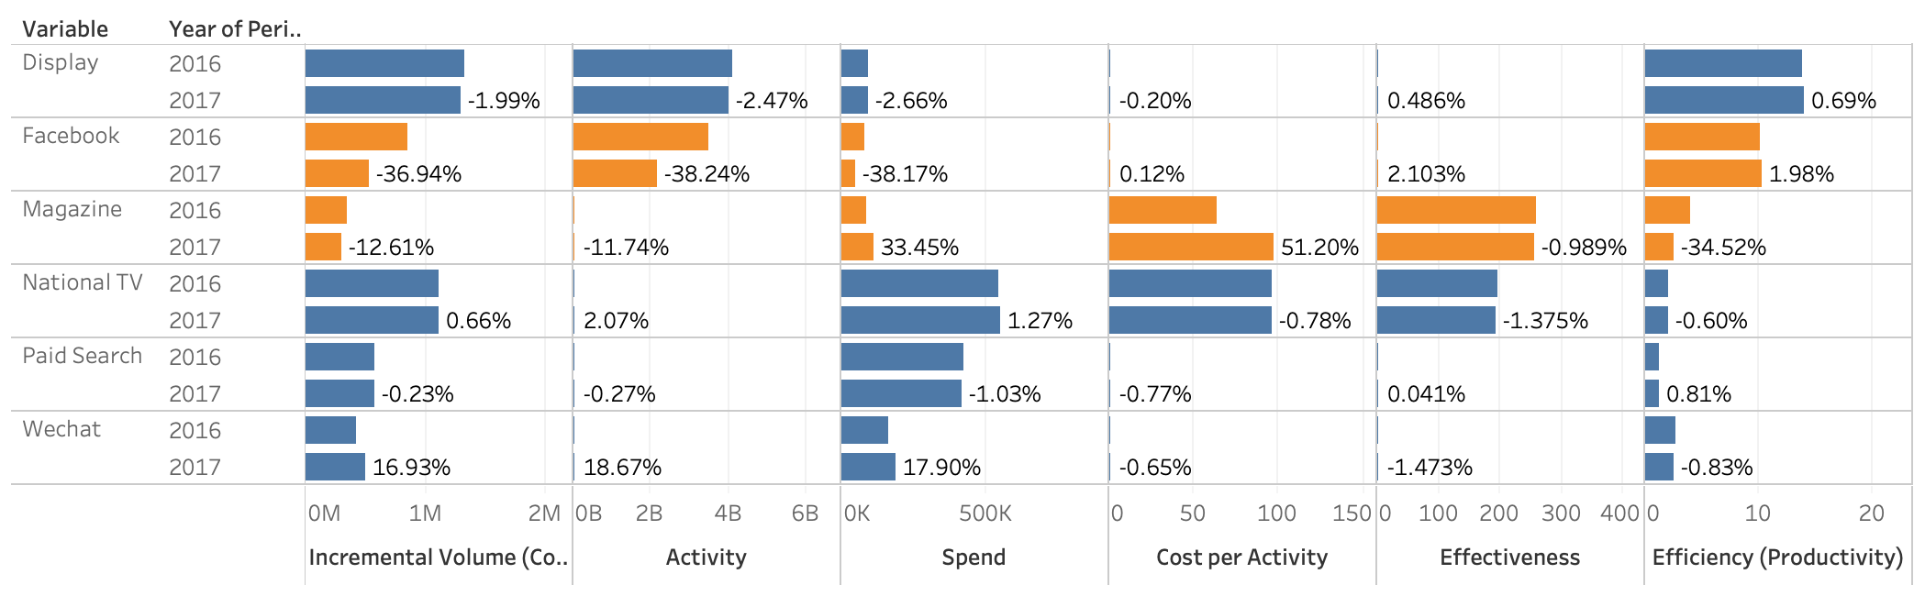
Why did Facebook perform poorly? We spend less on Facebook (-), it is almost as equally effective and efficient as 2016. Magazine is 50% more expensive (-), it is equally effective but 34% less efficient. We spent 17% more on WeChat (+).

Slide 11
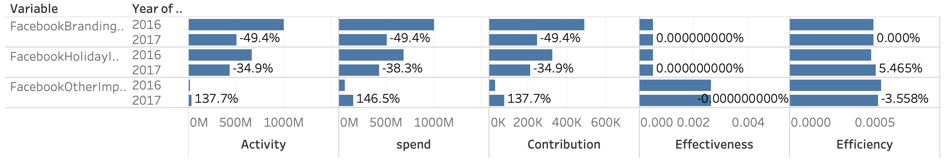
Side Diagnosis for Facebook “Branding” & “Holiday” are the main contributor of sales, despite their effectiveness & efficiency are lower than “Other”. “Other” is the most effective and most efficient channel. Therefore, we should continue on increasing Facebook spending in “Other”.

Slide 12
What should we do about marketing in 2018 to fix the problem? Optimize spending for 2018 & Prediction Without increasing marketing spend, marketing sales is increased by 36%, efficiency is increased by 37%, projected sales next year (2018) will be ~$13.4m.
Marketing sales is increased by 36%, Efficiency is increased by 37%!
Total Spend | TV | Magazine | Paid Search | Display | Facebook | WeChat | Total Sales | Efficiency
$623,337 | $274,552 | $57,546 | $209,566 | $46,368 | $25,770 | $9,532 | $3,518,629 | 5.64
Original
-29%
+30%
+17%
+30%
+30%
+30%
+36%
+37%
Total Spend | TV | Magazine | Paid Search | Display | Facebook | WeChat | Total Sales | Efficiency
$623,337 | $195,672 | $74,810 | $246,681 | $60,278 | $33,501 | $12,392 | $4,798,215 | 7.70
Optimized

Slide 13
Last Point
Why is Paid Search the least efficient but model chooses Paid Search over National TV?
Why didn’t the optimization just minimize the one with lowest efficiency (ROI)?
Because efficiency only says about overall ROI, but TV activity experiences significant decaying effect, so a lot of TV activity impact extends into 2019.
Whereas Paid Search activity doesn’t decay into longer time range.
To maximize 2018 sales, Paid Search would outperform TV, but if we include 2019 sales TV is more efficient.
To maximize 2018 & 2019 sales, I would recommend balance Paid Search and TV budget instead.

Slide 14
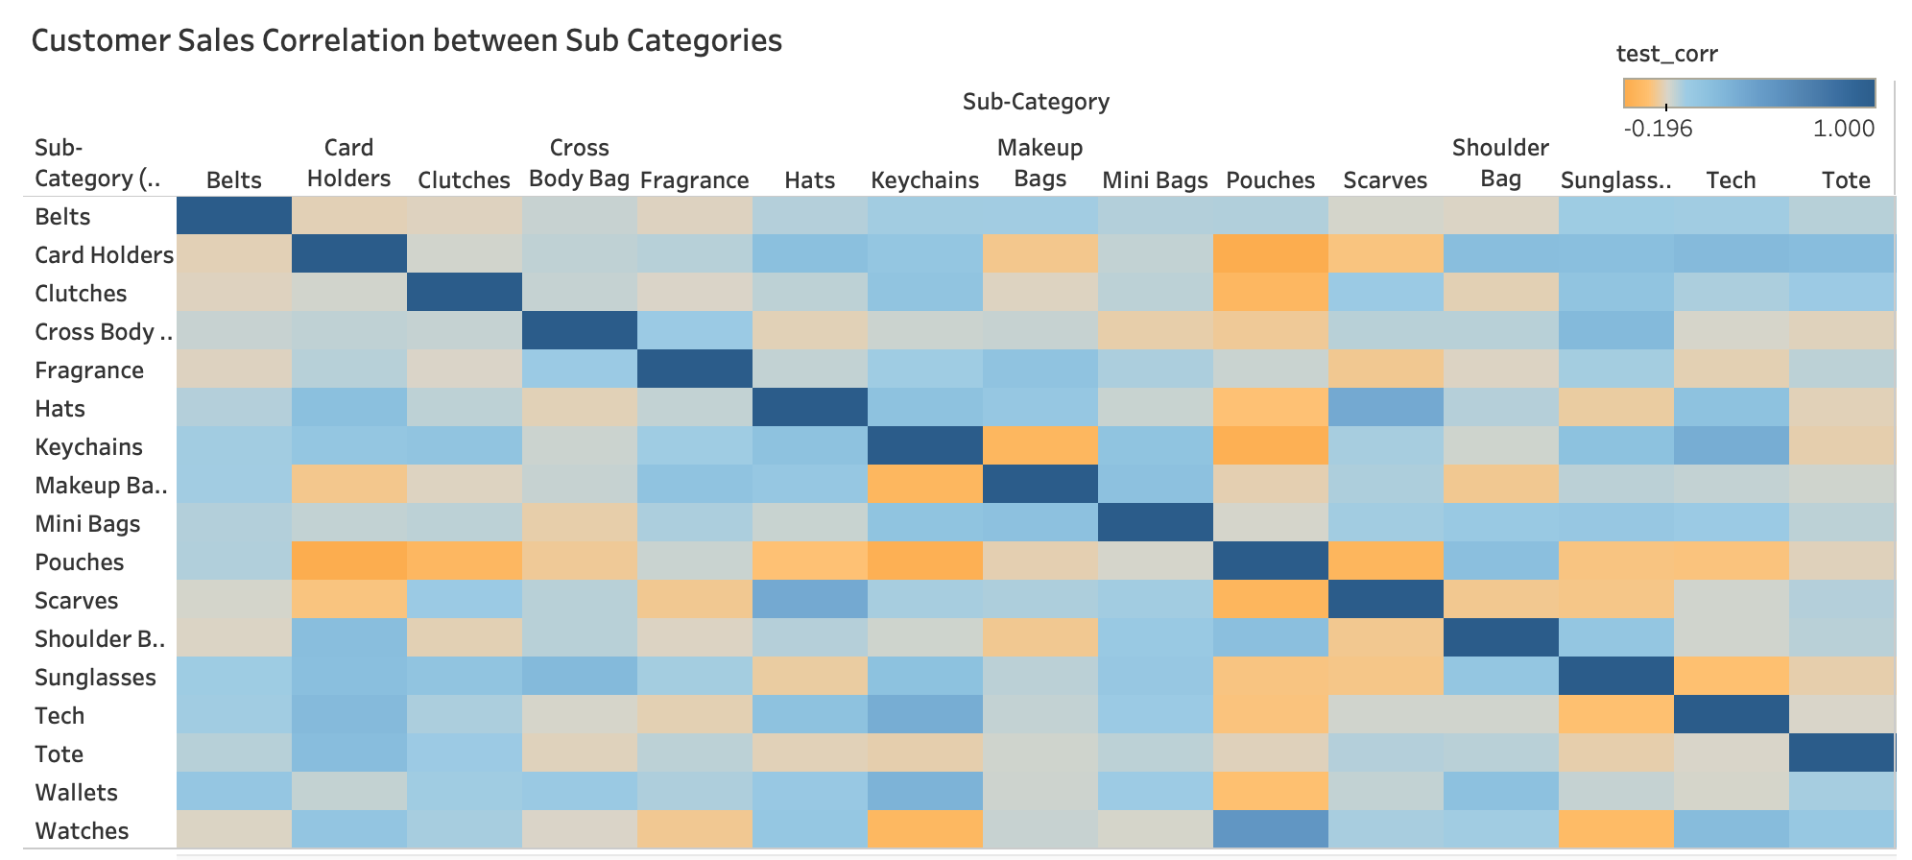
Other recommendations

Slide 15
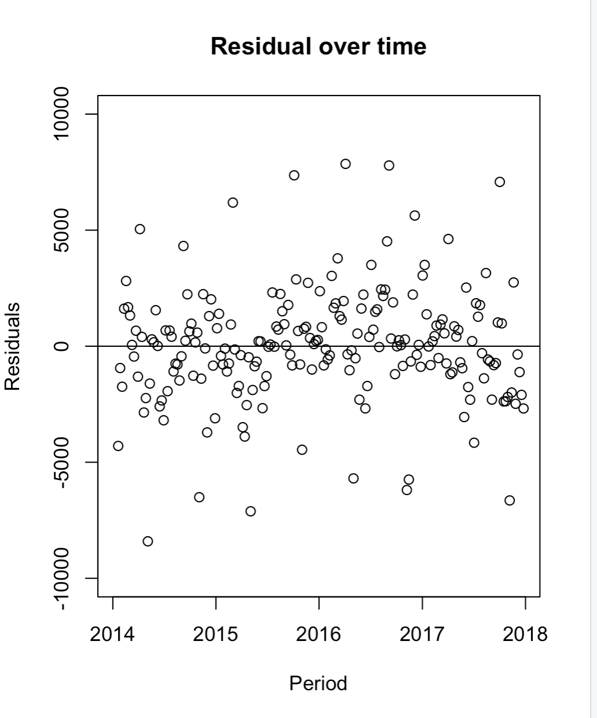
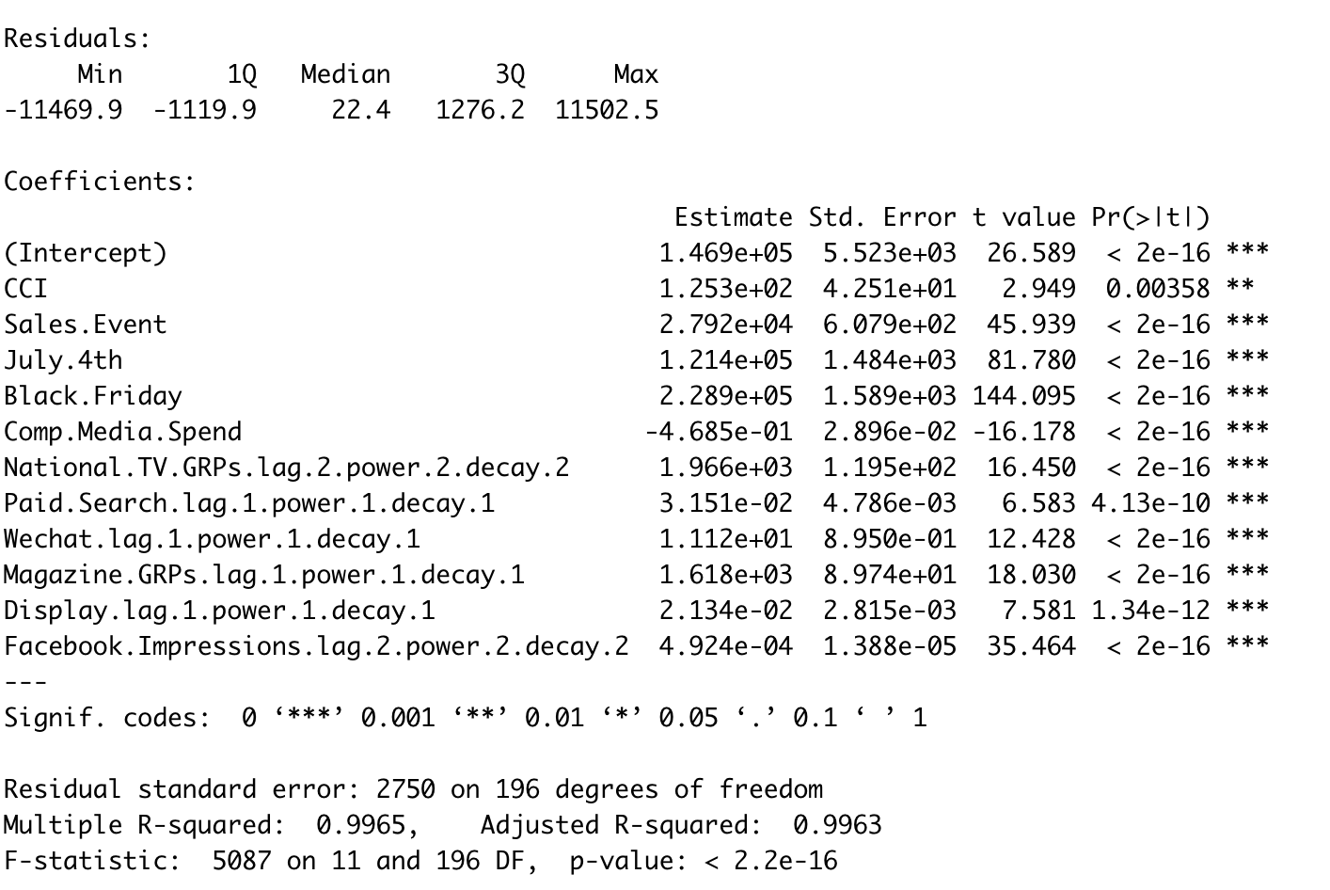
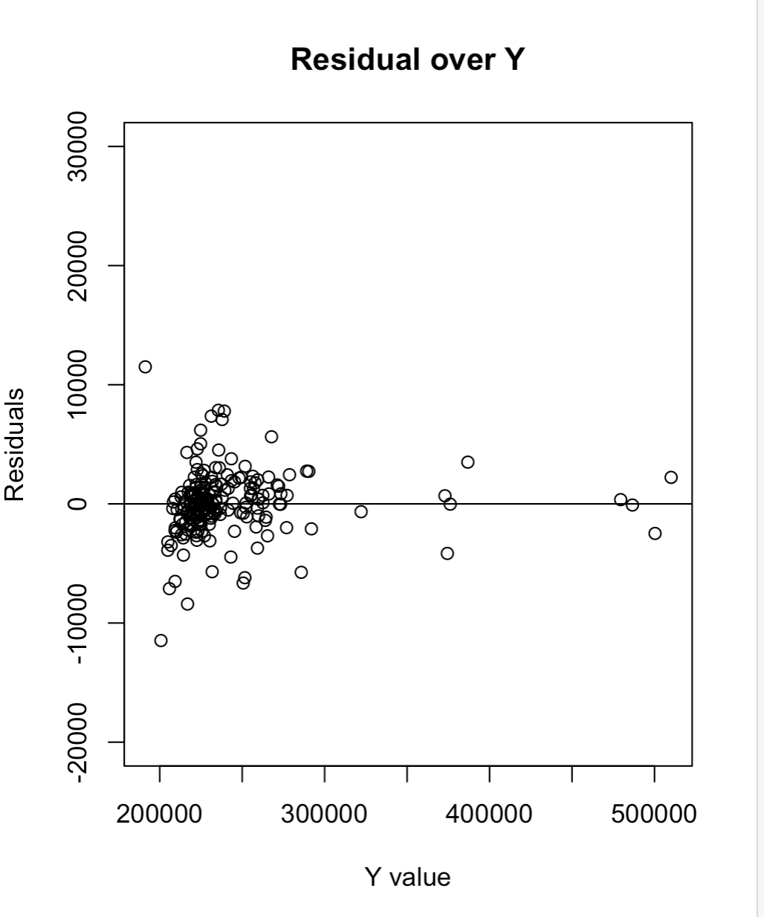
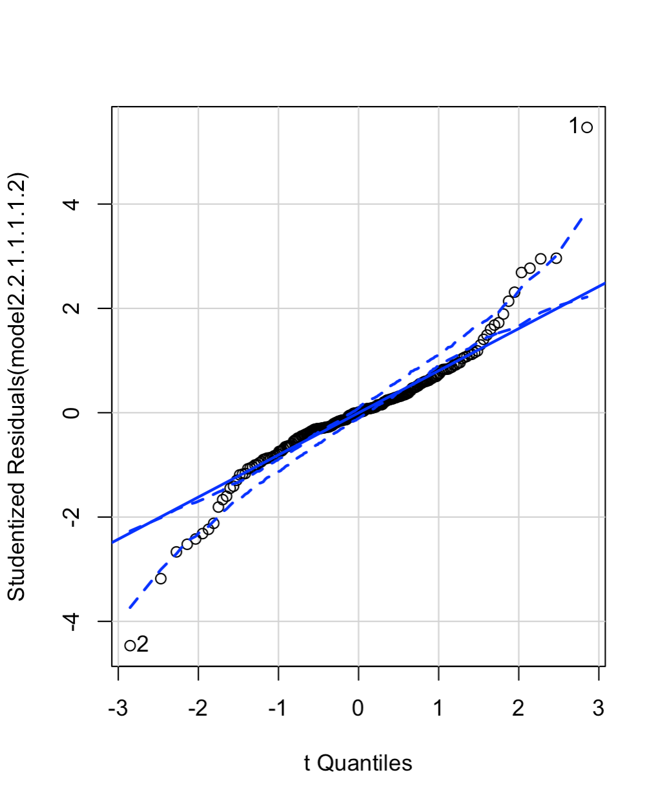
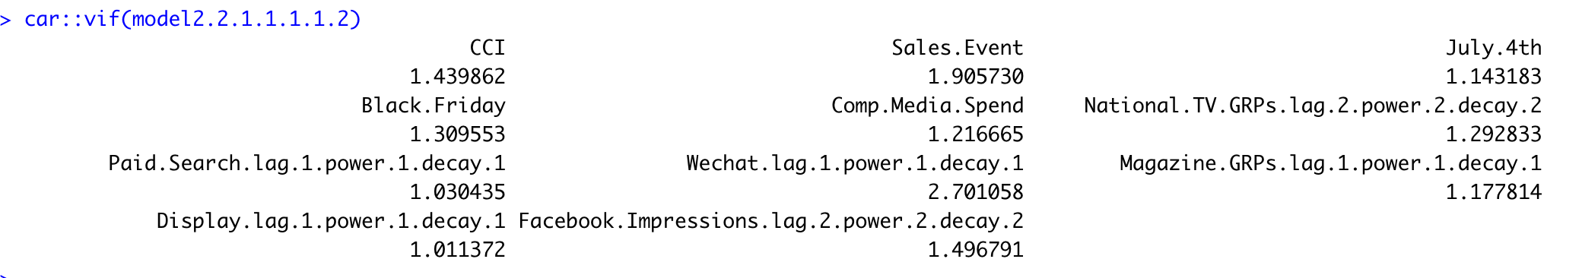
Appendix 1 Model details

