Slide 1
Graphs
It’s all about relationships
Terence Parr
MSDS program University of San Francisco

Slide 2
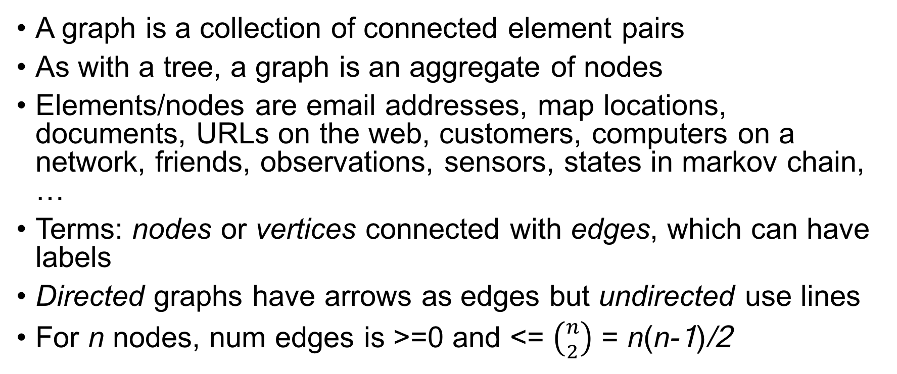
What’s a graph?
A graph is a collection of connected element pairs
As with a tree, a graph is an aggregate of nodes
Elements/nodes are email addresses, map locations, documents, URLs on the web, customers, computers on a network, friends, observations, sensors, states in markov chain, …
Terms: nodes or vertices connected with edges, which can have labels
Directed graphs have arrows as edges but undirected use lines
For n nodes, num edges is >=0 and <= $\left({n \atop 2}\right)$ = n(n-1)/2

Slide 3
Common questions
Is q reachable from p?
How many edges are on paths between p and q?
Is graph connected? (reach any p from any q)
Is graph cyclic? (p reaches p traversing at least one edge)
Which nodes are within k edges of node p? (neighborhood)

Slide 4
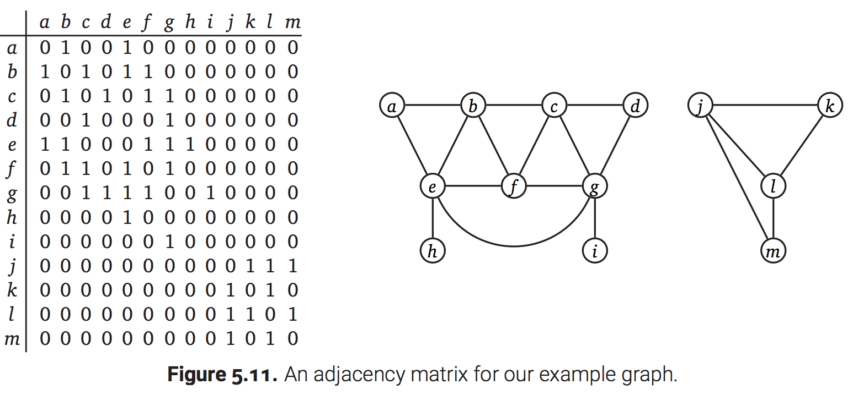
Adjacency matrix implementations
Adjacency matrix, n x n matrix of {0,1} if unlabeled or {labels} if edges are labeled; undirected matrices are symmetric
Wastes space for sparse edges
Fast to access arbitrary node’s edges
http://jeffe.cs.illinois.edu/teaching/algorithms/book/05-graphs.pdf

Slide 5
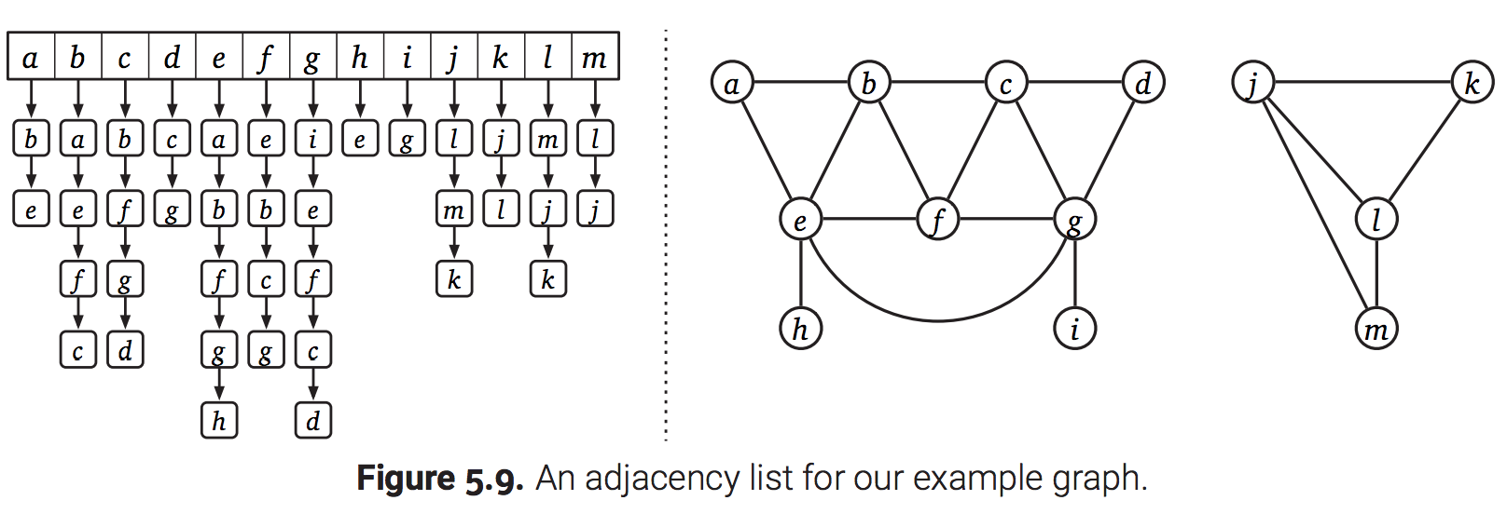
Adjacency list implementations
List of edge lists for nodes
Fast arbitrary node access for numbered nodes, space efficient
http://jeffe.cs.illinois.edu/teaching/algorithms/book/05-graphs.pdf

Slide 6
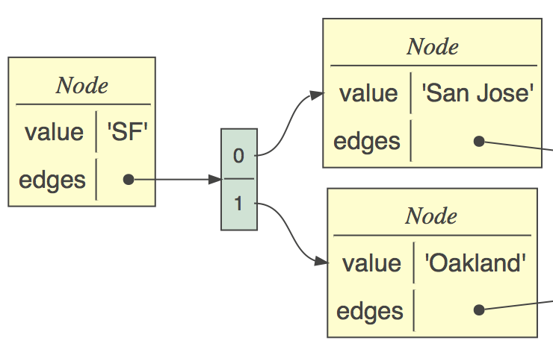
Connected nodes implementation
Most common implementation due to nice mapping to objects
Each node has info about node and edge list
Use list or dictionary index to access nodes directly
class Node:
def __init__(self, value):
self.value = value
self.edges = []
def add(self, target:Node):
self.edges.append(target)

Slide 7
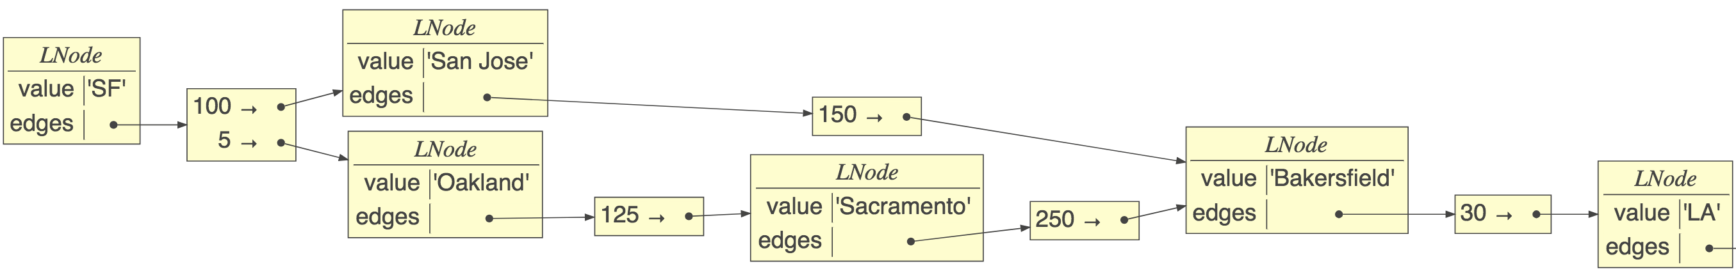
Implementation with labels
class LNode:
def __init__(self, value):
self.value = value
self.edges = {}
def add(self, label, target):
self.edges[label] = target
def __repr__(self):
return str(self.value)
Edge->node dictionary, not list
sf.add(100,sj)
sj.add(150,baker)
…

Slide 8
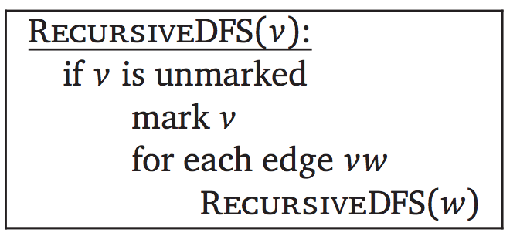
Depth-first search (review)
The fundamental algorithm for answering graph questions
Visits all reachable nodes from p, avoiding cycles
def walk_graph(p:Node, visited=set()):
if p in visited: return
visited.add(p)
for q in p.edges:
walk_graph(q, visited)
O(n,m) = n + m, for n nodes, m edges; m can be n^2

Slide 9
Are there cycles?
If we run into same node in seen set, return True
def iscyclic(p:Node, visited=set()) -> bool:
if p in visited: return True
visited.add(p)
for q in p.edges:
c = iscyclic(q, visited)
if c: return True # we can stop
return False
Could also test “p in reachable(p)”

Slide 10
Can p reach q?
Need two sets, one for avoiding cycles, another for reached
def reachable(p:Node) -> set:
reaches = set();
reachable_(p, reaches, set())
return reaches
def reachable_(p:Node, reaches:set, visited:set):
if p in visited: return
visited.add(p)
for q in p.edges:
reaches.add(q)
reachable_(q, reaches, visited)
https://github.com/parrt/msds689/blob/master/notes/graphs.ipynb

Slide 11
p reaches q at what (first) depth?
Track node->depth map, not just set of nodes
def reachable(p:Node) -> dict:
reaches = dict()
reachable_(p, reaches, set(), depth=0)
return reaches
def reachable_(p:Node, reaches:dict, visited:set, depth:int):
if p in visited: return
visited.add(p)
reaches[p] = depth
for q in p.edges:
reachable_(q, reaches, visited, depth+1)
https://github.com/parrt/msds689/blob/master/notes/graphs.ipynb

Slide 12
Find neighborhood within k edges
Track dict node->depth, stop when we reach depth
def neighbors(p:Node, k:int) -> dict:
reaches = dict()
neighbors_(p, k, reaches, set(), depth=0)
return reaches
def neighbors_(p:Node, k:int, reaches:dict, visited:set, depth:int):
if p in visited or depth>k: return
visited.add(p)
reaches[p] = depth
for q in p.edges:
neighbors_(q, k, reaches, visited, depth+1)

Slide 13
Find path from p to q?
def path(p:Node, q:Node) -> list:
return path_(p, q, [p], set())
def path_(p:Node, q:Node, path:list, visited:set):
if p is q: return path
if p in visited: return None
visited.add(p)
for t in p.edges:
pa = path_(t, q, path+[t], visited)
if pa is not None: return pa
return None
recursion tree
Must track path not set of nodes
https://github.com/parrt/msds689/blob/master/notes/graphs.ipynb

Slide 14
Breadth-first search vs DFS
Visit all children then grandchildren…

Slide 15
BFS implementation
Maintains work list of nodes and visited set
BFS DFS Visit A Visit A Visit B Visit B Visit D Visit C Visit C Visit D Visit E Visit E
Add to work list end, pull from front (queue)
def BFS(root:LNode):
visited = {root}
worklist = [root]
while len(worklist)>0:
p = worklist.pop(0)
print(f“Visit {p}”)
for e,q in p.edges.items():
if q not in visited:
worklist.append(q)
visited.add(q)
https://github.com/parrt/msds689/blob/master/notes/graphs.ipynb

Slide 16
Find shortest path from p to q?
BFS where work list is a list of paths not list of nodes
Tail of path is where we left off work on it
By searching all children before going deeper, we auto- magically find paths with shortest lengths
def shortest(root:Node, target:Node):
visited = {root}
worklist = [[root]]
while len(worklist)>0:
path = worklist.pop(0)
p = path[-1] # tail of path
if p is target: return path
for q in p.edges:
if q not in visited:
worklist.append(path+[q])
visited.add(q)
https://github.com/parrt/msds689/blob/master/notes/graphs.ipynb

Slide 17
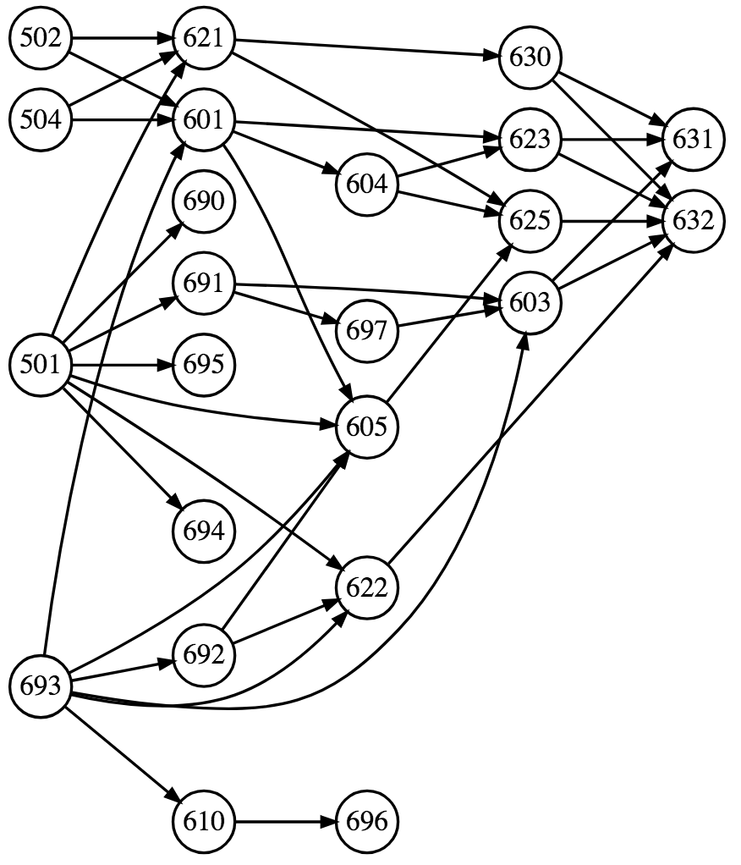
Topological sort (acyclic graphs)
Problem: Find linear ordering of nodes in directed acyclic graph such that all constraints, u->v, are satisfied where u depends on v so v must come before u
E.g., task ordering or course prereq chain. 501 depends on 501; 502,504,693 depend on 601… Find order we should take classes
Any linear ordering where edges point to left is solution
Sort is not unique

Slide 18
Example topo sort

Slide 19
How to approach the problem
What order should we do these tasks? Think in terms of traversal order
What if we add party goal?
Cycles would cause trouble; are meaningless when dealing with dependencies; how can 630-01 be attended before itself?

Slide 20
DFS-based Topo sort implementation
Lots of very complex algorithms on the web
Simplest solution: DFS-based topological sort
A valid sort is just the post-order graph traversal!
Well, we have to make sure to do DFS on all root nodes (nodes w/o incoming edges) but core is just DFS
With one root, it’s just postorder traversal via DFS

Slide 21
Example walk through
DFS starting with party: party -> 628 -> 630 back out then hit 689 then lunch back out and hit seminar
Postorder traversal processes after visiting children: 630, lunch, seminar, 689, 628, party
Solution: 630-01, lunch, seminar, 689-02, 628 hw, party
https://github.com/parrt/msds689/blob/master/notes/graphs.ipynb

Slide 22
DFS postorder traversal
def postorder(p:Node, sorted:set, visited:set):
if p in visited: return
visited.add(p)
for q in p.edges:
postorder(q, sorted, visited)
sorted.append(p)

Slide 23
With multiple roots, hit them all
def toposort(nodes):
sorted = []
visited = set()
while len(visited) < len(nodes):
todo = [node for node in nodes.values()
if node not in visited]
if len(todo)>0:
postorder(todo[0], sorted, visited)
return sorted

Slide 24
Summary
Graphs are for showing relationships between elements
DFS for finding a path or multiple paths
BFS for find shortest (in edges) path or neighborhood
DFS postorder great for topo sort
Recursive alg’s all use visited set to avoid cycles
Non-recursive DFS: (use work list stack)
push targets in reverse order onto work list
pop last work list item for next node to process
Non-recursive BFS: (use work list queue)
push targets in order onto work list
pull from first position

Slide 25
Sample graph problems

Slide 26
Exercise
Given 2 lists P,Q and function conn(p,q)=true if edge p->q exists. P is origin (starting) nodes and Q destination nodes. Report 1 for P[i] reaches Q[i] directly or indirectly.

Slide 27
Exercise: Boggle
Given m x n matrix of letters. Find all English words possible by taking one adjacent step to another letter, starting with any letter; one occurrence of each letter per word; you’re given a dictionary (/usr/share/dict/words)

