Slide 1
Graphs
It’s all about relationships
Terence Parr
MSDS program University of San Francisco

Slide 2
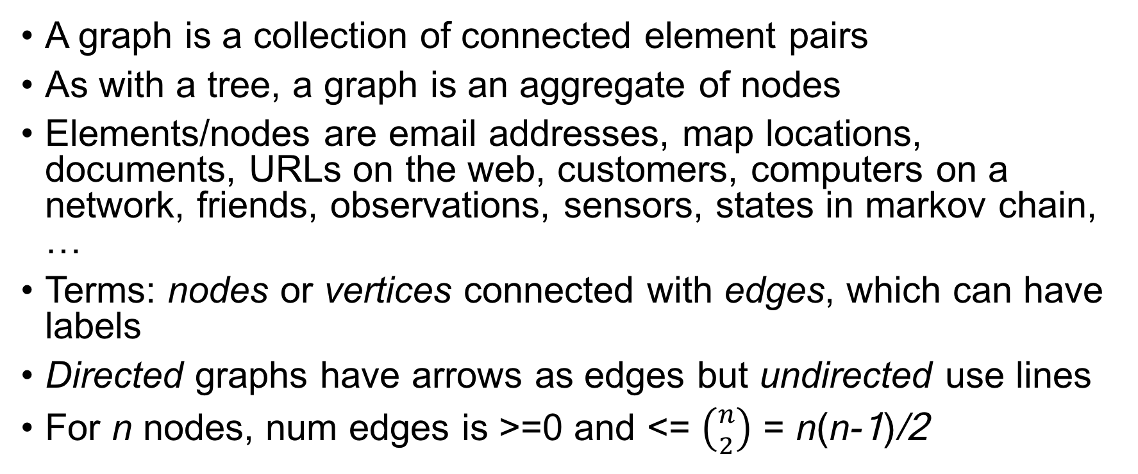
What’s a graph?
A graph is a collection of connected element pairs
As with a tree, a graph is an aggregate of nodes
Elements/nodes are email addresses, map locations, documents, URLs on the web, customers, computers on a network, friends, observations, sensors, states in markov chain, …
Terms: nodes or vertices connected with edges, which can have labels
Directed graphs have arrows as edges but undirected use lines
For n nodes, num edges is >=0 and <= $\left({n \atop 2}\right)$ = n(n-1)/2

Slide 3
Common questions
Is q reachable from p?
How many edges are on paths between p and q?
Is graph connected? (reach any p from any q)
Is graph cyclic? (p reaches p traversing at least one edge)
Which nodes are within k edges of node p? (neighborhood)

Slide 4
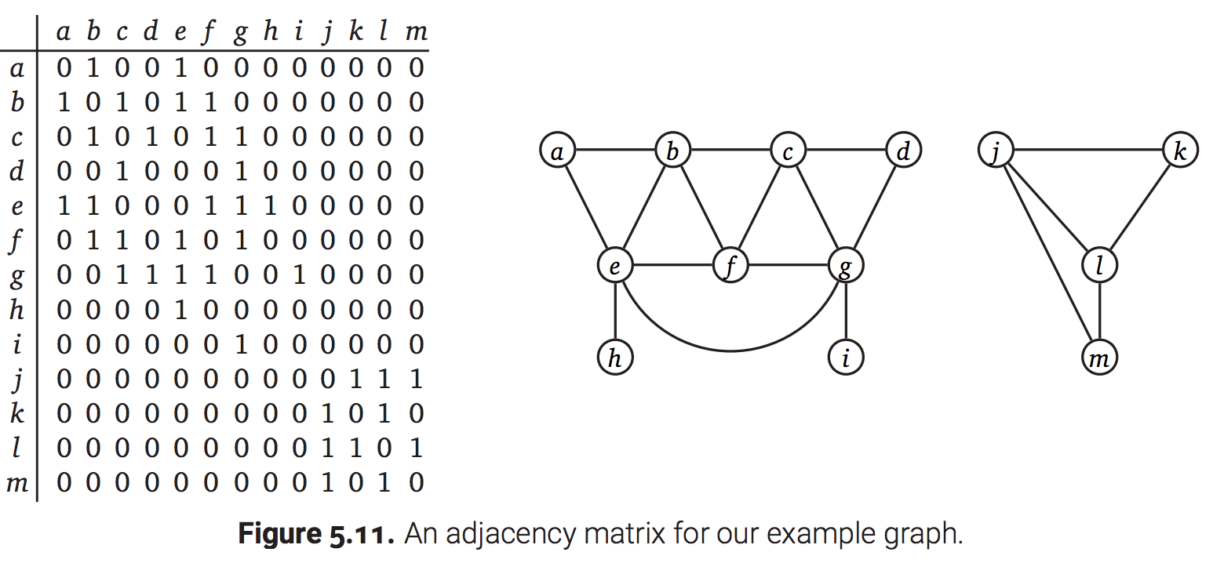
Adjacency matrix implementations
Adjacency matrix, n x n matrix of {0,1} if unlabeled or {labels} if edges are labeled; undirected matrices are symmetric
Wastes space for sparse edges
Fast to access arbitrary node’s edges
http://jeffe.cs.illinois.edu/teaching/algorithms/book/05-graphs.pdf

Slide 5
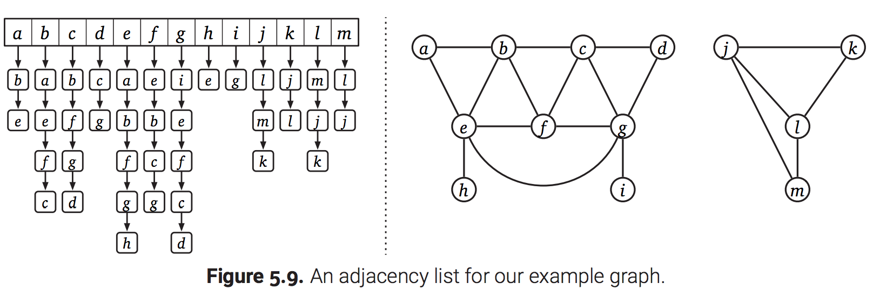
Adjacency list implementations
List of edge lists for nodes
Fast arbitrary node access for numbered nodes, space efficient
http://jeffe.cs.illinois.edu/teaching/algorithms/book/05-graphs.pdf

Slide 6
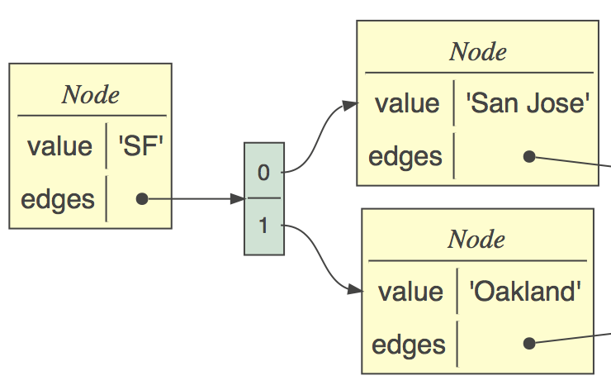
Connected nodes implementation
Most common implementation due to nice mapping to objects
Each node has info about node and edge list
Use list or dictionary index to access nodes directly
class Node:
def __init__(self, value):
self.value = value
self.edges = []
def add(self, target:Node):
self.edges.append(target)

Slide 7
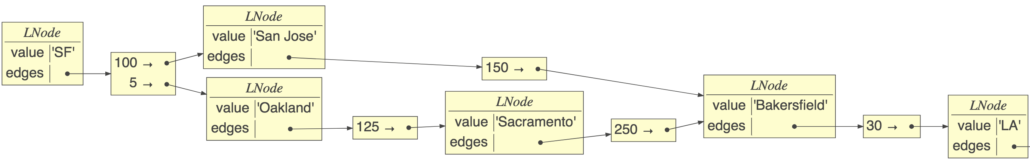
Implementation with labels
class LNode:
def __init__(self, value):
self.value = value
self.edges = {}
def add(self, label, target):
self.edges[label] = target
def __repr__(self):
return str(self.value)
Edge->node dictionary, not list
sf.add(100,sj)
sj.add(150,baker)
…

Slide 8
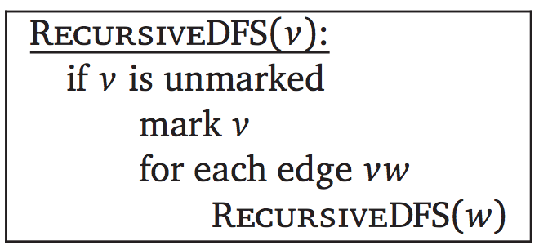
Depth-first search (review)
The fundamental algorithm for answering graph questions
Visits all reachable nodes from p, avoiding cycles
def walk_graph_(p:Node) -> None:
walk_graph_(p, set())
def walk_graph_(p:Node, visited:set):
if p in visited: return
visited.add(p)
for q in p.edges:
walk_graph_(q, visited)
O(n,m) = n + m, for n nodes, m edges; m can be n^2

Slide 9
Are there cycles?
If we run into same node in seen set, return True
def iscyclic_(p:Node) -> bool:
return iscyclic_(p, set())
def iscyclic_(p:Node, visited:set) -> bool:
if p in visited: return True
visited.add(p)
for q in p.edges:
c = iscyclic_(q, visited)
if c: return True # we can stop
return False
Could also test “p in reachable(p)”

Slide 10
Can p reach q?
Need two sets, one for avoiding cycles, another for reached
def reachable(p:Node) -> set:
reaches = set();
reachable_(p, reaches, set())
return reaches
def reachable_(p:Node, reaches:set, visited:set):
if p in visited: return
visited.add(p)
for q in p.edges:
reaches.add(q)
reachable_(q, reaches, visited)
https://github.com/parrt/msds689/blob/master/notes/graphs.ipynb

Slide 11
Find path from p to q?
def path(p:Node, q:Node) -> list:
return path_(p, q, [p], set())
def path_(p:Node, q:Node, path:list, visited:set):
if p is q: return path
if p in visited: return None
visited.add(p)
for t in p.edges:
pa = path_(t, q, path+[t], visited)
if pa is not None: return pa
return None
recursion tree
https://github.com/parrt/msds689/blob/master/notes/graphs.ipynb

Slide 12
Find shortest path from p to q?
FIRST, let’s look at breadth-first search vs depth-first search
Maintains work list and visited set
BFS DFS Visit A Visit A Visit B Visit D Visit D Visit E Visit C Visit B Visit E Visit C
Consider children then grandchildren etc…
def BFS(root:LNode):
visited = {root}
worklist = [root]
while len(worklist)>0:
p = worklist.pop(0)
print(f“Visit {p}”)
for e,q in p.edges.items():
if q not in visited:
worklist.append(q)
visited.add(q)
https://github.com/parrt/msds689/blob/master/notes/graphs.ipynb

Slide 13
Find shortest path from p to q?
BFS where work list is a list of paths not list of nodes
Tail of path is where we left off work on it
By searching all children before going deeper, we auto- magically find paths with shortest lengths
def shortest(root:Node, target:Node):
visited = {root}
worklist = [[root]]
while len(worklist)>0:
path = worklist.pop(0)
p = path[-1] # tail of path
if p is target: return path
for q in p.edges:
if q not in visited:
worklist.append(path+[q])
visited.add(q)
https://github.com/parrt/msds689/blob/master/notes/graphs.ipynb

