Slide 1
Computer Vision Final Project Depth Map Generation on More Realistic Scenes
B05901082 楊晟甫
B05901011 許秉倫

Slide 2
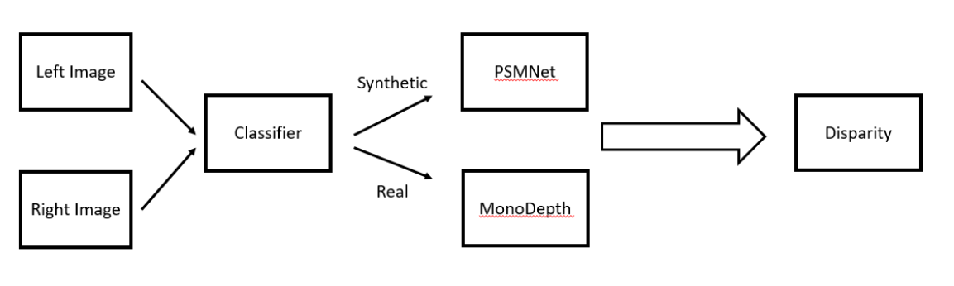
Architecture

Slide 3
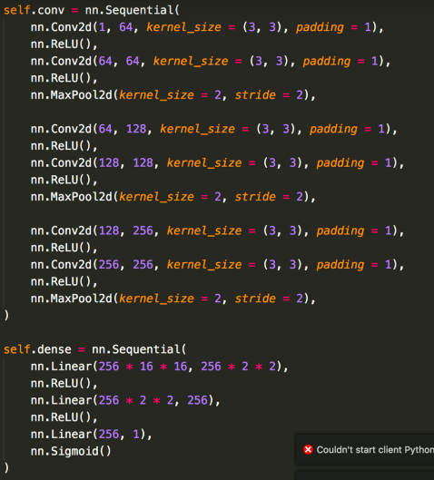
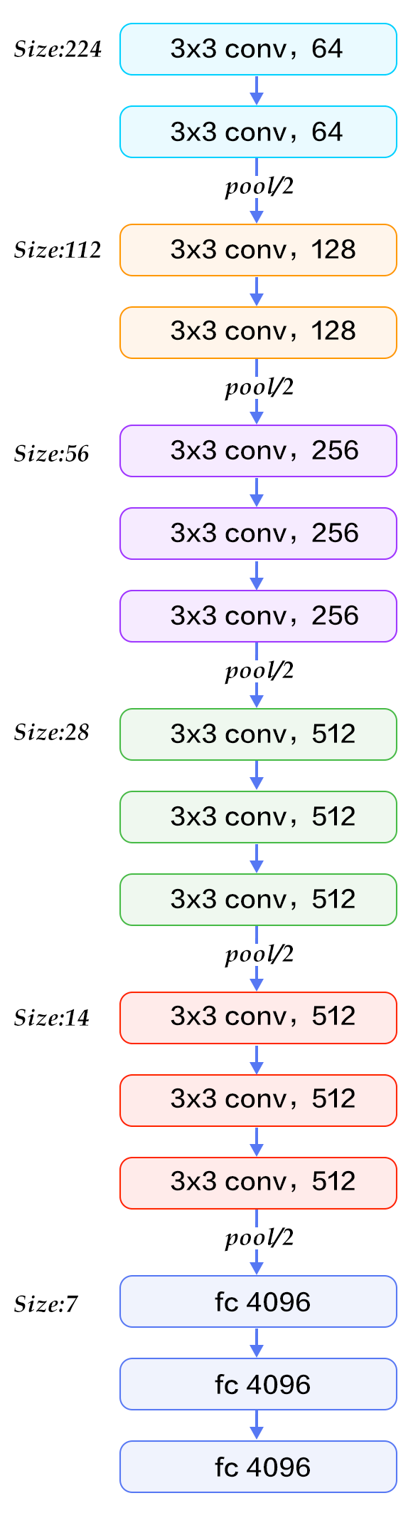
Implementation - Classifier

Slide 4
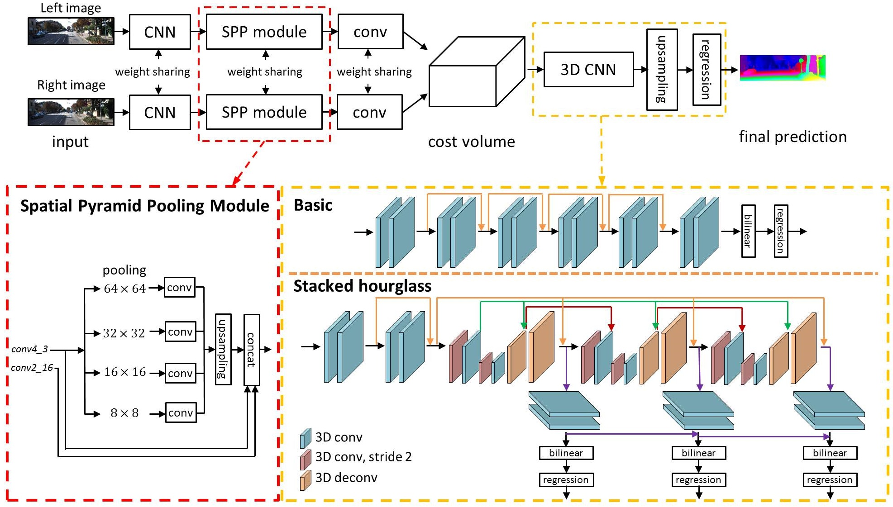
Implementation - PSMNet

Slide 5
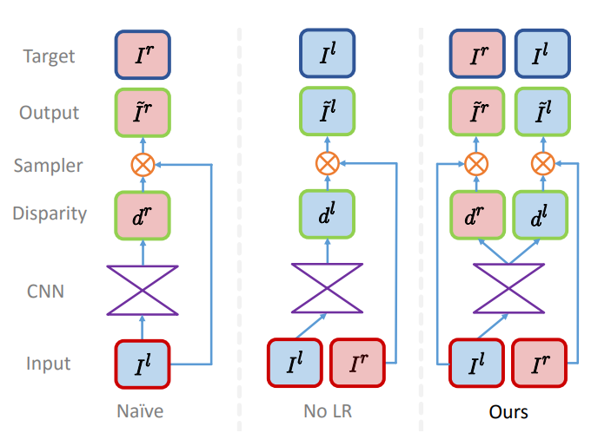
Implementation - Monodepth

Slide 6
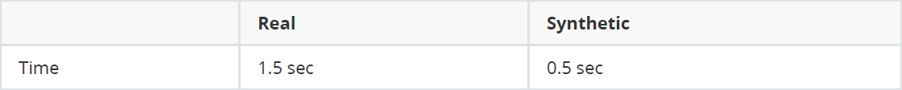
Results - Runtime & Error
Run time
Error (with augmentation)
Error (without augmentation)

Slide 7
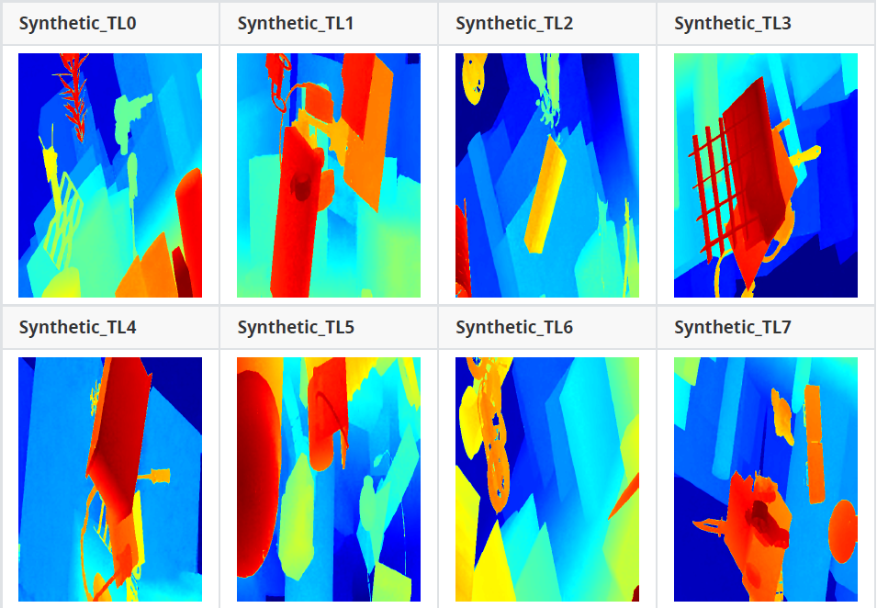
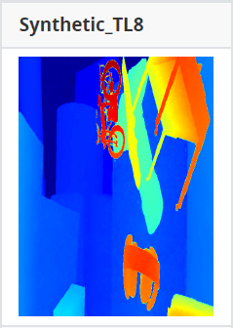
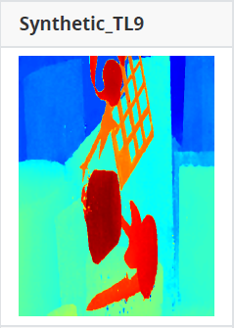
Results - Disparity Map (Syn)

Slide 8
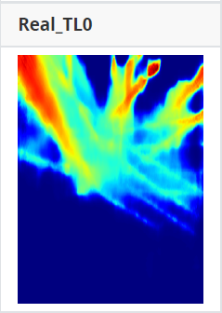
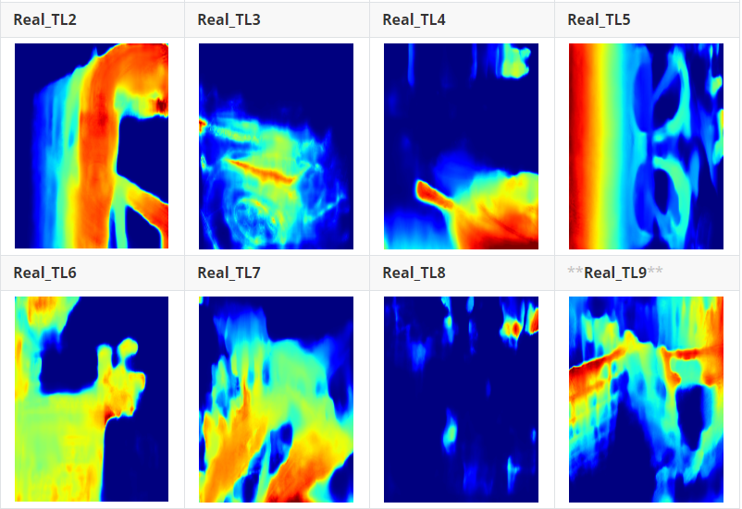
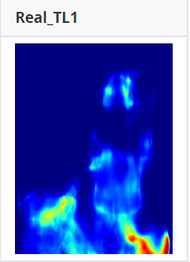
Results - Disparity Map (Real)

Slide 9
Thanks for listening

