Slide 1
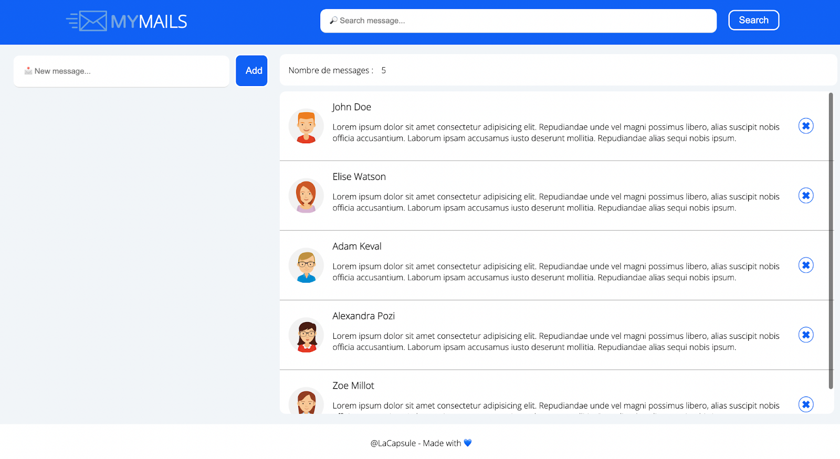
HEADER
CONTROL
PANEL
MAILS
FOOTER

