Slide 1

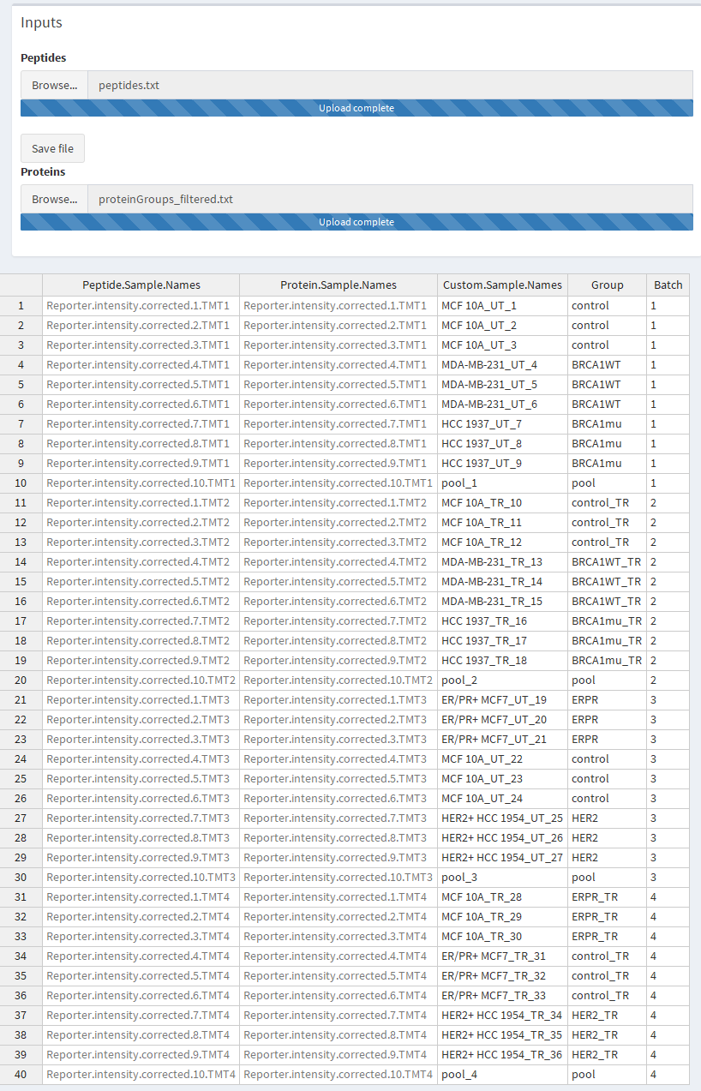
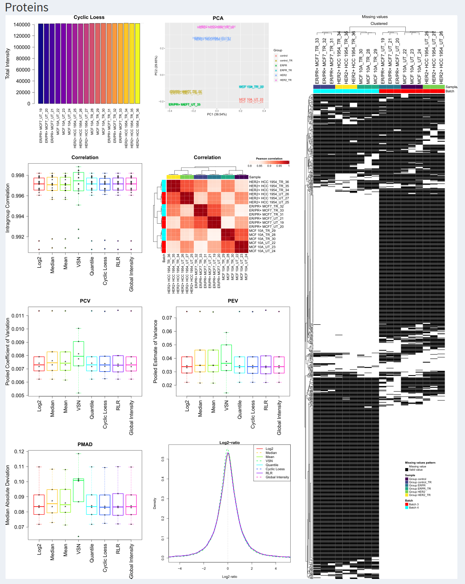
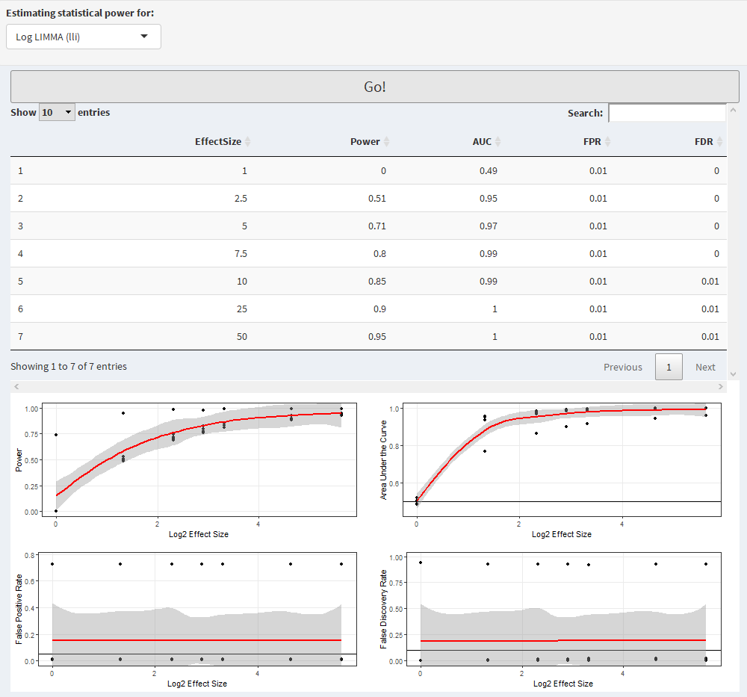
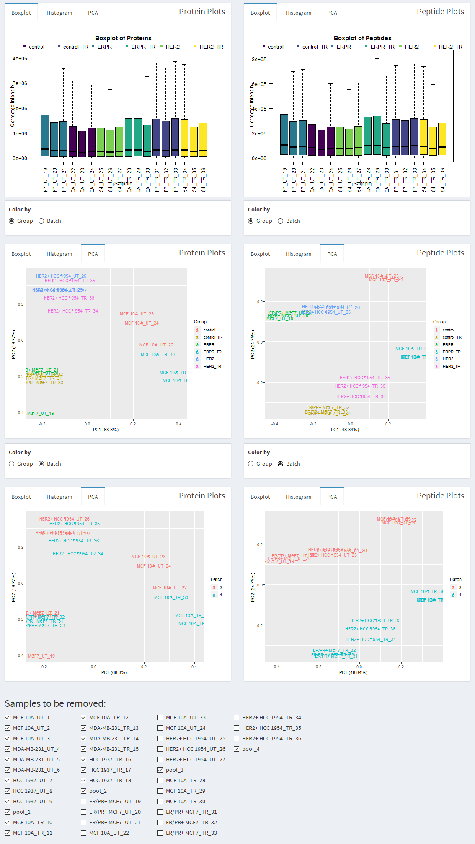
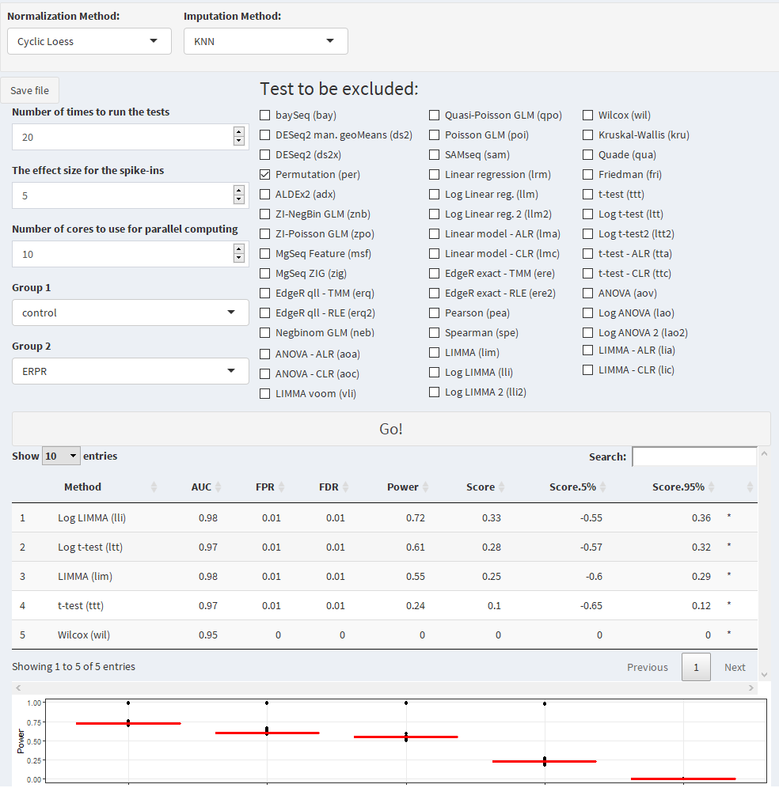
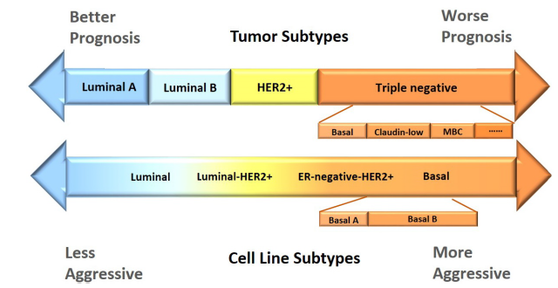

proteiNorm – A user-friendly tool for normalization and analysis of TMT and label-free protein quantification
Stefan Graw^{1,2}, Jillian Tang², Maroof Zafar¹, Alicia Byrd¹ and Stephanie D. Byrum^{1,2}
¹Department of Biochemistry and Molecular Biology, UAMS, Little Rock, AR, 72205
²Arkansas Children’s Research Institute, Little Rock, AR, 72202
Abstract
Input
Normalization
Power
The technological advances in mass spectrometry allow us to collect more comprehensive data with higher quality and increasing speed. With the rapidly increasing amount of data generated, the need for streamlining analyses becomes more apparent. Proteomic data is known to be often affected by systemic bias from unknown sources and failing to adequately normalize the data can lead to erroneous conclusions. To allow researchers to easily evaluate and compare different normalization via a user-friendly interface, we have developed “proteiNorm”.
The current implementation of proteiNorm accommodates some preliminary filter on peptide and sample level, followed by an evaluation of several popular normalization methods and identification of missing value pattern. The user then selects an adequate normalization method and one of several imputation methods used for the subsequent comparison of different differential abundance/expression methods and estimation of statistical power. The application of proteiNorm and interpretation of results is demonstrated on a Tandem Mass Tag mass spectrometry example, where the proteome of three different breast cancer cell lines was profiled.
With proteiNorm, we provide a user-friendly tool to identify an adequate normalization method and to select an appropriate method for a differential abundance/expression analysis.
Filtering
Conclusion
Filtering
Remove outlier peptides to stabilize proteins signal
Exclude undesired samples (e.g. pooled samples) or samples with poor quality
Normalization
Variety of normalization methods:
Log2 normalization
Median normalization
Mean normalization
Variance stabilizing normalization
Quantile normalization
Cyclic loess normalization
Global robust linear regression normalization
Global intensity normalization
Evaluation
Performance comparison of normalization methods
Guidance for choice of normalization and imputation method
Download normalized and imputed protein data
Power
Comparison of different differential analysis methods
Power evaluation of differential test for range of effect sizes
Future work
Support wider range of input data types
Enhance peptide level quality adjustment and control
Incorporate greater variety of normalization and imputation methods
Data
Study Design
3 breast cancer cell lines
With and without Hydroxyurea treatment
3 replicates each
2 batches
Control (MCF10As):
Non-tumorigenic epithelial cell line
Positive for epithelial sialomucins, cytokeratins and milk fat globule antigen
ERPR (MCF7; breast adenocarcinoma):
Isolated in 1970 from 69-year-old Caucasian woman
The cells express the WNT7B oncogene
HER2 (HCC1954):
Derived from primary stage IIA, grade 3 invasive ductal carcinoma with no lymph node metastases
Positive for the epithelial cell specific marker Epithelial Glycoprotein 2 and cytokeratin 19
Negative for expression of estrogen receptor (ER) and progesterone receptor (PR).
Her2/neu is overexpressed in the ELISA assay
DAtest¹
Acknowledgements
Support: This study was supported by the Arkansas Children’s Research Institute, the Arkansas Biosciences Institute, and the Center for Translational Pediatric Research under the National Institutes of Health (R21DA041822, P20GM121293, UL1TR000039, P20GM103625, S10OD018445 and P20GM103429). The authors would like to acknowledge the UAMS Proteomics Facility and the Little Rock Envoys Seeds of Science.
[1] Russel et al. (2018) DAtest: A framework for choosing differential abundance or expression method. biorXiv

