Slide 1
proteiNorm
A user-friendly tool for normalization and analysis of TMT and label-free protein quantification
Stefan Graw, PhD

Slide 2
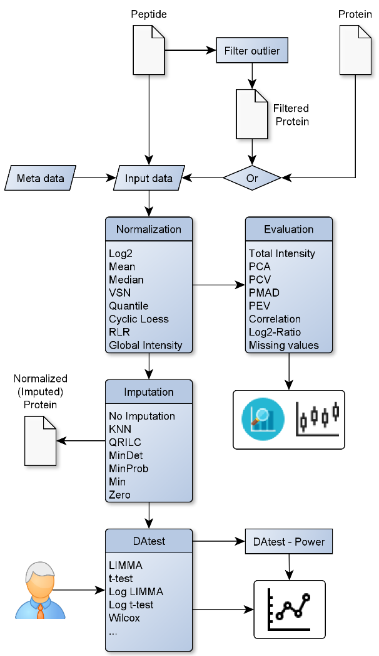
Overview

Slide 3
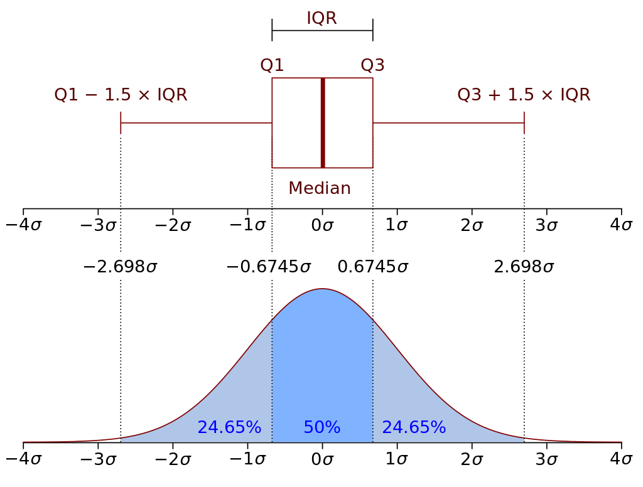
Filter outliers
https://en.wikipedia.org/wiki/Interquartile_range

Slide 4
PCA - Principal Component Analysis
Dimensionality reduction technique
Transform high dimensional data into smaller-dimensional subspace
Convert possibly correlated variables into set of values of linearly uncorrelated variables (PC: principal components)
Linear combination of variables
First principal component accounts for most variance

Slide 5
Normalization
Log2
Median
Mean
Variance stabilizing normalization (VSN) [1]
Quantile
Cyclic loess normalization (Cyclic Loess) [2]
Global robust linear regression normalization (RLR) [3]
Global Intensity [3]

Slide 6
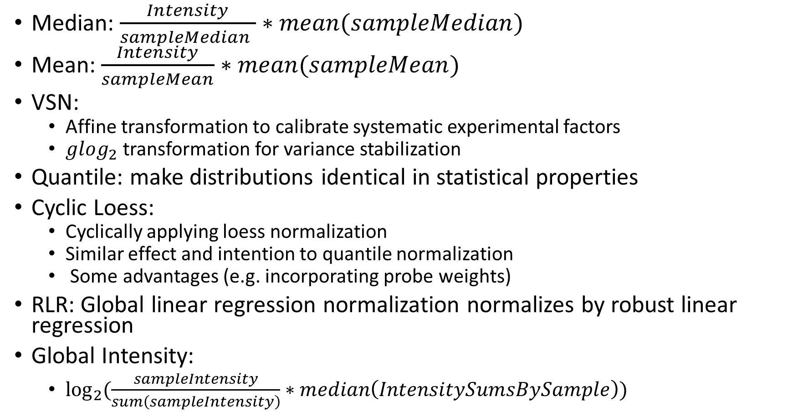
Median: $\frac{Intensity}{sampleMedian }∗mean(sampleMedian)$
Mean: $\frac{Intensity}{sampleMean}∗mean(sampleMean)$
VSN:
Affine transformation to calibrate systematic experimental factors
$glog_{2}$ transformation for variance stabilization
Quantile: make distributions identical in statistical properties
Cyclic Loess:
Cyclically applying loess normalization
Similar effect and intention to quantile normalization
Some advantages (e.g. incorporating probe weights)
RLR: Global linear regression normalization normalizes by robust linear regression
Global Intensity:
$\log_{2}{(\frac{sampleIntensity}{sum\left(sampleIntensity\right)}∗median\left(IntensitySumsBySample\right))}$
Notes:
glog = generalized logarithm

Slide 7
Normalization evaluation
Sum of normalized intensities
PCA
Pooled intragroup Coefficient of Variation (PCV)
Pooled intragroup Median Absolute Deviation (PMAD)
Pooled intragroup estimate of variance (PEV)
Intragroup correlation
Sample correlation heatmap (Pearson)
Log2-ratio distributions

Slide 8

Metrics
$PCV=mean(sd(X)/mean(X))$
$PMAD=mean(median\left(\left|X_{i}−median\left(X\right)\right|\right))$
$PEV=\frac{\sum{\left(n−1\right)∗var(X)}}{\sum{\left(n−1\right)}}$

Slide 9
DAtest & powerDA [4]
Comparing different differential abundance methods
Microbial marker-gene analysis
RNA-seq analysis
Protein/metabolite abundance analysis
Method:
Shuffle predictor variable (e.g. case/control)
Spike data for randomly chosen features
Apply tests and evaluate
Whether test finds spike-ins
Whether FDR is controlled

Slide 10
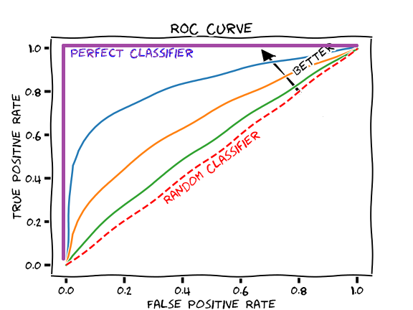
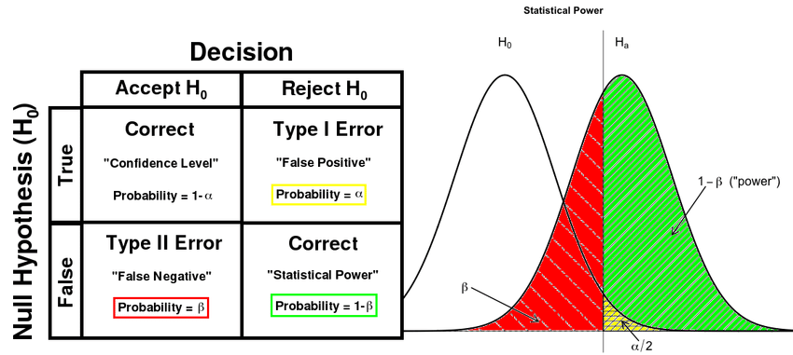
AUC & power
https://glassboxmedicine.com/2019/02/23/measuring-performance-auc-auroc/
https://www.researchgate.net/figure/Left-Definitions-of-terminologies-in-a-statistical-test-Right-An-illustration-of-power_fig3_316927316
Notes:
Sensitivity = True positive rate = TP/(TP+FN)
Specificity = 1 – False positive rate = TN/(TN+FP)
False positive rate = FP/(FP+TN)

Slide 11
References
Huber, W., et al., Variance stabilization applied to microarray data calibration and to the quantification of differential expression. Bioinformatics, 2002. 18 Suppl 1: p. S96-104.
Ritchie, M.E., et al., limma powers differential expression analyses for RNA-sequencing and microarray studies. Nucleic Acids Res, 2015. 43(7): p. e47.
Chawade, A., E. Alexandersson, and F. Levander, Normalyzer: a tool for rapid evaluation of normalization methods for omics data sets. J Proteome Res, 2014. 13(6): p. 3114-20.
Russel, J., et al., DAtest: a framework for choosing differential abundance or expression method. bioRxiv, 2018: p. 241802.

