Slide 1


GlassBox AI – A Fairness Detector for Filtering Models
SAP HACKFEST 2025 A National Level Hackathon - State Hub Round
Theme: Ethics in AI Models for Businesses - Ensuring Responsible Innovation
Presented By:
Team V - SSN College of Engineering
Vijay K (3122235001157)
Bysani Vishal (3122235001161)
Varsha M (3122235001153)
Varun P (3122235001154)
Vishal S (3122235001163)

Slide 2





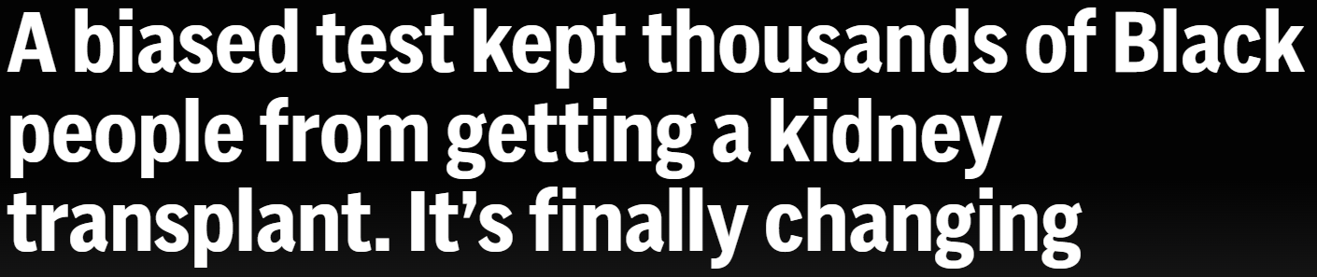
Problem
Impact
Biased and opaque AI harms individuals and undermines trust by:
Discriminating against marginalized groups
Lacking decision transparency
Risking legal and ethical violations
Eroding public trust
Businesses are increasingly integrating AI into critical decision-making areas such as:
Hiring
Healthcare
Insurance & Lending
Leading to serious concerns around fairness, accountability, and transparency.
Notes:
https://www.euronews.com/business/2018/10/10/amazon-scraps-secret-ai-recruiting-tool-that-showed-bias-against-women
https://apnews.com/article/kidney-transplant-race-black-inequity-bias-d4fabf2f3a47aab2fe8e18b2a5432135
As businesses increasingly integrate Artificial Intelligence (AI) into critical decision-making areas such as hiring, healthcare, insurance, and lending, serious concerns have emerged around fairness, accountability, and transparency.
AI systems can unintentionally discriminate, leading to biased outcomes that adversely affect individuals and marginalized groups. Moreover, the lack of transparency in AI decision-making processes leaves end users in the dark, unable to understand or challenge outcomes that impact their lives.
Organizations also struggle to detect, measure, and manage bias in their AI systems, making it difficult to ensure regulatory compliance, maintain ethical standards, and build public trust.

Slide 3
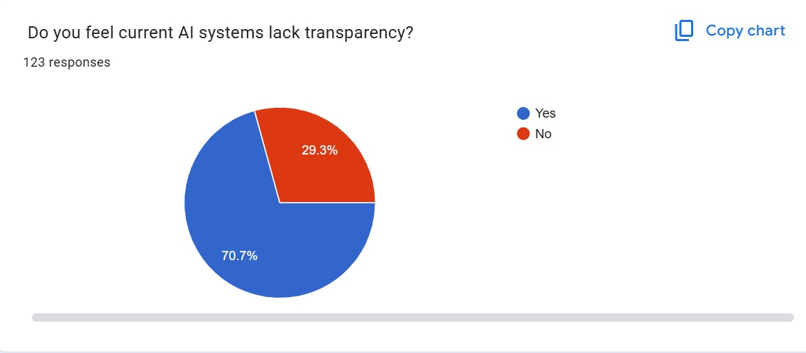
View on AI Transparency

Slide 4
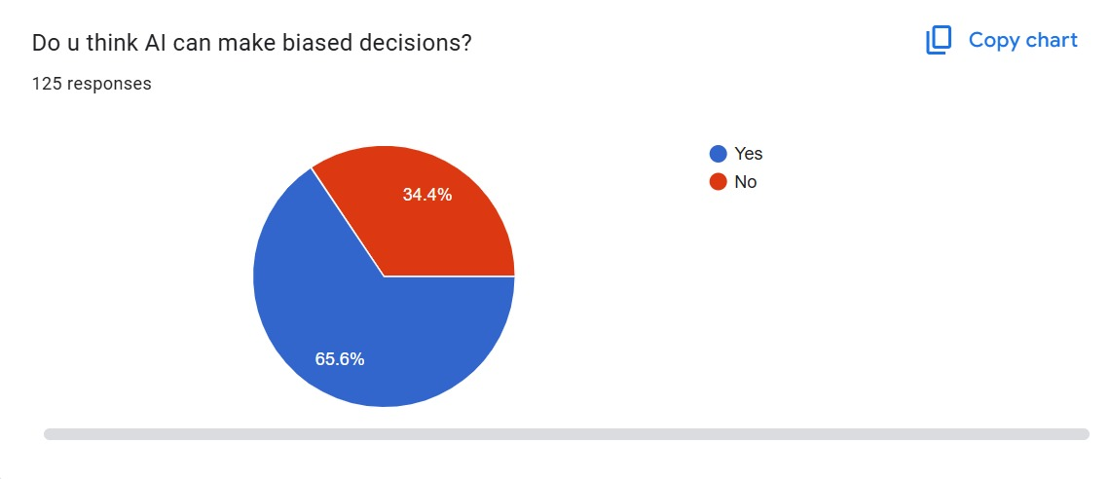
Perceived AI Capabilities

Slide 5
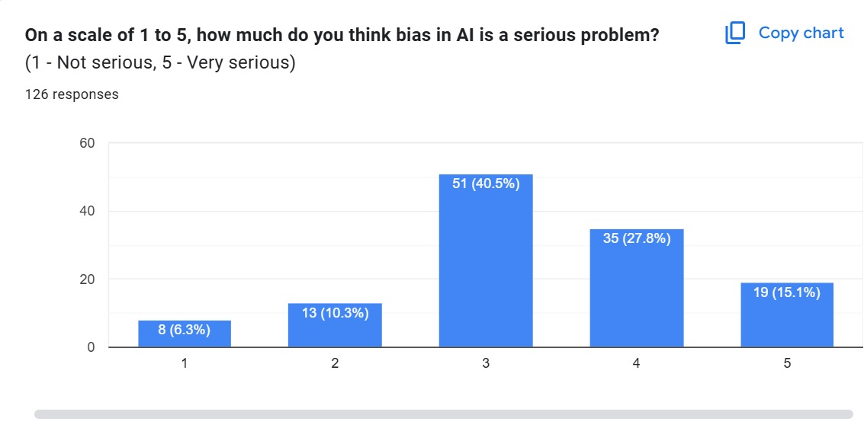
Public opinions on the impact of Biased Models

Slide 6


User Personas - A Business POV
Name: Anita
Age: 45
Role: Officer at a Bank or an Insurance Company
Name: Ram
Age: 37
Role: HR Manager at mid-sized Tech Firm
Goals: Ensure the company’s AI meets legal and ethical standards
Frustrations: Struggles to trace and explain AI decisions when audited
Why It Matters: Needs a simple way to prove the model isn’t biased and meets regulations
Goals: To hire top talent through a fair, inclusive, and compliant recruitment process
Frustrations: Frustrated by the lack of transparency and potential bias in his AI screening tool
Why It Matters: Unfair hiring could lead to legal trouble and harm the company’s reputation and diversity goals.

Slide 7
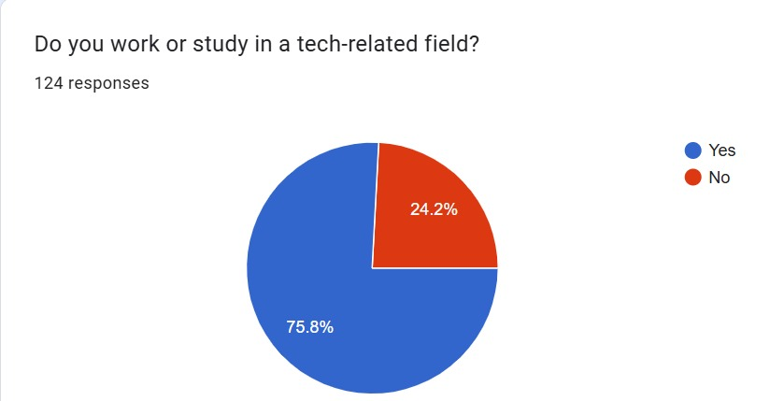
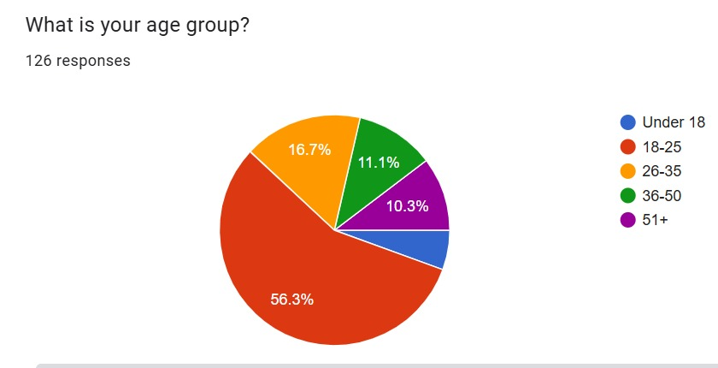
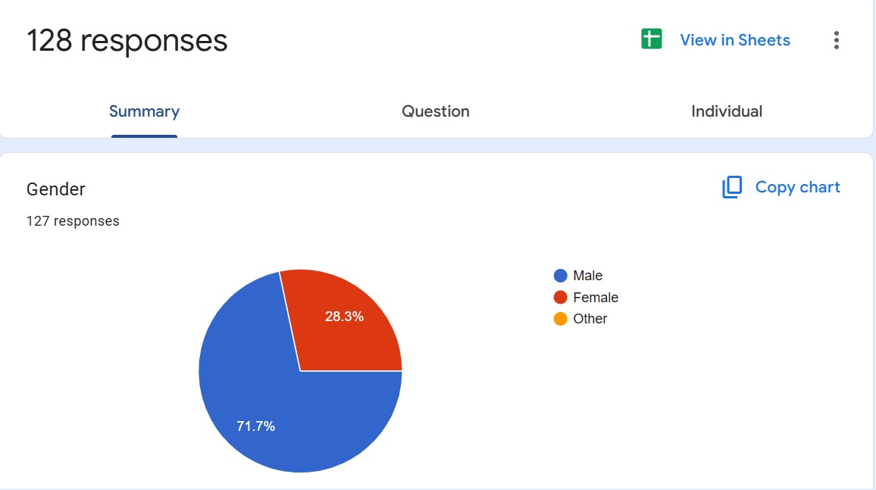
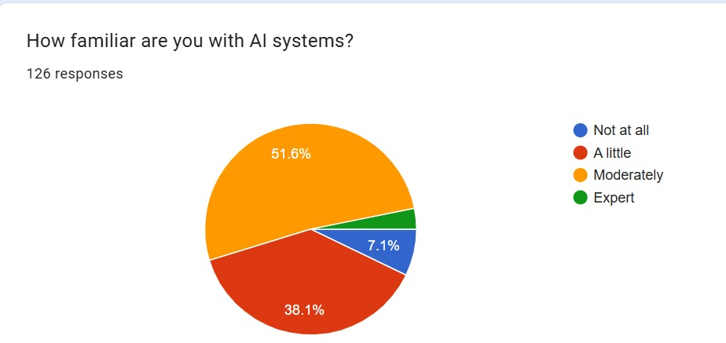

Sample Specifications

Slide 8
Situational Biases, Examples
Biased Class Weights
Indirect proxies/ Proxy Bias
Bias caused by overfitting to a majority-group testing data.
For example,preferences of common users with incomplete data to tribals with complete documentation for loan approval
Black men -underrepresented in training data- in need of transplants were denied insurance coverage
Due to using location as a proxy, model rejects promising candidate from a marginalized community due to low historical hiring rates from that zipcode.
Rejection of female candidates who have taken maternal leave as historical data shows resume gaps unsuccessful

Slide 9
Situational Biases - Continued
Bad Training Datasets
Marginalization
A Bad dataset which may not be the true representation of the population may make the model think that one class is significantly better than the other
Women being rejected from various jobs as they’re deemed to be less qualified by the model
When a model faces a new set of class, or a new set of variables previously untested, it naturally assumes that its unsafe, therefore rejecting them
People applying for loans the first time might not have a credit score, thus flagging them as unsafe

Slide 10
Needs of the User
Track and Log Model Decisions
Detect and Alert on Bias in Real-Time
Maintain a transparent audit trail of how and why AI systems make decisions, enabling accountability and post-analysis.
Continuously monitor AI outputs to identify discriminatory patterns or deviations from fairness standards as they happen.
Explain Rejected Cases
Provide Confidence
Offer clear, understandable explanations for adverse decisions (e.g., job rejections, loan denials) to impacted individuals.
Equip users with insights into AI decisions, increasing their trust in the system and ensuring they feel fairly treated.

Slide 11
Research on some Case studies
🔹 Amazon Resume Filter Bias AI recruiting tool downgraded resumes with the word “women’s” (e.g., “women’s chess club”), trained on mostly male applicant data.
🔹 Apple Card Gender Discrimination Apple’s credit algorithm gave lower credit limits to women despite identical financial profiles as male counterparts (e.g., Steve Wozniak & wife case).
🔹 Unemployment Fraud Detection Michigan's MiDAS system falsely accused 40,000+ people of fraud, relying on flawed logic without human oversight, disproportionately affecting the poor.
🔹 Bank Loan Approval Bias A 2022 study found mortgage algorithms in the U.S. were 80% more likely to deny Black and Latino applicants compared to white applicants, even when controlling for financials.
🔹 Insurance Pricing Bias Car insurance algorithms charged ZIP-code–based rates, leading to minorities paying more due to historical redlining, even with identical driving records.
🔹 Healthcare Risk Algorithms An algorithm used by hospitals rated Black patients as needing less care than white patients with the same conditions due to healthcare spending proxies.

Slide 12
Problem Statement
Considering all of the previously stated factors, we define the problem statement as follows:
Lack of Transparency : Increased deployment of AI models in critical areas like hiring, lending, and insurance without providing clarity on how automated decisions are made.
Unintentional Bias: AI systems often reflect biases present in historical training data, leading to unfair outcomes for certain groups — especially minorities, women, or people with disabilities.
Trust Gap with End Users: Consumers and applicants often feel powerless or uninformed when rejected by AI-driven decisions, which undermines trust in the business and its technology.
Lack of Tools for Continuous Fairness Monitoring: Existing systems focus heavily on accuracy and performance — overlooking real-time bias detection, version tracking, and meaningful logs for audit or end-user reporting.

Slide 13
The Solution? GlassBox AI
.
Log Transactions
Repair Models
Provide Certifications and Scores
Collaborate with Users and Businesses

Slide 14
What it is
A fairness-auditing software that lets companies upload models and users upload real documents (like resumes). Every decision the model makes is logged — and deeply analyzed for bias.
How it Works
Companies upload their AI models into our software, with all their custom embeddings and weights
Users submit real-world inputs (e.g., resumes) (or) Companies partnered with us can test with a large corpus of data
The model runs — and every weight, decision, calculation is logged privately on blockchain visible only to us
Outcome is shown with a high-level abstract explanation ("Rejected – Skill Gap") to the users to protect the Company’s Proprietary tech and to make sure abuse of models for perfect resumes don’t happen.
A Fairness Score is computed and made public. If fairness degrades below a threshold, certification is revoked. This score is computed by our software after analyzing the logs.
The company, if willing can partner with us even now, to use the logs to aid them rectify the model.

Slide 15
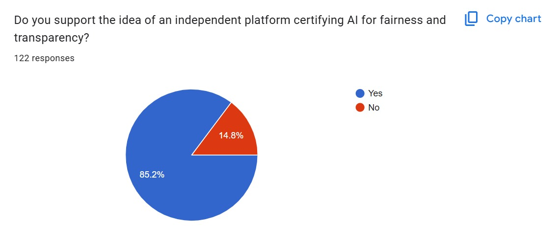
Feedback on a Preliminary Solution

Slide 16
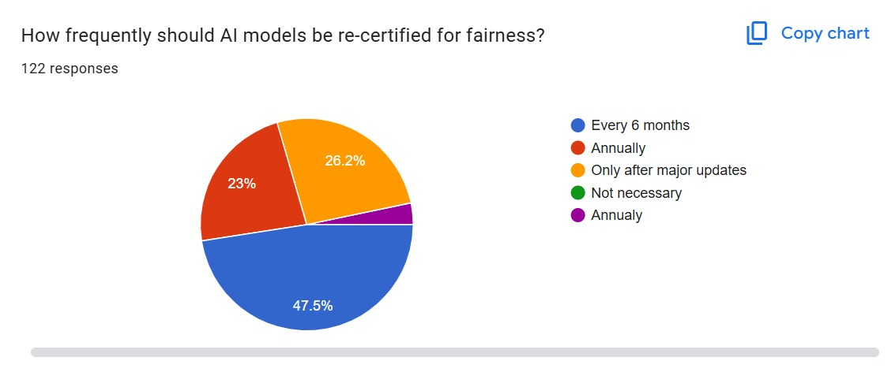


Revoking Fairness - Drift Bias

Slide 17
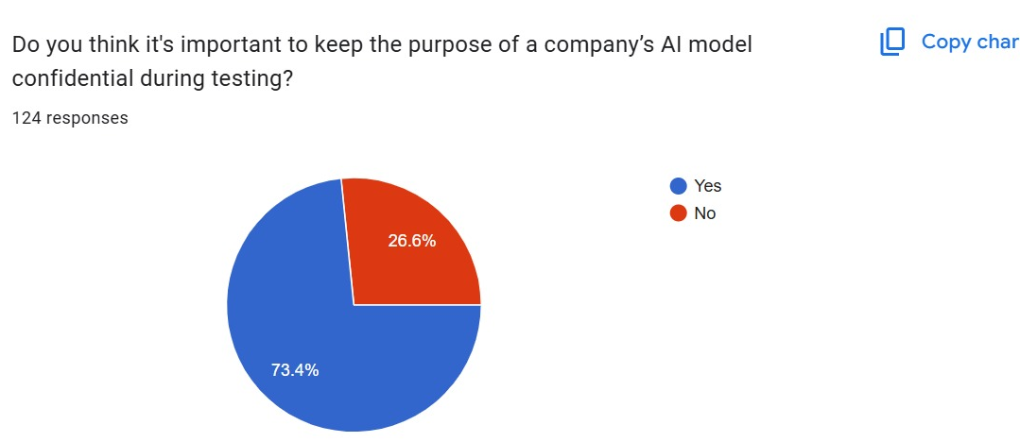
Concerns Addressed

Slide 18
Salient Features of GlassBox AI
Audits AI model decisions
01
Detects drift and bias
Keeps record of the AI’s decision-making for later analysis - any discovered biases are immediately flagged.
02
It checks if the AI starts treating people unfairly or if the data has changed over time.
Logs timelines of inferences
03
Displays compliance insights
It saves each AI decision along with the time it happened, enabling us to see snapshots of decisions and help for RL.
04
It shows whether the AI is following rules and fairness standards through easy-to-read reports.

Slide 19
05
Uncovers Deep & Proxy Biases
It examines not just direct features, but also hidden correlations (zip code ↔ race) and class imbalances as well.
Simulates Adversarial Cases
06
Provides Public Fairness Scores
Uses adversarial AI to generate thousands of synthetic scenarios to test model robustness and uncover hidden vulnerabilities.
07
Each model gets a live fairness score. If bias is detected, the score drops, and certification can be revoked.
Enables Model Reinforcement
08
Empowers Whistleblowers
Offers access to logs, failed cases, and synthetic edge tests to retrain and improve models using reinforcement learning techniques.
09
Users can directly test models with real data like resumes. It’s a direct channel for external validation and bias exposure.

Slide 20







Overall Solution Workflow
Bias Engine Checks
Logs Saved
Alert Generated/ Results Shown
Model Predicts
AI Audit Workflow Diagram
Data Submitted
User Views
Dashboard
This flowchart shows how GlassBox AI audits models step by step.

Slide 21
Our Edge Over Other Tools
Feature | Traditional Fairness Tools | Glass Box AI
Controlled dataset tests | ✅ | ✅
Real-world whistleblower testing | ❌ | ✅
Transaction-level internal logs | ❌ | ✅
Blockchain log storage | ❌ | ✅
Public Fairness Score + Certification | ⚠️ | ✅
Deep bias types (proxy, transitive, adversarial) | ❌ | ✅
Model repair via RL & adversarial sims | ❌ | ✅

Slide 22
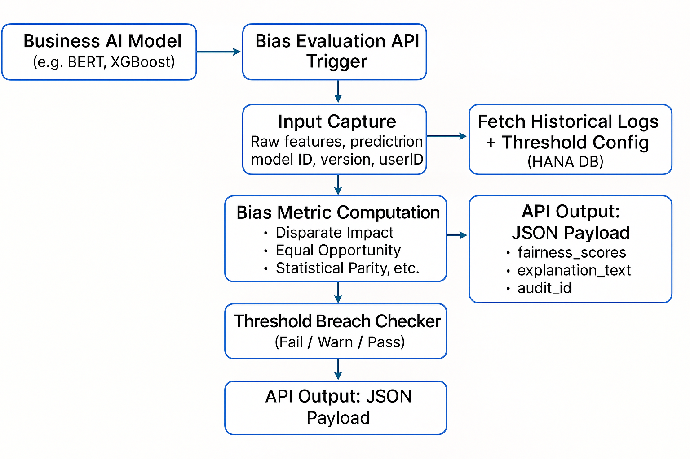
Prototype Implementation - Bias Eval API

Slide 23
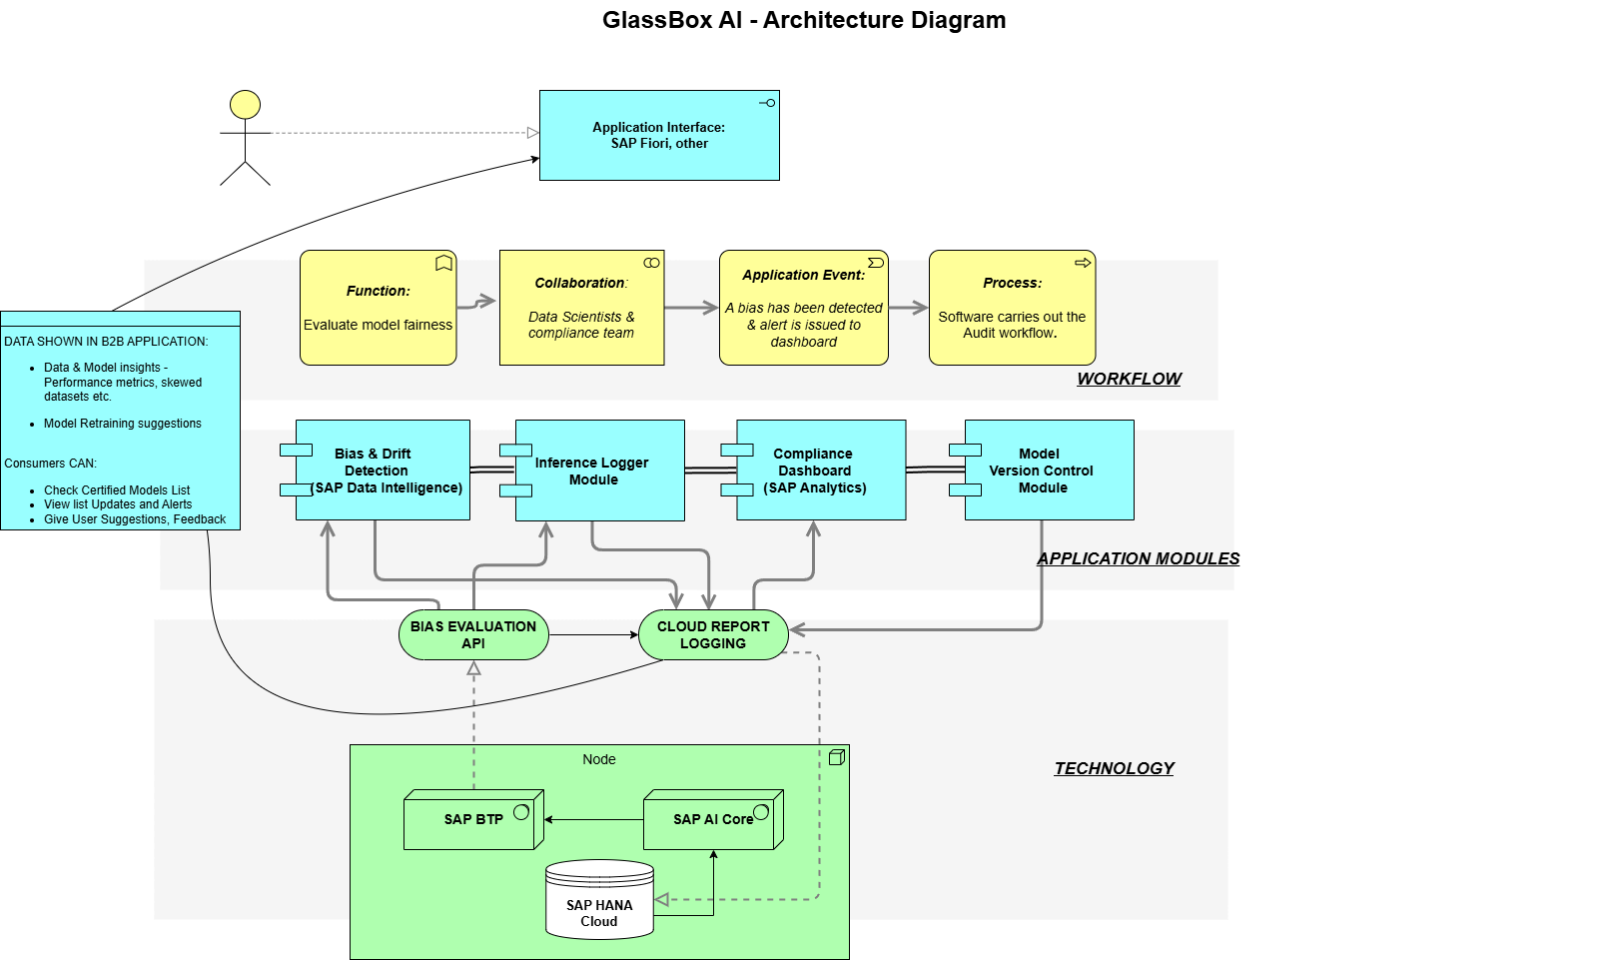
Architectural Diagram

Slide 24
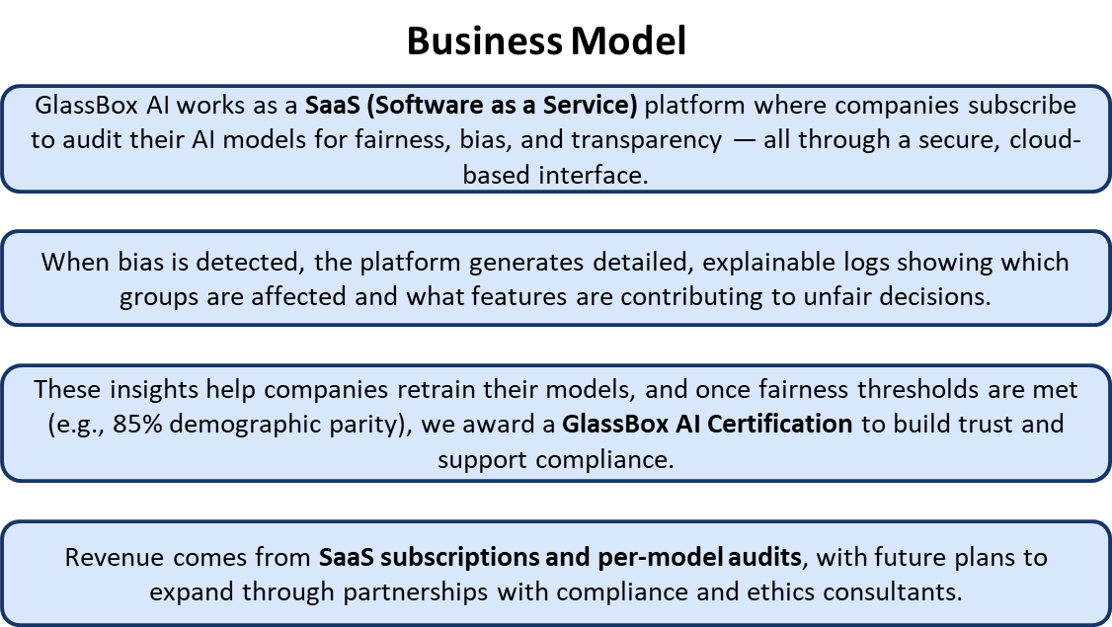

Slide 25
SAP Working Tools
How It Works using SAP Tools:
SAP AI Core – Runs and manages model inference
SAP Data Intelligence Cloud – Monitors data drift and bias in real-time
SAP Analytics Cloud – Visualizes metrics, alerts, and compliance dashboards
How It Works using Free/Open-Source Tools:
Scikit-learn / TensorFlow – Build and run machine learning models
Streamlit / Flask – Create interactive user interfaces and dashboards
MongoDB / PostgreSQL – Store inference logs and audit trails
Fairlearn / AIF360 / SHAP – Analyze fairness and explain model decisions

Slide 26




Impact & Benefits - Benchmarks
Human-Readable Explanations
Provides clear, understandable reasons behind AI decisions - no black box.
Real-time Detection
Instantly flags bias or model drift as it happens, enabling quick response.
End-User Trust & Regulatory Readiness
Boosts user confidence and helps meet compliance and fairness standards.
Timeline Logs for Backtracking
Detailed logs let teams trace every decision step-by-step for audits or investigations.

