Slide 1
Rigel: A 1,024-Core Architecture
Research By : University of Illinois at Urbana-Champaign
Presentation for UD ECE-636 by Ben Fortener and Andrew Kordik

Slide 2
Many computational unit Architectures are either SISD like CPUs or SIMD like GPUs
SISD architectures are obviously less suitable for parallelization.
SIMD compute units only benefit applications where there is a lot of data that needs the same operation performed. More general applications do not benefit
MIMD architectures benefit from being more generic and support a greater variety of applications.

Slide 3
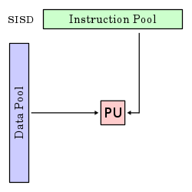
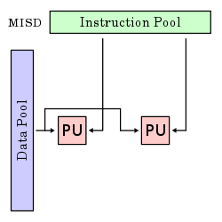
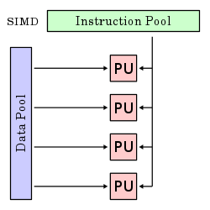
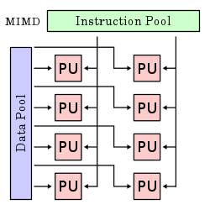
Flynn’s Taxonomy

Slide 4
Rigels Goals
Data AND Task parallelism (MIMD)
(Operations/sec)/mm^2
Balance between performance and being Programmer friendly

Slide 5
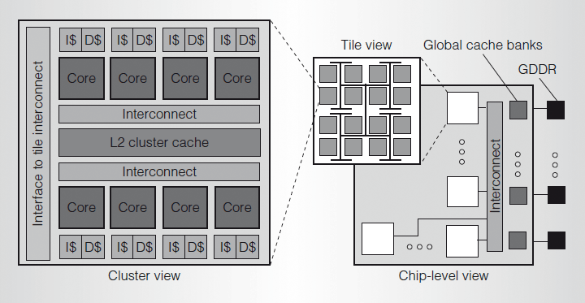
Rigel Architecture

Slide 6
Core Specs
Dual-issue, in-order, 32-bit RISC, Single precision FPU, Separated Fetch unit
8 Cores per cluster
16 clusters per tile
8 tiles total = 1024 cores
No core-to-core direct communication
Top Level cache uses 8 32-bit GDDR5 memory controlers and 32 global cache banks

Slide 7
Memory
All cores share a single address space
Local cache, Cluster Cache, Tile Cache, Global Cache

