Slide 1
Information-rich programming in F#
Tomas Petricek, University of Cambridge
Don Syme and the F# team, Microsoft
ML Workshop (Copenhagen, 13 September, 2012)

Slide 2
The confusion of languages

Slide 3
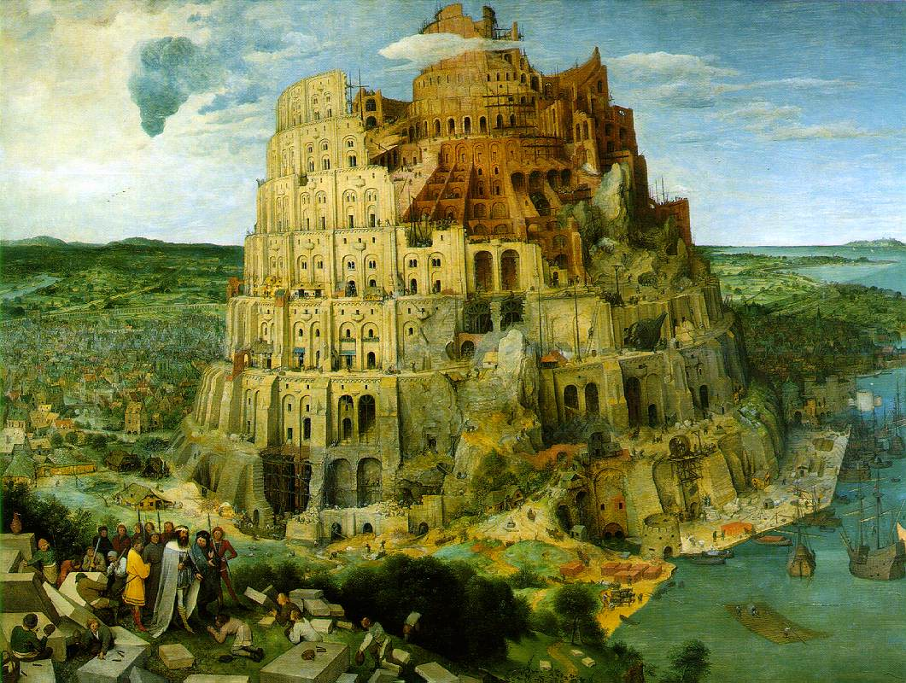
The confusion of languages

Slide 4
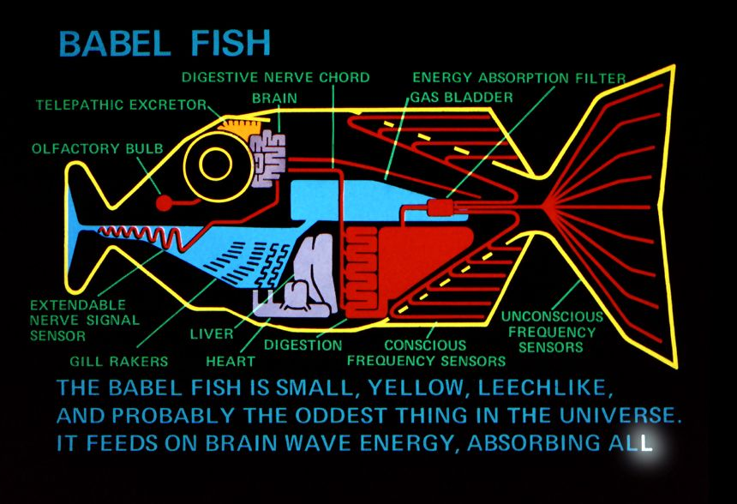
What is a type provider?

Slide 5
DEMO: Accessing World Bank
Comparing university enrollment rate in Czech Republic and OECD countries

Slide 6
Problems with data access
Data is not types with members
Use dynamic languages?
Need to know names of properties
Use code generation and static languages?
Enormous scale of data sources
Types need to be generated “on demand”

Slide 7
Components of a type provider
Compiler
Type-Check Provided Types
Compile using Type Provider
Type provider
IDE
IntelliSense for Provided Types

Slide 8
Research problems
Mapping data sources to types
What is a type? What is a value?
Types are provided on demand
Cannot generate all indicator types at once!
Representing data source properties as types
Physical units, provenance, temporal properties
Adapting to schema change
Type soundness is relative w.r.t. data source changes

Slide 9
Mapping data source to types
Country
Indicator
Year

Slide 10
Research problems
Mapping data sources to types
What is a type? What is a value?
Types are provided on demand
Cannot generate all indicator types at once!
Representing data source properties as types
Physical units, provenance, temporal properties
Adapting to schema change
Type soundness is relative w.r.t. data source changes

Slide 11
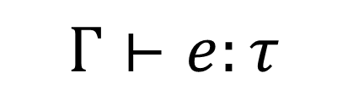
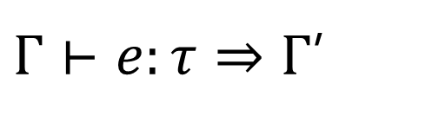
Gamma, The Forgotten
Standard typing judgments
Gamma on steroids
Reducing delayed context
$$Γ⊢e:τ$$
Γ = …, WB.DataContext
WB.DataContext = Countries : delay (…)
WB.DataContext = Countries : Country list
$Γ⊢e:τ⇒Γ$’

Slide 12
Research problems
Mapping data sources to types
What is a type? What is a value?
Types are provided on demand
Cannot generate all indicator types at once!
Representing data source properties as types
Physical units, provenance, temporal properties
Adapting to schema change
Type soundness is relative w.r.t. data source changes

Slide 13
DEMO: XML Type Provider
Working with XML data and adapting to schema change

Slide 14
Related Work
Compile-time meta-programming
Types generated eagerly, not on demand
Dependently typed languages
Type-level computation in the IO monad??
Multi-stage computations
Focus on performance vs. data access

Slide 15
For more information
Upcoming technical report
Don Syme, et al. Strongly-Typed Language Support for an Information-Rich World
Workshop on related topics
Data Driven Functional Programming Workshop, Co-located with POPL 2013

Slide 16
Summary
Mismatch between data and types
Type providers bridge the gap
Development-time, compile-time & run-time
Interesting future questions
Relative type safety and schema change
Capturing meta-data with types

Slide 17
Research problems
Mapping data sources to types
What is a type? What is a value?
Types are provided on demand
Cannot generate all indicator types at once!
Representing data source properties as types
Physical units, provenance, temporal properties
Adapting to schema change
Type soundness is relative w.r.t. data source changes

Slide 18
DEMO: FreeBase Type Provider
Working with chemistry data and units of measure

Slide 19
Structure of a Simple Provider
[<TypeProvider>]
type SampleTypeProvider(config: TypeProviderConfig) =
inherit TypeProviderForNamespaces()
// Define new type Samples.GeneratedType
let thisAssembly = Assembly.GetExecutingAssembly()
let providedType = ProvidedTypeDefinition( ... )
do
// Add property 'Hello' that just returns a string
ProvidedProperty
( "Hello", typeof<string>, IsStatic = true,
GetterCode = fun args -> <@@ Runtime.lookup "Hello" @@>)
|> providedType.AddMember
// Register the type with the compiler
this.AddNamespace(namespaceName, [ providedType ])

Slide 20
Compile-Time vs. Run-time

Slide 21
Compile-Time vs. Run-time

Slide 22
Queries in F#
Can be turned to quotations
Extensible query language
query { for movie in netflix.Titles do
where (movie.Name.Contains(search))
select movie }
query { for index in Numbers do
reverse
takeWhile index > 10 }

