Slide 1
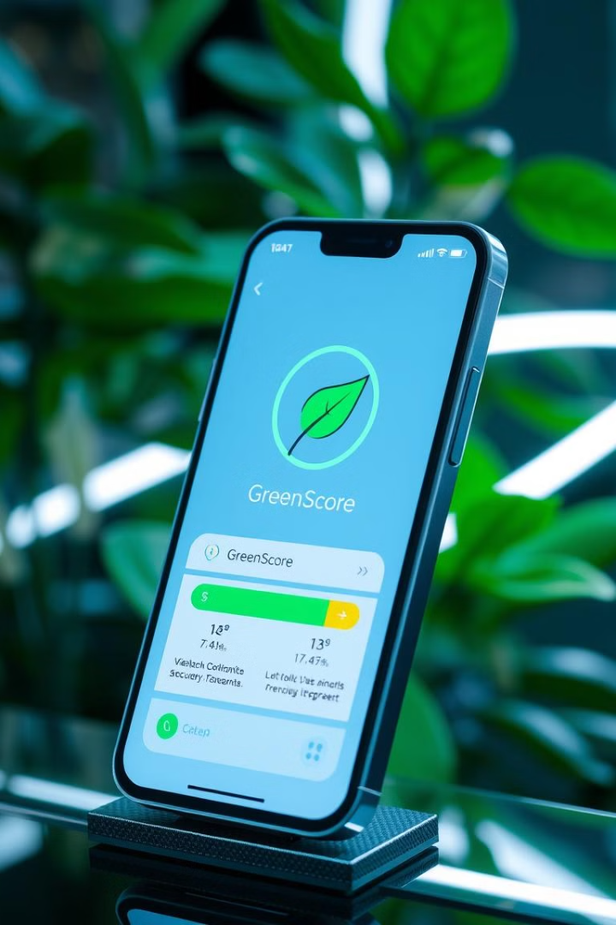
GreenScore
Empowering sustainable spending. GreenScore is a carbon footprint tracker. Users get financial incentives for eco-friendly choices. Track your impact, earn rewards, and build a greener future with every purchase.

Slide 2

The Problem We're Solving
Tracking Difficulties
Limited Incentives
Action Gap
Individuals struggle to monitor their carbon footprint due to a lack of accessible and user-friendly tools. Existing methods are often complex, time-consuming, and fail to provide personalized insights into daily spending habits.
Financial institutions find it challenging to effectively encourage sustainable behavior among their customers. Current incentive programs lack appeal, are poorly targeted, and fail to create a meaningful connection between financial rewards and eco-friendly actions.
A significant gap exists between knowing about sustainability and taking concrete action. Many people are aware of the importance of reducing their environmental impact, but they lack the knowledge, motivation, and support to translate their awareness into tangible lifestyle changes and purchasing decisions.

Slide 3

Introducing GreenScore
1
Real-Time Tracking
2
GreenScore
3
Financial Incentives
Tracks the carbon footprint of your transactions instantly, providing up-to-date insights into your environmental impact with every purchase.
Assigns you a personalized sustainability score based on your spending habits, helping you understand how your choices affect the planet.
Offers exciting rewards and exclusive benefits for making eco-conscious decisions, encouraging you to adopt a greener lifestyle while saving money.

Slide 4





How GreenScore Works
Track Transactions
Calculate Carbon
Assign GreenScore
Reward Improvement
Integrates with banking systems.
Estimates footprint of each transaction.
Scores users based on sustainability.
Offers rewards for consistent good scores.

Slide 5





Key Features
Carbon Tracking
Personalized Tips
Incentives
Offset Options
Real-time footprint analysis of your spending habits, providing clear insights into your environmental impact.
Receive tailored guidance and recommendations to reduce your emissions based on your spending patterns.
Earn cashback, exclusive discounts, and other rewards for making obtaining good green scores.
Contribute to tree planting initiatives and renewable energy projects to neutralize your carbon footprint.

Slide 6




Technology Stack
1
Mobile/Web App
2
AI/ML
3
Blockchain (Optional)
4
APIs

Slide 7
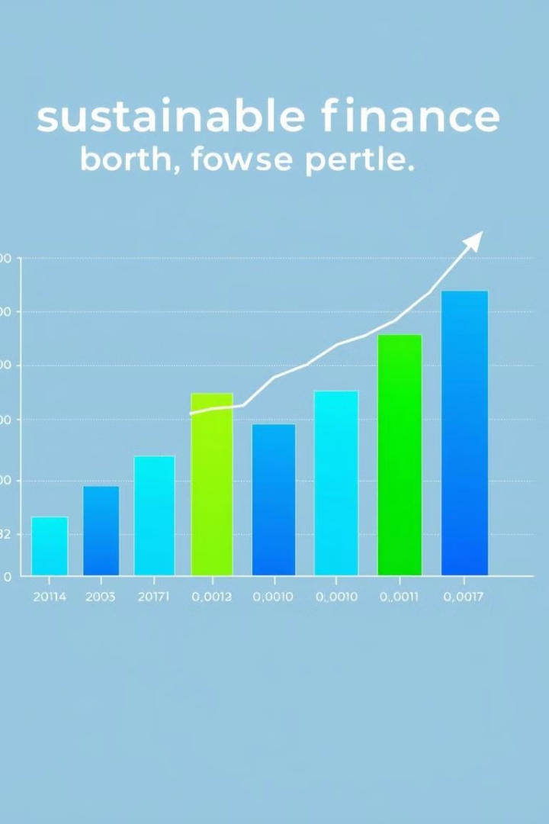
Market Opportunity
Demand Surge
Consumer Awareness
The market is experiencing a significant surge in demand for sustainable solutions. Consumers and investors are increasingly seeking eco-friendly products and services, creating a substantial market opportunity for GreenScore.
There is a rising awareness among consumers regarding the impact of their carbon footprint. People are becoming more conscious of the environmental consequences of their purchasing decisions, driving the demand for tools like GreenScore to help them make informed choices.
Potential Partnerships
GreenScore has the potential to forge valuable partnerships with banks and government entities. These collaborations can expand GreenScore's reach, provide access to a wider customer base, and facilitate the integration of sustainability into mainstream financial practices.

Slide 8




Business Model
Bank Partnerships
Business Subscriptions
Collaborate with financial institutions to offer GreenScore as a value-added service to their customers, integrating our carbon tracking and scoring system into their existing banking apps and platforms.
Provide premium subscriptions to businesses seeking to enhance their sustainability efforts, offering advanced analytics, reporting tools, and customized recommendations for reducing their carbon footprint.
1
2
Affiliate Marketing
Offset Revenue
Partner with eco-friendly brands and retailers to promote sustainable products and services, earning commissions on sales generated through our platform while promoting environmentally responsible consumption.
4
Generate revenue by facilitating carbon offsetting initiatives, enabling users to invest in verified carbon reduction projects, such as tree planting and renewable energy, through our platform.
3

Slide 9
The Impact of GreenScore
1
Eco-Spending
2
Meet ESG Goals
3
Reduce Carbon Emissions

Slide 10

Challenges & Solutions
Challenge
Solution
Calculating carbon footprint.
Use databases and AI.
Securing partnerships.
Pilot programs.
User data privacy.
Encryption, compliance.
Managing Smaller transactions.
implement a minimum transaction limit
Unable to keep track of cash related transaction
Allow users to manually update their cash expenses

