Slide 1
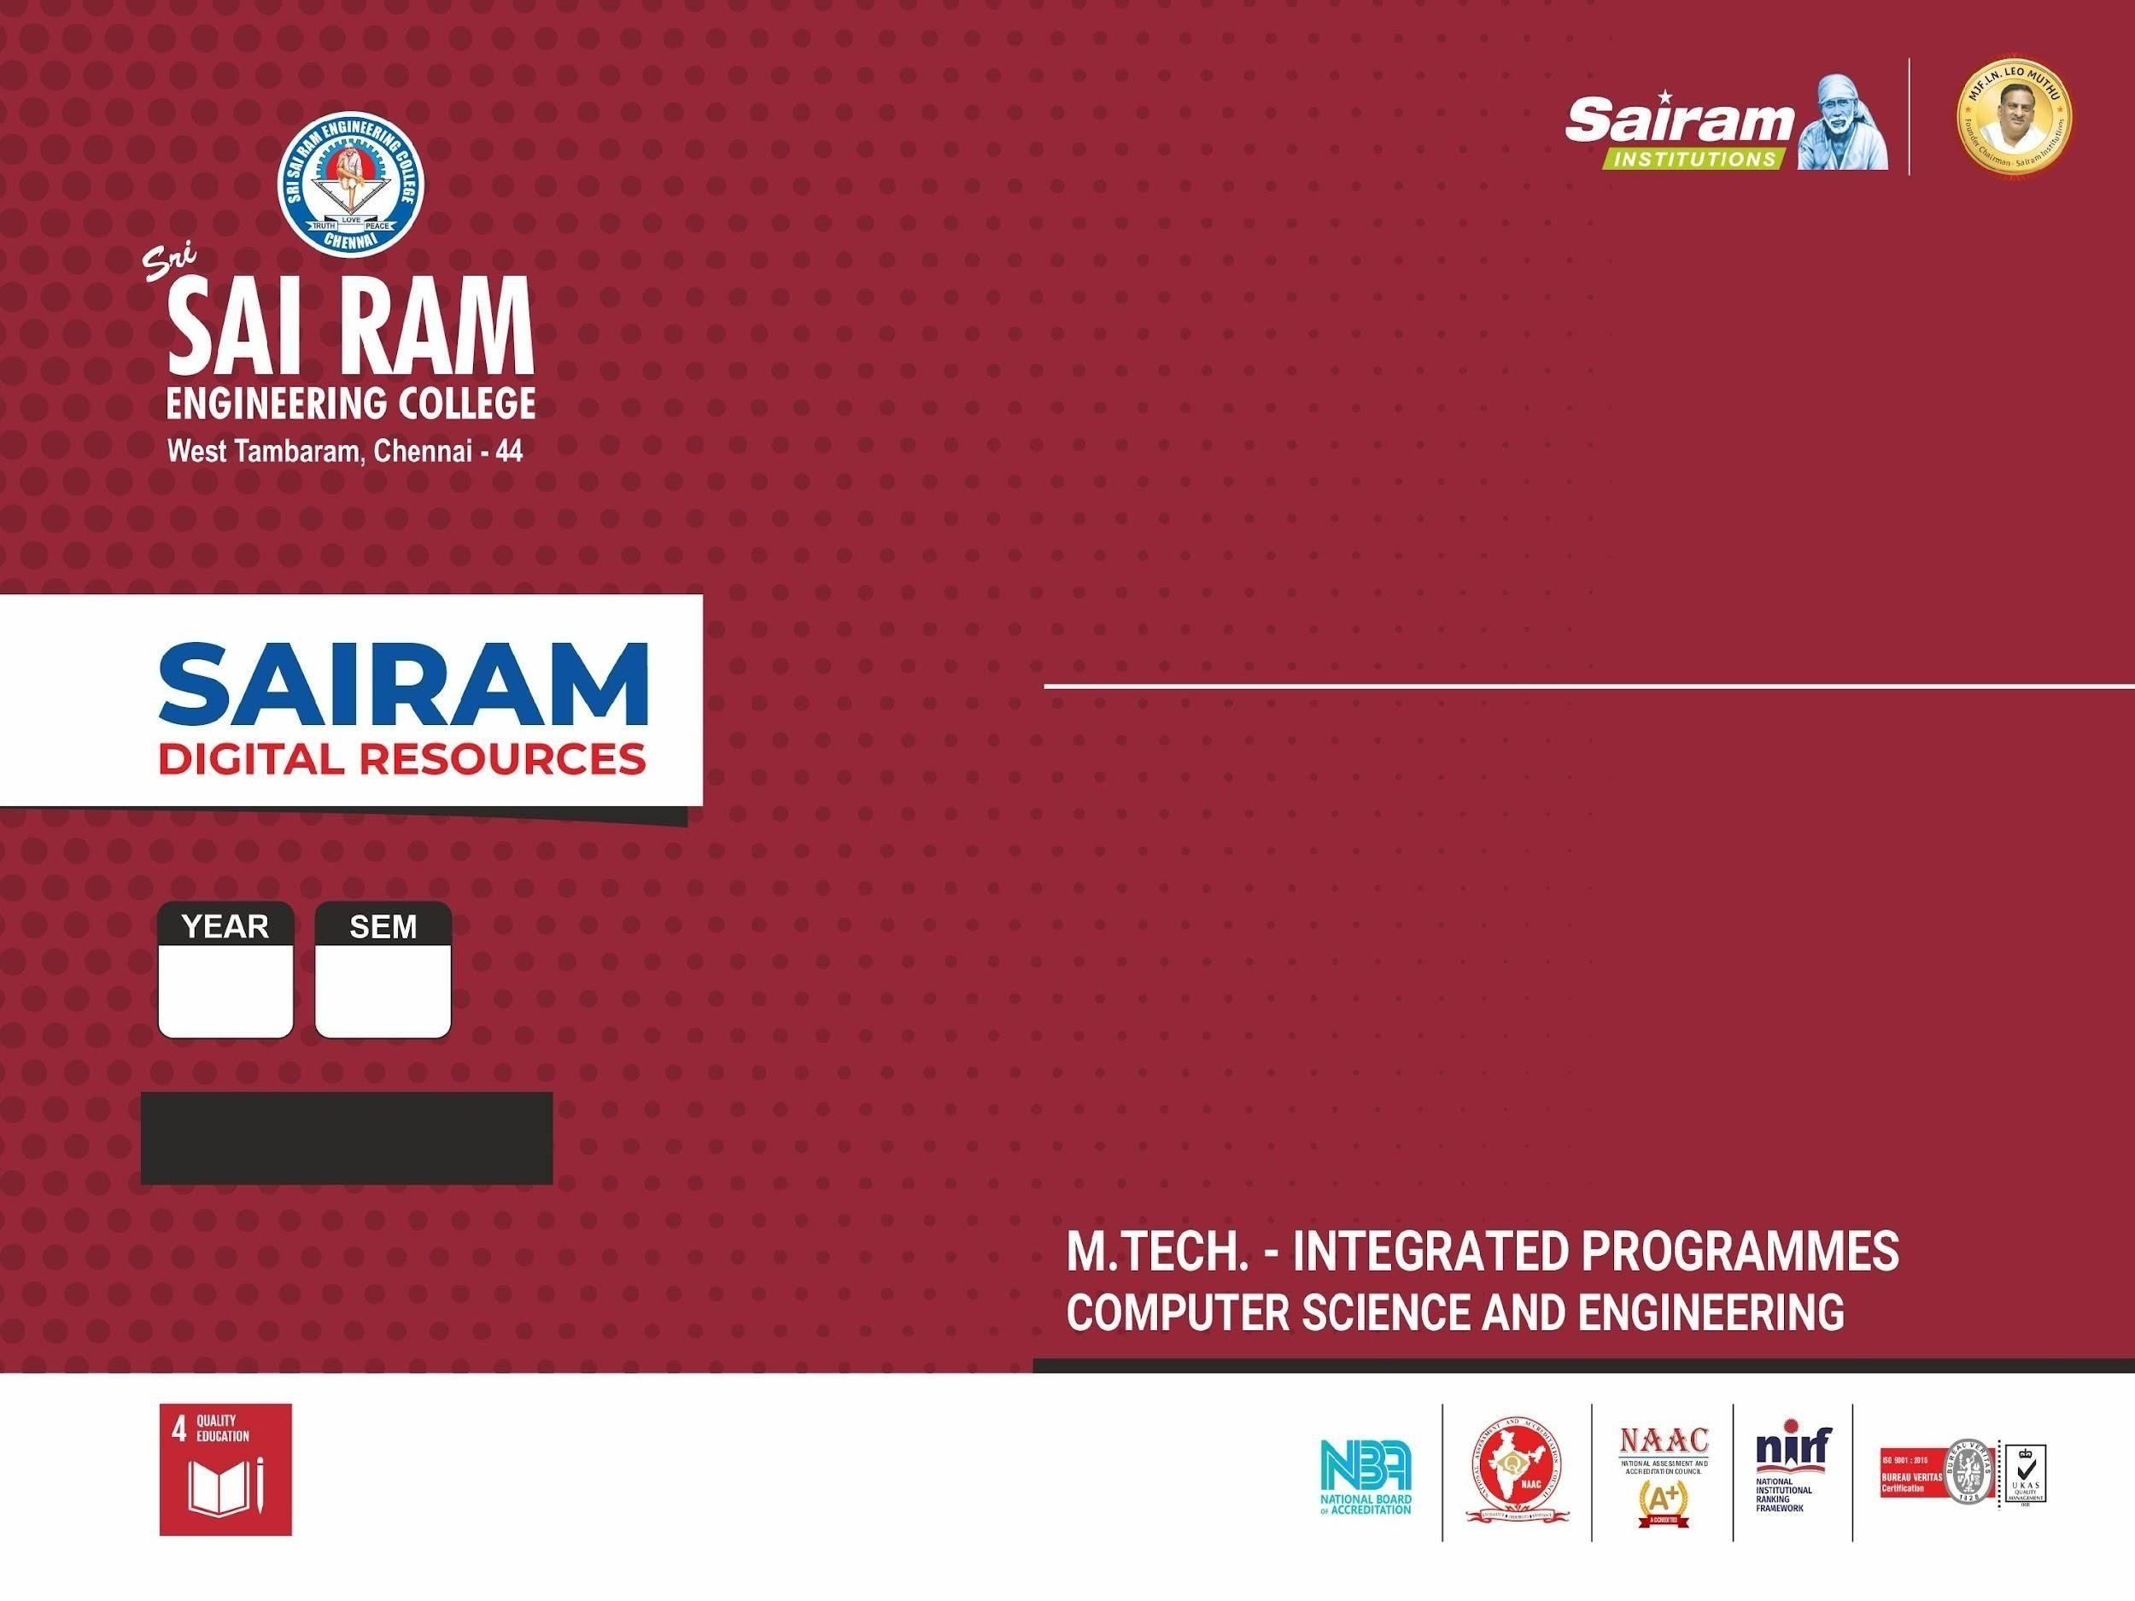

M.Tech Thesis Proposal
A Multimodal Knowledge Graph for Industrial Equipment Fault Diagnosis and Maintenance Documentation
Student :
V IX
M.Tech
Integrated Programme - Computer Science and Engineering
Guided By:Ms. V Saranya
Krishna

Slide 2
Domain of the Project
20CJPJ901
Applied AI for Industrial Manufacturing, at the intersection of multi-modal Retrieval-Augmented Generation (RAG), Knowledge Graph construction and graph-based reasoning, Human-in-the-Loop (HITL) verification for high-stakes domains, and computer vision for engineering diagram (P&ID) interpretation. Sub-domain: Question Answering support for centrifugal pump equipment using heterogeneous industrial documentation such as manuals, maintenance logs, P&IDs, and spec sheets as the knowledge source.

Slide 3
BACKGROUND AND GAP
20CJPJ901
Industrial equipment documentation, manuals, maintenance logs, P&IDs, and spec tables, is heterogeneous and technical. Recent multi-modal RAG systems such as ManuRAG (Journal of Intelligent Manufacturing, 2026) retrieve information as independent chunks ranked by embedding similarity. This works for single-fact lookup, but factual correctness drops to 45.75% on multi-hop, review/reasoning-type questions, its weakest reported category, since a causal chain spanning multiple documents is never explicitly linked.
ChatP&ID (AIChE Journal, 2026) shows that converting P&IDs into a knowledge graph improves QA accuracy by 18% and cuts token cost by 85%, but works only on standardized DEXPI-format diagrams and includes no human verification loop. The exact gap: no existing system combines multi-modal RAG, a knowledge graph built from both text and vision-parsed engineering diagrams, and an expert-in-the-loop correction mechanism together.

Slide 4
Research Objective
20CJPJ901
Primary goal: Design and evaluate a knowledge-graph-augmented, multi-modal RAG system for centrifugal pump documentation that improves factual correctness on multi-hop, causal, and relational maintenance queries beyond vector-only baselines, while providing traceable, expert-correctable answers. Main research question: Does augmenting multi-modal RAG with a knowledge graph built from text and vision-parsed engineering diagrams, combined with human-in-the-loop verification, significantly improve factual correctness on multi-hop maintenance questions compared to vector-retrieval-only baselines?

Slide 5
LITERATURE SURVEY
20CJPJ901
1. ManuRAG: Multi-modal RAG for Manufacturing QA — Li, Dong, Ameri, Zhang, Journal of Intelligent Manufacturing (Springer), 2026. Core base paper; multi-modal RAG backbone. Gap: retrieves independent chunks by similarity only, no knowledge graph; 45.75% factual correctness on multi-hop questions. 2. ChatP&ID: GraphRAG for Engineering Diagrams — AIChE Journal (Wiley), 2026. Supporting base paper; first GraphRAG application to P&IDs. Gap: works only on standardized DEXPI-format diagrams, no HITL loop. 3. SOPRAG: Multi-view Graph Experts Retrieval for Industrial SOPs — arXiv preprint, 2026. Structure-aware graph retrieval for procedural documents; procedural focus only. 4. Knowledge graph validation by integrating LLMs and human-in-the-loop — Information Processing & Management (Elsevier), 2025. HITL validation methodology; not tied to a retrieval/QA system.

Slide 6
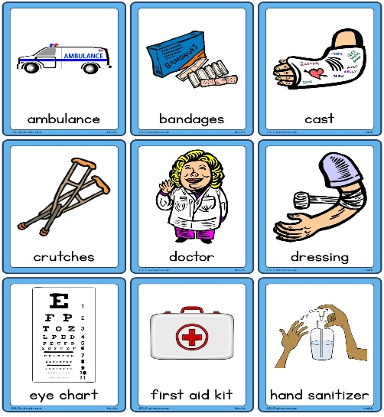
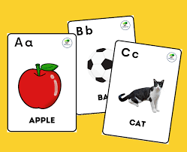
20CJPJ901
LIMITATIONS, MOTIVATION AND IMPACT
Vector-only RAG gives untraceable answers with no way to correct recurring errors, which is risky for equipment where a wrong diagnosis can cause improper maintenance actions or safety incidents. There is no structural way to identify which retrieved fact caused an error, and tacit expert knowledge never captured in manuals is missed entirely. Solving this improves diagnostic reliability, reduces unplanned downtime, supports maintenance-personnel safety in pressurized/rotating equipment, and helps preserve institutional knowledge as experienced technicians retire. The same GraphRAG plus HITL architecture generalizes to other safety-critical technical domains beyond centrifugal pumps.

Slide 7
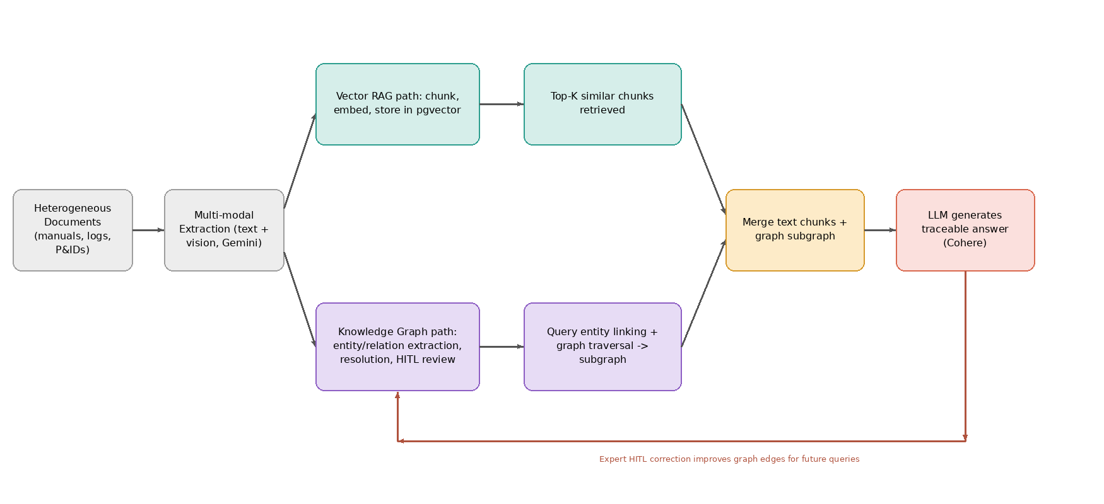
20CJPJ901
PROPOSED SOLUTION

Slide 8
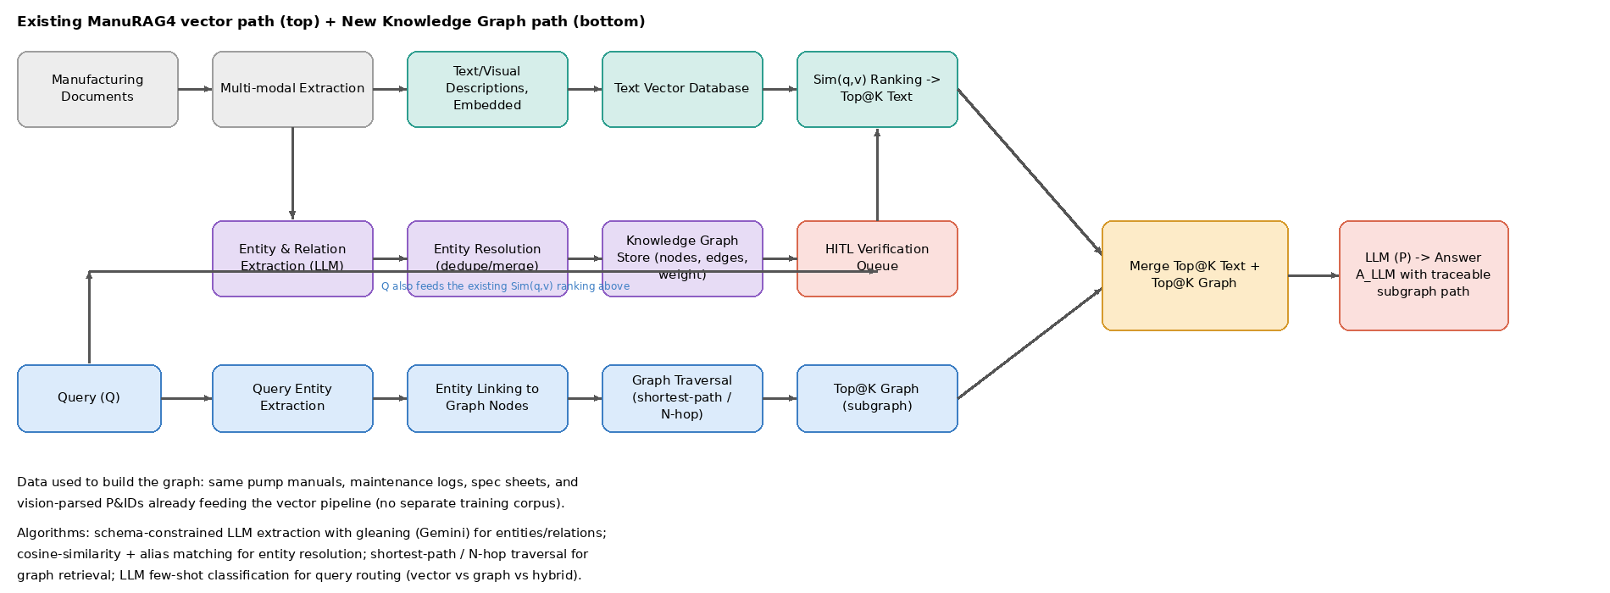
20CJPJ901
SYSTEM ARCHITECTURE

Slide 9
TOOLS AND TECHNOLOGY
20CJPJ901
Backend: FastAPI (Python). LLM and Vision: Cohere (text generation and embeddings), Gemini Vision (image and P&ID parsing). Database: PostgreSQL / Supabase with pgvector for vector storage; Neo4j or Postgres adjacency tables for the knowledge graph. Frontend: React and Vite, with React Flow for the Knowledge Graph Explorer. Object storage: S3 for raw extracted images and diagrams. Orchestration: LangChain and LangGraph for retrieval routing between vector, graph, and hybrid paths. Evaluation: RAGAS framework for factual correctness, context precision and recall. HITL interface: Verification Dashboard, extended to support graph-edge-level correction.

Slide 10
THANK YOU…!
20CJPJ901

