Slide 1
PRGC: Potential Relation and Global Correspondence Based Joint Relational Triple Extraction
刘斌轩 51215901114
https://arxiv.org/abs/2106.09895

Slide 2
previous work
Pipelined approaches which include two steps
named entity recognition
relation prediction

Slide 3
Problem
redundancy
poor generalization
inefficiency

Slide 4
Relation Judgement
PRGC
Task
Entity Extraction
Subject-object Alignment

Slide 5
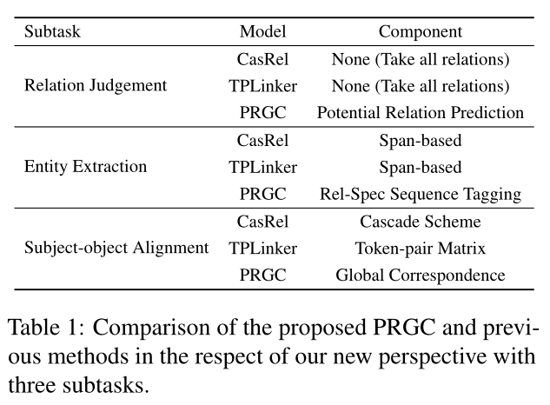

Slide 6
Relation Judgement
Potential Relation Prediction
Entity Extraction
Rel-Spec Sequence Tagging
Subject-object Alignment
Global Correspondence

Slide 7
i) Relation Judgement
aims to identify relations in a sentence
ii) Entity Extraction
aims to extract all subjects and objects in the sentence
iii) Subject-object Alignment
aims to align the subject-object pair into a triple.

Slide 8
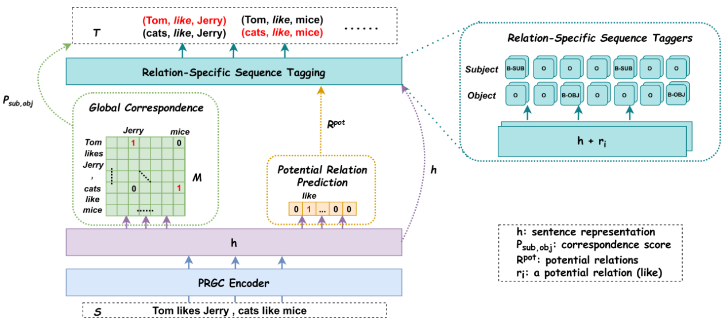
Model

Slide 9
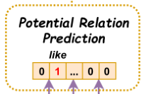


Slide 10
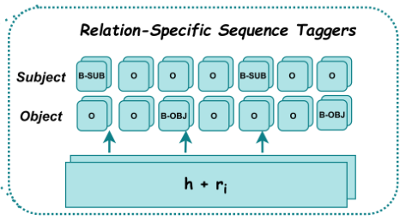
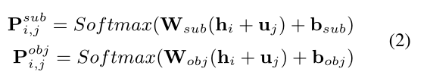

Slide 11
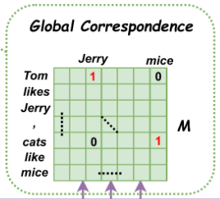

Slide 12
Model

Slide 13
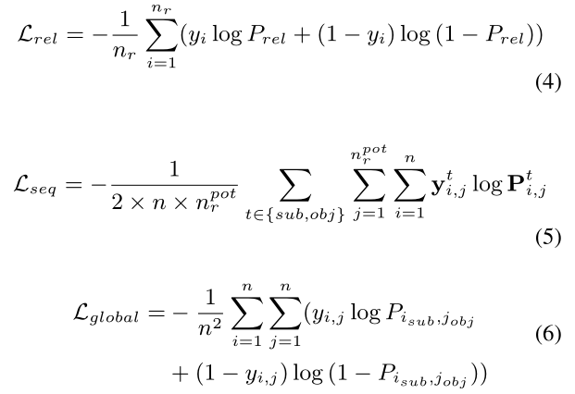

Slide 14
Datasets
NYT*
the last word of entities
NYT
WebNLG*
the whole entity
WebNLG

Slide 15
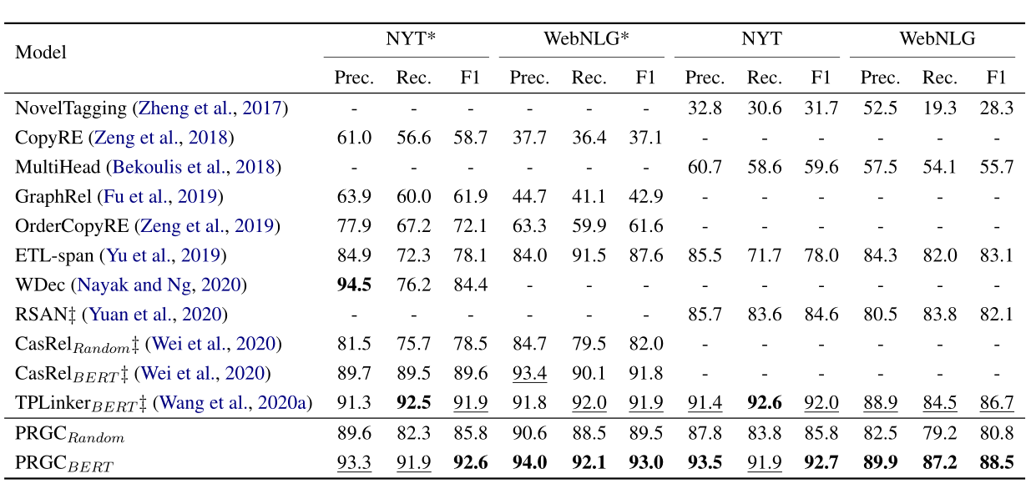
Experiments

Slide 16
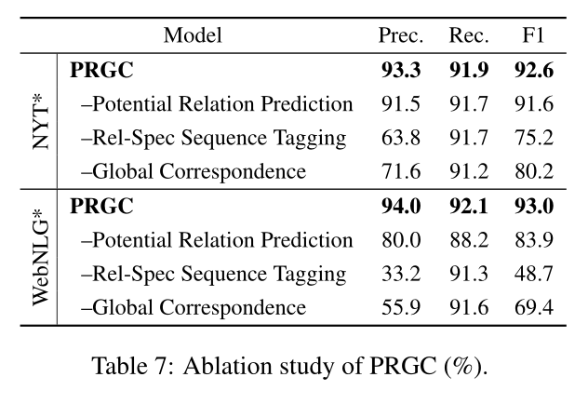

Slide 17
Problem

Slide 18
Thank You!

