Slide 1

How is BERT surprised？ Layerwise detection of linguistic anomalies
论文分享
姓名：伍洪意 学号：51215901087

Slide 2
Types of anomaly
Morphosyntactic/Syntactic: error in inflected of word (“The boy eat the sandwich.”)
Semantic: violation of semantic restriction (“The house ate the sandwich.”)
Commonsense: situation that's atypical in real world (“The customer served the waitress.”)

Slide 3
Syntactic and semantic anomalies
syntactic anomalies：
*The cat won't eating the food
*Furiously sleep ideas green colorless
semantic anomalies：
#The plane laughed at the runway
#colorless green ideas sleep furiously
Research Question: Are LMs sensitive to different types of linguistic anomalies?

Slide 4
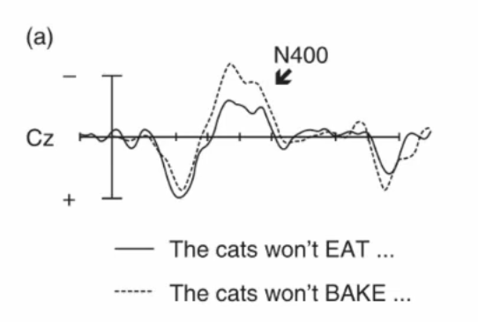
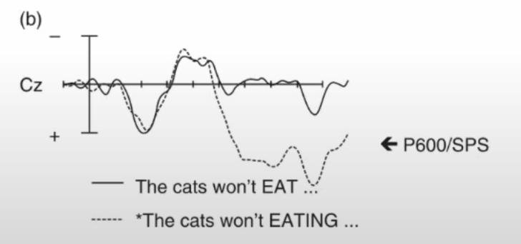
Motivation from N400 / P600
Early work on event-related potenials found semantic anomalies trigger N400, while syntactic anomalies trigger P600.
But follow-up experiments found it's not so simple.

Slide 5
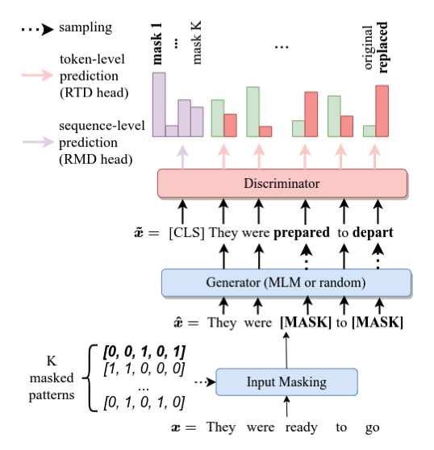
Background
anomaly detection
transformer
language model
the cause of anomaly
LMs do not compute likelihoods at
intermediate layers – only at the final layer.

Slide 6
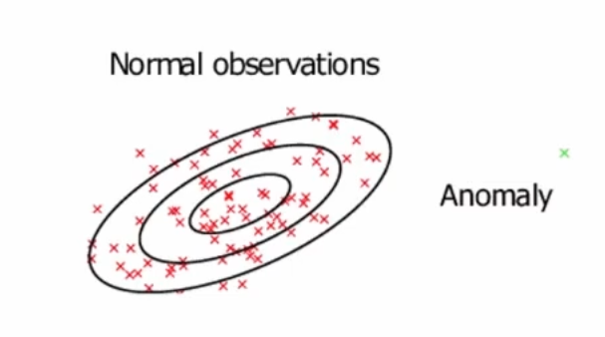
Proposed Method: Gaussian Model
Ideas: Train a Gaussian model (one per layer) on BERT embeddings from in-domain text (BNC).
Surprisal of new point = log likelihood according to this Gaussian distribution.

Slide 7
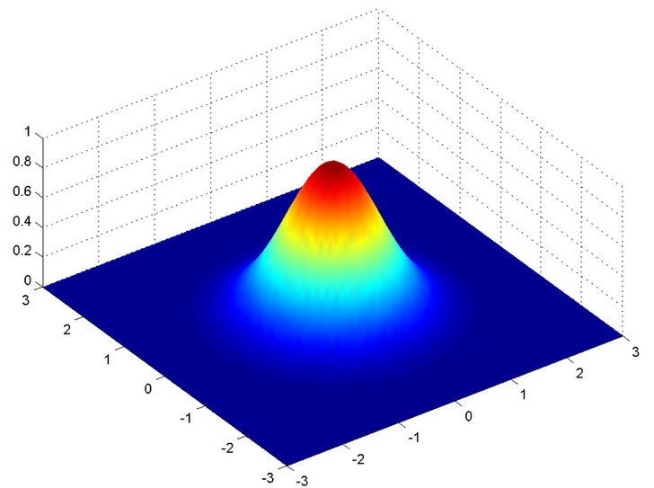
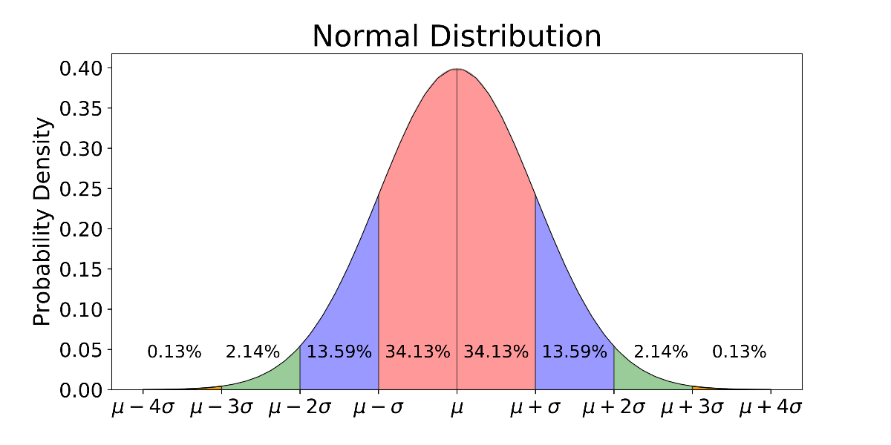

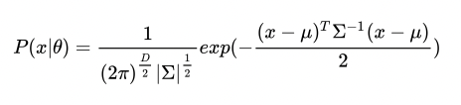
Gaussian model
One-dimensional gaussian distribution
N-dimensional gaussian distribution
mean -> vector
standard deviation -> covariance matrix
one-dimensional -> n-dimensional

Slide 8
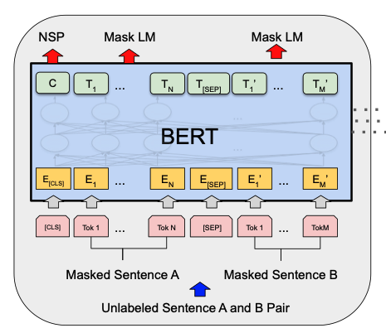
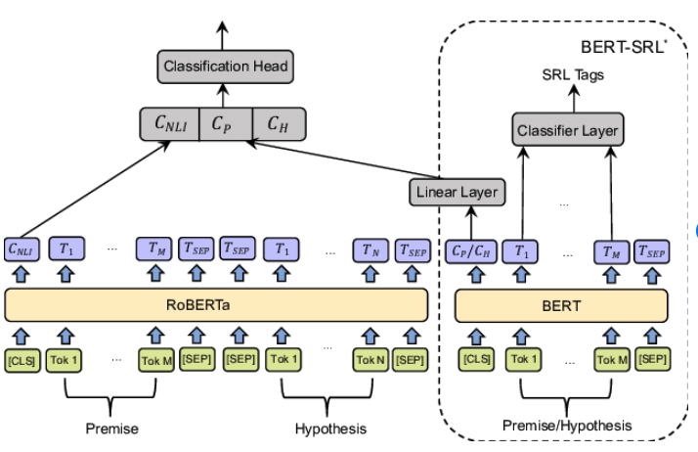
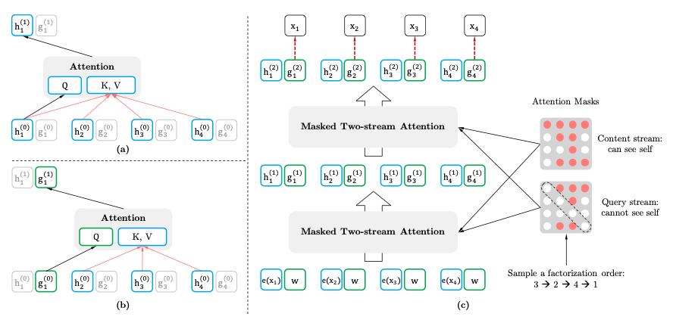
Task
BERT
Gaussian
models
density
estimation
middle
layers
evaluate
BLiMP
on
RoBERTa
Data sources: BLiMP (3 tasks, template generated), psycholinguistic studies (9 tasks from 7 papers, written by researchers)
XLNet

Slide 9
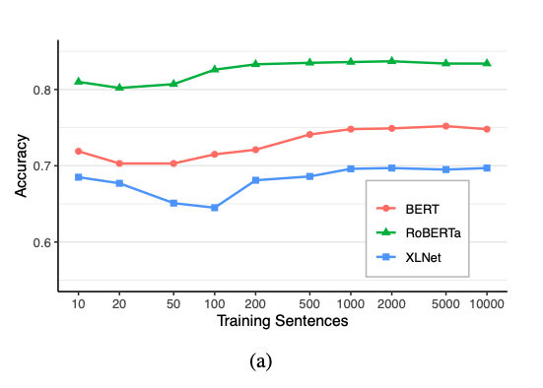
Evaluating Gaussian Model
Use BLiMP for validation (67k grammaticality sentence pairs).
Only takes 1k sentences for accuracy to plateau.
RoBERTa is best performing model (0.83 accuracy on BLiMP).

Slide 10
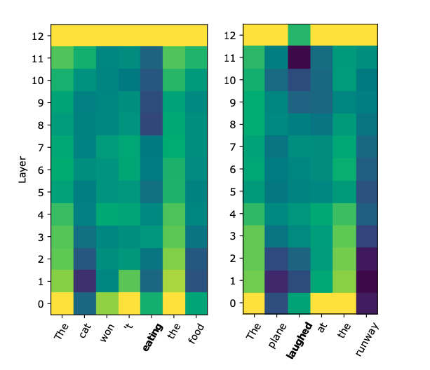
Example
Example sentence with a morphosyntactic anomaly (left) and semantic anomaly (right) (anomalies in bold).
Darker colours indicate higher surprisal. We investigate several patterns:
First, surprisal at lower layers corresponds to infrequent tokens, but this effect diminishes towards upper layers.
Second, morphosyntactic violations begin to trigger high surprisals at an earlier layer than semantic violations.
Morphosyntactic
Semantic

Slide 11

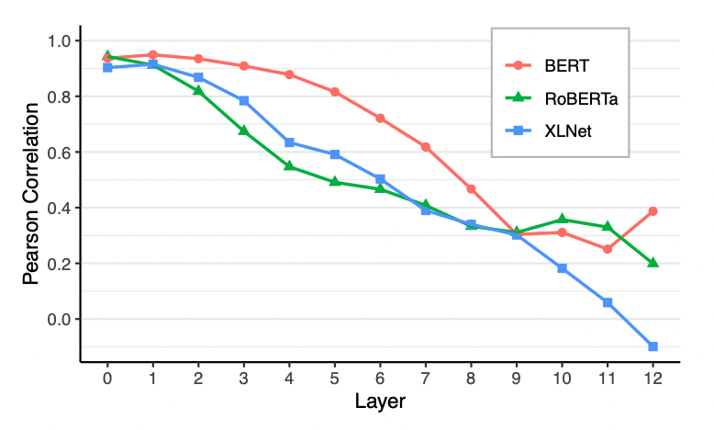
Word frequency and Surprisal
Compute Pearson correlation between log frequency and surprisal.
All models show positive correlation in lower layers, but diminishes at upper layers.

Slide 12
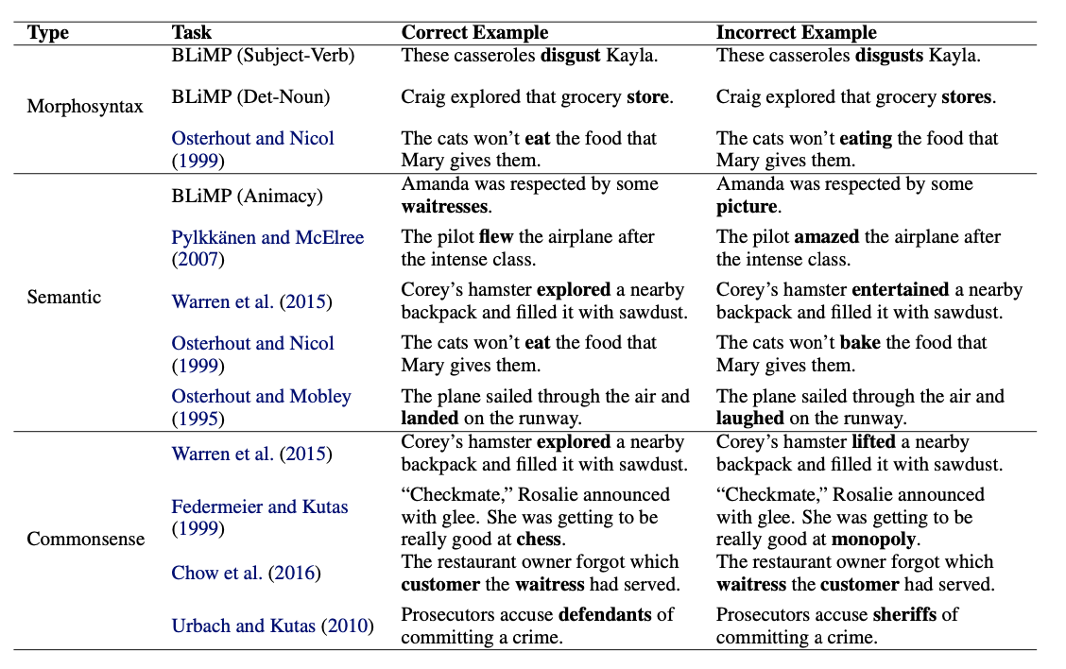
Example Sentences

Slide 13
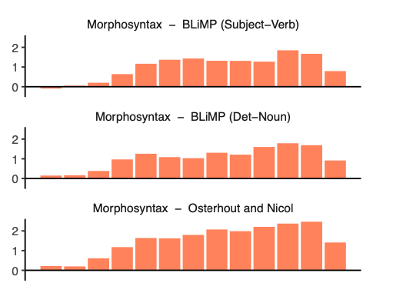
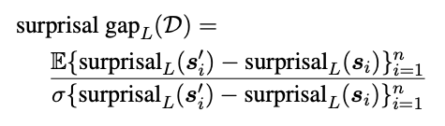
Surprisal Gap (RoBERTa)
Calculate difference in surprisals, scaled by standard deviation:
Morphosyntactic anomalies: produce surprisals starting from layers 3-4.

Slide 14
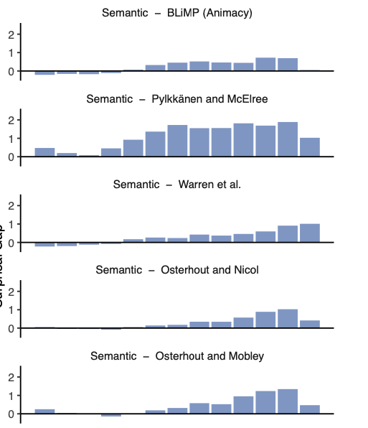
Surprisal Gap (RoBERTa)
Calculate difference in surprisals, scaled by standard deviation:
Semantic anomalies: low surprisals until upper layers (9 and above)

Slide 15
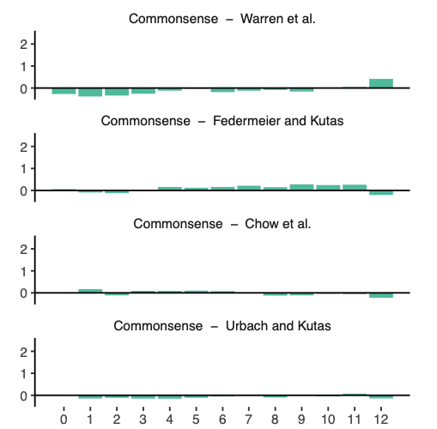
Surprisal Gap (RoBERTa)
Calculate difference in surprisals, scaled by standard deviation:
Commonsense anomalies: no surprisals at any layer.

Slide 16
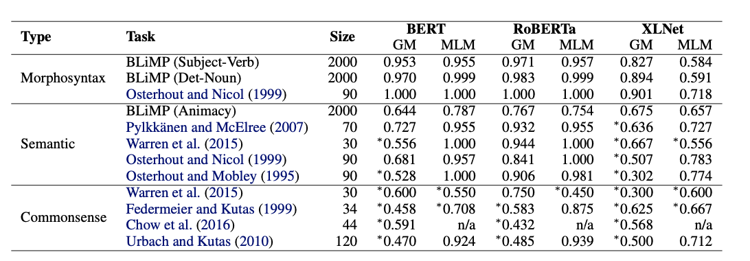
Comparing vs MLM
How does Gaussian anomaly model compare vs masked language model?
MLM usually better than GM, but still does not solve every task.

Slide 17
Conclusions
Proposed a new method to measure surprisals at intermediate layers of language model.
validated Gaussian model on BLiMP, training requires only a small amount of in-domain data.
RoBERTa exhibits different internal patterns depending on type of linguistic anomaly (morphosyntactic vs semantic vs commonsence).

Slide 18
Thank you

