Slide 1
EarlyBERT: Efficient BERT Training via Early-bird Lottery Tickets
Xiaohan Chen1∗ Yu Cheng2 Shuohang Wang2 Zhe Gan2 Zhangyang Wang1 Jingjing Liu2
1University of Texas at Austin, 2Microsoft Corporatio
沈新舒
2021年9月30日

Slide 2
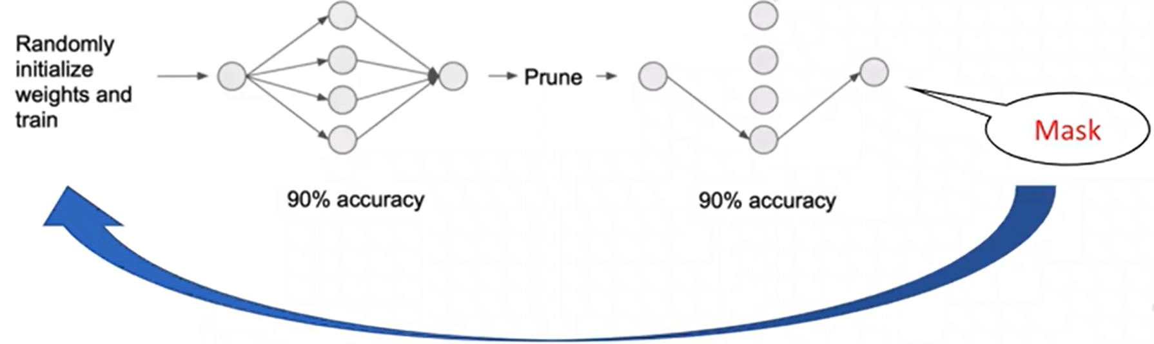
Motivation
Lottery ticket hypothesis(LTH)
Find sparse, trainable neural networks
Needs heavy full-model training
Unstructured sparsity - hard to exploit for acceleration
IMP
Notes:
基于LTH，Lottery ticket hypothesis的概念是ICLR2019文章提出的概念，认为较复杂的深度神经网络存在一个比较优化的稀疏子网络结构，称为winning tickets，可用于模型压缩，相比于原网络，稀疏子网络的参数量和复杂度要低许多，但推理精度基本相当。LTH剪枝获得的子网络从随机初始化开始训练，初始化的数值一一对应取自原网络初始化数值集合，子网络训练达到收敛的迭代次数不超过原网络所需的迭代次数
过程：随机初始化神经网络并训练、剪枝，创建一个mask m，重置其余参数，构建winning ticket
LTH存在的问题：
寻找稀疏的、可训练的神经网络
需要大量的全模型训练
非结构化稀疏性 - 难以利用加速
文章最后在MNIST、CIFAR10数据集上对全连接层网络与卷积网络做了实验验证，然而这些任务涉及的数据集都很小，设计的深度模型本身存在较大的参数冗余和过拟合倾向；

Slide 3
Motivation
Lottery ticket hypothesis(LTH)
Find sparse, trainable neural networks
Needs heavy full-model training
Unstructured sparsity - hard to exploit for acceleration
Early-bird tickets
Structured ticket - better supported for acceleration
Early-bird: ticket can be found in the early stage of full-model training
Notes:
在early stage得到structured ticket
彩票假说（LTH）：
寻找稀疏的、可训练的神经网络
需要大量的全模型训练
非结构化稀疏性 - 难以利用加速
Early-bird tickets:
结构化ticket – 可以更好的加速
Early-bird：指的在full-model training的early stage可以找到最优的ticket

Slide 4
Methodology - workflow
Searching Stage
Jointly train BERT and the sparsity-inducing coefficients to be used to draw the winning ticket;
Ticket-drawing Stage
draw the winning ticket using the learned coefficients;
Efficient-training Stage
train EarlyBERT for pre-training or downstream fine-tuning
Notes:
用非常少的时间，如试的0.2个epochs找到那个最优的tickets
在得到sparse的network后在同样data下加大了learning ra
EarlyBERT 的获胜策略是我们只需要在中奖票出现之前进行这个联合训练几步，这比预训练或微调的完整训练过程要短得多。
EarlyBERT过程：

Slide 5
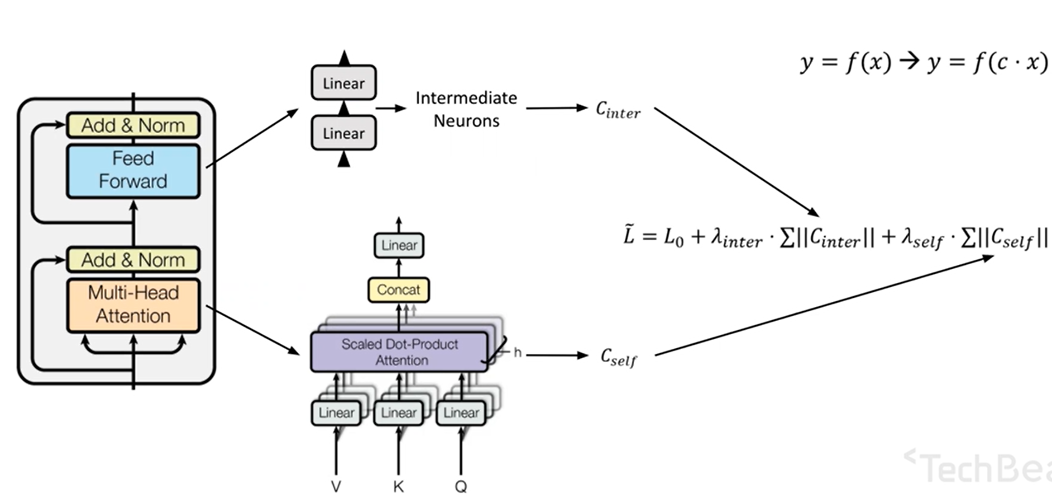
Methodology - Searching Stage
At the end of training, prune neurons/self-attention heads that correspond to small coefficients
Notes:
Pruning选择了Network Slimming，而NS的剪枝基于批量归一化中的缩放因子，这在NLP模型中并没有使用，因此对原始NS进行必要的修改，包括剪枝attention头部和剪枝中间神经元，将transformer中的全连接子层的注意力头部和中间层可学习系数相关联，将这些系数与BERT联合训练，L0是指在pre-training和fine-tuning中使用的原始损失函数，λ 是控制正则化强度的超参数

Slide 6
Methodology – Ticket-drawing stage
prune the attention heads
whose coefficients have the smallest magnitudes, and remove these heads from the computation graph
use layer-wise pruning for attention heads
prune intermediate neurons in the fully-connected sub-layers
Notes:
修建attention头
修剪系数具有最小幅度的注意力头，并将这些头从计算图中删除，修剪Wo中与移除的头部相对应的行
对注意力头使用逐层修剪，因为每层中的头数量非常少（全局修剪某些层中的注意力头可能会被完全移除，从而使网络无法训练）

Slide 7
Methodology - contribution
First to try to draw early-bird ticket for BERT
And use structured LT for efficient training
Save more than 35-45% time saved with similar resources
Notes:
较LT来说引入了structure pruning，无论在inference还是training上都有改进
实验发现加大learning rate可以在较短的时间中得到一个收敛的network

Slide 8
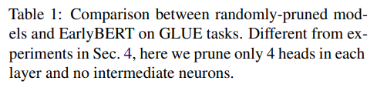
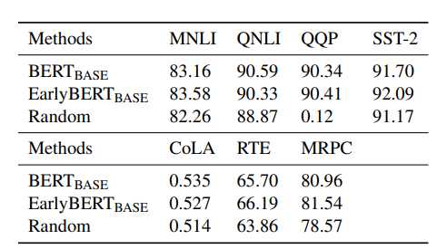
Result

Slide 9
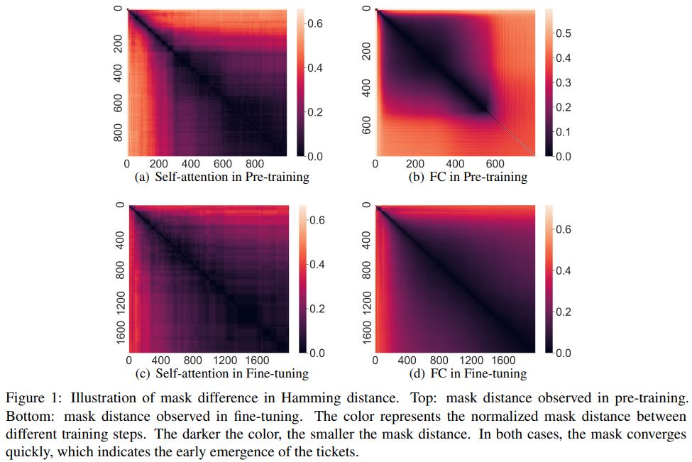
Result – early emergence

Slide 10
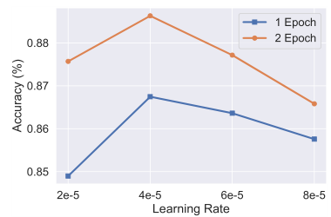

Experiment – fine-tuning
Notes:
在fing-tuning阶段做的实验，减少epoch来缩短训练时间，能否通过调整learning rate来弥补减少epoch带来的负面影响；实验发现适当提高learning rate能提升准确率

Slide 11
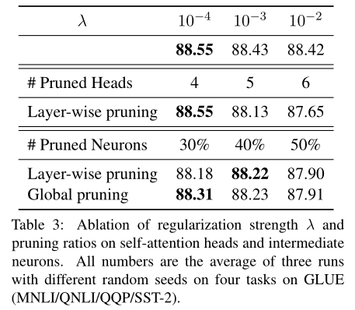
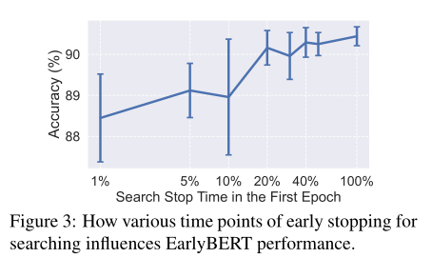
Experiment – fine-tuning
Notes:
Tabel3 最佳正则化系数、修剪attention head个数以及Neuron个数对精度的影响实验
Figure3 在searching stage停止时间与模型准确率的关系：停止在20%（这就是那0.2个epoch）时准确率突然增加，停止在最后轻微增加，考虑训练效率，认为20%-40%是最佳停止时间

Slide 12
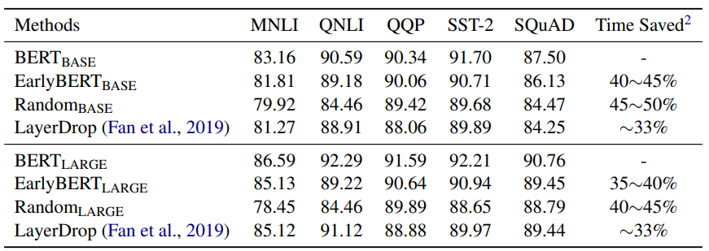
Result – fine-tuning

Slide 13
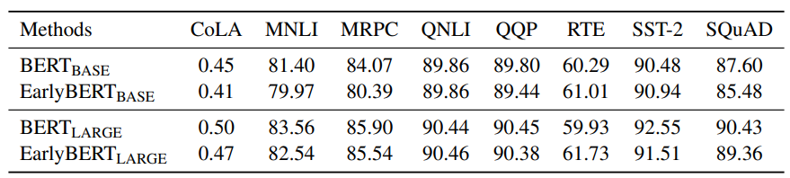
Result – pre-training

Slide 14
Thanks!
沈新舒
2021年9月30日

Slide 15
Methodology - discussion
The pruned network naturally enjoys computational efficiency due to structured pruning
(Structured) lottery ticket is different from pruning (though LT uses it)
Find trainable sub-network for that specific initialization
Start from random init instead of pretrained (same as our pretrain case)
Hence, also different from directly training a smaller network
Similar to random pruning
Verified by our random pruning results
Notes:
LT不是pruning，通过earlybert找到的network比不做pruning是要好的

Slide 16
Fine-tuning results
Prune self-attention heads only
Prune intermediate neurons only
Prune heads + neurons simultaneously
NOTES
In all experiments, with take the lottery ticket at 0.2 epoch
After taking ticket, we finetune for 2 epochs with doubled LR
We compare with random pruning (5 repetitions with diff seeds)
We omit small datasets (of less interests for training efficiency)

