Slide 1
When Do You Need Billions of Words of Pretraining Data?
王薏婷 51215901088
ACL 2021

Slide 2
Context
Introduction
01
Methods and Results
02
Conclusion
03
Notes:
我将从3个方面介绍这篇论文，分别是引言、5中评估方法及其实验结果、总结这3个部分

Slide 3
01
Introduction
Notes:
首先来看第一个部分

Slide 4
Introduction
0.1
Problem:
What exact knowledge or skills do Transformer LMs learn from large-scale pretraining that they cannot learn from less data?
Related Work：
Much recent work has used probing methods to evaluate what these models do and do not learn (Belinkov and Glass, 2019; Tenney et al., 2019b; Rogers et al., 2020; Ettinger, 2020)
Shortcoming of related work：
Since most of these works only focus on models pretrained on a fixed data volume (usually billions of words), many interesting questions regarding the effect of the amount of pretraining data remain unanswered
The author’s solution：
Evaluate and probe the MiniBERTas using five methods.

Slide 5
02
Methods and Rusults
Notes:
接下来，我会详细讲一下作者使用的评估方法和实验结果

Slide 6
Five styles of evaluation
Classifier Probing
01
Minimum Description Length Probing
feature information
02
Unsupervised Grammaticality Judgement
03
knowledge of individual grammatical phenomena
Unsupervised Language Model Knowledge Probing
04
Factual Knowledge
05
Fine-tuning on NLU Tasks
NLU

Slide 7
1 Classifier Probing
0.1
test the extent to which linguistic features like part-of-speech and coreference are encoded in the frozen model representations.
Task data source:
Part-of-Speech, Constituents, Entities, SRL, and OntoNotes coref. from Weischedel et al. (2013), De- pendencies from Silveira et al. (2014), Sem. Proto Role 1 from Teichert et al. (2017), Sem. Proto Role 2 from Rudinger et al. (2018), Relations (SemEval) from Hendrickx et al. (2010), and Winograd coref. from Rahman and Ng (2012); White et al. (2017).

Slide 8
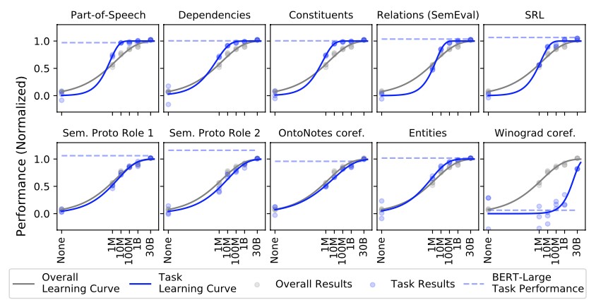
1 Classifier Probing
0.1
大多数曲线图显示出大致相似的学习曲线，在1M words前，学习曲线急剧上升，在1M words左右达到最快增长点，接近100M words时饱和。
Winograd是例外，只在1B到30B单词的预训练数据之间显著上升。

Slide 9
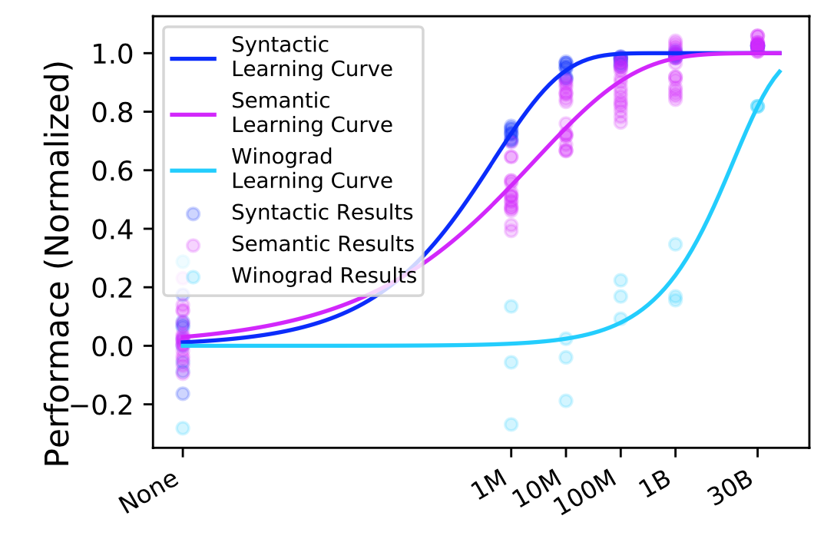
1 Classifier Probing
0.1
不同类型任务的对比
句法曲线比语义学习曲线上升得早，90%的句法学习可以用10M字完成，而语义在100M字后仍略有上升。
Winograd的常识学习曲线上升的要晚得多，且预计在句法和语义停止改善后，他会继续上升。
句法
语义
常识

Slide 10
2 Minimum Description Length Probing
0.1
In this experiment, we study the MiniBERTas with MDL probing (Voita and Titov, 2020), with the goal of revealing not only the total amount of feature information extracted by the probe, but also the effort taken by the probe to extract the features.
MDL = data codelength + model codelength

Slide 11
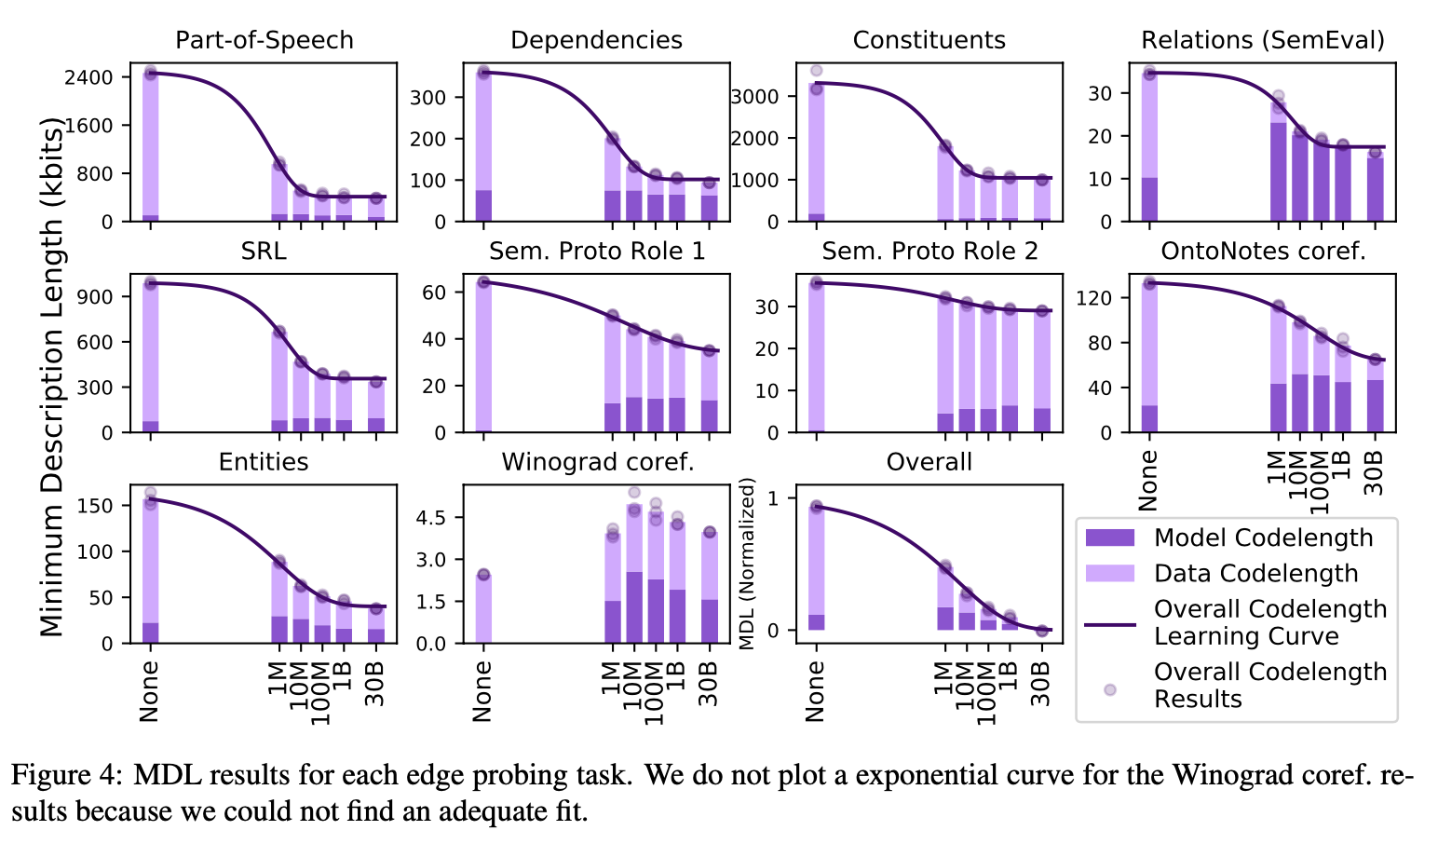
2 Minimum Description Length Probing
0.1
总体与Classifier probing 结果类似。
从逐渐递减的data codelength可以看出，数据规模越大的模型，损失函数越小
model codelength会在数据量超过一定量时减少，但这一趋势在不同的任务中不同，且影响相对较小

Slide 12
3 Unsupervised Grammaticality Judgement
0.1
We use the BLiMP benchmark to test models’ knowledge of individual grammatical phenomena in English.
What is BLiMP？
BLiMP is a challenge set of 67 tasks, each containing 1000 minimal pairs of sentences that highlight a particular morphological, syntactic, or semantic phenomena.
Minimal pairs in BLiMP consist of two sentences that differ only by a single edit, but contrast in grammatical acceptability.
we measure pseudo log-likelihood to score sentences

Slide 13
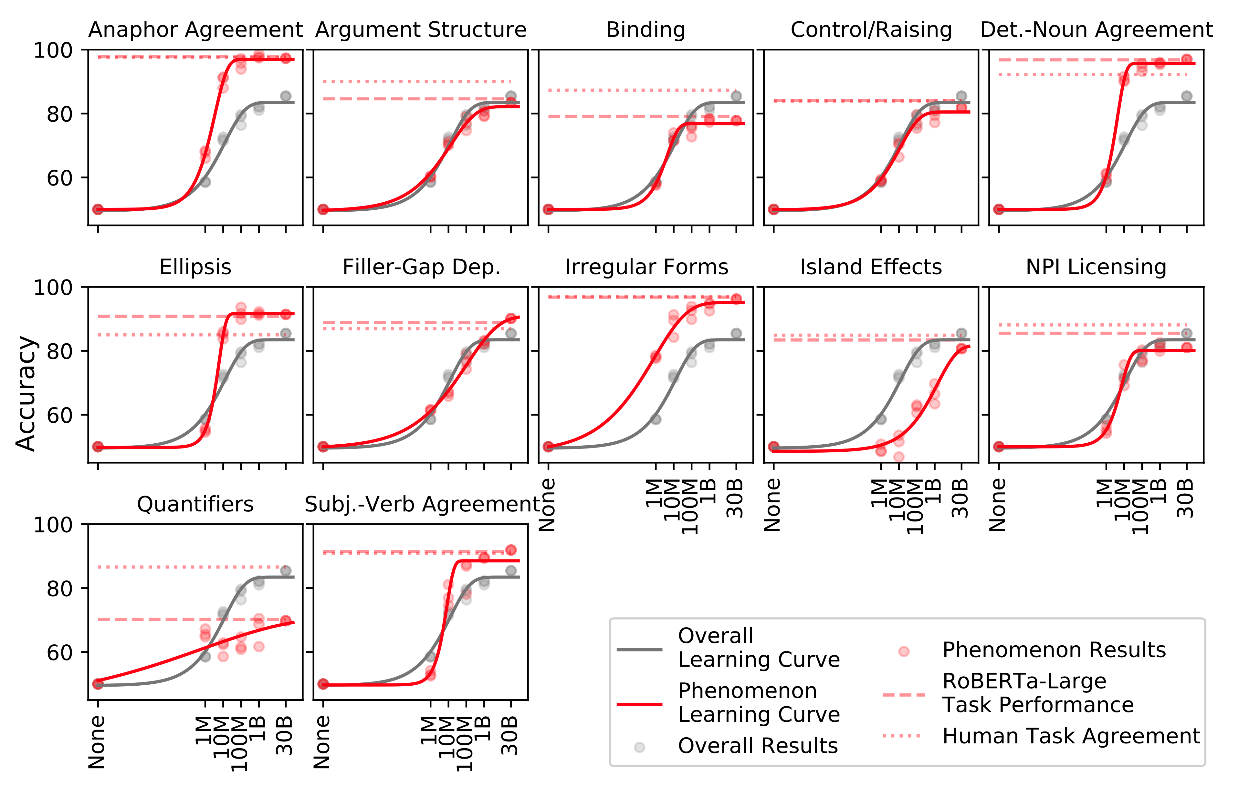
3 Unsupervised Grammaticality Judgement
0.1
结果
BLiMP整体性能在1M-100M字区间内改善最大

Slide 14
3 Unsupervised Grammaticality Judgement
0.1
结果
对于100M单词，模型与Human Task Agreement差距很小，且在更多数据的支持下不会有太大提升，所以大量语法知识可以在100M字的原始文本中学习到。

Slide 15
3 Unsupervised Grammaticality Judgement
0.1
结果
模型并未有效学习到量词范畴的知识，这些可能包含着难以学习到的实用知识。

Slide 16
4 Unsupervised Language Model Knowledge Probe
0.1
We use LAMA to test factual knowledge
What is LAMA？
LAMA is a test suite introduced by Petroni et al. to test LMs’ factual knowledge.
It contains over 50,000 cloze statements converted from subject-relation-object triples or question-answer pairs extracted from four datasets

Slide 17
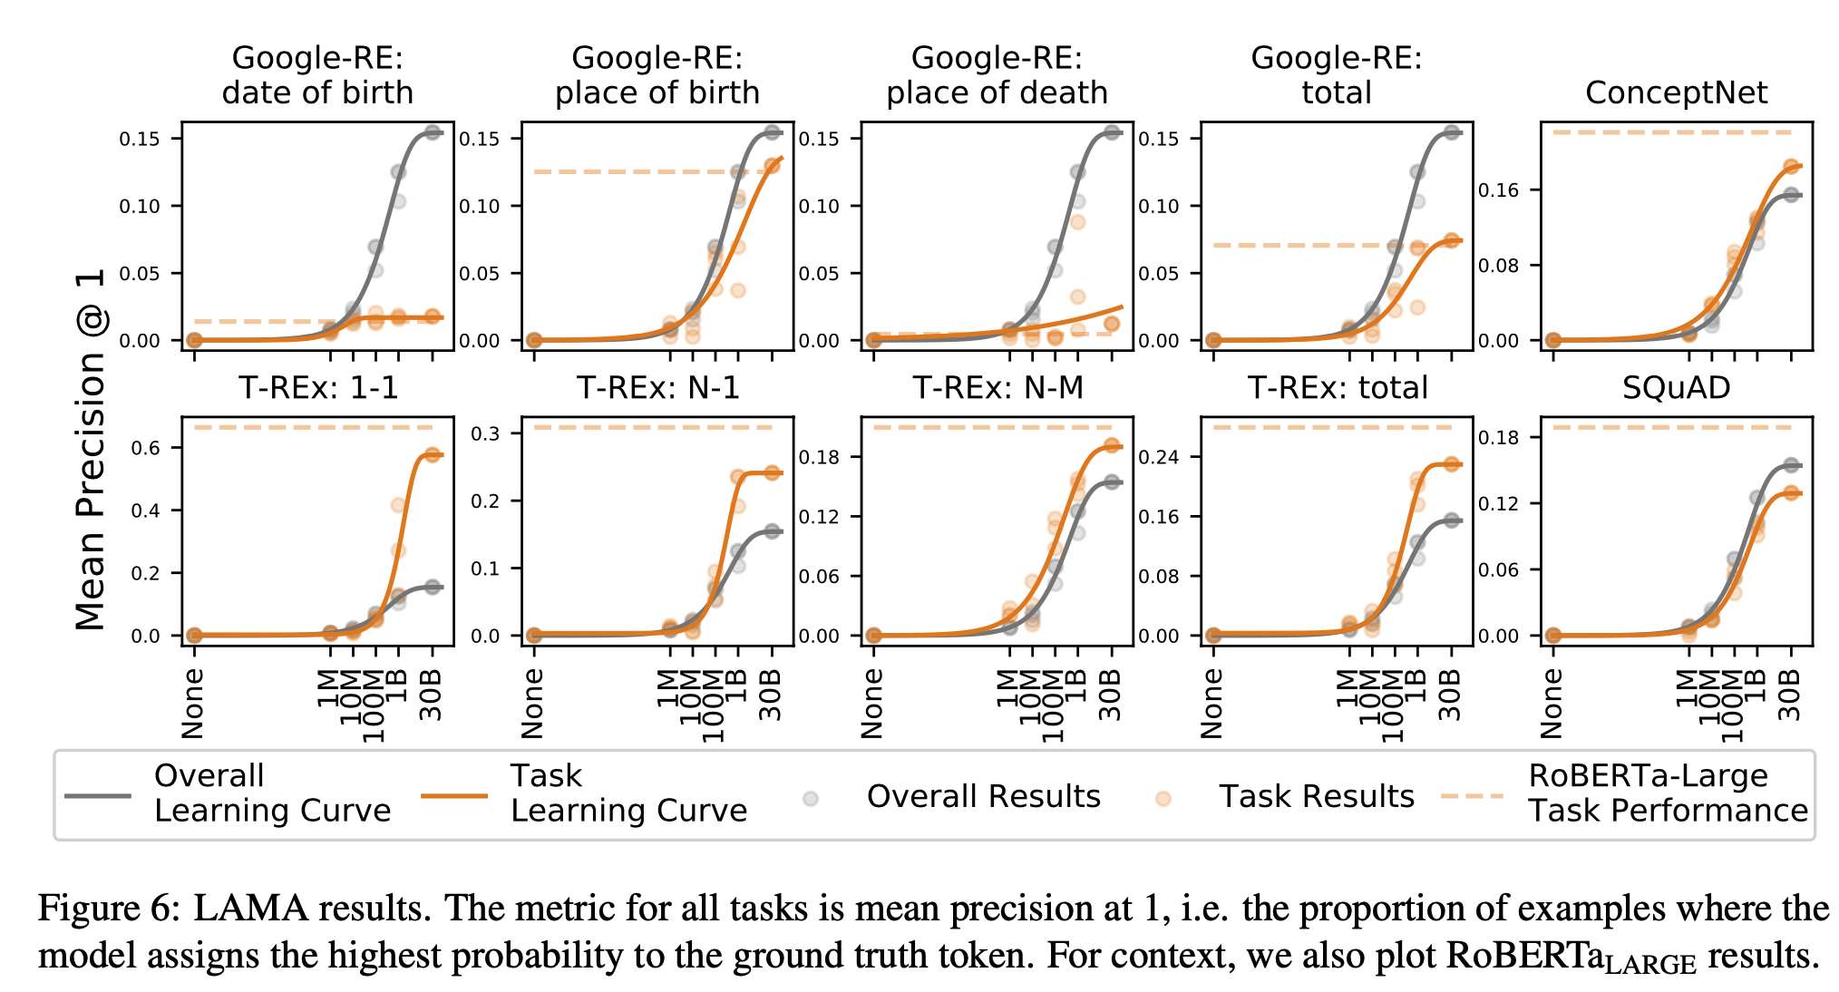
4 Unsupervised Language Model Knowledge Probe
0.1
Results：
大多数曲线在100M单词之后才开始快速增长
许多任务的学习曲线在0-30B文字区间内没有出现明显的饱和迹象

Slide 18
5 Fine-tuning on NLU Tasks
0.1
We test each MiniBERTa on five SuperGLUE tasks on which we expect to see significant variation at these scales.
What is SuperGLUE?
SuperGLUE is a benchmark suite of eight classification-based language-understanding tasks.

Slide 19
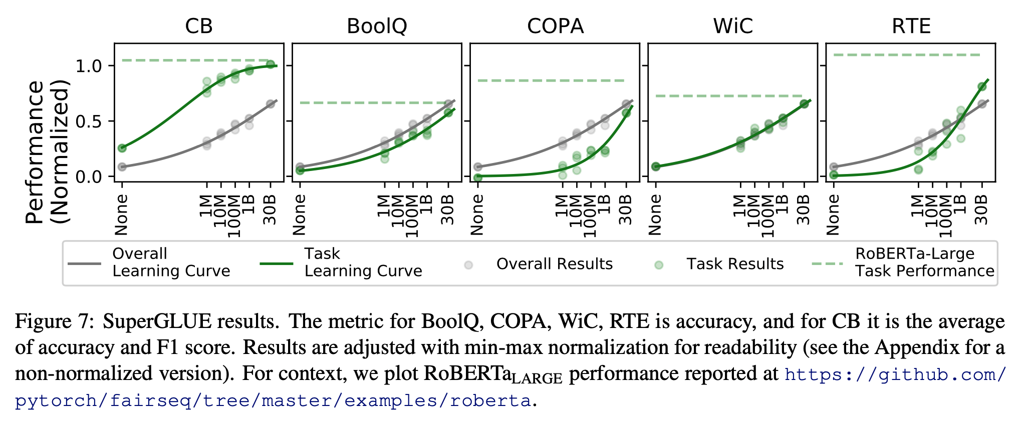
5 Fine-tuning on NLU Tasks
0.1
1 大多数任务快速提升的位置在超过1B单词的情况下。
2 几乎所有任务在30B单词时均未显示任何明显的饱和迹象。

Slide 20
04
Conclusion

Slide 21
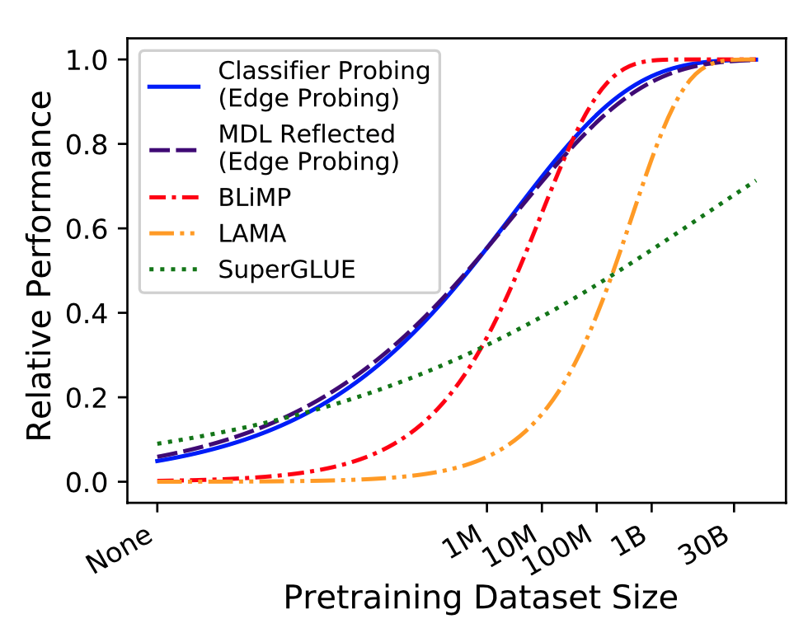
Conclusion
individual grammatical phenomena
(BLiMP)
NLU
(SuperGLUE)
1M
10M
100M
1B
30B
feature information
（Edge Probing）
Factual knowledge
(LAMA)

Slide 22
Conclusion
What drives improvements in NLU task performance at larger data scales？

Slide 23
Conclusion
What drives improvements in NLU task performance at larger data scales？
Factual knowledge may play a large role in explaining SuperGLUE performance.

Slide 24
Conclusion
What drives improvements in NLU task performance at larger data scales？
1. Factual knowledge may play a large role in explaining SuperGLUE performance.
2. linguistic features encoded by a model may not be easily accessible during fine-turning

Slide 25
Conclusion
0.1
We track several aspects of RoBERTa’s ability as pretraining data increases. We find that:
Ability in syntax and semantics largely saturates after only 10M to 100M words of pretraining data while learning factual knowledge requires much more data.
Scaling pretraining data size past billions of words significantly improves the NLU performance.
Ethical Considerations
Training massive LMs like RoBERTa from scratch comes with non-trivial environmental costs, and they are expensive to train, limiting contributions to pre- training research from scientists in lower-resource contexts.
Massive LMs also replicate social biases present in training data

Slide 26
THANKS

