Slide 1

华东师范大学
Paper Review
East China Normal University
GRADUATION DEFENSE
Are Pre-trained Convolutions Better than Pre-trained Transformers?
By Google Research

Slide 2
华东师范大学
PART I
East China Normal University
GRADUATION DEFENSE
01
Motivation
Click here to enter your text, change the color or size of the text. You can also format the appropriate. Click here to enter your text, change the color or size of the text.

Slide 3
华东师范大学
PART II
East China Normal University
02
GRADUATION DEFENSE
Research Questions and Discussion
Click here to enter your text, change the color or size of the text. You can also format the appropriate. Click here to enter your text, change the color or size of the text.

Slide 4
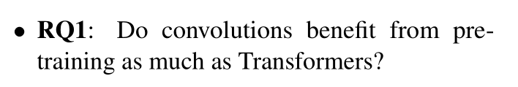
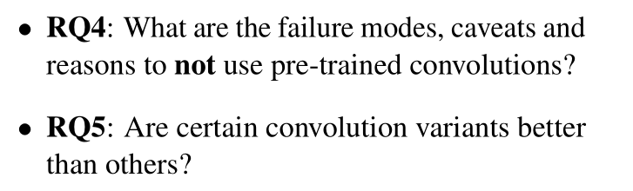
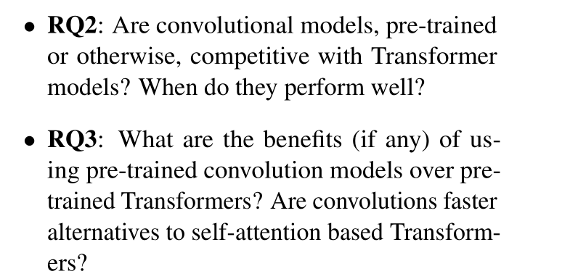
Research Questions and Discussion
East China Normal University

Slide 5
华东师范大学
PART III
East China Normal University
GRADUATION DEFENSE
03
Experiment Design
Click here to enter your text, change the color or size of the text. You can also format the appropriate. Click here to enter your text, change the color or size of the text.

Slide 6
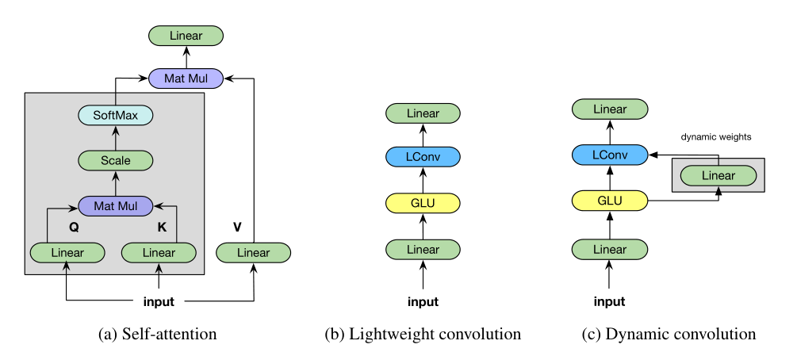
Experiment Design
East China Normal University
Alternative：
1.Standard Convolution
2.Lightweight Convolution
3.Dynamic Convolution
4.Dilated Convolution

Slide 7
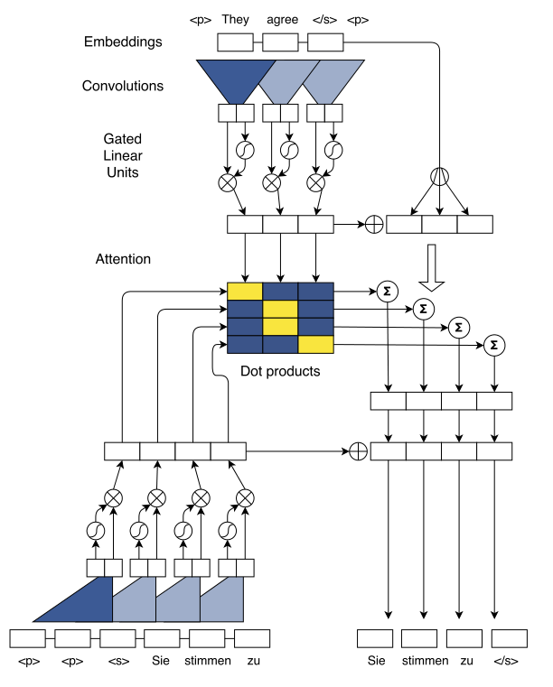
Experiment Design
East China Normal University
Convolutional Seq2Seq Architecture
2017. Convolutional sequence to sequence learning.
arXiv:1705.03122.
2019. Pay less attention with lightweight and dynamic convolutions. arXiv:1901.10430.

Slide 8
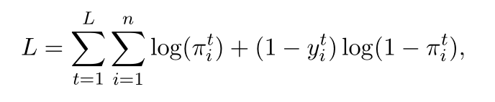
Experiment Design
East China Normal University
Pre-training method(self-supervised)
Randomly mask spans of lengths L and replace them with a special sentinel token. And the task is then to generate the masked tokens as targets.
For example:
Original : The happy cat sat on the mat
Input : The happy cat sat [mask]
Prediction : on the mat
Train method(supervised learning + Teacher forcing)

Slide 9
华东师范大学
PART IV
East China Normal University
GRADUATION DEFENSE
04
Result and Analysis
Click here to enter your text, change the color or size of the text. You can also format the appropriate. Click here to enter your text, change the color or size of the text.

Slide 10
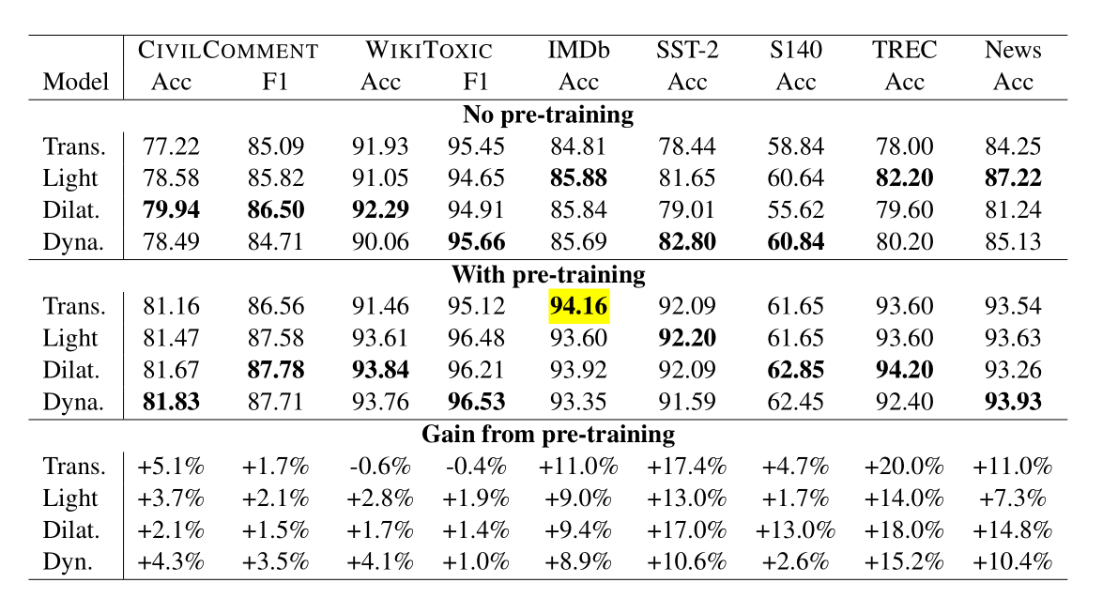
Result and Analysis
East China Normal University

Slide 11
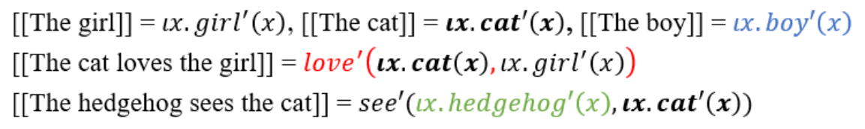
Result and Analysis
East China Normal University
Results on Compositional Generalization
Challenge and Semantic Parsing
On the in-distribution test set, Transformers and Convolutions have identical performance (95%)
On the generalization or out of distribution set,Transformers perform at 77.5% while convolutions come in at 76.9%

Slide 12
Research Questions and Discussion
East China Normal University

Slide 13
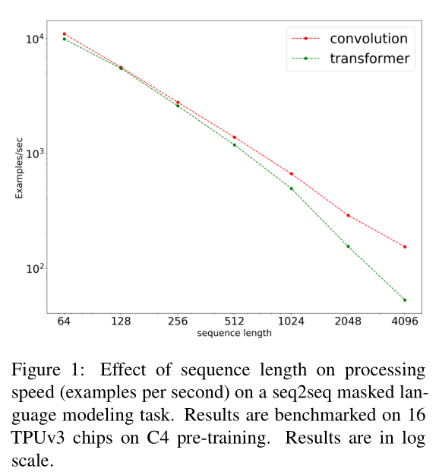
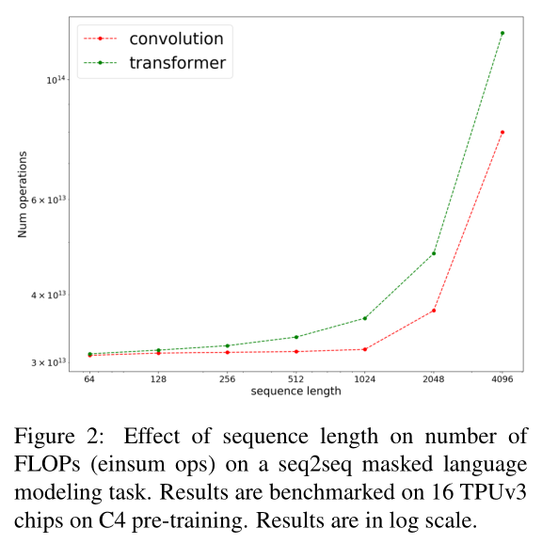
Result and Analysis
East China Normal University
RQ3 : What are the benefits of pre-trained convolutions over Transformers?

Slide 14
Result and Analysis
East China Normal University
RQ5 : When do we expect pre-trained convolutions to fail?
Failure mode : It’s not a good idea to use pre-trained convolutions for tasks
that requires modeling the relationship between two or more sequences
Reason : lack of cross-attention
To verify this:
Datasets : SQuAD and MultiNLI
Convolutions only achieve ≈ 75% accuracy on MultiNLI, while Transformers easily achieve≈ 84% accuracy on MultiNLI
Convolutions only achieve ≈ 70% accuracy on MultiNLI, while Transformers easily achieve≈ 90% accuracy on
SQuAD
When augmenting convolutions with a single layer of cross attention at the encoder, Convolutions achieve≈ 83% accuracy on MultiNLI

Slide 15
华东师范大学
PART V
East China Normal University
GRADUATION DEFENSE
05
Contribution
Click here to enter your text, change the color or size of the text. You can also format the appropriate. Click here to enter your text, change the color or size of the text.

Slide 16

华东师范大学
09/23
East China Normal University
GRADUATION DEFENSE
2021
感谢您的欣赏
Click here to enter your text, change the color or size of the text. You can also format the appropriate.
THNAK YOU

