Slide 1


Document Modeling with Graph Attention Networks for Multi-grained Machine Reading Comprehension
ACL2020
汇报人：李浩铭

Slide 2
Document Modeling with Graph Attention Networks for Multi-grained Machine Reading Comprehension
01 / 17
Introduction
Machine reading comprehension (MRC), a task that aims to answer questions based on a given document.

Slide 3
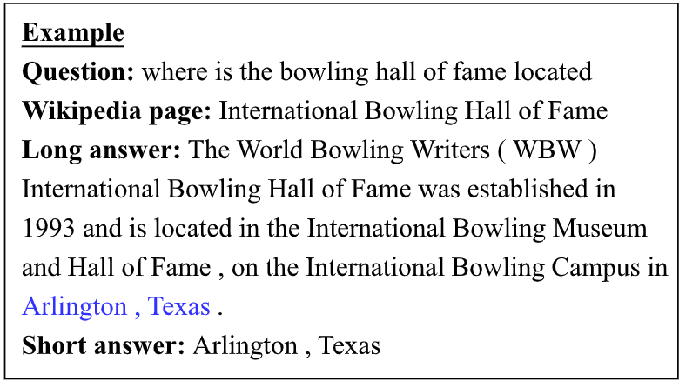
Document Modeling with Graph Attention Networks for Multi-grained Machine Reading Comprehension
02 / 17
Introduction
Natural Questions(NQ), a newly released benchmark.
1)introduce much longer documents than existing datasets.
2)questions that are from real user queries.
In NQ, answers are providedin a two-grained format: long answer and short answers.
图片

Slide 4
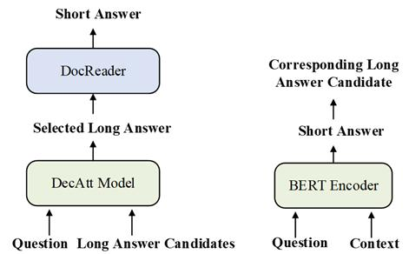
Document Modeling with Graph Attention Networks for Multi-grained Machine Reading Comprehension
03 / 17
Introduction
At present, the two methods to solve Natural Questions can be divided into two categories.
1)Pipeline method
2)Bert-based
图片

Slide 5
Document Modeling with Graph Attention Networks for Multi-grained Machine Reading Comprehension
04 / 17
Motivation
The above two methods treat these two sub-tasks individually during training while ignoring their dependencies.
We utilize graph attention networks to obtain different levels of representations so that they can be learned simultaneously. The long and short answers can be extracted from paragraph-level representation and token-level representation, respectively. In this way, we can model the dependencies between the two-grained answers to provide evidence for each other.

Slide 6
Document Modeling with Graph Attention Networks for Multi-grained Machine Reading Comprehension
05 / 17
Data Preprocessing
Since the average length of the documents in NQ is too long to be considered as one training instance,we first split each document into a list of documentfragments with overlapping windows of tokens.
Tag each document fragment with an answer type as one of the five labels to constructa training instance:
1)short
2)yes
3)no
4)long
5)no-answer

Slide 7
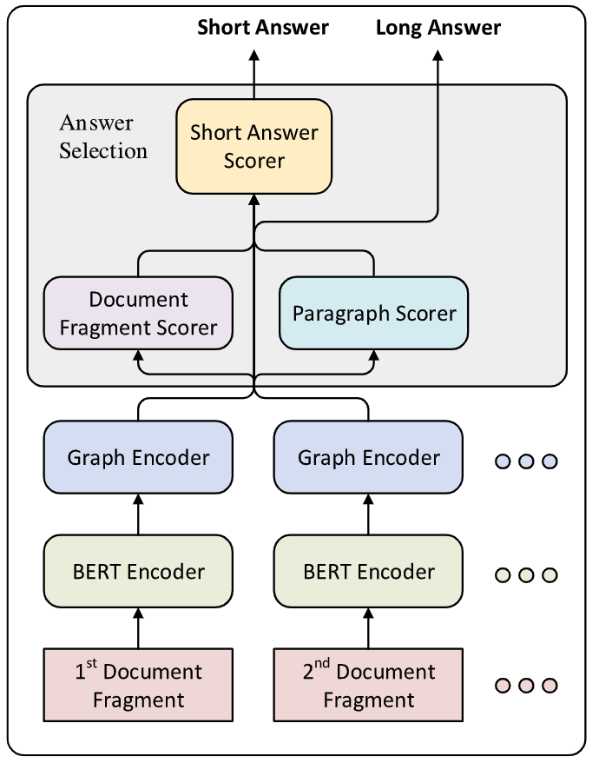
Document Modeling with Graph Attention Networks for Multi-grained Machine Reading Comprehension
06 / 17
Model
The main idea of model lies in multi-granularity document modeling with graph attention networks.
图片

Slide 8




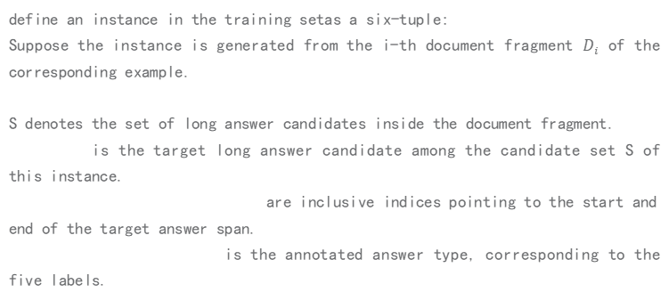
Document Modeling with Graph Attention Networks for Multi-grained Machine Reading Comprehension
07 / 17
Input & Output Definition
define an instance in the training setas a six-tuple:
Suppose the instance is generated from the i-th document fragment $D_{i}$ of the corresponding example.
S denotes the set of long answer candidates inside the document fragment.
is the target long answer candidate among the candidate set S of this instance.
are inclusive indices pointing to the start and end of the target answer span.
is the annotated answer type, corresponding to the five labels.

Slide 9
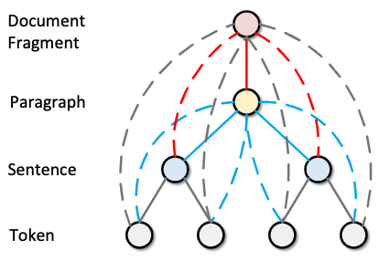
Document Modeling with Graph Attention Networks for Multi-grained Machine Reading Comprehension
08 / 17
Multi-granularity Document Modeling
The intuition of representing documents in multi-granularity is derived from the natural hierarchical structure of a document.
Treat the document structure as a tree,which has four types of nodes, namely token nodes,sentence nodes, paragraph nodes, and a document node.
图片

Slide 10
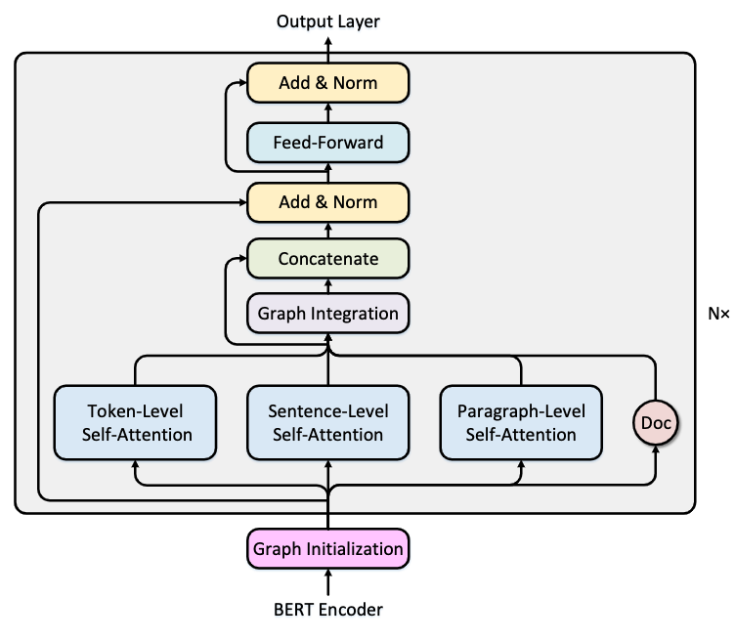
Document Modeling with Graph Attention Networks for Multi-grained Machine Reading Comprehension
09 / 17
Graph Encoder
Each layer in our graph encoder consists of three self-attention layers, a graph integration layer, and a feed-forward layer.

Slide 11

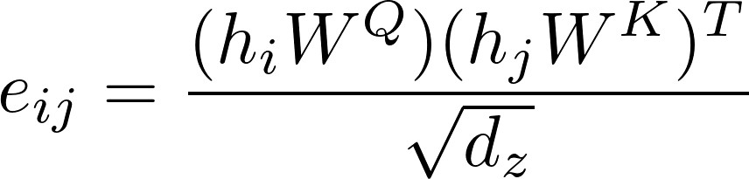
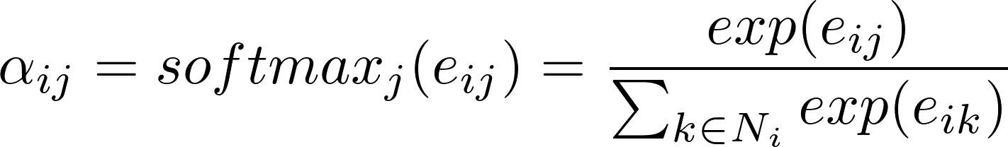
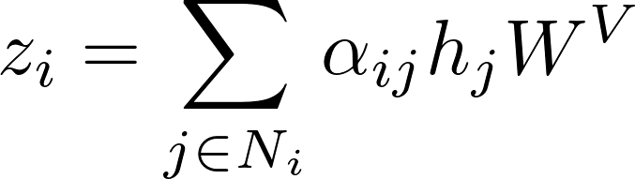


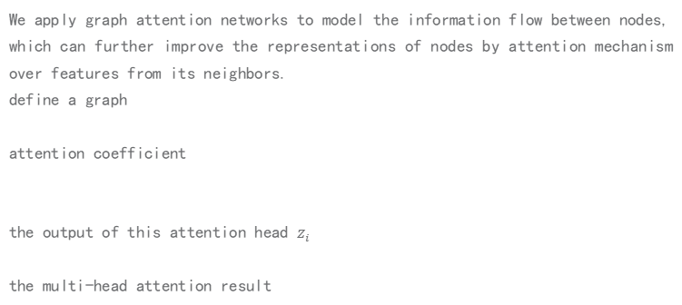
Document Modeling with Graph Attention Networks for Multi-grained Machine Reading Comprehension
10 / 17
Graph Attention Networks
We apply graph attention networks to model the information flow between nodes, which can further improve the representations of nodes by attention mechanism over features from its neighbors.
define a graph
attention coefficient
the output of this attention head $z_{i}$
the multi-head attention result

Slide 12
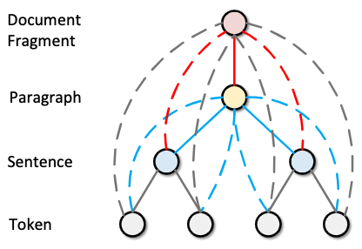
Document Modeling with Graph Attention Networks for Multi-grained Machine Reading Comprehension
11 / 17
Graph Integration Layer
We use graph attention networks on the graph, this layer allows information to be passed to nodes with different levels of granularity.
This layer helps to model the dependencies of the two-grained answers.

Slide 13
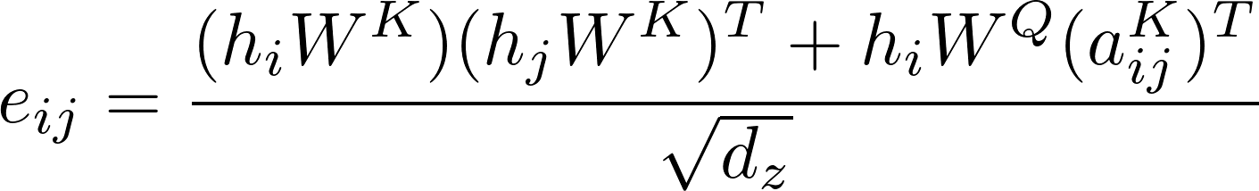
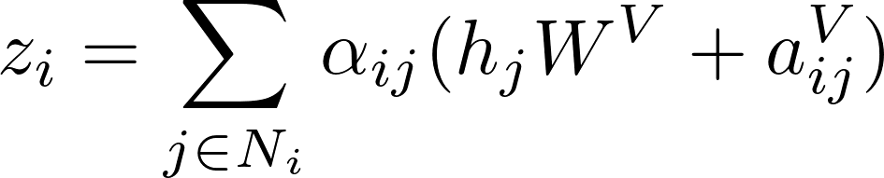
Document Modeling with Graph Attention Networks for Multi-grained Machine Reading Comprehension
12 / 17
Relational Embedding
introduce a novel relational embedding on constructed graph, which aims at modeling the relative position information between nodes on the multi-granularity documentstructure.
In above equations, the edge between node i and node j is represented by learnable embedding $a_{ij}^{K},a_{ij}^{V}∈R^{d_{z}}$

Slide 14

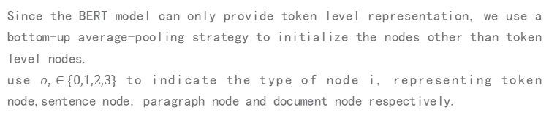
Document Modeling with Graph Attention Networks for Multi-grained Machine Reading Comprehension
13 / 17
Graph Initialization
Since the BERT model can only provide token level representation, we use a bottom-up average-pooling strategy to initialize the nodes other than token level nodes.
use $o_{i}∈\{0,1,2,3\}$ to indicate the type of node i, representing token node,sentence node, paragraph node and document node respectively.
$a_{ij},b_{o_{i}}∈R^{d_{h}}$ represent the relational embedding and node type embedding in the graph initializer.

Slide 15
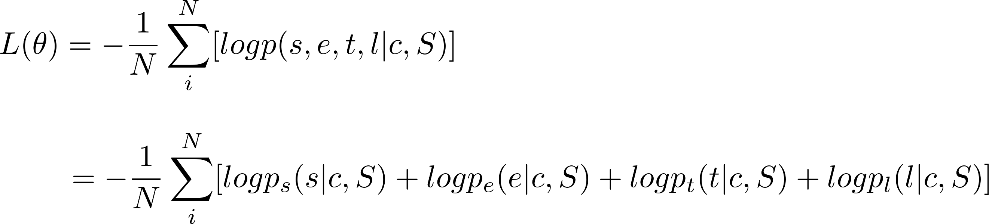

Document Modeling with Graph Attention Networks for Multi-grained Machine Reading Comprehension
14 / 17
Output Layer
The objective function is defined as the negative log likelihood of the prediction deviation of all training examples
$p_{s}(s|c,S),p_{e}(e|c,S),p_{l}(l|c,S),p_{t}(t|c,S)$are the probabilities for the start andend position of the short answer, probabilities forthe long answer candidate, and probabilities for theanswer type of this instance, respectively.

Slide 16
Document Modeling with Graph Attention Networks for Multi-grained Machine Reading Comprehension
15 / 17
Experiments
use three model settings for experiments,which are:
1）Model-I: A refined BERT baseline on the basis of Alberti et al. (2019b);
2）Model-II: A pipeline model with only graph initialization method to get representation of sentence, paragraph, and document;
3）Model-III: Adding two layers of our graph encoder on the basis of Model-II.
use three BERT encoders to initialize ourtoken node representation:
1）BERT-base: a BERT-base-uncased model finetuned on SQuAD2.0;
2）BERT-large: a BERT-large-uncased model finetuned on SQuAD 2.0;
3）BERT-syn: Google’s BERT-large-uncased model pre-trained on SQuAD2.0 with N-Gram Masking and Syn-thetic Self-Training.

Slide 17
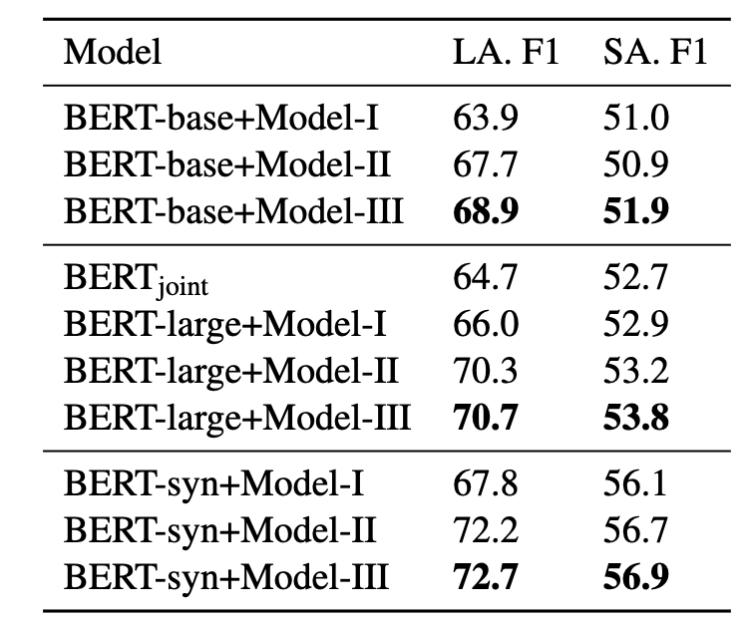
Document Modeling with Graph Attention Networks for Multi-grained Machine Reading Comprehension
16 / 17
Experiments

Slide 18
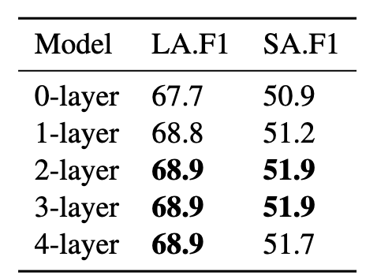
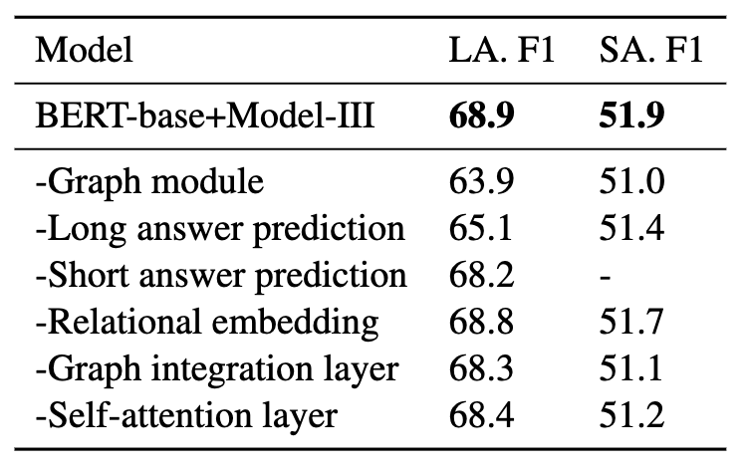
Document Modeling with Graph Attention Networks for Multi-grained Machine Reading Comprehension
17 / 17
Ablation Study
Influences of graph layer numbers on the development set.
Ablation study on the development set.

Slide 19
THANKS

