Slide 1


CLINE: Contrastive Learning with Semantic Negative Examples for Natural Language Understanding
ACL2021
汇报人：黄冲

Slide 2
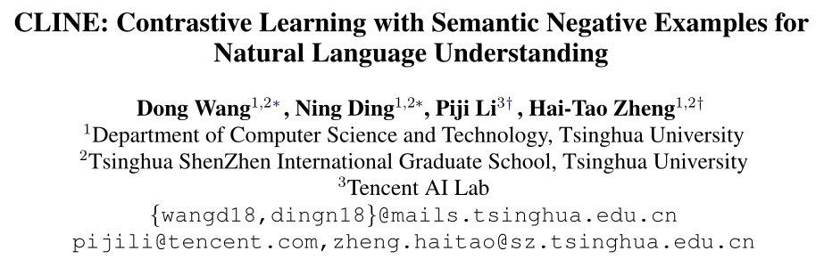
CLINE: Contrastive Learning with Semantic Negative Examples for Natural Language Understanding

Slide 3

目录 | CONTENT
1
Background
2
Method
3
Experiment

Slide 4
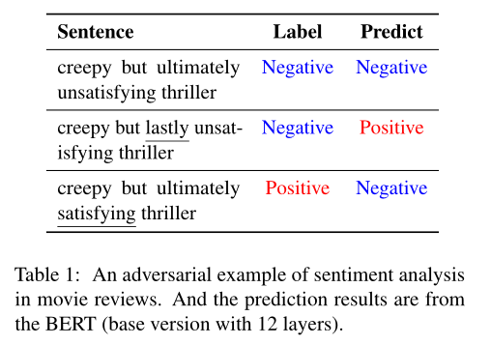
Background
Problem
PLM (BERT) is susceptible to interference when encountering adversarial examples and contrastive examples .
Denote
Adversarial Examples : perturbated examples without changed semantics
Contrastive Examples : perturbated examples with changed semantics
Contribution
1. Use unsupervised methods to construct negative samples, and improve the robustness of the model through comparative learning
2. We conduct a series of pilot experiments and surprisingly find that adversarial training is useless or even harmful for the model to detect these semantic changes.

Slide 5
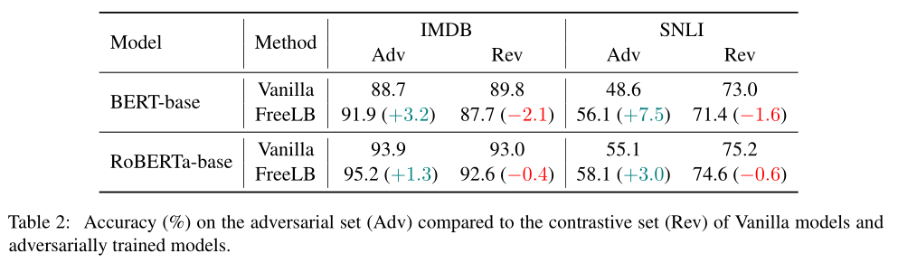
Background
The word-level adversarial attack model TextFooler to construct adversarial examples.
FreeLB is a method of adversarial training.

Slide 6
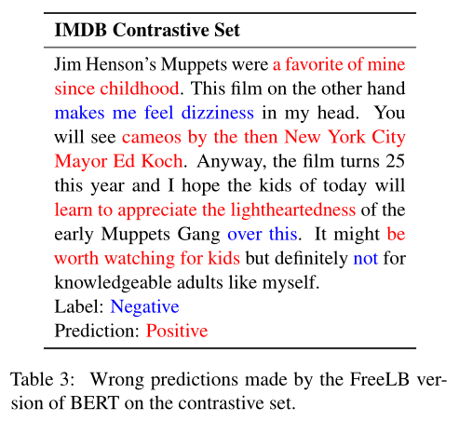
Background
Adversarial training method may take the features of negative sentiment as noise and predict the whole document as a positive sentiment.
Adversarial training tends to keep labels unchanged while the contrastive set tends to make small but label changing modifications.

Slide 7
目录 | CONTENT
1
Background
2
Method
3
Experiment

Slide 8


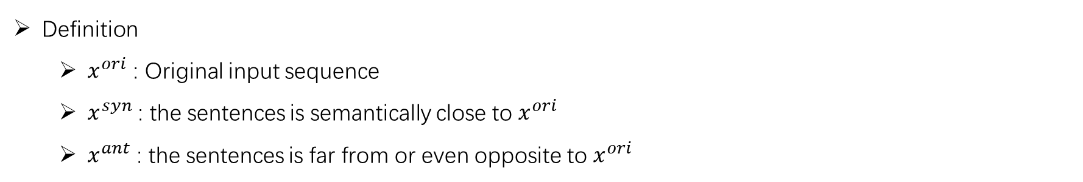
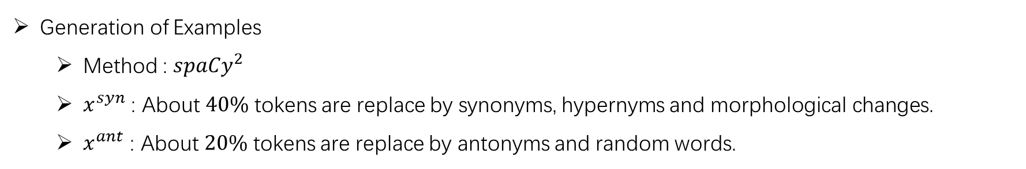
Method
Definition
$x^{ori}$ : Original input sequence
$x^{syn}$ : the sentences is semantically close to $x^{ori}$
$x^{ant}$ : the sentences is far from or even opposite to $x^{ori}$
Generation of Examples
Method : ${spaCy}^{2}$
$x^{syn}$ : About $40\%$ tokens are replace by synonyms, hypernyms and morphological changes.
$x^{ant}$ : About $20\%$ tokens are replace by antonyms and random words.

Slide 9
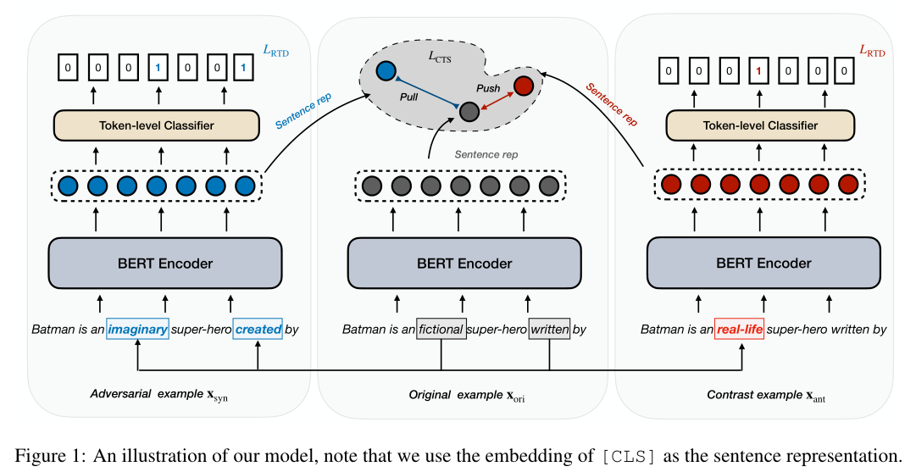
Method
Training Objectives
Masked Language Modeling Objective
Replaced Token Detection Objective
Contrastive Objective

Slide 10
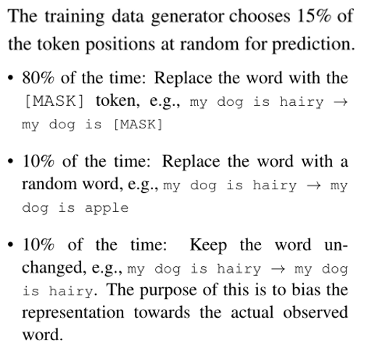
Method
Training Objectives
Masked Language Modeling Objective

Slide 11
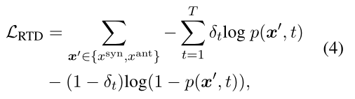
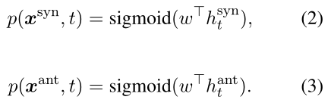


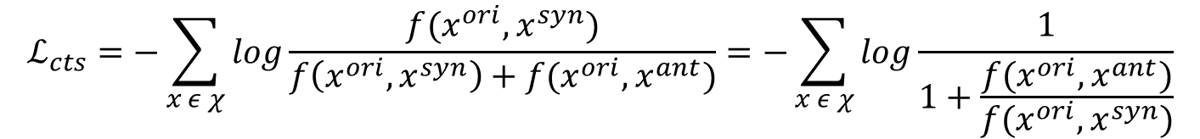
Method
Training Objectives
Replaced Token Detection Objective
Contrastive Objective
$$f\left(x^{∗} , x^{′}\right)=exp({h_{c}^{∗}}^{T}{h_{c}}^{′})$$
$$ℒ_{cts}=−\sum_{x ε χ}{log\frac{f(x^{ori}, x^{syn})}{f\left(x^{ori}, x^{syn}\right)+f(x^{ori}, x^{ant})}=−\sum_{x ε χ}{log\frac{1}{1+\frac{f(x^{ori}, x^{ant})}{f(x^{ori}, x^{syn})}}}}$$

Slide 12
目录 | CONTENT
1
Background
2
Method
3
Experiment

Slide 13
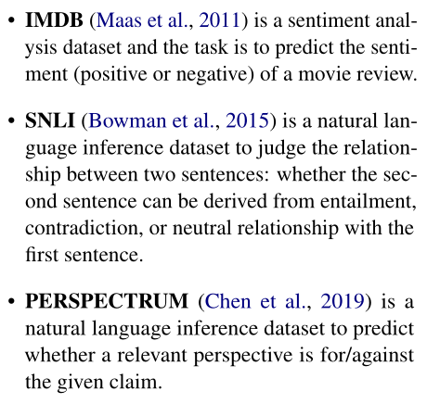
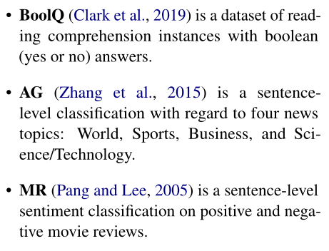
Experiment
Dataset

Slide 14
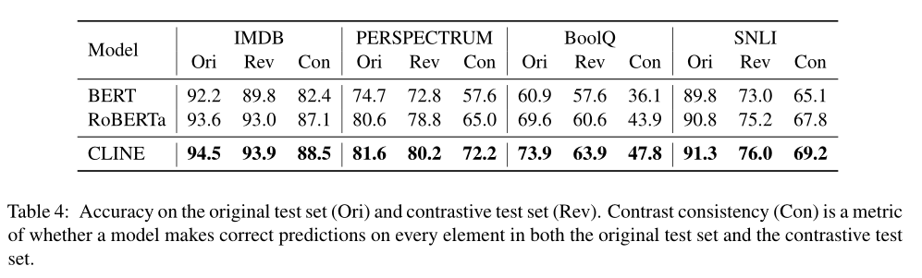
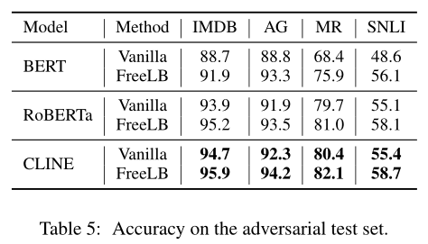
Experiment
Experiments on Contrastive Sets
Experiments on Adversarial Sets
Method : TextFooler identifies the important words in the text and then prioritizes to replace them with the most semantically similar and grammatically correct words.

Slide 15
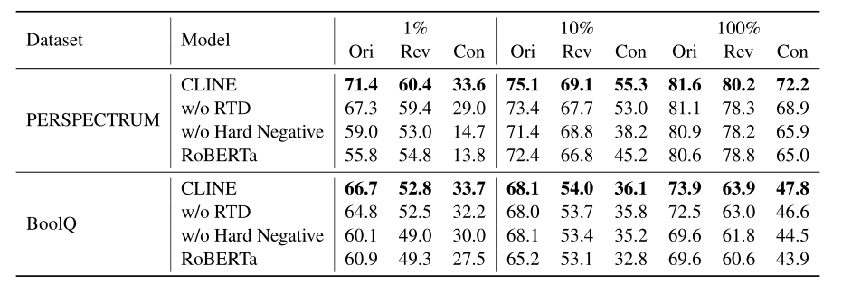
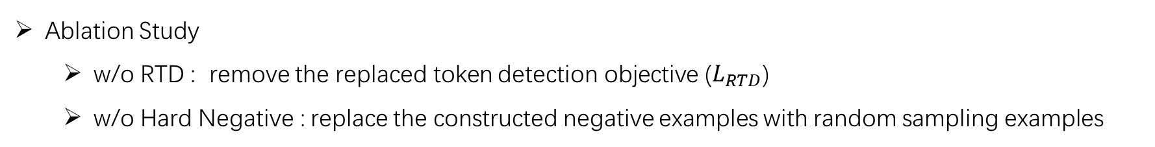
Experiment
Ablation Study
w/o RTD : remove the replaced token detection objective ($L_{RTD}$)
w/o Hard Negative : replace the constructed negative examples with random sampling examples

Slide 16

谢 谢
Thank You

