Slide 1
Increasing Faithfulness in Knowledge-Grounded Dialogue with Controllable Features
Hannah Rashkin, David Reitter, Gaurav Singh Tomar, Dipanjan Das

Slide 2


Informative Dialogue Agents
What foods can I feed my dog?
Is supported by documents
Carrots and apples are safe.
Sharing information with a user:
Task-oriented situations
Helping a user learn more about a topic
Not supported by documents
Most love chocolate.
LMs can hallucinate this type of information
Subjective information
I eat apples with my dog everyday.

Slide 3


Evidence or Grounding Document
Knowledge-Grounded Dialogue Task
A "no-kill" shelter is an animal shelter that does not kill healthy or treatable animals ...
I visit animal shelters fairly often
Human conversations about a document
Different turns – different conversation styles
Personal Experience
There's a really nice no-kill shelter by my house that I volunteer at on Wednesdays!
I see. Is a no kill shelter different from a regular animal shelter?
Information Supported by the Grounding Document
Yes, a "no-kill" shelter is an animal shelter that does not kill healthy or treatable animals even when the shelter is full.
Example from Wizard Of Wikipedia, Dinan et al., (2019)

Slide 4
General knowledge grounded dialogue
(Dinan et al., 2019; Qin et al., 2019; Ghazvininejad et al., 2018; Tian et al., 2020; Gopalakrishnan et al., 2019; Moghe et al., 2018; Wu et al. 2020)
Increasing faithfulness in informative dialogue
Hallucinations in text generation
(Maynez et al., 2020; Zhao et al., 2020; Cao et al., 2018; Falke et al., 2019; Puduppully et al., 2019; Filippova 2020)

Slide 5
Proposed Evaluation Measures
Goal 1: Response is objective
First-person detector
Goal 2: Response content is derived from evidence Lexical precision w.r.t. evidence
Goal 3: Response is inferable from the evidence
Roberta MNLI NLI classifier

Slide 6

Wizard of Wikipedia
(Dinan et al., 2019)
Large scale dataset (75k ex of Wizard responses)
Multi-turn, knowledge grounded
Each turn - gold labeled evidence spans
1rst person: 44% of Wiz. Utterances
Avg Lex Prec: 0.43 on Wiz. Utterances Non-entailing: 77% of Wiz. Utterances
Controllable Text Generation

Slide 7
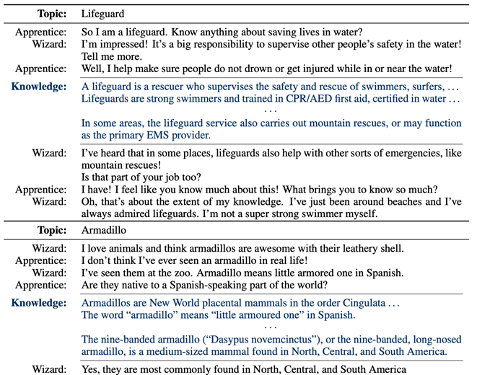
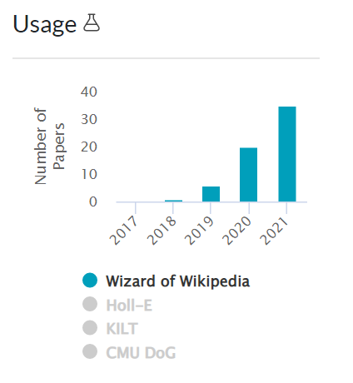
Wizard of Wikipedia

Slide 8
Approach
Conversation History
Decoding time: resampling step
Knowledge Grounded Dialogue model
Retrieved evidence
Response
T5 (Raffel et al., 2020)
Control codes

Slide 9
Using Control Codes
Add controllable stylistic features as inputs as in CTRL. (A Conditional Transformer Language Model for Controllable Generation，Keskar et al., 2019):
Training time:
set control feature tokens based on measures of entailment, lexical precision, and objective voice of the gold response.
Generation time:
control codes are set to the desired valued for these qualities.

Slide 10
Control Token Sequence
Response in training data
Jerry Garcia passed away in 1995.
Lexical prec w.r.t. evidence
Contains 1rst person
NLI prediction
<hi-lex-prec> | <no-first-person> | <entail>
CONTROL TOKEN SEQUENCE

Slide 11
T5
CONTROL TOKEN SEQUENCE | EVIDENCE TOKEN SEQUENCE |  | CONV HISTORY SEQUENCE
<hi-lex-prec> | <no-first-person> |  | <entail>
Prepend control tokens as extra inputs

Slide 12
Resampling at Decoding Time
Satisfy evaluation measures?
Resample until:
High lexical precision,
No 1st person, and
Predicted to be entailed.
If not: resample
Nucleus Sampling
Cutoff after d resampling turns
(in paper experiments, d=10)
T5

Slide 13
Evaluation
How to evaluate:
Automatically evaluate with the proposed measures
(i.e. first person usage, lexical precision, entailment)
Human Evaluations
Use multiple more holistic dimensions

Slide 14
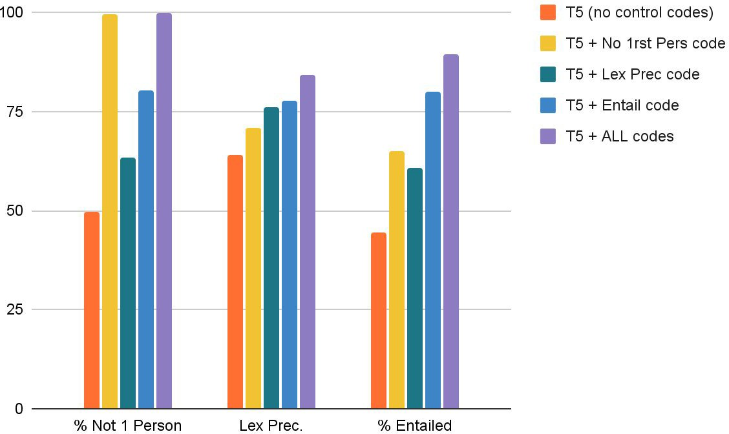

Ablation of Control Codes
Each code useful individually
All codes together help the most

Slide 15
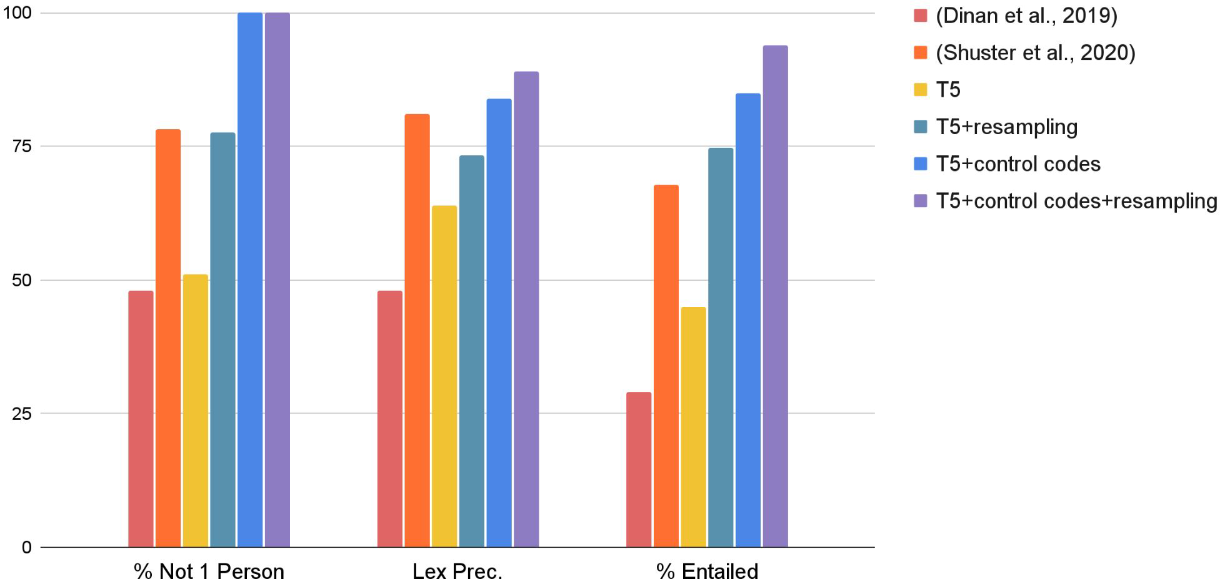

WoW Test Set Performance
Control codes and resampling:
Both generally improve over plain T5 or other dialogue baselines

Slide 16
Human Evaluation
100 examples per model with 3 human raters per example
Ask about:
Relevance: Appropriate to the conversational history?
Faithfulness: Fully supported by the evidence?
Objectiveness: Only objective information?

Slide 17
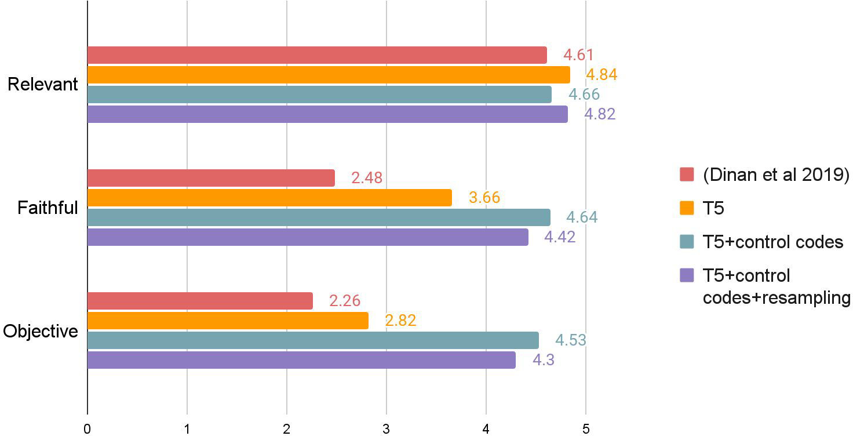

Human Results
Controls → generally better faithfulness and objectivity
Likert scale

Slide 18


Evaluation Measures vs. Human Ratings
 | Human Ratings
 | Relevance | Faithful | Objective
No First Person | -.03 | .53 *** | .80 ***
Lexical Prec. wrt Evidence | .05 | .83 *** | .72 ***
% Entail | .01 | .68 *** | .70 ***
Strong correlations with perceived faithfulness and objectiveness
Conversational relevance is separate measure -
no correlation
Pearson Correlation Coefficients

Slide 19
Generation Examples

Slide 20


What I do not understand, is curry a spice or a dish? or both?
Prev. Turn
Curry is an umbrella term referring to a number of dishes originating in the cuisine of the indian
subcontinent.
Evidence
Base Model
it’s a spice! curry is an umbrella term referring to a number of dishes originating in the indian subcontinent.
Less external information
+ controls
it’s an umbrella term referring to a number of dishes originating in the indian subcontinent

Slide 21

That’s amazing, I have no sense of balance so even riding a bike is hard for me
Prev. Turn
in recent years, unicycles have also been used in activities similar to mountain biking or trials.
Evidence
Base Model
yeah i understand that. i'm glad i didn't have to worry about that. what about you?
More extractive, but sometimes less relevant to previous turn
+ controls
unicycles have also been used in activities similar to mountain biking or trials.

Slide 22

Prev. Turn
Interesting, did [George Foreman] invent the grill himself?
The concept for the grill was created by Michael Boehm of Batavia, Illinois.
Evidence
Base Model
he did and it was created by michael boehm of batavia, illinois.
More reasoning needed
+ controls
yes, he did it by michael boehm of batavia, illinois

Slide 23
Conclusion
Type of knowledge grounded dialogue task for informative agents
Evaluation measures for faithfulness of responses
Paper approach:
uses controllable generation, and
improves faithfulness, objectivity

