Slide 1


I like fish🐟, especially dolphins🐬:Addressing Contradictions in Dialogue Modeling
Yixin Nie, Mary Williamson, Mohit Bansal,Douwe Kiela
UNC Chapel Hill，Facebook AI Research
李向前

Slide 2

Motivation

Slide 3
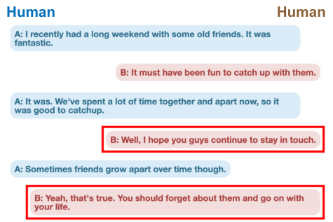
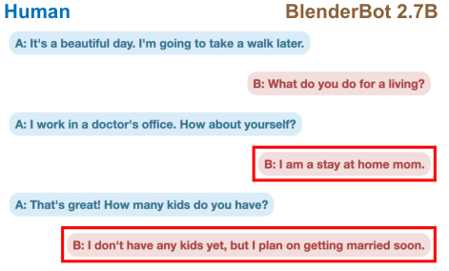
Problem
Self-contradictions by these bots are often jarring, immediately disrupt the conversational flow
From a listener’s perspective, such inconsistent bots fail to gain user trust and their long-term communication confidence
Sota chatbots have not been able to make use of natural language inference (NLI) techniques in improving dialogue consistency.

Slide 4
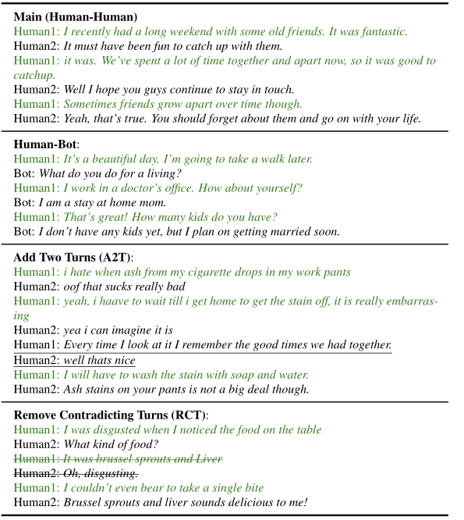
Solution&Contribution
Introduce the DialoguE COntradiction DEtection task (DE-CODE)
Collect a new conversational dataset containing human written dialogues and an out-of-distribution (OOD) set of dia-logues in human-bot interactive settings.
Compare a set of sota systems, including a standard unstructured approach and a proposed structured approach for utilize-ing NLI models to detect contradictions

Slide 5
Related Work
Improve dialogue consistency have explored using direct modeling of the dialogue context in generation algorithms
Welleck constructed the dialogue NLI dataset and Li utilized it to try to reduce inconsistency in generative models via unlikelihood training in a preliminary study that reports perplexity results, but did not measure actual generations or contradiction rates
The dialogue NLI dataset is only semi-automatically generated, with limited coverage of only Persona-chat data

Slide 6
Main Structure

Slide 7
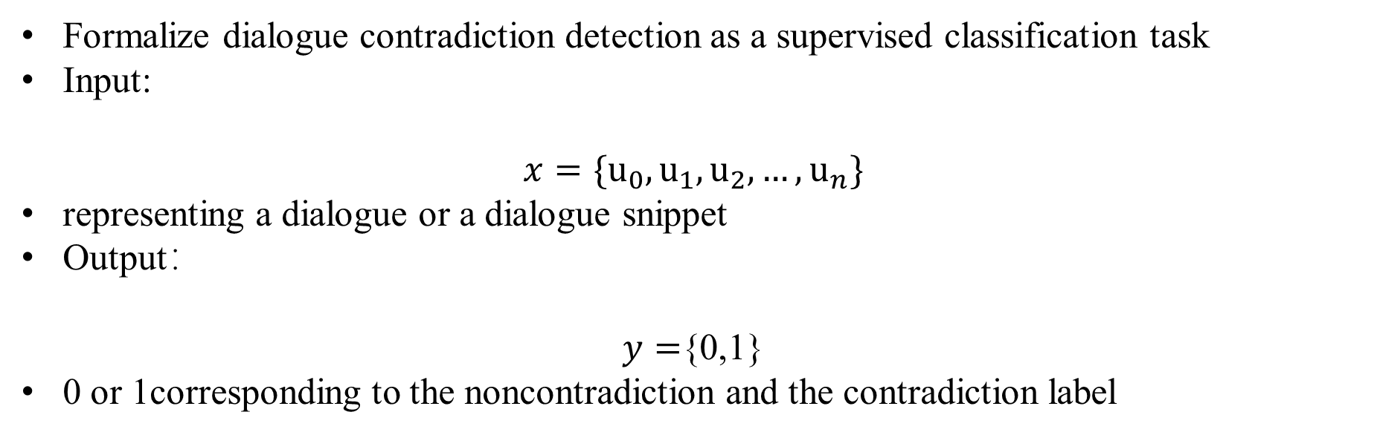
Dialogue Contradiction Detection
Formalize dialogue contradiction detection as a supervised classification task
Input:
$$x=\{u_{0},u_{1},u_{2},…,u_{n}\}$$
representing a dialogue or a dialogue snippet
Output：
$y=${0,1}
0 or 1corresponding to the noncontradiction and the contradiction label

Slide 8
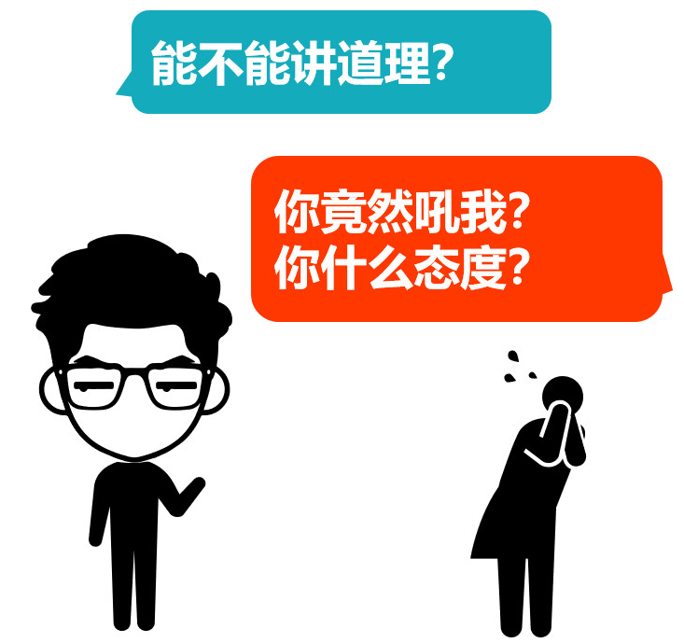
Data Collection
Give annotators dialogue snippets from pre-selected dialogue corpora, and then ask them to continue the conversation by writing contradicts in the dialogue history
Mark all the utterances in the dialogue history
Don’t impose constraints on the annotation
Crowdsource the continuation and annotation data with Amazon Mechanical Turk via ParlAI

Slide 9
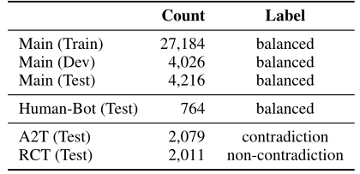
Dataset
Collected 17,713 human-written contradicting dialogues in which 4,121 are verified by 3 annotators.
Sample an equal number of non-contradicting dialogues according to the same dialogue length distribution as the contradicting ones from the same dialogue corpus.
Add Two Turns(A2T):Insert a pair of randomly sampled utterances into the dialogue
Remove Contradicting Turns(RCT):Remove all the turns marked as supporting evidence for the contra-diction in the dialogue except the last utterance.

Slide 10
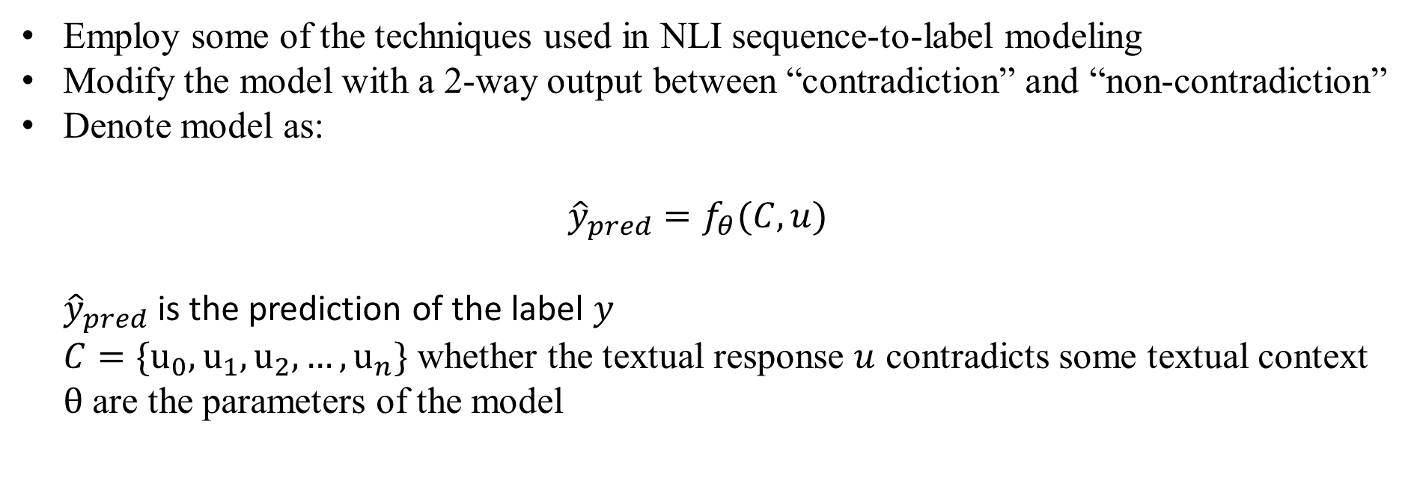
Models
Employ some of the techniques used in NLI sequence-to-label modeling
Modify the model with a 2-way output between “contradiction” and “non-contradiction”
Denote model as:
$${\hat{y}}_{pred}=f_{θ}(C,u)$$
${ \hat{y}}_{pred}$ is the prediction of the label $y$
$C=\{u_{0},u_{1},u_{2},…,u_{n}\}$ whether the textual response $u$ contradicts some textual context
$θ$ are the parameters of the model
Notes:
蕴涵，中立和矛盾

Slide 11
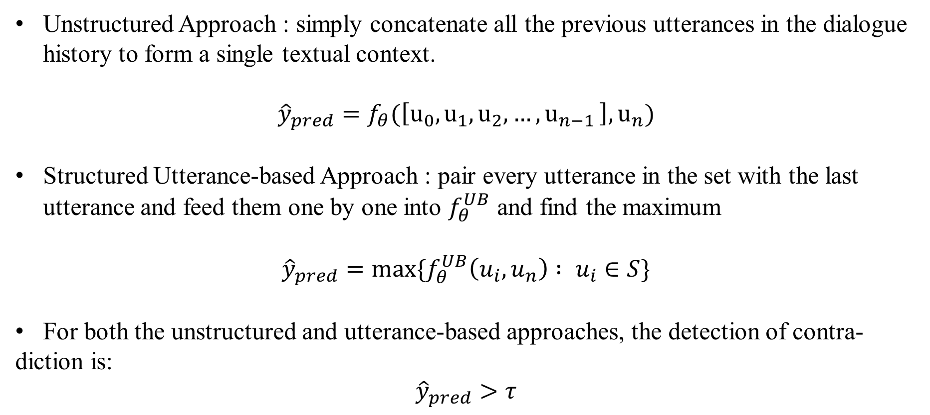
Dialogue Contradiction Detectors
Unstructured Approach : simply concatenate all the previous utterances in the dialogue history to form a single textual context.
$${\hat{y}}_{pred}=f_{θ}(\left[u_{0},u_{1},u_{2},{…,u}_{n−1}\right],u_{n})$$
Structured Utterance-based Approach : pair every utterance in the set with the last utterance and feed them one by one into $f_{θ}^{UB}$ and find the maximum
$${\hat{y}}_{pred}=max⁡\{f_{θ}^{UB}\left(u_{i},u_{n}\right) : u_{i}∈S\}$$
For both the unstructured and utterance-based approaches, the detection of contra-
diction is:
$${\hat{y}}_{pred}>τ$$

Slide 12
Experiment

Slide 13
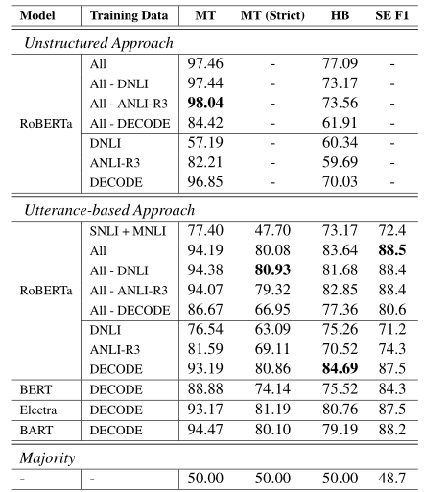
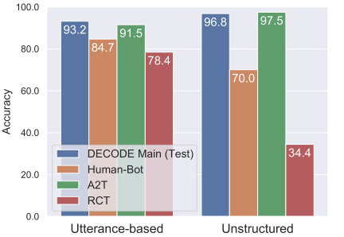
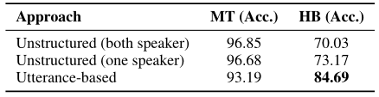
Performance on Constructed Dataset
MT : Main Human-Human Test
HB : Human-Bot
SE F1 : F1 score for supporting evidence retrieval
ALL : (SNLI, MNLI , ANLI-R3, DNLI, DECODE)
ALL-?: remove ? from all

Slide 14
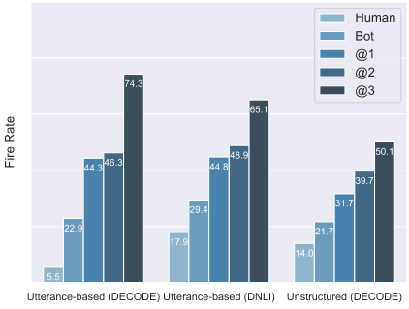
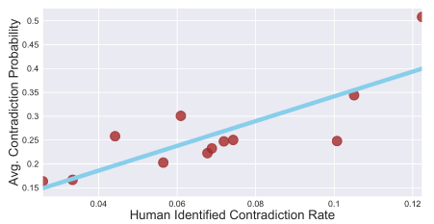
Performance in an Interactive Setting
Fire Rate : the percentage that it predicts “contradiction”
Human/Bot : utterances by the human or the bot
@N : category where N annotators agreed on the contradiction label
Right figure reveals that the scores are positively correlated with human judgments, with a Pearson correlation coefficient of 0.81.

Slide 15
Conclusion

Slide 16
Conclusion
Introduce the DialoguE COntradiction DEtection task (DECODE) and a new conversational dataset containing both human-human and human-bot contradictory dialogues.
Training models on DECODE achieves better performance than other existing NLI data by a large margin.
We further propose a structured utterance-based approach where utterances are paired before being fed into Transformer NLI models to tackle the dialogue contradiction detection task.
We show the superiority of such an approach when transferring to out-of-distribution dialogues compared to a standard unstructured approach representative of mainstream NLU modeling.
We further show that our best contradiction detector correlates with human judgments

Slide 17

请老师和同学批评指正

