Slide 1
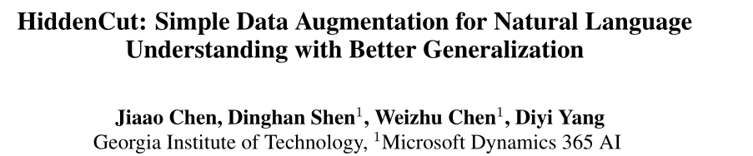
ACL 2021

Slide 2
Data Augmentation
Improving the model robustness by enriching the original training set
Creating syntactically-rich examples with specific rules
Crowdsourcing counterfactual augmentation to avoid learning spurious features
Combining examples in the dataset to increase compositional generalizabilities
Require:
careful design to infer labels for generated data
extensive human annotations
Hard to generalize to different tasks/datasets

Slide 3
Motivation——Regularization
PLM——Fine-tuning large-scale pre-trained language models
The majority of information within the self-attention networks is redundant and not utilized effectively during the fine-tuning stage.（Due to the huge gap between the number of model parameters and that of task-specific data available）
Models are very likely to overfit and make predictions based on spurious patterns.
Leading to inferior results when generalizing the obtained models to out-of-domain distributions.
Various regularization approaches have been proposed.

Slide 4
Motivation——Regularization
Most Regularization Approaches：
Adversarial training that injects label-preserving perturbations in the input space
Generating augmented data via carefully-designed rules
Annotating counterfactual examples
Require:
significant computational and memory overhead
human annotations
Rethinking the simple and commonly-used regularization technique—dropout.

Slide 5
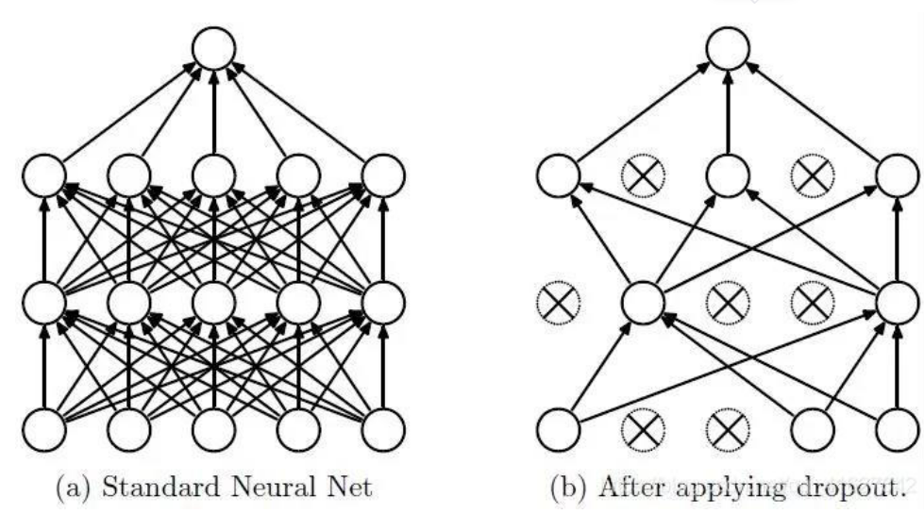
Motivation——Regularization
过拟合：模型在训练集上预测准确率较高；但是在测试集上准确率较低
在机器学习模型中，模型的参数太多，训练样本又太少，训练出来的模型很容易产生过拟合的现象
Dropout：在向前传播的时候，让某个神经元的激活值以一定的概率p停止工作，这样可以使模型的泛化性更强，因为它不会太依赖某些局部的特征
Dropout原理[E]. https://blog.csdn.net/qq_41627642/article/details/104662952

Slide 6
Motivation——Regularization
为什么说Dropout可以解决过拟合？
取平均的作用： dropout掉不同的隐藏神经元类似于在训练不同的网络，整个dropout过程就相当于对很多个不同的神经网络取平均，而不同的网络产生不同的过拟合，一些互为“反向”的拟合相互抵消就可以达到整体上减少过拟合。
减少神经元之间复杂的共适应关系： 因为dropout程序导致两个神经元不一定每次都在一个dropout网络中出现。这样权值的更新不再依赖于有固定关系的隐含节点的共同作用，阻止了某些特征仅仅在其它特定特征下才有效果的情况
Dropout类似于性别在生物进化中的角色：物种为了生存往往会倾向于适应这种环境，环境突变则会导致物种难以做出及时反应，性别的出现可以繁衍出适应新环境的变种，有效的阻止过拟合，即避免环境改变时物种可能面临的灭绝。
Dropout原理[E]. https://blog.csdn.net/qq_41627642/article/details/104662952

Slide 7
Motivation——Regularization
Still suffer from inferior performances when it comes to out-of-distribution cases.
The underlying reasons:
The linguistic relations among words in a sentence is ignored while dropping the hidden units randomly. (these masked features could be easily inferred from surrounding unmasked hidden units with the self-attention networks)
The standard dropout assumes that every hidden unit is equally important. (failing to characterize the different roles these features play in distinct tasks)
The resulting model might easily overfit to high-frequency features without utilizing all the important task-related information in the hidden space.

Slide 8
Solutions
A simple yet effective data augmentation method——HiddenCut
Linguistic intuition：Hidden representations of adjacent words are more likely to contain similar and redundant information——Dropping hidden units more structurally
fully utilize all the task-related information
Avoiding injecting too much noise to the input——Performing HiddenCut in the hidden space, the impact of dropped information is only mitigated rather than completely removed

Slide 9
Contribution
Proposing a simple data augmentation method, HiddenCut, to regularize PLMs during fine-tuning by cutting contiguous spans of representations in the hidden space.
Exploring and designing different strategic sampling techniques to dynamically and adaptively construct the set of spans to be cut.
Demonstrating the effectiveness of HiddenCut through extensive experiments on both indistribution and out-of-distribution datasets.

Slide 10

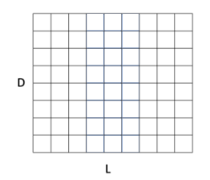
HiddenCut
An input sequence
A pre-trained transformer model with M layers
Hidden representations
the whole sequence could be viewed as a hidden matrix
An inference network
Predicting the corresponding labels

Slide 11
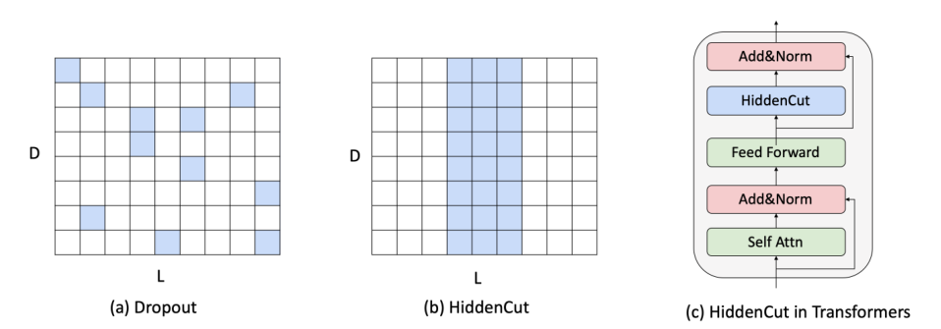

HiddenCut
HiddenCut drops a contiguous span of hidden information encoded in every layer.
: augmented training data

Slide 12
Strategic Sampling
Different tasks rely on learning distinct sets of information from the input to predict the corresponding task labels.
So, Performing HiddenCut randomly might be inefficient
Relying on a small set of spurious patterns
Forcing models to discover other useful clues to make predictions

Slide 13
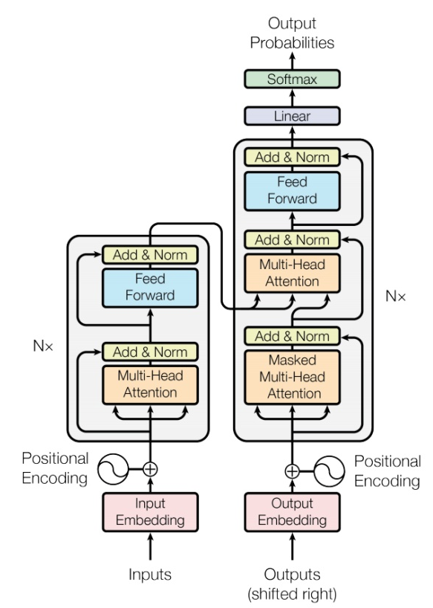
Attention-based Sampling Strategy
Defining the set of tokens to be cut by utilizing attention weights assigned to tokens in the self-attention layers.
The information redundancy is alleviated and models would be encourage to attend to other important information.

Slide 14

Attention-based Sampling Strategy
①Derive the average attention for each token
②Sample the start token h_{i} for HiddenCut from the set that contains top βL tokens with higher average attention weights
③Mask the hidden representations between h_{i} to h_{i+l}

Slide 15

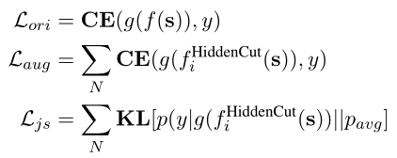

Objectives
Already have: n augmented examples
The whole model training:
General classification loss
Consistency regularization
Overall objective function:
Consistency regularization：一致性正则，给输入图片或者中间层注入 noise，模型的输出应该尽可能保持不变或者近似。

Slide 16
Experiments
Datasets:
In-Distribution Datasets：GLUE benchmark
single-sentence tasks
Stanford Sentiment Treebank (SST-2) | the sentiment of movie reviews to be positive or negative
Corpus of Linguistic Acceptability (CoLA) | predict whether a sentence is linguistically acceptable or not
similarity and paraphrase tasks
Quora Question Pairs (QQP) | whether two question are paraphrases
Semantic Textual Similarity Benchmark (STS-B) | the similarity ratings between two sentences
Microsoft Research Paraphrase Corpus (MRPC) | whether two given sentences are semantically equivalent
inference tasks
Multi-Genre Natural Language Inference (MNLI) | classified the relationships between two sentences into entailment, contradiction, or neutral
Question Natural Language Inference (QNLI) | whether a given sentence is the correct answer to a given question
Recognizing Textual Entailment (RTE) | whether the entailment relation holds between two sentences

Slide 17
Experiments
Datasets:
Out-Of-Distribution Datasets：
Using the models that are fine-tuned on GLUE benchmark datasets:
Single Sentence Tasks：
Models fine-tuned from SST-2
IMDB Contrast Set
IMDB Counterfactually Augmented Dataset（asking NLP researchers or Amazon Mechanical Turkers to make minor edits to examples in the original IMDB dataset）
Similarity and Paraphrase Tasks：
Models fine-tuned from QQP
PAWS-QQP （word-swapping and back-translation from the original QQP dataset）
Inference Tasks：
Models fine-tuned from MNLI
HANS（using syntactic rules to generate non-entailment examples with high premisehypothesis overlap from MNLI）
Adversarial NLI（adversarial human-and-modelin-the-loop framework to create hard examples based on BERT-Large models pre-trained on SNLI and MNLI）

Slide 18
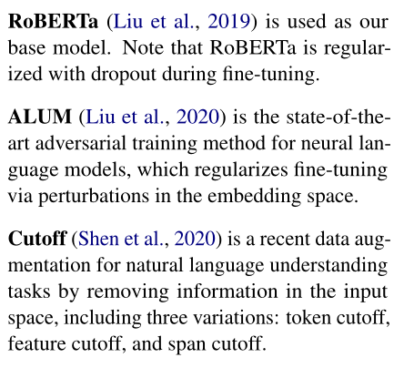
Experiments Baselines：

Slide 19
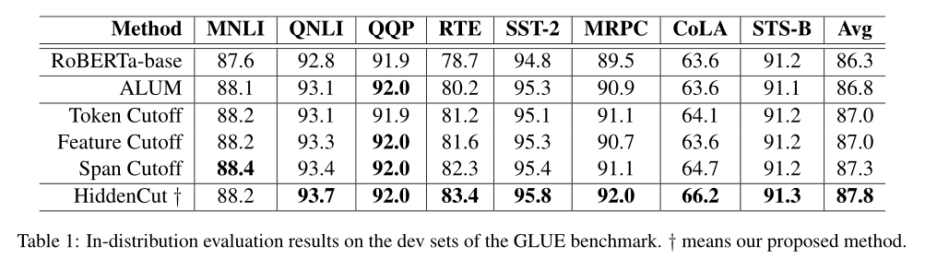
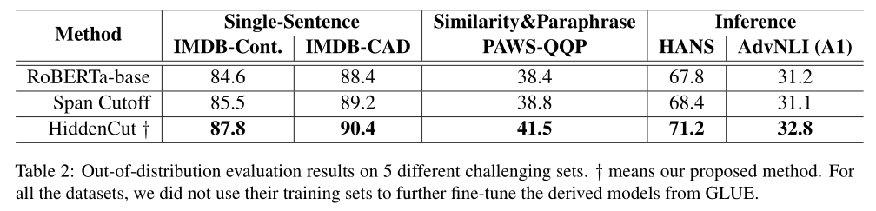
Experiments

Slide 20
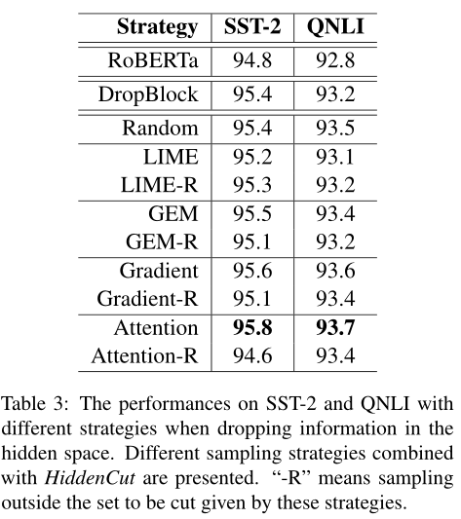
Experiments

Slide 21
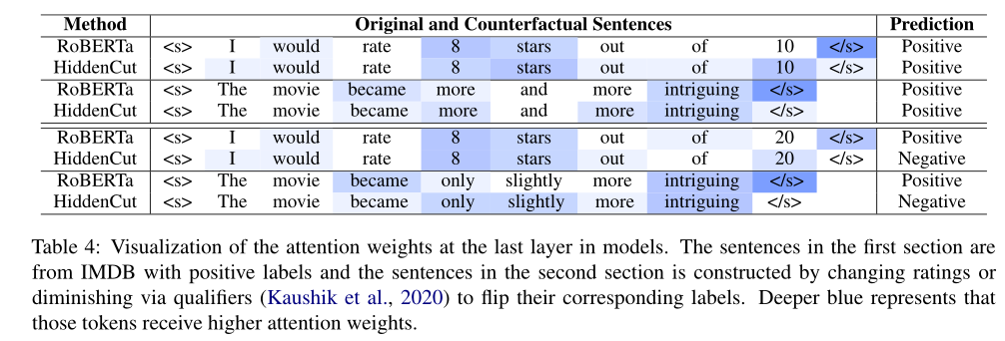
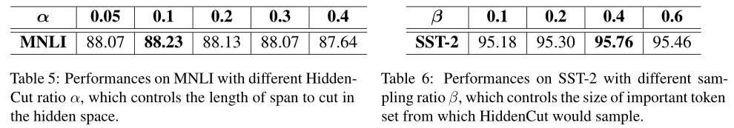
Experiments

Slide 22
谢谢！

